Slide 1
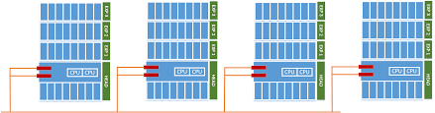
DevOps & Cloud Infrastructure SEIS 665 Week 3
Jason Baker
Adjunct Instructor
Graduate Programs in Software
University of St. Thomas
St. Paul, MN

Slide 2
Agenda
Distributed infrastructure
Virtualization
Vagrant

Slide 3

How was last week’s assignment?

Slide 4
Distributed infrastructure
Let’s look at where we’ve been
Mainframes presenting applications via direct terminals
Personal computers running desktop applications
Client-server applications (thick client <-> database)
Web applications (thin client <-> middleware+db)
Distributed applications (highly scaled in the cloud)
Distributed apps are broken into small components which can be individually scaled

Slide 5
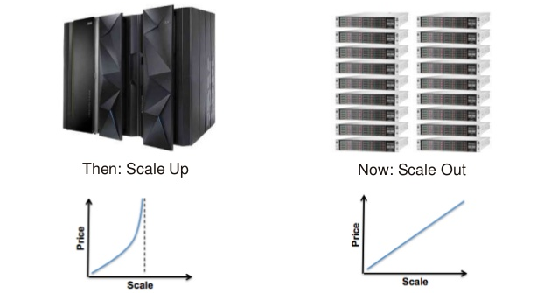
Scale Up vs. Out

Slide 6
Managing Distributed infrastructure
Example: Single large webserver vs. many small webservers
Single large server | Multiple small servers
Easy to maintain | Difficult to maintain, need to sync content and handle performance differences
Finite amount of processing, memory & I/O | Unlimited* amount of processing, memory & I/O
Requires no special application support | Application needs to support distributed deployment architecture (stateless, ephemeral, etc.)
* Nothing is really unlimited ☺

Slide 7
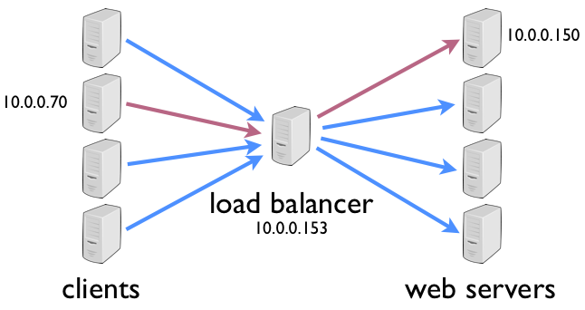
Distributed composition patterns
Load balancer with backend servers
LB coordinates communication between users and servers
LB watches the health of servers and dynamically re-routes requests to maintain high availability

Slide 8
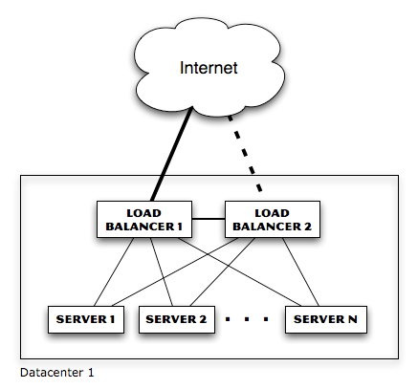
Distributed composition patterns
LB eliminates single-point-of-failure with servers, but what about LB itself?
Now we need redundant LB (and switches and firewalls and routers…)

Slide 9
Distributed composition patterns
LB can use a variety of algorithms to determine which server handles a request
Random: each incoming request is sent to a random server in the pool
Round-robin: each incoming request is sent to a different server in a predetermined order (sometimes referred to as spray-and-pray)

Slide 10
Distributed composition patterns
Least load: LB monitors load of each server and sends requests to least loaded system
Problem? What if least loaded system is actually malfunctioning in some way the LB cannot detect.
Least loaded system could be quickly overwhelmed because avg load metrics lag behind requests (solution = slow start)
Weighted round robin: servers are given specific weights so that higher-weighted servers receive a greater percentage of requests

Slide 11
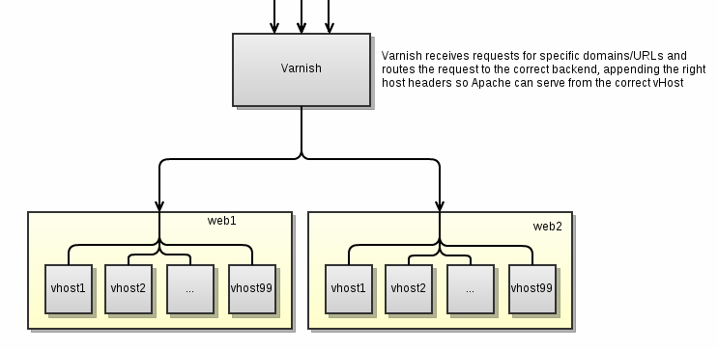
Distributed composition patterns
Server with multiple back-ends
Server partitions request into multiple queries to backend systems and then aggregates responses
Response impacted by highest latency
Fan-in I/O challenges

Slide 12
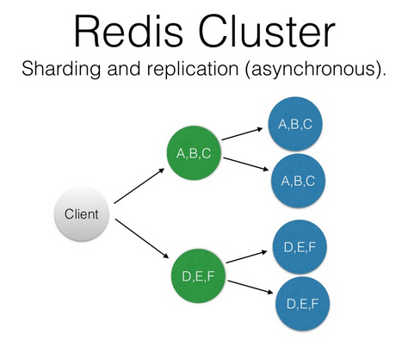
Distributed composition patterns
Server tree
Commonly used by distributed databases
Found in services like Active Directory and DNS
Main benefit is parallelization and reduced request latency

Slide 13
The distributed state challenge
Large distributed systems need to store state (data that changes)
Single database server will eventually run out of processing power
Solution: store data across multiple database servers
New problem: users reading old data from database servers that haven’t been updated yet (consistency problem)

Slide 14
Database Sharding
Partition your database into multiple slices, called shards
Shards may be stored on separate servers
Shards distribute load horizontally, improving performance for some operations
Improved write and indexing performance
Potential challenges rebalancing data on shards

Slide 15
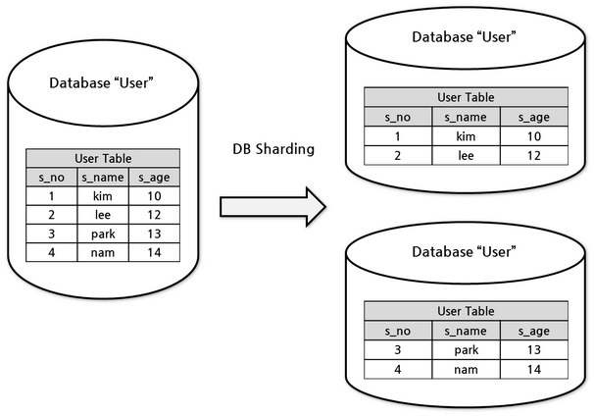
Database Sharding

Slide 16
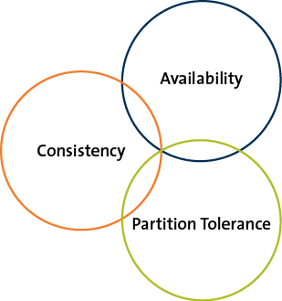
CAP Principle
Presented by Eric Brewer in 1999
It is not possible to build a distributed system that guarantees consistency, availability, and partition tolerance.
You can only pick
2 of the 3!

Slide 17
CAP Principle
Consistency
All nodes see the same data at the same time
Options:
Application waits until all server nodes are updated (slow)
Application reads data from an available server knowing data might be outdated (fast – eventual consistency)
Apps where transactions are significant, like banks, need strong consistency
Apps where speed is more important than data recency, like social media, leverage eventual consistency

Slide 18
CAP Principle
Availability
Means that the system is accessible when a user makes a request. It’s up!
We spread and replicate data on multiple servers to guarantee availability
Can an application on a single server be available? Sure, but a single server isn’t a distributed architecture. ☺

Slide 19
CAP Principle
Partition tolerance
The system continues to operate despite the failure of part of the system.
Classic failure scenario: network link is severed between groups in a pool of servers, creating a partition (split-brain scenario)
Can’t maintain consistency because writes to one partition cannot be communicated to other.

Slide 20
CAP Principle
Q: Why is understanding CAP important?
A: Because it informs our design decisions when building highly distributed systems
Consistency & Availability (Traditional RDMS)
Consistency & Partition Tolerance (MongoDB)
Availability & Partition Tolerance (Dynamo)

Slide 21
NoSQL
Growth of NoSQL correlated to the growth of distributed systems
Store data closer to the way it’s actually represented
NoSQL = Not only SQL
Several different types of NoSQL database, each solving different scaling issues
Big data is a major scaling issue
NoSQL approach is to shard the data
Sharding = partitioning the data across multiple databases

Slide 22
NoSQL types
Key/value
Provide a key/value
Query a key and get a value returned
Based on hashing algorithm & easy to shard
Popular way to store web user sessions
Key = sessionId
Value = serialized session object
Examples: Redis, memcached

Slide 23
NoSQL types
Columnar
Imaging pivoting a traditional database table
Store columns instead of storing columns in sequential disk pages
Super-fast tabulation-type operations (whats the total profit across all products in the company)
Examples: Hbase, Redshift

Slide 24
NoSQL types
Document
Store documents instead of individual atomic records
Each document is stored in the form of Javascript Object Notation (JSON)
Supports hierarchical and embedded data structures
A person can have many addresses, each address is embedded in the document
Examples: MongoDB, DynamoDB

Slide 25
NoSQL types
Graph
Stores data in nodes and edges of a graph
Able to easily store and maintain complex relationships (social media)
Example Neo4j
If you are interested in NoSQL, take the Big Data Management course

Slide 26
Distributed system coupling
You learned about the concept of coupling in the software engineering course
In general, loose coupling is desirable
Easier to maintain and replace components
Fewer bugs and hidden dependencies
More flexible
Loose coupling is highly desirable in distributed systems as well

Slide 27
Scaling performance of distributed systems
The speed of small systems cannot easily be translated to large distributed systems
Network and disk I/O is orders of magnitude slower than CPU and memory access
Be very wary of these kinds of requests
Slow request latencies are magnified at scale

Slide 28
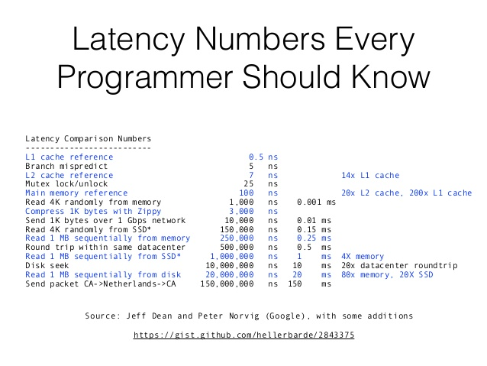

Slide 29
Virtualization
A stack: combination of infrastructure, OS, and applications required to support a service
Before early 2000’s, a stack = 1 server/ 1 OS
Software applications
Operating System
Compute/Storage

Slide 30
Virtualization
Problem: It’s hard for IT organizations to determine the right-size server to support a required stack
How much CPU, memory, and network?
Selected server is either going to be oversized or undersized
Common to see servers with 10% Avg. CPUutilization, 90% of system capacity wasted!
Problem: What happens when IT needs to move or upgrade stack to a bigger server?
Painful process of building new server, installing applications and moving data (forklift upgrade)

Slide 31
Virtualization
Problem: How does IT partition one customer from another?
Just buy another server ☺
Expensive to scale when every stack needs a separate physical server

Slide 32
Virtualization
Computers basically just execute code statements and address memory
Manipulating memory in the right patterns and sequences allows us to create operating systems and applications
Program code can be designed to emulate a physical computer
“Virtualization turns hardware into software.”
Allows us to run multiple operating systems and stacks of applications on a single physical server
Multiple stacks have logical partitions from a process, memory, and networking perspective

Slide 33
Virtualization
4 things that accelerated adoption of x86 server-based virtualization:
Faster, multi-socket CPU boards
Powerful old mainframes supported virtualization, but Intel/AMD-based servers were not powerful enough until late 90’s.
Faster, cheaper memory
Faster network storage (NAS/Fiber-channel)
Development of VMWare software

Slide 34
Virtualization solves problems
Virtualization allows multiple stacks to run on one physical machine
Increases average resource utilization from 10% to 80-90%
Reduces physical footprint of servers
Greener approach
Sometimes we call this phenomenon server compression

Slide 35
Virtualization solves problems
Servers are turned into software
It’s easier to move software around
Easy to move a stack from an older physical server to a newer physical server
No need to purchase a separate server for each customer because virtualization provides partitioning.

Slide 36
Virtualization Types
First, some definitions:
Host machine: physical server that supports multiple stacks
Virtual machine: virtualized server instance running on a host machine (also known as an instance)
Host OS: operating system running on a bare-metal server
Guest OS: operating system running on a virtual machine
Hypervisor: Software that emulates and manages the communication between virtual machines and the physical server

Slide 37
Virtualization Types
Hardware virtualization
Part of physical server dedicated to a specific stack
Big expensive mainframe-type systems

Slide 38
Virtualization Types
Software virtualization
Type 1 Hypervisor
Runs on top of the bare-metal server and sits between hardware and operating systems in the stacks
Examples: VMWare ESX, Microsoft Virtual Server, Xen
Type 2 Hypervisor
Runs on top of an operating system
Easy installation
Example: Oracle VirtualBox, VMWare Fusion

Slide 39
Virtualization Types
Type 1 vs. Type 2
Type 1 provides higher performance & security
Full virtualization vs. Paravirtualization
Full virtualization = guest operating systems are not “aware” that they are being virtualized
Paravirtualization = guest operating system are “aware” of virtualization and have special kernel modifications
better performance than full virtualization in past years

Slide 40
Virtualization Types
OS Partitioning
Host (or guest) operating system can partition out processes, memory, and scheduling to emulate a separate OS environment
Separate OS environments all use same kernel
If host is Linux then all “guests” are Linux
Example: Docker containers
We will cover this later in the course. ☺

Slide 41
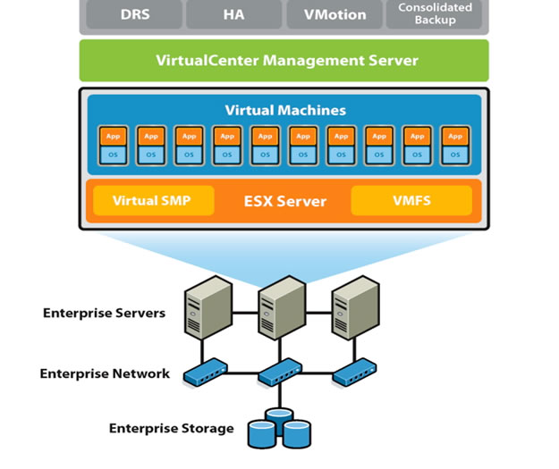
Virtualization infrastructure
Server virtualization is predominant form of virtualized infrastructure
Most servers in enterprises are now virtualized

Slide 42
Virtualization infrastructure
Other forms of virtualized infrastructure:
Virtual Desktop Infrastructure (VDI)
Storage virtualization: pooling together storage devices from disparate vendors and presenting as a single device
Network virtualization: replace physical switches and firewalls with software (AWS VPC)
Software Defined Networking (SDN)

Slide 43
VirtualBox
Hypervisor for x86 systems originally developed by Innotek, acquired by Sun, acquired by Oracle
Core package is open source, extensions are licensed by Oracle for personal/educational use.
Not quite as fast as commercial offerings like VMWare Fusion, but good enough for dev/testing.

Slide 44

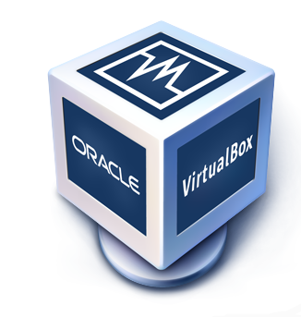
Virtual Box Hands On

Slide 45
Vagrant
Creating virtual machines is time-consuming, repetitive, and mistake prone
Imagine writing code and needing to stand up a test environment several times a day
Need to share a virtual machine with other team members, clients, or the market (do they need to download a large virtual machine image?)
Vagrant automates the creation of virtual machines (configuration management)
Create one or entire group of machines

Slide 46
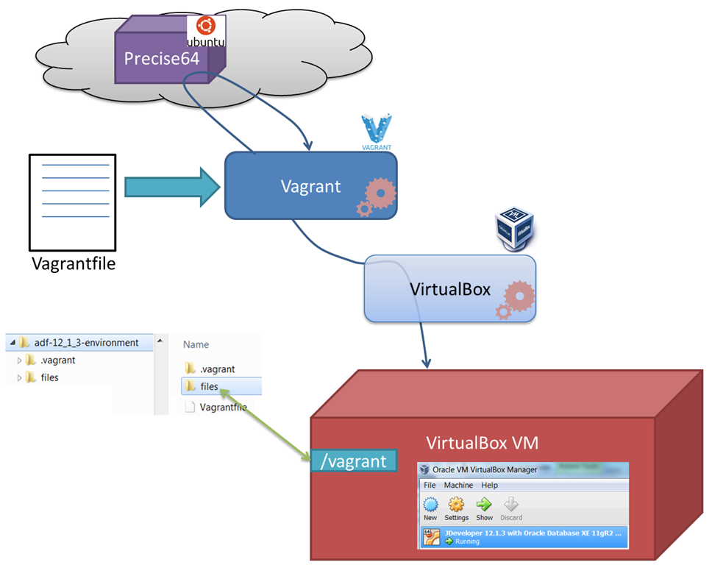
Vagrant architecture

Slide 47
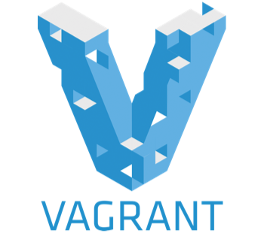
Vagrant Hands-on

Slide 48
Homework
Assignment 3
Read Practice of Cloud Systems Administration Chapter 3
Read Overview of Amazon Web Services (December 2015)

