Slide 1

DevOps & Cloud Infrastructure SEIS 665 Week 9
Jason Baker
Adjunct Instructor
Graduate Programs in Software
University of St. Thomas
St. Paul, MN

Slide 2
Agenda
Infrastructure as Code
AWS CloudFormation

Slide 3

AWS CloudFormation
AWS service used for automating the deployment of cloud infrastructure
Several AWS services (Elastic Beanstalk, ECS, etc.) use CloudFormation for infrastructure provisioning
CloudFormation uses a template to describe what resources to configure on AWS
Template is written in JSON format
Supports good Infrastructure as Code practices
Store in version control
Ability to test
Repeatable
A set of configured cloud resources is called a stack.

Slide 4
CloudFormation
Common use-cases include:
Creating multiple environments for application development, staging, and production
Templates support parameters to allow for reuse in different situations
Deploying stacks of cloud resources in different regions
Blue/green deployments
Disaster Recovery

Slide 5
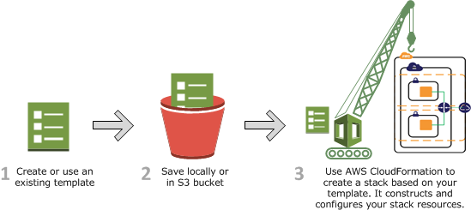
How CloudFormation Works
CloudFormation uses template definition to make API calls to AWS
User’s permissions determines what resources it can create.
Process:
1. Create a CloudFormation Template (JSON) in CloudFormation Designer or a text editor.
2. Save the template locally or in an S3 bucket.
3. Create a stack by specifying the template and providing any required input parameters using console, API, or CLI.
4. CloudFormation provisions resources and reports back when the stack is created.

Slide 6
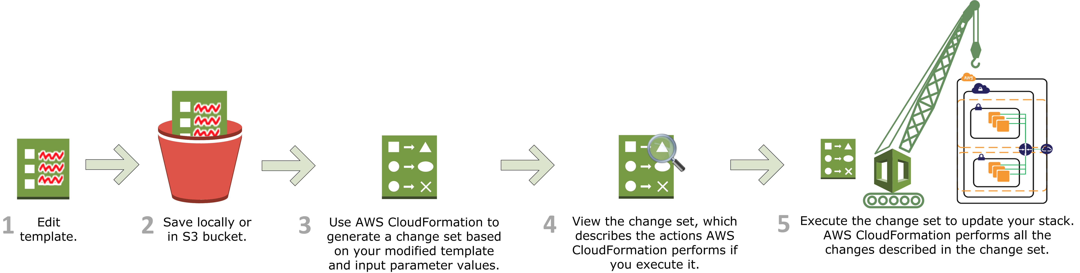
Updating a stack
Update stacks by submitting a modified version of the original stack template or by providing new input parameters.
CloudFormation compares the original and modified template and generates a change set.
After reviewing the changes, you can execute the change set to update the stack.
Note: the update may disrupt stack services because some may be replace.

Slide 7
Stack Policies
Sometimes you may not want to update all the resources in a stack during stack updates.
Use stack policies to protect resources.
Creating a stack policy protects all resources by default so you have to specify what types of updates are allowed.
Example: preventing the update or replacement of a production database instance.
{
"Statement" : [
{
"Effect" : "Allow",
"Action" : "Update:*",
"Principal": "*",
"Resource" : "*"
},
{
"Effect" : "Deny",
"Action" : "Update:*",
"Principal": "*",
"Resource" : "LogicalResourceId/ProductionDatabase"
}
]
}

Slide 8
CloudFormation Template
{
“AWSTemplateFormationVersion” : “version date”,
“Description” : “JSON string”,
“Metadata” : {
template metadata
},
“Parameters” : {
set of parameters
},
“Mappings” : {
set of mappings
},
“Conditions” : {
set of conditions
},
“Resources” : {
set of resources
},
“Outputs” : {
set of outputs
}
}

Slide 9
Intrinsic Functions
CloudFormation supports several built-in functions to help you build stacks.
Only usable in certain parts of the template – mainly in resource properties.
"Properties" : {
"MyMyLBDNSName" : {
"Fn::GetAtt" : [ "MyLoadBalancer", "DNSName" ]
}
}

Slide 10
Intrinsic Functions
Fn::Base64
Returns the Base64 representation of a string.
Typically used for passing userdata to an EC2 instance.
{ “Fn::Base64” : “SEIS 665” }
Fn:FindInMap
Returns the value corresponding to keys in a map
"Fn::FindInMap" : [ "MapName", "TopLevelKey", "SecondLevelKey"]
Fn:GetAtt
Returns the value of an attribute from a resource in the template.
"Fn::GetAtt" : [ "MyLB" , "DNSName" ]
Fn:GetAZs
Returns an array that lists Availability Zones for a specified region.
{ "Fn::GetAZs" : { "Ref" : "AWS::Region" } }

Slide 11
Intrinsic Functions
Fn:Join
Appends a set of values into a single value with an optional delimiter.
"Fn::Join" : [ ":", [ "a", "b", "c" ] ]
Returns: “a:b:c”
Fn:Select
Returns a single object from a list of objects.
{ "Fn::Select" : [ "1", [ "apples", "grapes", "oranges", "mangoes" ] ] }
Returns: “grapes”
Ref
Returns the value of the specified parameter or resource.
"Ref" : "logicalName”
Condition Functions
Used within conditions sections to conditionally create resources.
"Fn::Equals" : ["value_1", "value_2"]
"Fn::If": [condition_name, value_if_true, value_if_false]
"Fn::And": [{condition}, {...}]
"Fn::Or": [{condition}, {...}]
"Fn::Not": [{condition}]

Slide 12
Format Version & Description sections
The optional AWSTemplateFormatVersion section specifies the template version to use.
Defaults to “2010-09-09” version.
"AWSTemplateFormatVersion" : "2010-09-09”
The optional Description section includes arbitrary comments about the template.
Must follow the AWSTemplateFormatVersion section
Literal string of 0-1024 characters
"Description" : "Here are some details about the template."

Slide 13
Metadata section
The optional Metadata section includes arbitrary JSON objects that provide details about the template.
Useful for documentation/ comments
A few special metadata parameters affect other CloudFormation features:
AWS::CloudFormation::Init, AWS::CloudFormation::Interface
"Metadata" : {
"Instances" : {"Description" : "Information about the instances"},
"Databases" : {"Description" : "Information about the databases"}
}

Slide 14
Parameters section
Templates allow the user to supply input parameters when launching a stack.
Parameter logical names must be unique
Logical name definition followed by a series of parameter properties
Types: String, Number, List, or AWS-specific type
Maximum of 60 parameters allowed in a template
Input parameters are referenced within a template using the “Ref” function.
"Parameters" : {
"ParameterLogicalID" : {
"Type" : "DataType",
"ParameterProperty" : "value“
}
}

Slide 15
Parameters section
Useful properties (not a complete list):
AllowedValues: an array containing list of values allowed for the parameter.
Default: the value used for the property if no value is specified.
Description: a string describing the parameter.
MaxLength/MinLength/MaxValue/MinValue: set a constraint on the input value
NoEcho: hide the parameter value in any output logs (useful for passwords)

Slide 16
Parameters section
“Parameters” {
“InstanceTypeParameter” : {
“Type” : “String”,
“Default” : “t2.micro”,
“AllowedValues” : [“t2.micro”, “t2.small”, “t2.medium”},
“Description” : “Enter the instance type (t2.micro, t2.small, or t2.medium).”
}
}
“Ec2Instance” : {
“Type” : “AWS::EC2::Instance”,
“Properties” : {
“InstanceType” : { “Ref” : “InstanceTypeParameter” },
“ImageId” : “ami-398de234”
}
}

Slide 17
Pseudo Parameters
Pseudo Parameters are predefined parameters provided by CloudFormation.
Use them the same way as normal parameters.
List of pseudo parameters:
AWS::AccountId
returns AWS account ID in which stack is created
AWS::NotificationARNs
returns list of AWS Resource Names for stack
AWS::NoValue
acts like a NOOP and removes the property identifier
AWS::Region
returns a string representing the AWS region for the stack
AWS::StackId
returns ID of the stack
AWS:StackName
returns the name of the stack

Slide 18
Mappings section
Template mappings allow the user to define keys that map to corresponding sets of named values.
Commonly used for setting values based on different conditions, such as regions.
Example: Set a value to an AMI ID based on the region the stack is launching into.
The “FindInMap” function is used in the template to find a matching value based on a key.
"Mappings" : {
"Mapping01" : {
"Key01" : {
"Name" : "Value01“
},
"Key02" : {
"Name" : "Value02“
},
}
}

Slide 19
Mappings section
"Mappings" : {
"RegionMap" : {
"us-east-1" : { "32" : "ami-6411e20d", "64" : "ami-7a11e213" },
"us-west-1" : { "32" : "ami-c9c7978c", "64" : "ami-cfc7978a" },
"eu-west-1" : { "32" : "ami-37c2f643", "64" : "ami-31c2f645" },
"ap-southeast-1" : { "32" : "ami-66f28c34", "64" : "ami-60f28c32" },
"ap-northeast-1" : { "32" : "ami-9c03a89d", "64" : "ami-a003a8a1" }
}
},
"Resources" : {
"myEC2Instance" : {
"Type" : "AWS::EC2::Instance",
"Properties" : {
"ImageId" : { "Fn::FindInMap" : [ "RegionMap", { "Ref" : "AWS::Region" }, "32"]},
"InstanceType" : "m1.small"
}
}
}
If AWS::Region is us-east-1, ImageId is set to ami-6411e20d.

Slide 20
Conditions section
Template conditions control the creation of resources or the definition of properties
Conditions are defined by the template author and applied to resources.
A condition must evaluate to true in order for the resources to get built.

Slide 21
Conditions section
“Parameters” : {
“EnvType” : {
“Description” : “Environment type.”,
“Default” : “dev”,
“Type” : “String”,
“AllowedValues” : [“prod”, “dev”],
“ConstraintDescription” : “Must specify prod or dev.”
}
},
“Conditions” : {
“CreateProdResources” : {“Fn::Equals” : [{“Ref” : “EnvType”}, “prod”]}
},
“MountPoint” : {
“Type” : “AWS::EC2:VolumeAttachment”,
“Condition” : “CreateProdResources”,
“Properties” : {
“InstanceId” : { “Ref” : “EC2Instance” },
“VolumeId” : { “Ref” : “NewVolume” },
“Device” : “/dev/sdh”
}
}

Slide 22
Resources section
Required section that describes the AWS resource to be built in the stack.
IAM policies, VPCs, Subnets, Security Groups, EC2 instances, Elastic Load Balancers, RDS databases, S3 buckets, etc.
"Resources" : {
"Logical ID" : {
"Type" : "Resource type",
"Properties" : {
Set of properties
}
}
}
DependsOn attribute allows you to specify that a resource must wait for CloudFormation to create another resource first.
"DependsOn" : [ String, ... ]

Slide 23
Resources section
Multiple ways to define properties:
"Properties" : {
"String" : "one-string-value",
"Number" : "123",
"LiteralList" : [ "first-value", "second-value" ],
"Boolean" : "true",
"ReferenceForOneValue" : { "Ref" : "MyLogicalResourceName" } ,
"FunctionResultWithFunctionParams" : {
"Fn::Join" : [ "%", [ "Key=", { "Ref" : "MyParameter" } ] ] }
}

Slide 24
Resources section
"Resources" : {
"MyInstance" : {
"Type" : "AWS::EC2::Instance",
"Properties" : {
"UserData" : {
"Fn::Base64" : {
"Fn::Join" : [ "", [ "Queue=", { "Ref" : "MyQueue" } ] ]
} },
"AvailabilityZone" : "us-east-1a",
"ImageId" : "ami-20b65349"
}
},
"MyQueue" : {
"Type" : "AWS::SQS::Queue",
"Properties" : {
}
}
}

Slide 25
Outputs section
The optional outputs section declares values that CloudFormation will return when the stack is created.
Example: return the name of an S3 bucket after CloudFormation creates it
Maximum of 60 outputs allowed in a template
Value of an output can be a literal, parameter reference, pseudo parameter, mapping value, or intrinsic function
It’s possible to set a condition on the output using the “Condition” parameter
"Outputs" : {
"Logical ID" : {
"Description" : "Information about the value",
"Value" : "Value to return"
}
}

Slide 26
Outputs section
"Outputs" : {
"BackupLoadBalancerDNSName" : {
"Description": "The DNSName of the backup load balancer",
"Value" : { "Fn::GetAtt" : [ "BackupLoadBalancer", "DNSName" ]},
"Condition" : "CreateProdResources"
},
"InstanceID" : {
"Description": "The Instance ID",
"Value" : { "Ref" : "EC2Instance" }
}
}

Slide 27
Nested Stacks
CloudFormation stacks can be used as resources in other stacks.
Useful for making reusable templates and segmenting resources.
Launching a template with nested stacks will launch multiple sub-stacks.
Nested stack templates must be stored in an S3 bucket.
Deleting launching stack will delete all substacks.

Slide 28
Nested Stacks
Nested Stack definition properties:
Parameters: define set of parameters passed to nested stack.
TemplateURL: S3 bucket location for the nested stack.
TimeoutInMinutes: length of time CloudFormation waits for the nested stack to complete (default is no timeout).
{
"Type" : "AWS::CloudFormation::Stack",
"Properties" : {
"NotificationARNs" : [ String, ... ],
"Parameters" : { CloudFormation Stack Parameters Property Type },
"Tags" : [ Resource Tag, ... ],
"TemplateURL" : String,
"TimeoutInMinutes" : String
}
}

Slide 29
CloudFormation Best Practices
Don’t build a template from scratch.
Read sample templates or use AWS CloudFormation Designer as a starting point.
Reuse templates as much as possible.
Don’t nest stacks more than one level.
Use parameters to set the environment, region, instance names & sizes, etc.
Remember to add tags to all resources.
Consider using a snapshot to backup resources that may be changed during a stack update.
Example: changing engine type of an RDS instance.
Alternatively: set a stack policy to protect resources from updates.

Slide 30
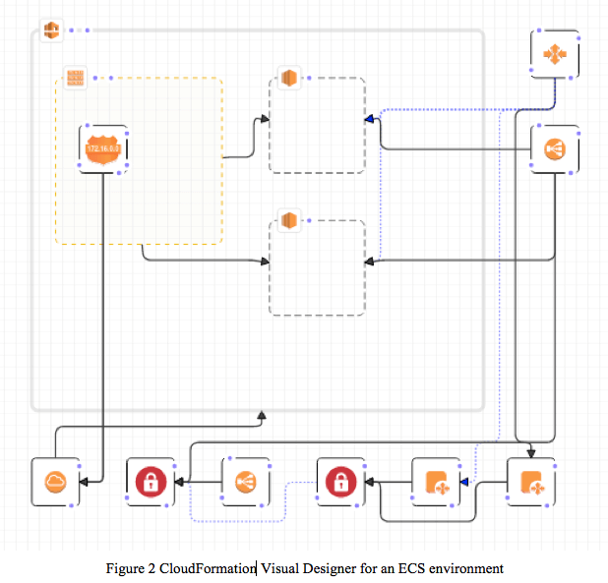
CloudFormation Designer
A graphical tool to visualize and edit CloudFormation templates.
Easy way to start new designs or edit specific resources in complex templates.
JSON template editor supports auto-complete using Ctrl-Space.

Slide 31

CloudFormation Hands-on
Create a simple stack with an EC2 instance and security group
Setup EC2AvailabilityZone input parameter:
Add EC2 Instance and rename to “MyFirstInstance”
Add SecurityGroup and rename to “Webservers”
Connect instance to security group
Save template to local disk, validate template, and launch.
Go back to CloudFormation stacks and update stack with new AZ.
Delete the stack
{
"Parameters": {
"EC2AvailabilityZone": {
"Description": "Select an availability zone.",
"Type": "AWS::EC2::AvailabilityZone::Name"
}
}
}

Slide 32
CloudFormation Hands-on
….
"Type": "AWS::EC2::Instance",
"Properties": {
"AvailabilityZone": {
"Ref": "EC2AvailabilityZone"
},
"InstanceType": "t2.micro",
"ImageId": "ami-6869aa05",
"KeyName": "seis665",
….
….
"Type": "AWS::EC2::SecurityGroup",
"Properties": {
"GroupDescription": "Allow incoming web requests.",
"SecurityGroupIngress": [
{
"FromPort": "80",
"ToPort": "80",
"IpProtocol": "tcp",
"CidrIp": "0.0.0.0/0"
},
{
"FromPort": "22",
"ToPort": "22",
"IpProtocol": "tcp",
"CidrIp": "0.0.0.0/0"
}
]
}
….

Slide 33
Additional Resources
AWS re:Invent 2015 (DVO304) CloudFormation Best Practices presentation
https://youtu.be/fVMlxJJNmyA
CloudFormation documentation
https://www.amazon.com/en/documentation/cloudformation/

Slide 34
Homework
Assignment 8
Read Infrastructure as Code Chapters 7 & 8

