Slide 1

DevOps & Cloud Infrastructure SEIS 665 Week 10
Jason Baker
Adjunct Instructor
Graduate Programs in Software
University of St. Thomas
St. Paul, MN

Slide 2
Agenda
Application Deployment Strategies
Immutable Infrastructure
Packer
Configuration Management
Ansible

Slide 3
Deployment strategies
Question: Once an application is built, how do we deploy it to distributed infrastructure?
Strategy for deploying to 1 server very different than 100’s.
Trade-offs between deployment speed and risk.
Cloud elasticity and pricing model supports new strategies.

Slide 4
Deployment strategies
Single Server Deployment
Application is deployed to a single server.
Very common for testing and small production applications.
Benefits:
Easy and quick to deploy app on a single server.
Problems:
Service outage occurs during app deployment
No ability to test app in production before deployment
Rolling back app requires complete reinstallation
Build
Server

Slide 5
Deployment strategies
Big Bang Deployment
Application is deployed to all servers at once.
Common for a small set of servers (2-5)
Benefits:
Quick to deploy app on multiple servers, though requires orchestration.
Problems:
Service outage occurs during app deployment.
No ability to test app in production before deployment.
Rolling back app requires complete reinstallation.
Server
Build
Server
Server

Slide 6
Deployment strategies
Minimum-in-service Deployment
Application is deployed in multiple stages with a minimum set of servers supporting service.
Benefits:
Supports large environments
No downtime
Fast, most systems updated
Deployments are tested in production
Problems:
Requires significant automation and orchestration capabilities
May require rollback
2 server minimum-in-service
1
2
3
4
5
6
----Updating---
1
2
3
4
5
6
Updating
1
2
3
4
5
6
1
2
3
4
5
6

Slide 7
Deployment strategies
Rolling (Canary) Deployment
Application is deployed to a specified number of servers at each stage
Benefits:
Low risk strategy
Maintains health of service
Minimize user impact through early service issue detection
Problems:
Requires significant automation and orchestration capability
Slow, depending on number of servers updated at each stage
2 server rolling deployment
1
2
3
4
5
6
Updating
1
2
3
4
5
6
Updating
1
2
3
4
5
6
Updating
1
2
3
4
5
6

Slide 8
Deployment strategies
Blue Green Deployment
Application is deployed to a completely new production environment in parallel.
Benefits:
Maintains health of service
Rapid cut-over deployment
Ability to test complete deployment in production
Easy to perform full rollback
Problems:
Requires significant automation and orchestration capability
Extra cost, but manageable with cloud instances
App.com Domain
1
2
3
1
2
3
App.com Domain
1
2
3
1
2
3

Slide 9
Server Lifecycle

Slide 10
Create a new server
How do we create new servers using automation?
Server consists of:
Infrastructure definition (server type)
Operating system
Software (php, apache, mysql)
OS & application configuration
Data
Use Terraform, CloudFormation, Auto-scaling or other tools to create the infrastructure.
Select a server template (image) containing an operating system and software.
Deploy software and configuration using a command tool (Capistrano) or configuration management tool (Chef/ Puppet/ Ansible).
Potentially package everything in containers (Docker – Lecture 12).

Slide 11
Server Template
There are two general approaches to building a server:
Bake: pre-generate a software image which contains an OS and all the required software components.
Example: Use an AMI based on a snapshot of a fully working system.
May need to perform a few configuration tasks once it’s launched.
Benefit: Allows you to launch a new server quickly.
Risk: May require you to frequently create and manage new images.
Practice: minimize amount of software in a template.
Fry: launch a server with a plain OS distribution and then install required software on-the-fly.
Example: Use a base AMI image and run a userdata shell script.
Benefit: No need to manage images.
Risk: New instances may take a long time to deploy.

Slide 12
Packer
Packer is a tool to create multiple machine images based on a configuration file.
Can create images for AWS, VMWare, Docker, and others.
Configuration file uses JSON.
Developed by HashiCorp (Terraform & Vagrant).
Free tool available at: http://www.packer.io
The configuration file defines:
Builders: describe the type of machine image to create and what infrastructure is used to create it.
Provisioners: describe what software components to install on the machine image.

Slide 13

Packer Hands-on
Review Packer JSON file.
Build new image.
$ packer build -var-file=variables.json example.json
View image in AWS console.

Slide 14
Update a server
4 models for making configuration changes to servers:
Ad hoc change management: leave server alone until a specific change needs to be made and manually make the change.
Tends to leave servers inconsistently configured.
Leads to configuration drift – a set of servers identically configured will gradually drift apart.
Continuous configuration synchronization: server configuration tool runs on an unattended schedule and applies the current set of configuration definitions.
Minimizes configuration drift by continuously reapplying configuration.
Only manages configuration covered by definition files, creating opportunities for other parts of the server configuration to drift.

Slide 15
Update a server
Immutable servers: a deployment methodology where we replace systems instead of updating them.
Allows us to fully test configuration changes and not worry about unexpected effects of changing running systems.
Eliminates pets from the infrastructure environment.
Mitigates configuration drift because systems don’t live long.
Practice: replace servers anytime a server template changes.
Phoenix server pattern: replace servers on a scheduled basis regardless of whether changes need to be made or not.
Containerized servers: use containers to package applications and their dependencies.
Basically immutable servers, but with containers.

Slide 16
Dynamic Infrastructure Challenges
Server sprawl
It’s really easy to provision new servers.
It becomes difficult to patch and consistently maintain servers and the numbers grow.
Configuration drift
Configuration of servers gradually change over time.
Unmanaged variation leads to support and maintenance challenges.
Snowflake servers
Unique servers that cannot be easily replicated.
Leads to fragile infrastructure and components that nobody knows how to fix.
Automation fear
Fear of running automation tools because so much infrastructure is hand-cranked.
Erosion
Natural entropy suggests that problems will creep into systems over time.

Slide 17
Continuous synchronization
Regularly run a process to apply the current configuration definitions to a server.
Three synchronization patterns:
Pushing to synchronize: a master server pushes configuration to the servers it manages.
Typically uses common communication channels like SSH.
No need to install special software agent on managed servers.
Centralized control over when changes are distributed to servers.
Pulling to synchronize: each managed server pulls configuration from a master server.
Polling is controlled by an agent on each managed server.
May be more secure because an incoming communications channel does not need to be always open on the server.
May be more scalable than a push-based synchronization architecture.
Masterless configuration management: each managed server downloads copies of the configuration definitions and runs a configuration management tool in a local mode.
Eliminates a central server as a single point of failure.

Slide 18
Ansible
A free-software platform for configuring and managing servers.
Push-based configuration using SSH as a communications channel – no agents!
Supports both synchronized and ad hoc task execution on Linux and Windows systems.
Uses YAML to describe the configuration of systems.
Python over SSH.
Originally developed by Michael DeHaan and acquired by Red Hat.
Written in Python and available at www.ansible.com
Control application must run on Unix/Linux system

Slide 19
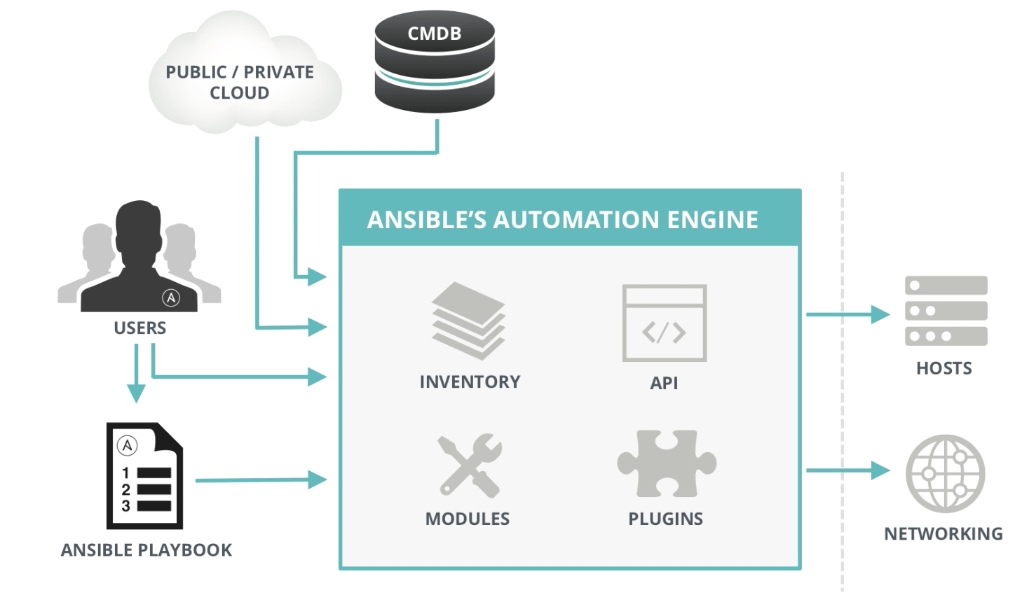
Ansible Architecture

Slide 20
Playbooks
Playbooks are Ansible’s configuration, deployment, and orchestration language.
Plain-text YAML files that describe the configuration state of a system.
Playbooks contain plays.
Plays contain tasks.
Tasks call modules.
Tasks run sequentially.
Handlers may be triggered by tasks, and run once at the end of plays.

Slide 21
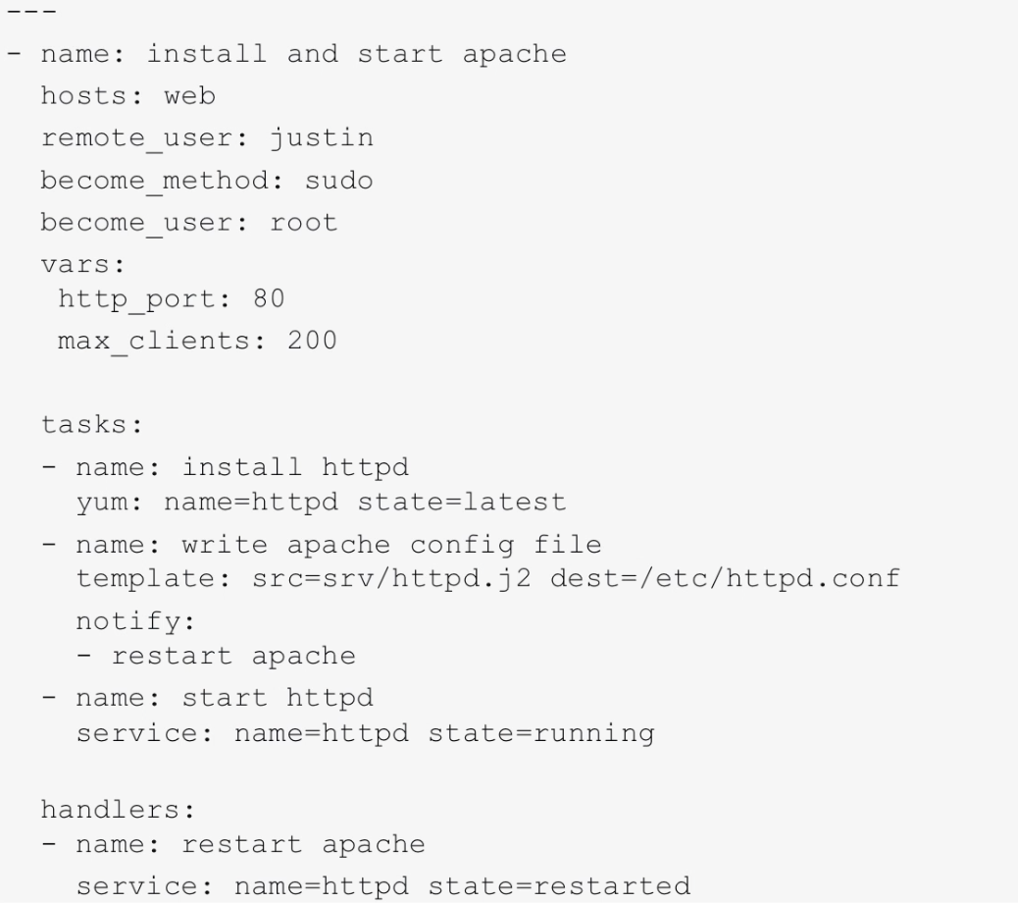
Example playbook

Slide 22
Inventory
Ansible uses an inventory file, named hosts, to store a list of systems that may be configured.
The hosts file uses an INI-like format:
[webservers]
web1 ansible_host=54.162.154.245 ansible_user=ec2-user
web2.mydomain.com ansible_user=ec2-user
[databases]
db[01:10].mydomain.com maxRequests=1000
Hosts may be members of one or more groups.

Slide 23
Inventory Variables
Variables hold values that hosts or groups of hosts can use for configuration.
Dynamically alter how playbooks run.
We can pass in variables via the inventory (group_vars or host_vars directories), command line, or using facts.
Example for ../group_vars/webservers.yml
---
ntp_server: ntp.google.com
database_server: storage.mydomain.com

Slide 24
Dynamic Inventory
Oftentimes the set of hosts in an environment is not static because of mechanisms like auto scaling.
Ansible can use inventory data generated dynamically by scripts.
Gather the current list of running EC2 instances.
Pull host list from enterprise CMDB.
Example using Terraform:
$ ansible -i terraform.py -m ping all

Slide 25
Configuration file
Ansible uses a configuration file to control specific software settings.
Stored in an INI format.
User can override default settings.
Where Ansible looks for configuration settings:
ANSIBLE_CONFIG (an environment variable)
ansible.cfg (in the current directory)
.ansible.cfg (in the home directory)
/etc/ansible/ansible.cfg
A convenient configuration setting is to define the location of the inventory file:
# ansible.cfg file
[defaults]
inventory = /home/username/configuration/hosts

Slide 26
Host Selection Patterns
We use patterns to decide which groups of hosts to manage.
all (all hosts, can also use *)
*.com (all hosts ending in .com domain)
web1.mydomain.com (single host)
webservers:dbservers (webservers OR dbservers)
webservers:!web1 (webservers, except for web1)
webservers:&mpls (intersection of webservers & mpls)
webservers[1] (2nd host listed in webservers group)

Slide 27
Modules
Modules are helper applications that Ansible uses to automate every part of your infrastructure.
Over 450 modules available and you can create your own.
We pass in directives to modules to control behavior.
Standard structure:
module: directive1=value directive2=value

Slide 28
Conditionals
Conditional directives are used to dynamically alter how tasks execute on a host.
with_items
failed_when
changed_when
until
ignore_errors
We can loop and apply conditionals to any task.

Slide 29
Role
A role is a special kind of re-usable playbook that is fully self-contained:
Tasks
Variables
Configuration templates
Supporting files
We can use a role to define how to build a specific type of system, like a webserver.
Ansible Galaxy: global repository where Ansible users share roles.
https://galaxy.ansible.com

Slide 30
Running Ansible
3 ways to run Ansible:
Ad-hoc: ansible <inventory> -m <module>
Playbooks: ansible-playbook <YAML file>
Automation Framework: Ansible Tower

Slide 31
Ad hoc commands
Ansible can be used to execute quick commands on hosts.
Used for very small tasks or testing.
$ ansible <host pattern> -m <module_name> -a <arguments>
$ ansible web1 command –a “uptime”
The command module is the default module, so we don’t have to specify it.
$ ansible all –a “tail /var/log/boot” –u sudo
Ansible will execute the command as the user specified by the –u option.

Slide 32
Ad hoc commands
Copy files to a group of servers using copy module:
$ ansible minneapolis –m copy –a “src=~/archive.zip dest=/var/www/archive.zip”
Create and delete a directory using file module:
$ ansible webservers -m file –a “dest=/path/to/files mode=755 state=directory”
$ ansible webservers –m file –a “dest=/path/to/files state=absent”
Install a software package using yum module:
$ ansible dbserver –m yum –a “name=mysql state=present”

Slide 33
Ad hoc commands
Create and remove user accounts with user module:
$ ansible web1 -m user –a “name=jason password=<crypted password>”
$ ansible web1 -m user –a “name=jason state=absent”
Manage services using service module:
$ ansible webservers -m service –a “name=httpd state=started”
$ ansible webservers –m service –a “name=httpd state=restarted”
Facts represent a set of values which describe the configuration of a system. Gather facts using the setup module:
$ ansible web1 –m setup

Slide 34
Ansible Hands-on
Run ad-hoc commands:
Ping command:
$ ansible localhost –m ping
Uptime:
$ ansible localhost –a “uptime”
Install nginx package:
$ ansible localhost –m yum --become -a “name=nginx state=present”
Re-run nginx package install.
Commands are idempotent.
Manual changes to system will be removed to correct configuration drift.
Remove nginx package:
$ ansible localhost –m yum --become -a “name=nginx absent”

Slide 35
Check Mode
Ansible can perform a dry-run for ad-hoc commands and playbooks.
Implemented with the –C flag on command line.
Used to validate Ansible execution before making state changes on target systems.
Note: Not all modules support check mode.
$ ansible web –C –m –yum –a “name=httpd state=latest”
$ ansible-playbook –C my-playbook.yml

Slide 36
Playbooks
Let’s start with something easy:
$ ansible all –m shell –a ‘echo hello world’
We can turn this into a playbook called helloworld.yml containing a single play:
---
hosts: all
tasks:
- shell: echo “hello world”
Execute a playbook:
$ ansible-playbook <playbook> -f <parallelism level>
$ ansible-playbook playbook.yml -f 10

Slide 37
Playbooks
Playbooks can declare configurations, but also orchestrate steps of complex ordered processes.
Bounce back-and-forth between sets of machines.
Launch tasks synchronously or asynchronously.
Playbooks contain one or more plays in a list.
A play maps a group of hosts to well defined roles, represented by tasks.

Slide 38
Plays
We can define the hosts to target and remote user to perform tasks for each play:
---
- hosts: webservers
remote_user: ec2-user
tasks:
- name: test connection
ping
Some tasks require root access to execute properly and we can become a super-user:
---
- hosts: webservers
remote_user: yourname
tasks:
- service: name=nginx state=started
become: yes
become_method: sudo

Slide 39
Tasks
Each play contains a list of tasks which are executed in order, one at a time.
Tasks are executed against matched host pattern.
All hosts receive the same task directives.
Hosts with failed tasks are removed from the entire playbook.
Each tasks executes a module with specified arguments.
Variables may be used as arguments for modules.
Modules are idempotent and will only make the changes necessary to bring the system to the desired state.
Every task should have a name which is included in the output from running the playbook.

Slide 40
Tasks
A task specifies a module and a set of key/value arguments:
tasks:
- name: make sure apache is running
service: name=httpd state=started
The command and shell modules just take a list of arguments vs. key/value:
tasks:
- name: disable selinux
command: /sbin/setenforce 0
Tasks can also use variables as arguments:
tasks:
- name: create a virtual host file for {{ vhost }}
template: src=somefile.j2 dest=/etc/httpd/conf.d/{{ vhost }}

Slide 41
Handlers
Handlers are a special kind of task that only run once when triggered by a notify action.
Example: multiple updates to app configuration on a system may require an apache restart.
- name: template configuration file
template: src=template.j2 dest=/etc/foo.conf
notify: “restart web services”
Handlers are referenced by a unique name and will only run once, if notified, after all tasks complete in a play.
handlers:
- name: restart memcached
service: name=memcached state=restarted
listen: “restart web services”
- name: restart apache
service: name=apache state=restarted
listen: “restart web services”

Slide 42
Includes
We can use include files to reuse tasks between plays or playbooks.
tasks:
- include: tasks/foo.yml
We can also pass variables into includes:
tasks:
- include: wordpress.yml wp_user=timmy
- include: wordpress.yml wp_user=alice
- include: wordpress.yml wp_user=bob
It’s also possible to include one playbook file into another:
- name: this is a play at the top level of a file
hosts: all
tasks:
- name: say hi
shell: echo "hi..."
- include: load_balancers.yml
- include: webservers.yml

Slide 43
Roles
Roles provide a way to organize playbooks.
Basically automates include directives.
Playbook file with defined roles looks like:
---
- hosts: webservers
roles:
- common
- webservers
We can also parameterize roles like:
---
- hosts: webservers
roles:
- common
- { role: foo_app_instance, dir: '/opt/a', app_port: 5000 }
- { role: foo_app_instance, dir: '/opt/b', app_port: 5001 }

Slide 44
Roles
Example project structure:
site.yml
webservers.yml
fooservers.yml
roles/
common/
files/
templates/
tasks/
handlers/
vars/
defaults/
meta/
webservers/
files/
templates/
tasks/
handlers/
vars/
defaults/
meta/
Roles automatically implement a number of rules:
If roles/x/tasks/main.yml exists, add those tasks to the play.
If roles/x/handlers/main.yml exists, add those handlers to the play.
If roles/x/vars/main.yml exists, add those variables to the play.
… and so on.

Slide 45
Variables
Variables allow us to deal with small configuration differences between systems.
Variable names should be letters, numbers, and underscores.
Should always start with a letter.
YAML can map keys to values:
foo:
field1: one
field2: two
Multiple ways to reference a specific field in a dictionary value:
foo[‘field1’]
foo.field1
Define variables directly in a playbook using vars section:
- hosts: webservers
vars:
http_port: 800

Slide 46
Variable Scopes
Ansible implements 3 main variable scopes:
Global: this is set by config, environment variables and the command line
Play: each play and contained structures, vars entries, include_vars
Host: variables directly associated with a host like inventory variables or facts

Slide 47
Facts
Facts are a type of variable that contain information about remote systems.
System name, IP address, OS version, etc
Facts are discovered automatically by the setup module and stored in a JSON structure.
"ansible_architecture": "x86_64",
"ansible_bios_date": "09/20/2012", "ansible_bios_version": "6.00",
"ansible_swapfree_mb": 665,
"ansible_swaptotal_mb": 1021,
"ansible_system": "Linux",
"ansible_system_vendor": "VMware, Inc.",
"ansible_user_id": "root”
…
We can refer to a fact in a play like any other variable:
{{ ansible_architecture }}

Slide 48
Registered Variables
Registered variables contain the output returned by executing a command.
- hosts: web_servers
tasks:
- shell: /usr/bin/foo
register: foo_result
ignore_errors: True
The variable foo_result will contain the output from running the /usr/bin/foo command on a remote host.

Slide 49
Templates
Templates allow us to dynamically create configuration files using variable substitution.
Uses the Jinja2 template format.
# nginx.conf.j2 template
server {
listen {{ webserver_name }}:8080;
server_name {{ webserver_name }}
alias {{ website_alias }};
location / {
root html;
index index.html index.htm;
}
}
Copy a template to a remote host:
template: src=nginx.conf.j2 dest=/etc/nginx/nginx.conf

Slide 50
Jinja2 Filters
Jinja2 supports a number of filters we can use in templates to manipulate variables.
Set a default value for a variable:
{{ some_variable | default(5) }}
The maximum value from a list of numbers:
{{ [3, 4, 2] | max }}
Get a random item from 0 to 10:
{{ 10| random }}
Test if a string is a valid IP address:
{{ myvar | ipaddr }}
Concatenate a list into a string:
{{ var_list | join(“ ”) }}

Slide 51
Conditionals
Use the when statement to skip a particular task from executing on a host.
tasks:
- name: "shut down Debian flavored systems"
command: /sbin/shutdown -t now
when: ansible_os_family == "Debian”
Note that Ansible facts and vars like ansible_os_family can be used directly in conditionals without double curly braces.
We can specify that multiple conditions need to be true:
tasks:
- name: "shut down CentOS 6 systems"
command: /sbin/shutdown -t now
when:
- ansible_distribution == "CentOS"
- ansible_distribution_major_version == "6"

Slide 52
Loops
Oftentimes it’s useful to repeat tasks to save some typing.
Loop using with_items directive.
- name: add several users
user: name={{ item }} state=present groups=developers
with_items:
- jadams
- msmith
- cmilwaui
Items in loops do not have to be simple strings:
- name: add several users
user: name={{ item.name }} state=present groups={{ item.groups }}
with_items:
- { name: 'testuser1', groups: 'wheel' }
- { name: 'testuser2', groups: 'root' }

Slide 53
Loops
The with_fileglob directive selects all files in a single directory that match a pattern.
---
- hosts: all
tasks:
# first ensure our target directory exists
- file: dest=/etc/fooapp state=directory
# copy each file over that matches the given pattern
- copy: src={{ item }} dest=/etc/fooapp/ owner=root mode=600
with_fileglob:
- /playbooks/files/fooapp/*

Slide 54
Loops
The with_sequence directive generates a sequence of items in ascending order.
# create a series of directories with even numbers for some reason
- file: dest=/var/stuff/{{ item }} state=directory
with_sequence: start=4 end=16 stride=2
Sometimes we want to retry a task until a certain condition is met.
- action: shell /usr/bin/foo
register: result
until: result.stdout.find("all systems go") != -1
retries: 5
delay: 10

Slide 55
Blocks
Blocks provide a way to logically group common tasks.
tasks:
- block:
- yum: name={{ item }} state=installed
with_items:
- httpd
- memcached
- template: src=templates/src.j2 dest=/etc/foo.conf
- service: name=bar state=started enabled=True
when: ansible_distribution == 'CentOS'
become: true
become_user: root

Slide 56
Error Handling
Blocks introduce the ability to handle errors in a way similar to exceptions in programming languages.
rescue tasks are execute if a task in the block fails.
always tasks will always execute.
tasks:
- block:
- debug: msg='i execute normally'
- command: /bin/false
- debug: msg='i never execute, cause ERROR!'
rescue:
- debug: msg='I caught an error'
- command: /bin/false
- debug: msg='I also never execute :-('
always:
- debug: msg="this always executes"

Slide 57
Ansible Hands-on
Launch two RHEL7 EC2 instances using Terraform.
$ terraform plan
$ terraform apply
Review Ansible playbook and role.
Execute Ansible playbook using dynamic inventory script.
$ ansible-playbook -i terraform.py site.yml
Watch script install full Wordpress application stack on each instance.

Slide 58
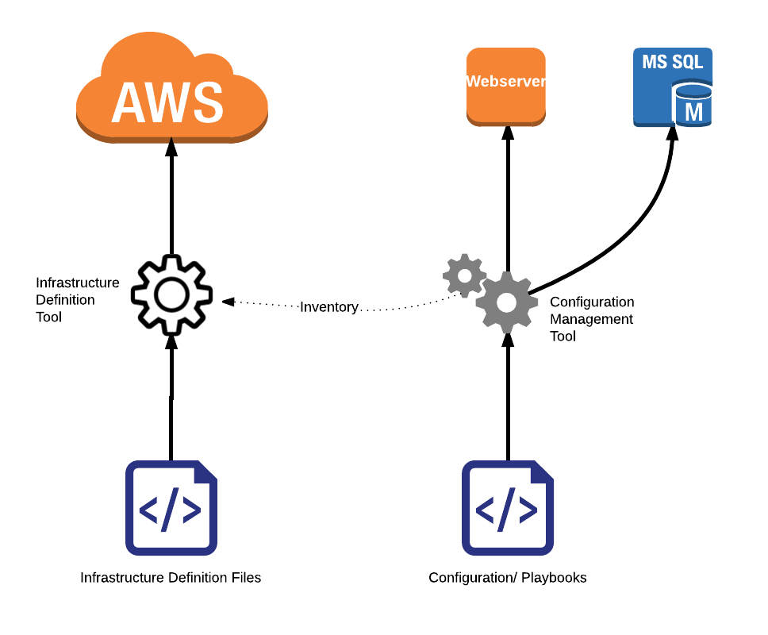
Putting it all together

Slide 59
Resources
Ansible documentation:
http://docs.ansible.com/
Ansible module index:
http://docs.ansible.com/ansible/modules_by_category.html
Ansible Absolute Basic Overview video:
https://www.youtube.com/watch?v=MfoAb50Br94

Slide 60
Homework
Assignment 8
Read Infrastructure as Code Chapters 9 & 10

