Slide 1

DevOps & Cloud Infrastructure SEIS 665 Week 2
Jason Baker
Adjunct Instructor
Graduate Programs in Software
University of St. Thomas
St. Paul, MN

Slide 2

Agenda
Review readings
Linux fundamentals
Package management
Shell scripting

Slide 3
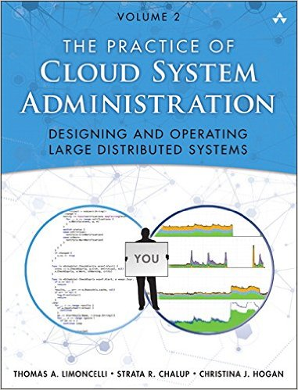
Automation
CSA Chapter 12: Automation
Automation is a critical component of DevOps and modern IT practices
Example: Software build pipeline
Changes are made to files in version control system
New files picked up by software delivery platform and tested
New files deployed to production systems

Slide 4

Automation
Automation approaches:
Left-Over Principle: automate everything possible
Easy/rare = manual
Easy/frequent = automate
Difficult/rare = manual (document)
Difficult/frequent = automate (but maybe acquire)
Compensatory Principle
People aren’t infinitely versatile machines
Machines do some things better than people and vice-versa
Example: machines better at polling remote hosts every 5 minutes for performance metrics

Slide 5
Automation
Automation approaches:
Complementarity Principle
The more a system is automated, the less people understand how the system works
Try to strike a balance between automation and future growth in learning
Tool building vs. automation
Tools improve a manual task so that it can be done better
Self-service web interface allowing user to launch a new server
Automation eliminates the need to perform a manual task
Auto-scaling service that automatically launches a server based on predefined trigger

Slide 6

Automation goals
Help scaling: one person performs the work of many
Improve accuracy/ repeatability: perform task same way every time
Save time: perform task faster than human
Make processes safer: eliminate mistakes
Empower users: let’s less experienced people perform complex tasks

Slide 7
Automation
Creating automation
Majority of IT team’s time should be spent on automation
Identify and fix the biggest bottleneck first (Theory of Constraints)
Start small and work incrementally, don’t try to automate everything at once
How to automate
Shell scripts, scripting languages, configuration management

Slide 8
Shell Scripting
Shell scripts are traditionally the most common tool used for infrastructure automation.
Simple and quick to create
Interpreted and executed by systems immediately
Batch of commands grouped together in a file and executed from top to bottom
Supported by wide variety of operating systems including Unix, Linux, Windows

Slide 9
Shell Scripting
We will focus on Linux shell scripts in this course using the BASH shell.
Free replacement for the Bourne shell
Released in 1989 and used as default shell for most Linux distributions
What is a shell?
An interactive command line processer that runs in a text window.
User can type in commands manually or the shell can read commands from a file (shell script).

Slide 10
Shell Scripting
Example script:
#!/bin/bash
echo “Hello, world!”
echo “These are the current files, $PWD”
ls
exit 0
Let’s look at each line:
#!/bin/bash: aka ”sha-bang-bin-bash”, specifies the shell processor to execute the commands
echo: prints text to the display terminal (aka standard output)
ls: command to list files
$PWD: a variable that contains the present working directory
exit: terminate the script execution with a specified status code

Slide 11
Shell variables
Shell variables act like those found in typical programming languages.
Shells variables are not typed (i.e., no string, int, char, etc.)
Define a variable using: X=“value”
Note: Do not put spaces in assignment statement!
Common practice to capitalize variable names.
Refer to the variable in a script using: $X
Single quotes vs. double quotes
Variables are expanded within double quotes, but not single quotes
echo ‘$USER’ literally prints out the text: $USER
echo “$USER” prints out the value of the variable

Slide 12
Shell variables
The shell replaces every occurrence of a variable with its value in the script.
#!/bin/bash
LS=“ls”
LS_FLAGS=“-al”
$LS $LS_FLAGS
The shell replaces the last line with the value of the variables and executes it!
What if you need to display a variable followed by other characters?
echo “$MYVARxyz”
Protect the variable by surrounding it with braces.
echo “${MYVAR}xyz”

Slide 13
Shell variables
Executing a shell script from command-line:
scriptname arg1 arg2 arg3
Shell has some built-in variables associated with this command execution:
$0: scriptname
$1: arg1
$2: arg2
$3: arg3
$#: number of command-line arguments (3)
Other common built-in variables
$HOME: home directory of current user
$HOSTNAME: name assigned to the system
$PATH: file directories where executable applications are located
$PWD: current working directory
$UID: current user ID number

Slide 14
Shell conditionals
Shell supports conditional checks to branch execution:
if condition1
then
statement1
statement2
elif condition2
else
statement3
fi
Statement #1 & #2 are executed if condition1 is true.
The condition is typically written in the form: [operand1 operator operand2]
if [ $X –lt $Y ] # if $X is less than $Y
if [ -n “$X” ] # if $X is not empty
if [ -z “$X” ] # if $X is empty
if [ $X = $Y ] $ if $X equals $Y
Note: The spaces in the test bracket really matter!

Slide 15
Shell loops
Loops allow the script to execute a series of commands multiple times
for loops
for arg in [list]
do
commands(s)…
done
Example:
for planet in Mercury Venus Earth Mars
do
echo $planet
done

Slide 16
Shell loops
while loop
while [ condition ]
do
command(s)…
done
Example:
#!/bin/bash
X=0
Y=5
while [ ”$X” –lt “$Y” ]
do
echo “$X”
let X=X+1
done
exit 0

Slide 17
Shell loop globbing
Anytime the shell sees a string containing an asterisk (*) it is replaced with a list of matching file names.
echo *.jpg # list all jpeg files
We can use this globbing action to our advantage:
#!/bin/bash
for X in *.jpg
do
cp $X $X.bak # Backup all the jpeg files
done

Slide 18
Shell command substitution
Command substitution takes the output of a command and uses it as if it is a statement.
Two methods: parenthesis or backtick
#!/bin/bash
FILES=“$(ls)”
WEB_FILES=`ls /var/www/html`
echo $FILES
echo $WEB_FILES
Setting a variable to the output from a loop:
#!/bin/bash
# var1 = 1234
var1=`for x in 1 2 3 4
do
echo –n “$x”
done`

Slide 19
Shell parameter substitution
Parameter substitution is used to manipulate variable values
Uses braces {} to enclose variable construct
#!/bin/bash
var1=1
var2=2
echo $(var1-$var2} # output is 1
Useful for assigning a default value to a variable using the :- characters
#!/bin/bash
echo “Name is ${name:-Sam}” # name defaults to Sam
exit 0

Slide 20
Linux
History
Started by Linus Torvalds in 1991
Inspired by Unix, developed at AT&T in 1970s
Linux is not Unix, but uses same concepts
Open Source Software (General Public License)
Runs on cells phones to largest supercomputers
Perfect for supporting service-based application architecture in the cloud

Slide 21
Linux
Why Linux?
Common platform for modern distributed applications
Automation starts at the command line, not the GUI
Caveat: It’s not possible to learn Linux in a few hours.
Plan to invest meaningful time outside of class if you aren’t already familiar with it.

Slide 22

Linux
We will use Amazon Linux running on AWS in this course
Rolling release maintained in an AWS AMI
Designed for the AWS ecosystem
Based on Red Hat Enterprise Linux/ CentOS
Most basic OS concepts are the same across Linux distributions (i.e., Ubuntu, SUSE, etc)
Key differences in package and service management

Slide 23

Linux Hands-on
Requirements:
Amazon Linux EC2 micro instance running in a public subnet
Public/Private access keys for the instance
SSH Client
Windows -> PuTTY (www.putty.org)
MacOS -> Terminal (built-in) or iTerm2 (www.iterm2.com)
Linux vm -> xterm or other terminal

Slide 24

Linux Hands-on
Launching a Linux instance on AWS EC2
Connecting to instance via terminal
Mac & Windows
Linux Hands-on Guide

Slide 25
Git Flow
Git is designed to scale from teams of one to teams of thousands
Git Flow is a popular workflow for categorizing work and controlling releases
Not promoting this as the only or necessarily best workflow
Based around several branches:
master = deployed code in production
develop = current development code base
feature = experimental code for specific feature
release = point-in-time code release
hotfixes = emergency fixes to production code

Slide 26
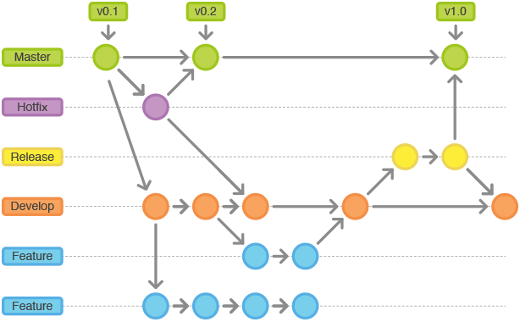
http://nvie.com/posts/a-successful-git-branching-model/

Slide 27

Homework
Assignment 2: Linux and Git
Read Practice of Cloud Systems Administration Chapter 1
Read Infrastructure as Code Chapter 1
Finish reading Linux Hands-on Guide
** Remember to use Slack channel for questions!

