Slide 1

DevOps & Cloud Infrastructure SEIS 6XX Week 13
Jason Baker
Adjunct Instructor
Graduate Programs in Software
University of St. Thomas
St. Paul, MN

Slide 2
Agenda
Data center architecture
Major data center components
Data center efficiency
Data center tiers
Experimental architectures
Final

Slide 3
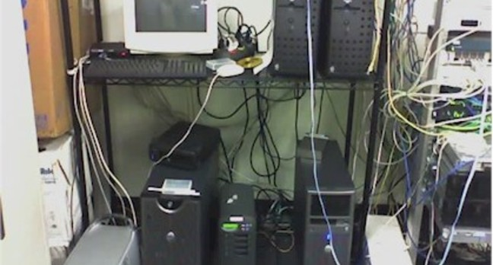
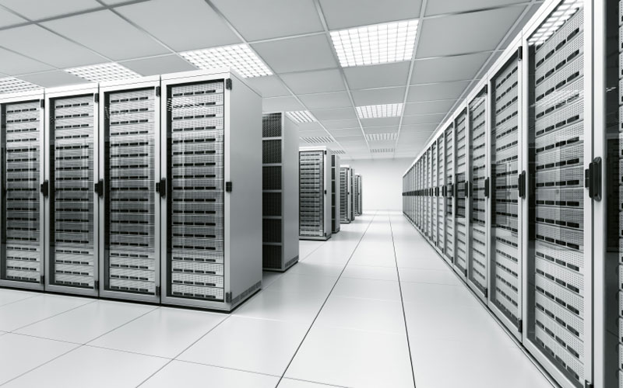
What is a data center?
Specialized physical location designed to support computing infrastructure
NOT THIS
THIS

Slide 4
Key Attributes
Physical enclosure for greater security
High grade electrical and heating, venting & cooling (HVAC) systems for greater reliability
Easy access to mechanical and computing systems for greater maintainability

Slide 5
Overall Architecture
DC consists of both internal and external assets
it’s not just a building, it’s a property
Internal (facility)
Server room: 50%
Support equipment: 40%
Miscellaneous: 10%
Equipment storage
Setup bench
NOC
Employee workspace
External
Generators, cooling towers, power transformers, parking lot

Slide 6
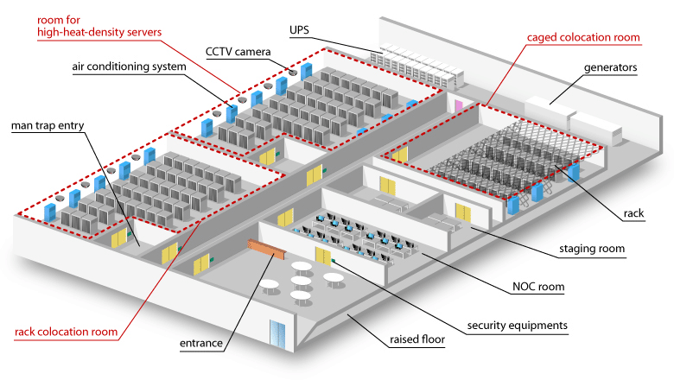

Slide 7
DC Key Components
Power system is critical for IT system reliability
3 basic parts:
Generation: most DCs have the ability to generate their own power using generators (gensets)
Distribution: power from utility providers and gensets must be distributed to IT equipment
Switching: DC operator must be able to control flow of power in facility

Slide 8
Power Generation
DC operators consider self-generated power to be the most reliable power in facility and primary power source.
Utility power is used even though it is less reliable because it’s cheaper.
Generators configured in an N+1 configuration
N+1 means that one additional generator is installed beyond what is needed to support the DC (failover for redundancy/ maintenance)
Generators usually run on diesel fuel mixture
Special mix and heating bed required for cold climates
Onsite storage tank required (thousands of gallons)
Emergency response refueling contract

Slide 9
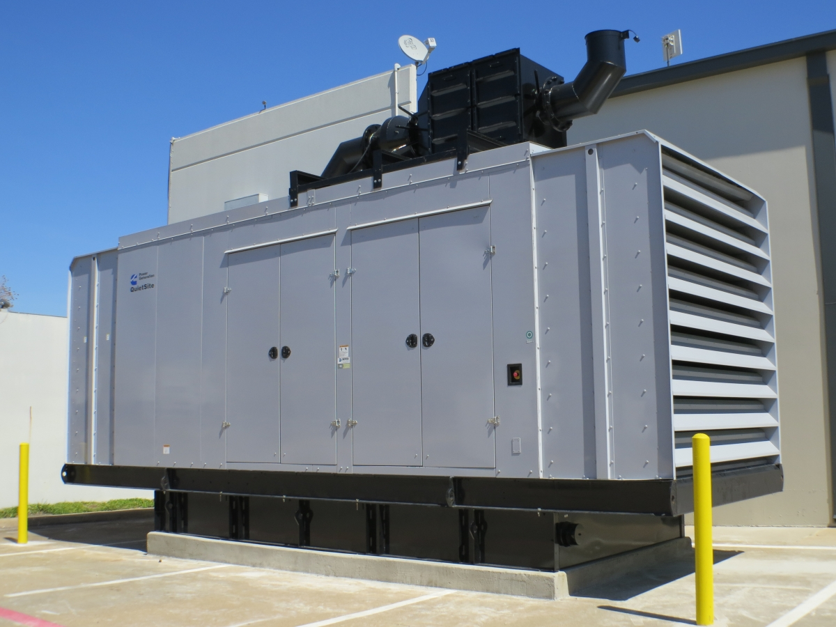
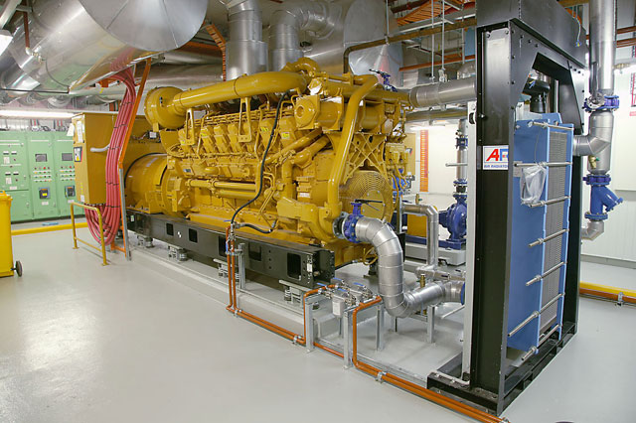
External generator sitting on fuel
bed.
Internal generator – lower risk of weather-related issues.

Slide 10
Homework
No homework this week.
Good luck on the final exam!

