Slide 1
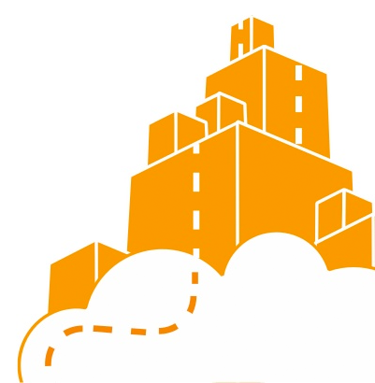
DevOps & Cloud Infrastructure SEIS 665 Week 5
Jason Baker
Adjunct Instructor
Graduate Programs in Software
University of St. Thomas
St. Paul, MN

Slide 2
Agenda
EC2
Elastic Load Balancing
Placement Groups
EFS
VPC
Bastion hosts
NATing
RDS
DynamoDB, Redshift

Slide 3
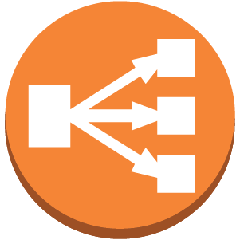
Elastic Load Balancing (ELB)
ELB is a managed load balancer for EC2 instances.
Provides a single endpoint for external users and redirects incoming requests to instances.
Monitors health of instances and routes requests to healthy instances.
Load balancing algorithms:
Round-robin for TCP requests
Least Outstanding Requests for HTTP/HTTPS

Slide 4
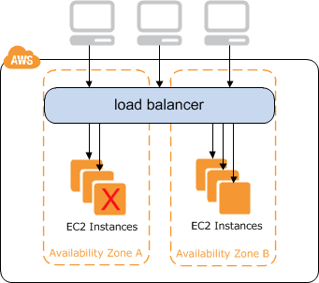
ELB
Benefits:
Scale application performance by adding more instances
Automatically handle failed instances
Protect against failure of an entire availability zone

Slide 5
ELB
ELB is priced on an hourly basis like EC2 instances.
Additional features:
Sticky sessions: bind a user’s session to a specific instance instead of randomly redirecting (session affinity).
SSL termination: install an SSL/TLS certificate directly on the ELB versus on individual instances.
Internal load-balancing: can also use to load balance internal traffic such as database connections.

Slide 6

ELB Hands-on
Launch two instances running webservers (using webserver-failover AMI)
Create a new ELB:
Listen on HTTP
Setup health check
Add two instances
Monitor status of ELB to verify service health.
Access webservers via ELB endpoint.
Remove one webserver instance to monitor ELB status.

Slide 7
EC2 Placement Groups
A set of EC2 instances placed together in a single AZ to improve network performance.
Very low latency 10Gbps network access.
Only supports certain types of instances.
Instances in a placement group should be similar type.
Need to define a placement group before launching instances into it.
Cannot move existing instances into group.
Cannot merge placement groups.
Use-cases: Sharded NoSQL databases, Hadoop

Slide 8

Elastic File System (EFS)
A file system that can be shared across multiple EC2 instances.
Where EFS fits in:
Type | Purpose
S3 | Object storage Data presented as buckets
EBS | Block storage (like a SAN) Data presented as volumes
EFS | File storage (like a NAS) Data presented as file systems

Slide 9
EFS
A fully managed file system for EC2 instances.
Shareable across thousands of instances
Scalable to petabytes
Works with standard operating system APIs
Based on Network File System version 4 (NFSv4).
Files redundantly stored across multiple AZs.

Slide 10
EFS
Use cases:
Scalable content repository storing customer uploads.
Deploying website files across fleet of deployed EC2 instances.
Sharing home directories across instances.
Benefits:
Native file system interaction with OS and applications.
AWS managed infrastructure.

Slide 11

Virtual Private Cloud (VPC)
A VPC is a logically isolated virtual network within a region that is used to partition resources.
It’s like a private cloud-based data center.
Benefits:
Allow you to build secure application architectures.
Securely partition applications and organizations.
VPCs are hard to understand at first, but are critically important to working with AWS.

Slide 12
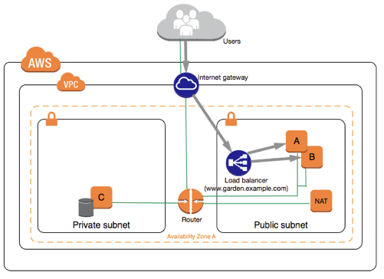
VPC
Example use case: public webservers with backend database servers

Slide 13
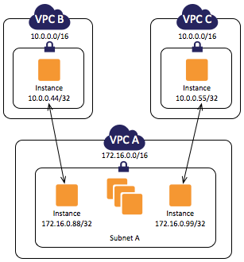
VPC
A region may contain multiple VPCs.
Each VPC has its own privately-routable network.

Slide 14
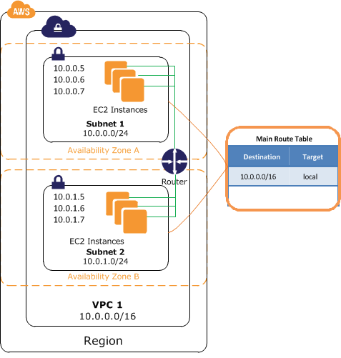
VPC
A VPC network is partitioned into one or more subnets.
Each subnet is associated with one AZ.
Each subnet is associated with one route table.

Slide 15
VPC IP addressing
Every EC2 instance has a private IP address, automatically assigned based on the subnet.
Some instances may have a dynamically assigned public IP address based on subnet setting.
Dynamically assigned public IP addresses are pulled from a general pool and change every time an instance starts.

Slide 16
Elastic IP
An elastic IP is a permanent public IP address that is associated with an instance.
IP address doesn’t change when the instance is restarted.
AWS user can provision elastic IP addresses and assign the addresses to instances as needed.
Small monthly fee for each IP address (even if not associated with instance).

Slide 17
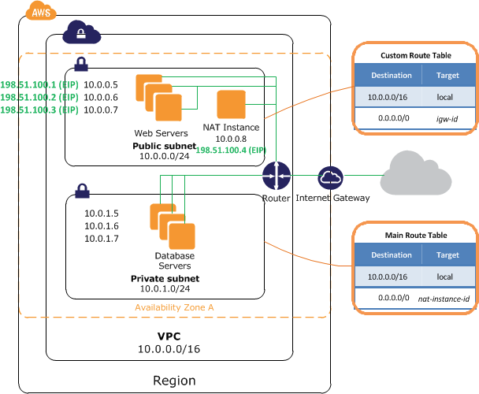
Internet Gateway
To access the Internet directly an instance must have a public IP address and be on a subnet that routes through an Internet Gateway.
Only one IG allowed per VPC.
No extra fee for using an IG.

Slide 18
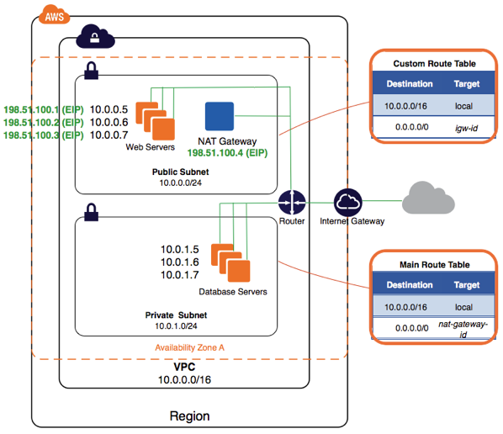
NAT Gateway
A NAT Gateway allows an instance on a private subnet to communicate with the Internet.
Hourly fee for a NAT (it’s basically a managed EC2 instance).

Slide 19
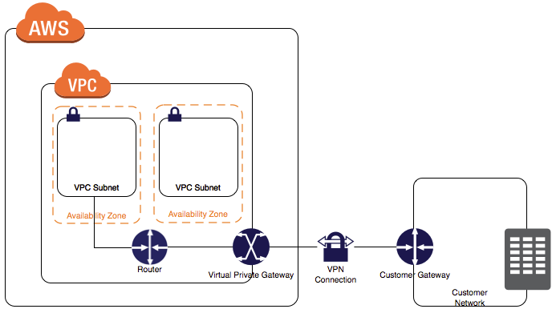
Virtual Private Gateway
VPG securely connects a VPC to a corporate network.

Slide 20
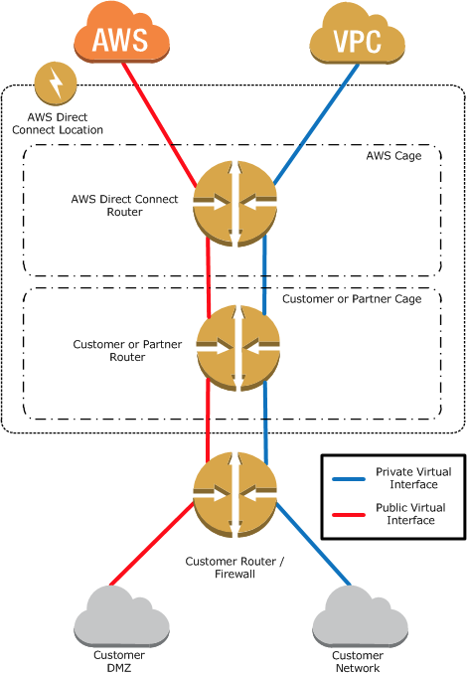
AWS Direct Connect
Dedicated physical network connection between enterprise and AWS network.
Network equipment co-located at meet-me room.

Slide 21
Access Control Lists
ACLs define rules to filter network traffic to and from subnets.
It’s like a firewall for subnets.
Filters traffic outside of subnet and before security groups.
Rules are stateless, meaning ingress and egress rules must be explicitly defined.
Default rule is all ingress/egress data allowed.
New rules start by denying all data.

Slide 22
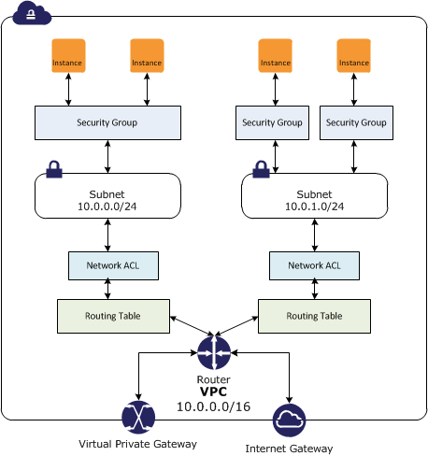
Access Control Lists

Slide 23
VPC Tenancy
VPCs can support three different tenancy options:
Default: instances run on shared hardware.
Dedicated: instances run on single-tenant hardware.
Host: an instance runs on a dedicated host (bare-metal).
Single tenant options help meet certain regulatory requirements, but at a much higher cost.
~ $2,000/mo region fee to deploy dedicated instances.

Slide 24
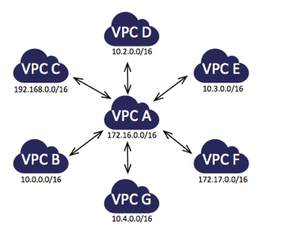
VPC Peering
It’s possible to route traffic between VPCs.
Traffic routing cannot be transitive (VPC C cannot communicate with VPC F).
A star topology is the recommended peering strategy.

Slide 25
Bastion Host
Bastion host is an instance in a public subnet that is used to proxy secure communications to an instance on a private subnet.
Not an AWS service, just a common type of configuration.

Slide 26
Default VPC
Your AWS account has a default VPC setup in each AWS region.
The default VPC has an Internet Gateway and all subnets will route public traffic through it.
All subnets will dynamically assign public IPs to new instances.
Default VPC is great for learning AWS, but is likely not appropriate for production.

Slide 27
VPC Hands-on
Create a new VPC
Name: classvpc
CIDR block: 10.0.0.0/18
Create two subnets in VPC on separate AZs
Public subnet
Name: class-public
AZ: us-east-1a
CIDR block: 10.0.1.0/24
Private subnet
Name: class-private
AZ: us-east-1b
CIDR block: 10.0.2.0/24
Review main route table for VPC and current subnet association

Slide 28
VPC Hands-on
Add Internet Gateway to VPC
Name: class-IG
Attach to new VPC
Launch one instance into each subnet.
Configure routing tables for public and private subnets.
Public routing table routes through IG
Setup a NAT in the public subnet.
Modify private subnet route table to route through NAT.
Terminal into public and private servers to verify access.

Slide 29

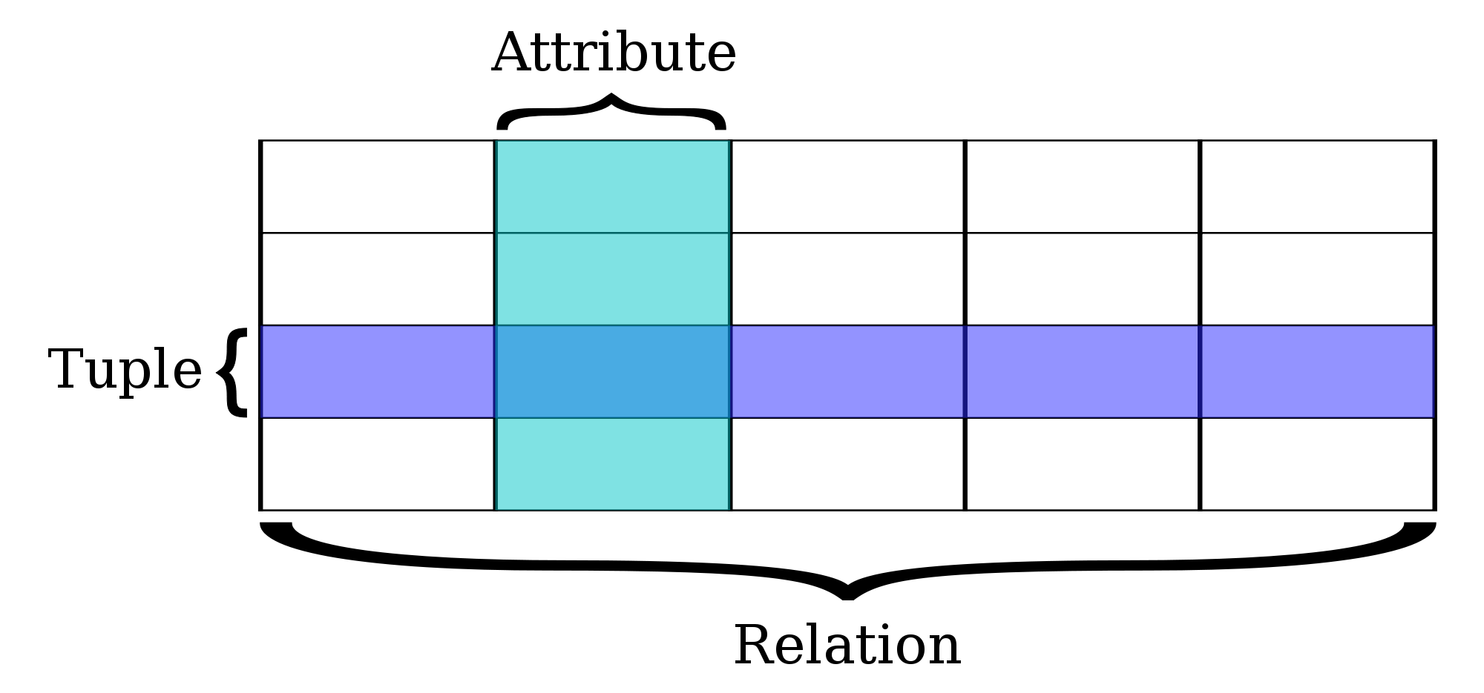
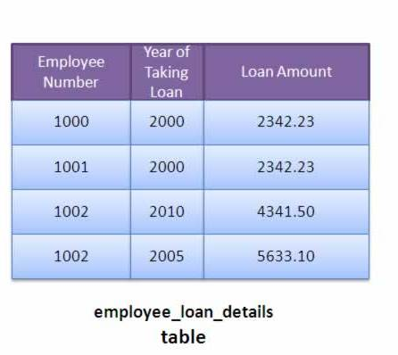
Relational Database Service (RDS)
Managed database service supporting traditional relational databases.

Slide 30
RDS
Supported databases:
MySQL
MariaDB (MySQL fork)
Microsoft SQL Server
Oracle
PostgreSQL
Aurora (designed by AWS)
RDS provides an endpoint for each database which is used by an application for communication.

Slide 31
RDS
RDS supports two different database backup schemes:
automated backups
snapshots.
Automated backups: RDS performs a full daily backup of the database and stores transaction logs since the backup job.
Retains backup data for 1 to 35 days.
During recovery full backup is restored and then transaction logs are replayed.
Backup data is stored on S3.
Backups occur during a specified window and the database storage I/O may be significantly reduced.

Slide 32
RDS
RDS snapshots are initiated manually by the user and exist indefinitely – even after database is removed.
It’s possible to use RDS data backups to copy databases (for testing or to move).
Multi-AZ capability provides standby database instance in a separate AZ for fail-over purposes.
Writes to main database server are synchronized to the standby database.
Main purpose is for greater service resiliency, it does not improve performance.
Although, it allows RDS to update or backup a server without degrading I/O.

Slide 33
RDS
All database types support Multi-AZ
Aurora is special because it is only offered in a multi-AZ architecture (2 DBs in 3 AZs = 6 total!).
Read Replica: a database instance in a separate AZ which asynchronously copies data from the main database.
Only used for READS
Scales database performance by allowing database clients to read data from multiple instances.
Up to 5 read replicas supported.
Owner can promote a read replica into a separate database, splitting relationship with parent.

Slide 34
RDS Hands-on
Create an RDS database.
Create database security group.
Locate database endpoint.
Review automatic backup schedule.
Perform a snapshot.

Slide 35
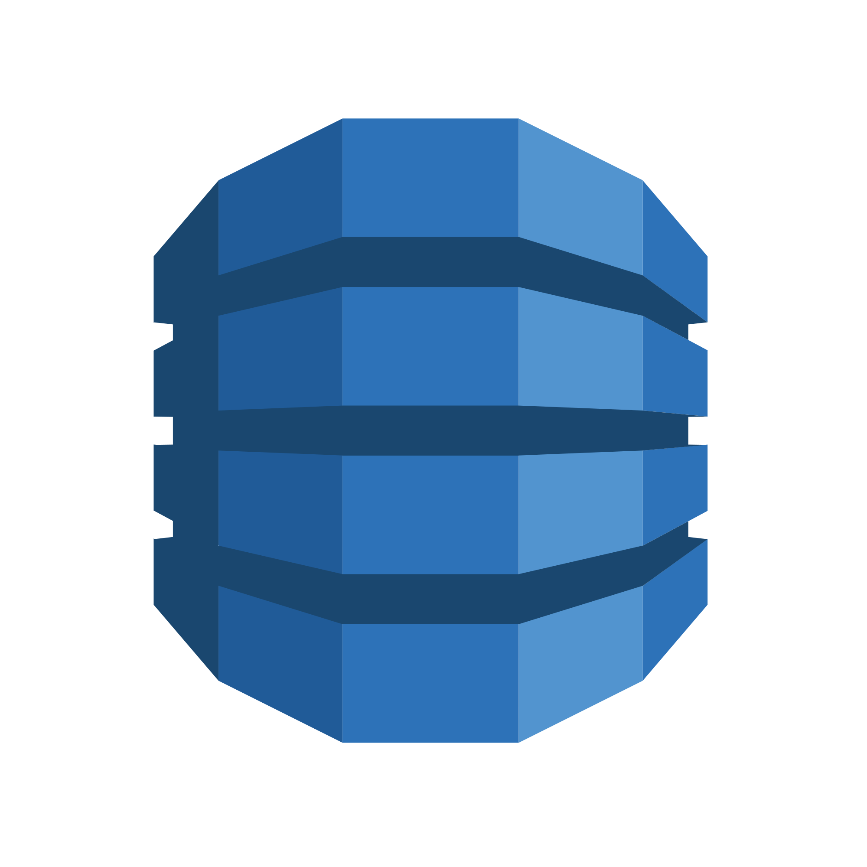
DynamoDB
AWS NoSQL database utilizing a document processing architecture.
Based on Google Big Table design.
Each document is comprised of key/value pairs stored in JavaScript Object Notation (JSON).
Supports highly scalable number of reads and writes with unlimited data storage.
Automatically scales data storage, no need to reconfigure database like RDS (relational).
Data replicated between 3 separate datacenters (not necessarily in separate AZs).

Slide 36
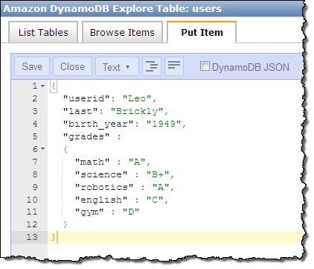
DynamoDB

Slide 37
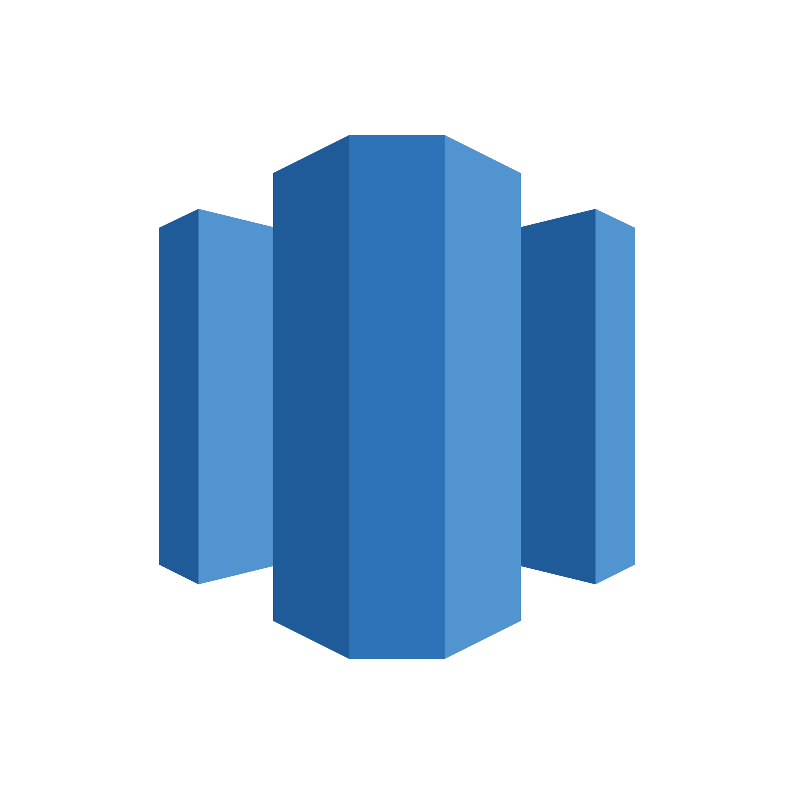
Redshift
Managed data warehousing and analytics database (OLAP).
Online Transaction Processing (OLTP) focuses on querying and maintaining individual transactions.
Products purchased in a specific order
Online Analytical Processing (OLAP) focuses on the analysis of aggregate sets of data.
Total store sales across North America
Uses columnar storage to improve performance.
Generally computation is performed on values within a column, so store them in the same page to improve query performance (reduce I/O).

Slide 38
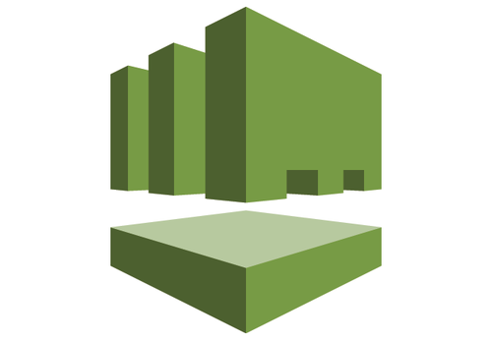
Directory Service
Provides multiple ways to use Microsoft Active Directory with AWS services.
Three options:
Simple AD
Microsoft AD-compatible service powered by Samba 4.
Supports most AD functionality.
Designed for less than 5000 users.
Microsoft AD Enterprise
Full Microsoft AD service managed by AWS.
Designed for more than 5000 users.
AD Connector
Proxy service for connecting on-premise AD servers to AWS resources.

Slide 39
Homework
Assignment 5
Read Infrastructure as Code Chapters 3 & 4

