Slide 1
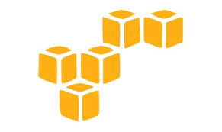
DevOps & Cloud Infrastructure SEIS 665 Week 4
Jason Baker
Adjunct Instructor
Graduate Programs in Software
University of St. Thomas
St. Paul, MN

Slide 2
Agenda
Cloud Computing
Amazon Web Services (AWS)
IAM
S3
EC2

Slide 3
Cloud Computing
What is cloud computing?
Cloud computing is a model for enabling convenient, on-demand network access to a shared pool of configurable computing resources (e.g., networks, servers, storage, applications, and services) that can be rapidly provisioned and released with minimal management effort or service provider interaction.
National Institute of Standards and Technology
NIST SP 800-145

Slide 4
Cloud Computing Characteristics
On-demand
Infrastructure available as needed via a self-service interface
Network access
Infrastructure accessed via a broad network (generally Internet)
Resource pooling
Infrastructure aggregated into large resource pools which are subsequently partitioned to support specific functions
Elasticity
Utility service
Ability to rapidly provision and de-provision services as needed
Pay-for-usage pricing model with no minimum commitments

Slide 5
Cloud Computing Benefits
On-demand
Rapidly provision infrastructure to support development, testing, project deployment.
Easily support transient applications that require significant resources for a short period of time.
Self-service interfaces = reduced demand on system admins, storage engineers, network admins, etc.
Manage infrastructure programmatically via APIs (Infrastructure as code).

Slide 6
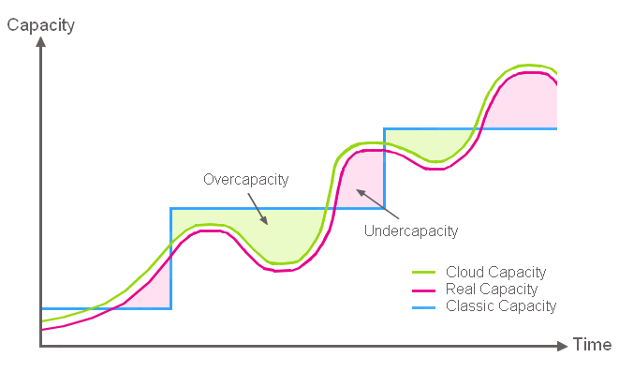
Cloud Computing Benefits
Align infrastructure capacity with current IT demand to achieve cost savings.

Slide 7
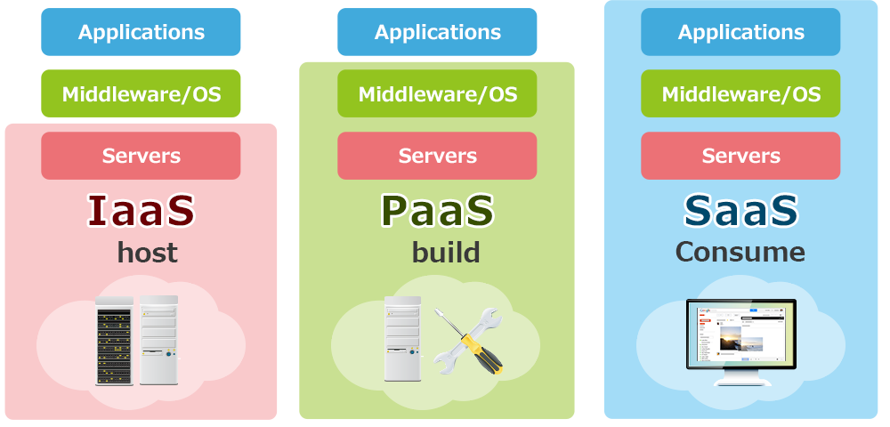
Cloud Computing Service Models
Infrastructure-as-a-Service
Platform-as-a-Service
Software-as-a-Service

Slide 8
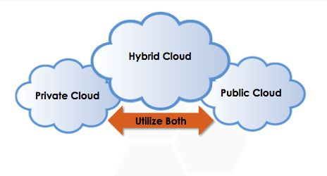
Cloud Deployment Models

Slide 9
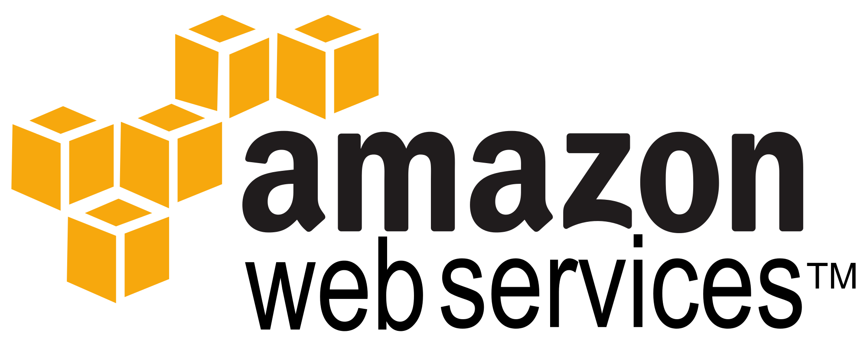

Slide 10
Amazon Web Services
1st public cloud computing platform
Chris Pinkman and Benjamin Black described what Amazon infrastructure should like and how it could be sold as a service.
Simple Queue Service (SQS) launched in 2004.
S3 & EC2 (AWS) launched in 2006.
Largest public cloud provider with millions of customers
Gartner 2015: AWS 10x larger than next 14 largest cloud providers combined
Amazon.com runs on top of AWS (though on completely separate infrastructure).

Slide 11
Why AWS?
AWS platform contains all of the services needed to reinforce concepts in this course.
IT professionals should understand how to use the most popular cloud platform.
Students receive educational credits for using AWS.
Course lectures based on AWS Solution Architect Certification training.

Slide 12
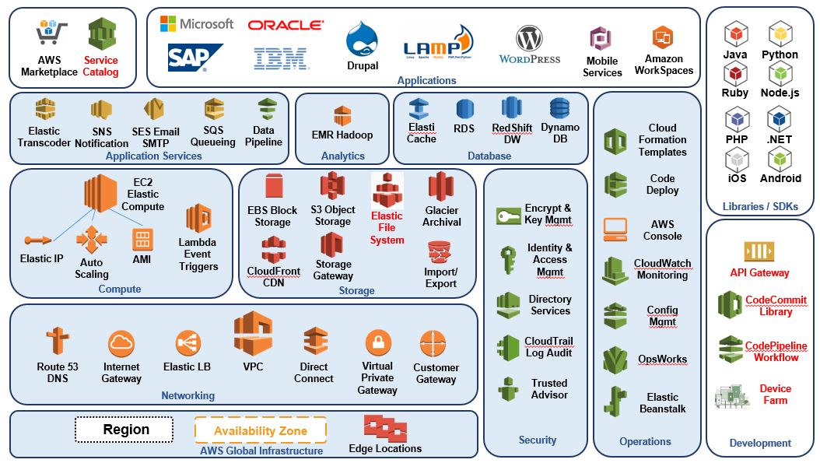
AWS Ecosystem

Slide 13
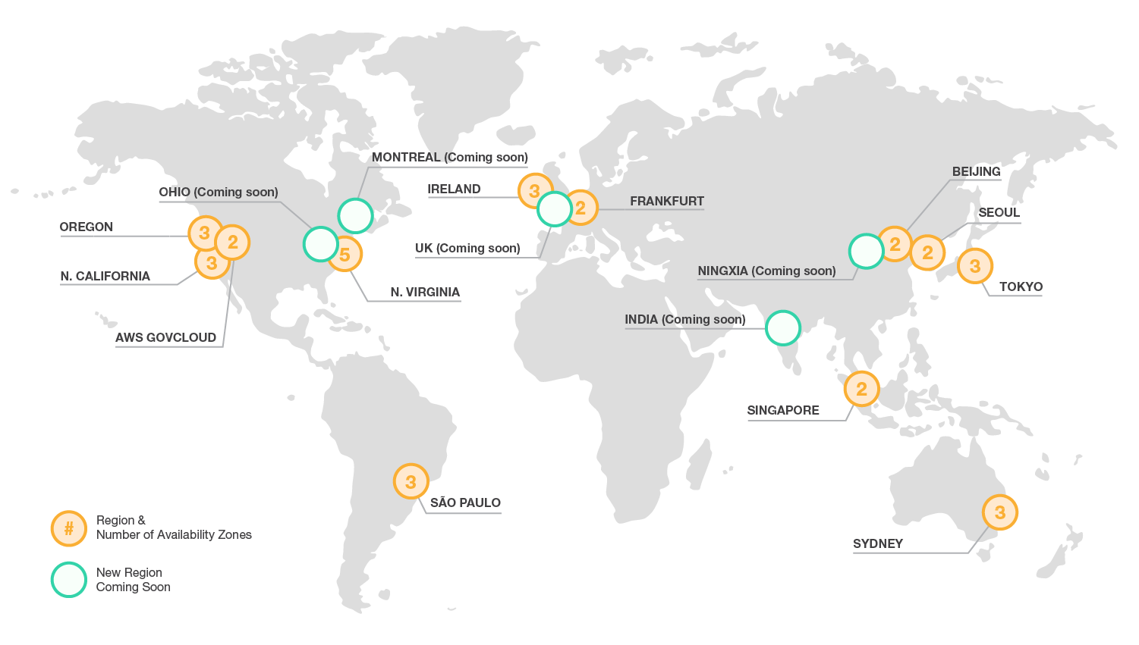
Global Infrastructure

Slide 14
AWS Regions & Zones
AWS Infrastructure partitioned into many regions, each of which contains one or more availability zones (AZs).
Regions are in completely separate physical parts of the world.
AZs represent datacenters within a particular region.
Note: Not all services are available in every region.
Region: us-east
Region: us-west
Availability Zone
Availability Zone
Availability Zone
Availability Zone
Availability Zone
Availability Zone

Slide 15

Identity & Access Management (IAM)
IAM allows organizations to create users and manage their access to AWS resources.
Provides granular governance controls and federated access.
Password expiration/strength
Login via Active Directory, Facebook, etc
Signup account (root account) is your master account, best practice is not to use it for day-to-day management.

Slide 16
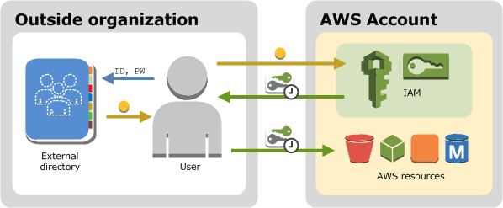
IAM

Slide 17
IAM Terms
User: an individual setup with an account in IAM.
Group: a set of users sharing similar access privileges.
Role: access privileges that may be assigned to AWS resources.
Lets resources act like users with specific privileges.
Policy: a document containing one or more defined privileges.

Slide 18

IAM Hands-on
IAM is global, any changes we make impact all regions.
All activities we do on the web console may also be done via command line or SDK.
IAM users sign-in link is the web login URL for users (and it may be customized).
IAM Security Status shows important security steps (recommend turning on MFA).

Slide 19
IAM Hands-on
Create new user
Each user has a user name, password, access key ID, and secret access key.
User name and password required to log into web console.
Access key and secret access key required to use AWS API (** KEEP THESE SAFE!!)
Create a new group
Each group has one or more policies attached.
Policies define access privileges for group members.
Account Settings
Define password strength/expiration requirements.
Roles
Allow a resource to access other resources with set privileges.
Example: Allow webserver on EC2 to retrieve files stored on S3.

Slide 20

Simple Storage Service (S3)
Secure, durable, highly-scalable object storage
Object based and stored as a key/value + metadata
Key = filename
Value = data
Version ID = version of the file
Metadata = various descriptive information about the file
Standard S3 data is stored across multiple AZs in a region (11 9’s durability: 99.999999999%)
Highly available: 4 9’s availability (99.99%)
Unlimited storage
Individual files may be 0 bytes to 5TB
You cannot install a file system on S3 or use for database storage!

Slide 21
S3
S3 storage namespace is partitioned into buckets in each region.
Files are stored in a bucket.
Bucket name is global and must be unique.
Limit of 100 buckets per account (but can be increased).
Data consistency
New objects = Read after Write consistency
Updated or deleted objects = Eventual consistency
If you update an object and then try to immediately read it again, you might get the old version.

Slide 22
S3
Security
Set access control policies on a bucket level or a per-file level.
Encrypt data-at-rest for greater security (AES-256).
Transmit data to S3 via SSL/TLS.
Create logs tracking all access to buckets and files.
Cost
Pay for storage space per GB, number of requests (GET, PUT, etc.) and data transmission.
No fee for incoming data.
Additional S3 features
Tiered storage options for increased performance or lower cost.
Lifecycle management to automatically delete or archive data.
Versioning to track changes to file.

Slide 23
S3 Storage Tiers
Standard S3: default storage tier appropriate for most requirements.
Durability: 99.999999999% (11 9’s)
Availability: 99.99% (4 9’s)
S3-IA (Infrequently Accessed): data which isn’t accessed frequently, but must be available immediately.
Durability: 99.999999999% (11 9’s)
Availability: 99.9% (3 9’s)
RRS (Reduced Redundancy Storage): storage for non-critical or easily reproduced data.
Durability: 99.99%
Availability: 99.99%
Glacier: inexpensive data archiving, 3-5 hours to restore data.

Slide 24
S3 Hands-on
Create a new bucket
Bucket name must be globally unique and associated with a specific region
https://s3-us-east-1.amazonaws.com/ust123
Permissions: set bucket-level access policy.
Static website hosting: host a website using a set of files in a bucket.
Events: trigger notifications based on file changes.
Versioning: track file changes.
Lifecycle: automate file archiving or deletion.
Tags: create unique metadata for tracking

Slide 25
S3 Hands-on
Add a new file
Upload a file through web console or API/SDK.
File changes via HTTP PUT or DELETE.
Each file has a set of metadata.
Each file has a unique web link.
Can set storage class and encryption on a per-file basis.

Slide 26
S3 Hands-on
Versioning
Enabled on a per-bucket basis.
Once versioning on a bucket is enabled, it cannot be disabled only suspended.
S3 tracks the version of each file.
Files are hidden (delete markers) and not deleted.
Great for protecting and tracking files, but consumes more storage space.
Cross region replication: requires versioning to be enabled on the source bucket.

Slide 27
S3 Hands-on
Lifecycle Management
Automatically transition files from one storage tier to another after a specified amount of time.
Permanently delete files based on a set schedule.
Benefits:
Convenient way to enforce organizational data retention policies.
Reduce storage costs by moving older data to cheaper tiers of storage.

Slide 28

CloudFront
Global Content Distribution Network (CDN)
Cache S3 files at over 50 edge locations throughout the world.
Edge location = point of presence in a datacenter
Don’t confuse edge locations with regions
Distribution: a set of S3 files that are cached in edge locations.
Benefit: Website visitor is automatically directed to closest file cache, decreasing download latency and improving website response time.
Note: it can be expensive to remove (invalidate) cached objects. Oftentimes people just add new versions of their files to the distribution.

Slide 29
Storage Gateway
A software solution to connect data storage within an enterprise to S3.
Three different options:
Store all files on S3, but cache frequently-accessed files locally.
Store all files locally, but replicate some or all files on S3.
Treat S3 like a virtual tape library when using backup software.
Benefits:
Backup data in a highly-resilient secondary location.
Leverage unlimited storage available on S3.

Slide 30
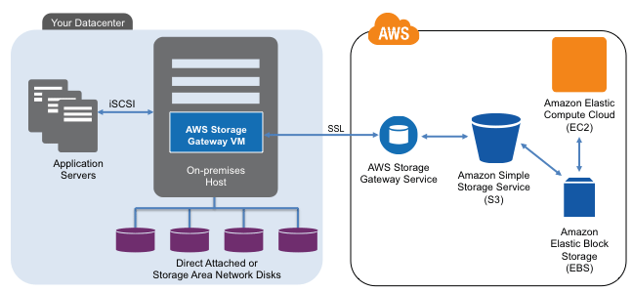
Storage Gateway

Slide 31
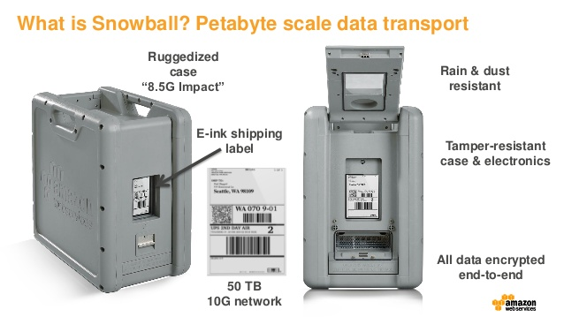
Snowball

Slide 32
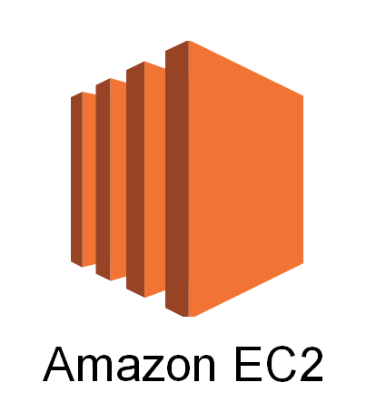
Elastic Compute Cloud (EC2)
Service that provides resizable compute capacity in the cloud.
Core computing infrastructure building block that supports many other AWS services.
It’s basically a cloud-based virtual machine (AWS calls them instances) running on top of the Xen hypervisor.

Slide 33
EC2 Deployment Options
On Demand: pay a fixed rate for the EC2 instance on an hourly basis (default).
Short-term unpredictable workloads
Customer controls start/termination because the application cannot be interrupted.
Reserved: reserve a certain amount of computing capacity for 1-to-3 years at a discounted rate.
Long-term, predictable workloads with known capacity requirements.
Spot: make a bid for computing capacity that’s not currently being used.
Very short-term workloads
AWS may terminate the instance at any time if the spot prices increases over the bid price.

Slide 34
EC2 Instance Types
Type | Purpose
T2 | Low cost, general purpose computing, small web server or test/dev server
M3 & M4 | General purpose computing, typical application server
C3 & C4 | Compute optimized, CPU intensive applications
R3 | Memory optimized, in-memory caching or database systems
G2 | Graphics optimized (GPU), video transcoding and machine learning
I2 | High speed storage optimized, database systems
D2 | Dense storage system, file servers, Hadoop
* Easy way to compare instance features and pricing: http://www.ec2instances.info/

Slide 35
EC2 Amazon Machine Image (AMI)
You create an EC2 instance using an AMI (template).
An AMI defines the base OS, applications, networking and storage components for an EC2 instance.
AMI sources:
Amazon curated images
Community provided images
Commercial images on the Amazon Marketplace
Your own private images
AMIs only exist within a specific region (you can copy to other regions if necessary).

Slide 36
Elastic Block Storage (EBS)
Service that allows you to create disk storage volumes that can be attached to EC2 instances.
A volume is like a hard drive for your instance.
EBS volumes are block storage and support file systems and databases.
Each volume replicated within the AZ to provide high availability.
Its delivered like a volume from a SAN.
EC2 instance sees it as a physically attached drive.

Slide 37
EBS Volume Types
General Purpose SSD (GP2)
5 9’s availability (99.999%)
3 IOPS per GB, up to 10,000 IOPS
Provisioned IOPS SSD (IO1)
Very high IOPS capacity for disk I/O intensive applications requiring > 10,000 IOPS
Magnetic
Cheapest storage option with lowest performance

Slide 38
EBS Snapshots
A snapshot is a point-in-time copy of an EBS volume stored on S3.
Snapshots are incremental, only saving data that changed since the previous snapshot.
You pay for snapshot storage at S3 rates.
Benefits:
Quickly backup data periodically or before making big changes.
Roll back system changes by reverting to previous snapshots.
Notes:
Initial snapshots will take longer.
You should stop a root volume before taking a snapshot to ensure consistency.

Slide 39
Instance Store
Instance store is another data storage option for EC2 instances.
The original storage option!
Instance data is stored on a physical hard drive attached to the host server versus a networked volume.
The storage is ephemeral, if the instance is stopped the data is gone forever.
You can still reboot the instance without loosing data though.
Why ephemeral storage?
Cheap
Data persistence may not matter in certain architectures.

Slide 40
Security Groups
Security groups provide a security layer around EC2 instances.
Define a set of IP addresses and protocols that can send data to and from servers.
It’s like a basic layer-4 firewall system.
Default security group
All inbound traffic blocked
All outbound traffic allowed
Security groups are stateful meaning that responses from allowed connections are valid.
Server can initiate outbound web request and receive an inbound response even if port 80 (http) incoming traffic is blocked.

Slide 41
Security Groups
SG can contain any number of EC2 instances
An EC2 instance may be associated with up to 5 different security groups
0.0.0.0/0 represents “everywhere”
Web Security Group
DB Security Group
Instance
Instance
Instance
Instance
Instance
Instance
Incoming port 80 from 0.0.0.0/0
Incoming port 443 from 0.0.0.0/0
Outgoing any to 0.0.0.0/0
Incoming port 3306 from Web SG
Incoming port 22 from Web SG
Outgoing port 80 to Web SG
VPC

Slide 42
EC2 Hands-on
Launch a new EC2 instance
Select an Amazon Linux AMI
Choose an instance type
Add/modify storage
Tag instance
Log into EC2 instance
Add a new security group (webservers)
Make sure ssh port is open in SG
Update server packages
Show instance meta-data capability:
curl http://169.254.169.254/latest/meta-data/
curl http://instance-data/latest/meta-data/
Show AWS CLI (aws help)
Snapshot instance volume
Create AMI from instance
Terminate EC2 instance

Slide 43
Homework
Assignment 4
Read Architecting for the Cloud: AWS Best Practices (February 2016)
Read Infrastructure as Code Chapter 2

