Slide 1
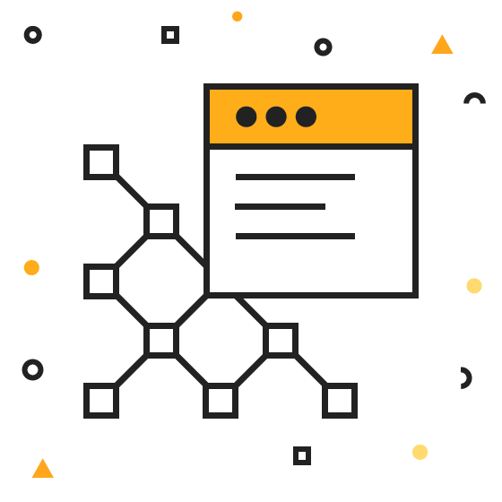
DevOps & Cloud Infrastructure SEIS 665 Week 10
Jason Baker
Adjunct Instructor
Graduate Programs in Software
University of St. Thomas
St. Paul, MN

Slide 2
Agenda
Application Deployment Strategies
Immutable Infrastructure
Packer.io
Configuration Management
Ansible

Slide 3
Deployment strategies
Question: Once an application is built, how do we deploy it to distributed infrastructure?
Strategy for deploying to 1 server very different than 100’s
Trade-offs between deployment speed and risk
Cloud elasticity and pricing model supports new strategies

Slide 4
Deployment strategies
Single Server Deployment
Application is deployed to a single server
Very common for testing and small production applications
Benefits:
Easy and quick to deploy app on a single server
Problems:
Service outage occurs during app deployment
No ability to test app in production before deployment
Rolling back app requires complete reinstallation
Build
Server

Slide 5
Deployment strategies
Big Bang Deployment
Application is deployed to all servers at once
Common for a small set of servers (2-5)
Benefits:
Quick to deploy app on multiple servers, though requires orchestration
Problems:
Service outage occurs during app deployment
No ability to test app in production before deployment
Rolling back app requires complete reinstallation
Server
Build
Server
Server

Slide 6
Deployment strategies
Minimum-in-service Deployment
Application is deployed in multiple stages with a minimum set of servers supporting service
Benefits:
Supports large environments
No downtime
Fast, most systems updated
Deployments are tested in production
Problems:
Requires significant automation and orchestration capabilities
May require rollback
2 server minimum-in-service
1
2
3
4
5
6
----Updating---
1
2
3
4
5
6
Updating
1
2
3
4
5
6
1
2
3
4
5
6

Slide 7
Deployment strategies
Rolling (Canary) Deployment
Application is deployed to a specified number of servers at each stage
Benefits:
Low risk strategy
Maintains health of service
Minimize user impact through early service issue detection
Problems:
Requires significant automation and orchestration capability
Slow, depending on number of servers updated at each stage
2 server rolling deployment
1
2
3
4
5
6
Updating
1
2
3
4
5
6
Updating
1
2
3
4
5
6
Updating
1
2
3
4
5
6

Slide 8
Deployment strategies
Blue Green Deployment
Application is deployed to a completely new production environment in parallel
Benefits:
Maintains health of service
Rapid cut-over deployment
Ability to test complete deployment in production
Easy to perform full rollback
Problems:
Requires significant automation and orchestration capability
Extra cost, but manageable with cloud instances
App.com Domain
1
2
3
1
2
3
App.com Domain
1
2
3
1
2
3

Slide 9
Immutable Infrastructure
A deployment methodology where we replace systems instead of updating them.
Aligns well with dynamic nature of cloud computing.
Eliminates pets from the infrastructure environment.
Mitigates natural entropy experienced by systems.
We need to be able to build any system at any time in an automated and repeatable fashion.
Sometimes called phoenix servers – able to rise from the ashes.

Slide 10
Immutable Infrastructure
How do we rebuild servers using automation?
Server consists of:
Infrastructure definition (server type)
Operating system
Software (php, apache, mysql)
OS & application configuration
Data
We can use Terraform, CloudFormation, Auto-scaling or other tools to create the infrastructure.
Need a way to all all the software pieces.

Slide 11
Bake vs. Fry
There are two general approaches to installing software on a server:
Bake: pre-generate a software image which contains an OS and all the required software components.
Like an AMI based on a snapshot of a fully working system.
May need to perform a few configuration tasks once it’s launched.
Benefit: Allows you to launch a new server quickly.
Risk: May require you to frequently create and manage new images.
Fry: launch a server with a plain OS distribution and then install required software on-the-fly.
Like a base AMI image running a userdata shell script.
Benefit: No need to manage images.
Risk: New instances may take a long time to deploy.

Slide 12
Packer
Packer is a tool to create multiple machine images based on a configuration file.
Can create images for AWS, VMWare, Docker, and others.
Configuration file uses JSON.
Developed by HashiCorp (Terraform & Vagrant).
Free tool available at: http://www.packer.io
The configuration file defines:
Builders: describe the type of machine image to create and what infrastructure is used to create it.
Provisioners: describe what software components to install on the machine image.

Slide 13

Packer Hands-on
Review Packer JSON file.
Build new image.
$ packer build -var-file=variables.json example.json
View image in AWS console.

Slide 14
Homework
Assignment 8
Read Infrastructure as Code Chapters 9 & 10

