Slide 1

DevOps & Cloud Infrastructure SEIS 665 Week 10
Jason Baker
Adjunct Instructor
Graduate Programs in Software
University of St. Thomas
St. Paul, MN

Slide 2
Agenda
Application Deployment Strategies
Immutable Infrastructure
Packer.io
Configuration Management
Ansible

Slide 3
Deployment strategies
Question: Once an application is built, how do we deploy it to distributed infrastructure?
Strategy for deploying to 1 server very different than 100’s
Trade-offs between deployment speed and risk
Cloud elasticity and pricing model supports new strategies

Slide 4
Deployment strategies
Single Server Deployment
Application is deployed to a single server
Very common for testing and small production applications
Benefits:
Easy and quick to deploy app on a single server
Problems:
Service outage occurs during app deployment
No ability to test app in production before deployment
Rolling back app requires complete reinstallation
Build
Server

Slide 5
Deployment strategies
Big Bang Deployment
Application is deployed to all servers at once
Common for a small set of servers (2-5)
Benefits:
Quick to deploy app on multiple servers, though requires orchestration
Problems:
Service outage occurs during app deployment
No ability to test app in production before deployment
Rolling back app requires complete reinstallation
Server
Build
Server
Server

Slide 6
Deployment strategies
Minimum-in-service Deployment
Application is deployed in multiple stages with a minimum set of servers supporting service
Benefits:
Supports large environments
No downtime
Fast, most systems updated
Deployments are tested in production
Problems:
Requires significant automation and orchestration capabilities
May require rollback
2 server minimum-in-service
1
2
3
4
5
6
----Updating---
1
2
3
4
5
6
Updating
1
2
3
4
5
6
1
2
3
4
5
6

Slide 7
Deployment strategies
Rolling (Canary) Deployment
Application is deployed to a specified number of servers at each stage
Benefits:
Low risk strategy
Maintains health of service
Minimize user impact through early service issue detection
Problems:
Requires significant automation and orchestration capability
Slow, depending on number of servers updated at each stage
2 server rolling deployment
1
2
3
4
5
6
Updating
1
2
3
4
5
6
Updating
1
2
3
4
5
6
Updating
1
2
3
4
5
6

Slide 8
Deployment strategies
Blue Green Deployment
Application is deployed to a completely new production environment in parallel
Benefits:
Maintains health of service
Rapid cut-over deployment
Ability to test complete deployment in production
Easy to perform full rollback
Problems:
Requires significant automation and orchestration capability
Extra cost, but manageable with cloud instances
App.com Domain
1
2
3
1
2
3
App.com Domain
1
2
3
1
2
3

Slide 9
Server Lifecycle

Slide 10
Create a new server
How do we create new servers using automation?
Server consists of:
Infrastructure definition (server type)
Operating system
Software (php, apache, mysql)
OS & application configuration
Data
Use Terraform, CloudFormation, Auto-scaling or other tools to create the infrastructure.
Select a server template (image) containing an operating system and software.
Deploy software and configuration using a command tool (Capistrano) or configuration management tool (Chef/ Puppet/ Ansible).
Potentially package everything in containers (Docker – Lecture 12).

Slide 11
Server Template
There are two general approaches to building a server:
Bake: pre-generate a software image which contains an OS and all the required software components.
Example: Use an AMI based on a snapshot of a fully working system.
May need to perform a few configuration tasks once it’s launched.
Benefit: Allows you to launch a new server quickly.
Risk: May require you to frequently create and manage new images.
Practice: minimize amount of software in a template.
Fry: launch a server with a plain OS distribution and then install required software on-the-fly.
Example: Use a base AMI image and run a userdata shell script.
Benefit: No need to manage images.
Risk: New instances may take a long time to deploy.

Slide 12
Packer
Packer is a tool to create multiple machine images based on a configuration file.
Can create images for AWS, VMWare, Docker, and others.
Configuration file uses JSON.
Developed by HashiCorp (Terraform & Vagrant).
Free tool available at: http://www.packer.io
The configuration file defines:
Builders: describe the type of machine image to create and what infrastructure is used to create it.
Provisioners: describe what software components to install on the machine image.

Slide 13

Packer Hands-on
Review Packer JSON file.
Build new image.
$ packer build -var-file=variables.json example.json
View image in AWS console.

Slide 14
Update a server
4 models for making configuration changes to servers:
Ad hoc change management: leave server alone until a specific change needs to be made and manually make the change.
Tends to leave servers inconsistently configured.
Leads to configuration drift – a set of servers identically configured will gradually drift apart.
Continuous configuration synchronization: server configuration tool runs on an unattended schedule and applies the current set of configuration definitions.
Minimizes configuration drift by continuously reapplying configuration.
Only manages configuration covered by definition files, creating opportunities for other parts of the server configuration to drift.

Slide 15
Update a server
Immutable servers: a deployment methodology where we replace systems instead of updating them.
Allows us to fully test configuration changes and not worry about unexpected effects of changing running systems.
Eliminates pets from the infrastructure environment.
Mitigates configuration drift because systems don’t live long.
Practice: replace servers anytime a server template changes.
Phoenix server pattern: replace servers on a scheduled basis regardless of whether changes need to be made or not.
Containerized servers: use containers to package applications and their dependencies.
Basically immutable servers, but with containers.

Slide 16
Dynamic Infrastructure Challenges
Server sprawl
It’s really easy to provision new servers.
It becomes difficult to patch and consistently maintain servers and the numbers grow.
Configuration drift
Configuration of servers gradually change over time.
Unmanaged variation leads to support and maintenance challenges.
Snowflake servers
Unique servers that cannot be easily replicated.
Leads to fragile infrastructure and components that nobody knows how to fix.
Automation fear
Fear of running automation tools because so much infrastructure is hand-cranked.
Erosion
Natural entropy suggests that problems will creep into systems over time.

Slide 17
Continuous synchronization
Regularly run a process to apply the current configuration definitions to a server.
Three synchronization patterns:
Pushing to synchronize: a master server pushes configuration to the servers it manages.
Typically uses common communication channels like SSH.
No need to install special software agent on managed servers.
Centralized control over when changes are distributed to servers.
Pulling to synchronize: each managed server pulls configuration from a master server.
Polling is controlled by an agent on each managed server.
May be more secure because an incoming communications channel does not need to be always open on the server.
May be more scalable than a push-based synchronization architecture.
Masterless configuration management: each managed server downloads copies of the configuration definitions and runs a configuration management tool in a local mode.
Eliminates a central server as a single point of failure.

Slide 18
Ansible
A free-software platform for configuring and managing servers.
Push-based configuration using SSH as a communications channel – no agents!
Supports both synchronized and ad hoc task execution on Linux and Windows systems.
Uses YAML to describe the configuration of systems.
Python over SSH.
Originally developed by Michael DeHaan and acquired by Red Hat.
Written in Python and available at www.ansible.com
Control application must run on Unix/Linux system

Slide 19
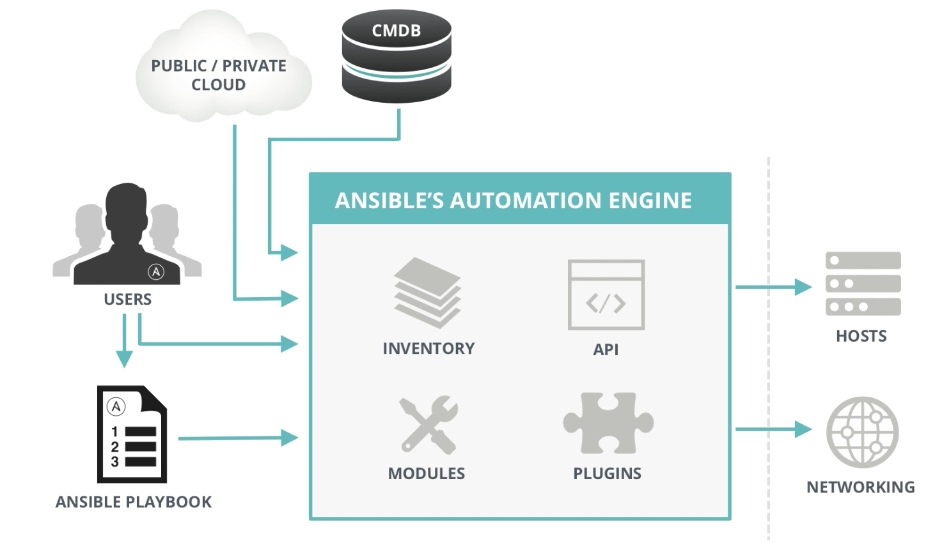
Ansible Architecture

Slide 20
Playbooks
Plain-text YAML files that describe the configuration state of a system.
Playbooks contain plays.
Plays contain tasks.
Tasks call modules.
Tasks run sequentially.
Handlers may be triggered by tasks, and run once at the end of plays.

Slide 21
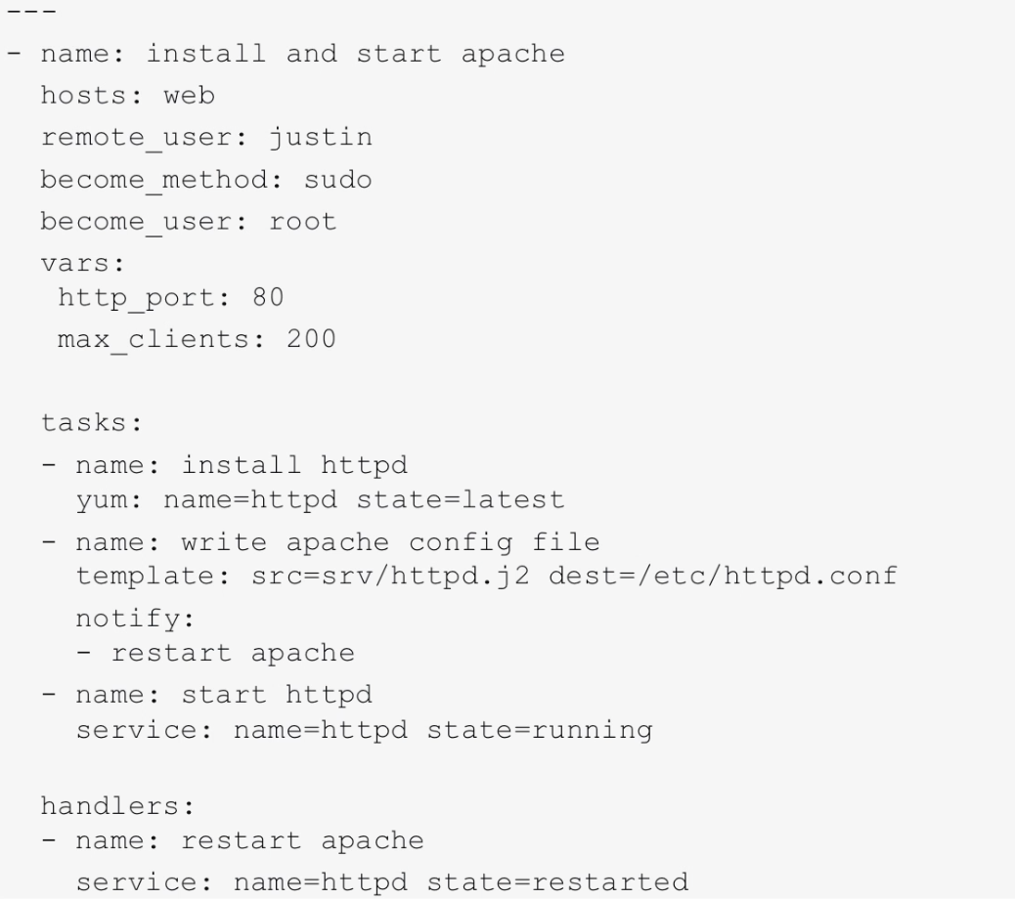
Example playbook

Slide 22
Variables
Variables hold values that hosts or groups of hosts can use for configuration.
Variables can dynamically alter the execution of playbooks.
We can pass in variables via the inventory (group_vars or host_vars directories), command line, or using facts.
Example for ../group_vars/webservers.yml
---
ntp_server: ntp.google.com
database_server: storage.mydomain.com

Slide 23
Inventory
Ansible uses an inventory file, named hosts, to store a list of systems that may be configured.
The hosts file uses an INI-like format:
[webservers]
web1 ansible_host=54.162.154.245 ansible_user=ec2-user
web2.mydomain.com ansible_user=ec2-user
[databases]
db[01:10].mydomain.com maxRequests=1000
Hosts may be members of one or more groups.

Slide 24
Dynamic Inventory
Oftentimes the set of hosts in an environment is not static because of mechanisms like auto scaling.
Ansible can use inventory data generated dynamically by scripts.
Gather the current list of running EC2 instances.
Pull host list from enterprise CMDB.
Example using Terraform:
$ ansible -i terraform.py -m ping all

Slide 25
Host Selection Patterns
We use patterns to decide which groups of hosts to manage.
all (all hosts, can also use *)
*.com (all hosts ending in .com domain)
web1.mydomain.com (single host)
webservers:dbservers (webservers OR dbservers)
webservers:!web1 (webservers, except for web1)
webservers:&mpls (intersection of webservers & mpls)
webservers[1] (2nd host listed in webservers group)

Slide 26
Ad hoc commands
Ansible can be used to execute quick commands on hosts.
Used for very small tasks or testing.
$ ansible –i hosts <pattern> -m <module_name> -a <arguments>
$ ansible –i hosts web1 command –a “uptime”
The command module is the default module, so we don’t have to specify it.
$ ansible –i hosts web1 –a “tail /var/log/boot” –u sudo
Ansible will execute the command as the user specified by the –u option.

Slide 27
Ad hoc commands
Copy files to a group of servers using copy module:
$ ansible –i hosts minneapolis –m copy –a “src=~/archive.zip dest=/var/www/archive.zip”
Create and delete a directory using file module:
$ ansible –i hosts webservers -m file –a “dest=/path/to/files mode=755 state=directory”
$ ansible –i hosts webservers –m file –a “dest=/path/to/files state=absent”
Install a software package using yum module:
$ ansible –i hosts dbserver –m yum –a “name=mysql state=present”

Slide 28
Ad hoc commands
Create and remove user accounts with user module:
$ ansible –i hosts web1 -m user –a “name=jason password=<crypted password>”
$ ansible –i hosts web1 -m user –a “name=jason state=absent”
Manage services using service module:
$ ansible –i hosts webservers -m service –a “name=httpd state=started”
$ ansible –i hosts webservers –m service –a “name=httpd state=restarted”
Facts represent a set of values which describe the configuration of a system. Gather facts using the setup module:
$ ansible –i hosts web1 –m setup

Slide 29
Homework
Assignment 8
Read Infrastructure as Code Chapters 9 & 10

