Slide 1
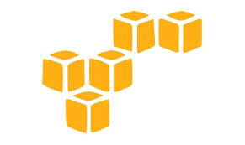
DevOps & Cloud Infrastructure SEIS 665 Week 4
Jason Baker
Adjunct Instructor
Graduate Programs in Software
University of St. Thomas
St. Paul, MN

Slide 2
Agenda
Weekly reading
Cloud Computing
Amazon Web Services (AWS)
IAM
S3
EC2

Slide 3
Origin of Cloud Computing
Pre-web era (pre-1994)
Applications used by limited set of users
9-to-5 service availability, limited need for high-availability architectures
No web!
First-web era: The Bubble (1995-2000)
Static websites, 1 website per machine
Very expensive to provide resiliency and scalability
Dot-coms spent millions on hardware alone
Dot-bomb era (2000-2003)
Surplus of datacenters and computing capacity
Commoditization of cpu/memory/storage
Rise of open source platforms (Linux, MySQL, Apache)

Slide 4
Origin of Cloud Computing
Second-web era (2003-2010)
Virtualized infrastructure
Horizontal scaling
Outsourced application hosting
Cloud computing era (2010-present)
Utility computing
Applications designed around APIs
Infrastructure orchestration/ Infrastructure as code
This timeline aligns with my personal experience.

Slide 5
Cloud Computing
What is cloud computing?
Cloud computing is a model for enabling convenient, on-demand network access to a shared pool of configurable computing resources (e.g., networks, servers, storage, applications, and services) that can be rapidly provisioned and released with minimal management effort or service provider interaction.
National Institute of Standards and Technology
NIST SP 800-145

Slide 6
Cloud Computing Characteristics
On-demand
Infrastructure available as needed via a self-service interface
Network access
Infrastructure accessed via a broad network (generally Internet)
Resource pooling
Infrastructure aggregated into large resource pools which are subsequently partitioned to support specific functions
Elasticity
Utility service
Ability to rapidly provision and de-provision services as needed
Pay-for-usage pricing model with no minimum commitments

Slide 7
Cloud Computing Benefits
On-demand
Rapidly provision infrastructure to support development, testing, project deployment
Easily support transient applications that require significant resources for a short period of time
Self-service interfaces = reduced demand on system admins, storage engineers, network admins, etc
Manage infrastructure programmatically via APIs (Infrastructure as code)

Slide 8
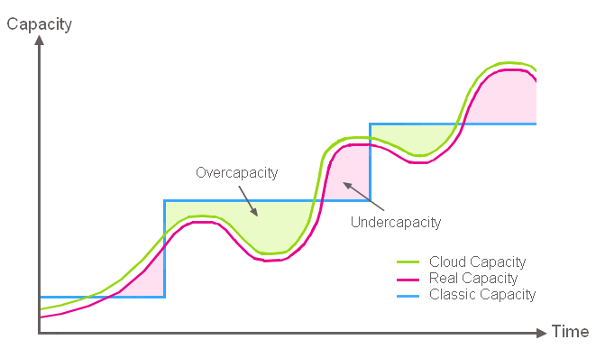
Cloud Computing Benefits
Elasticity
Align infrastructure capacity with current IT demand to achieve cost savings

Slide 9
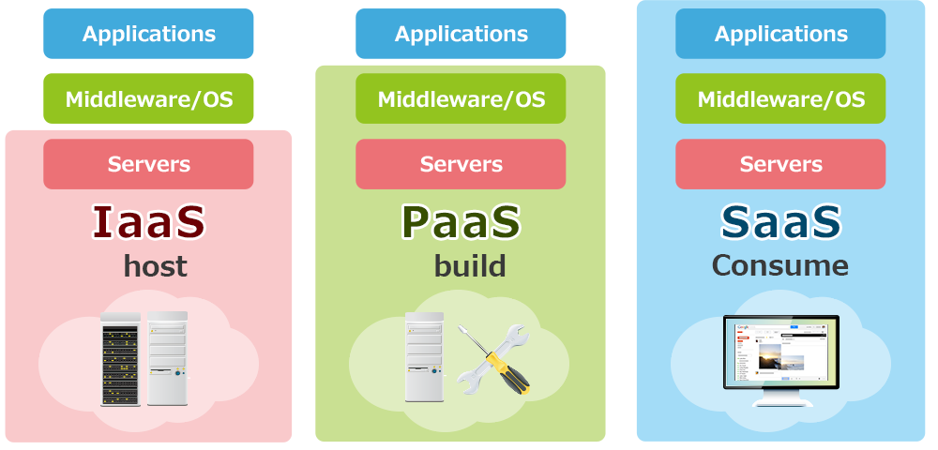
Cloud Computing Service Models
Infrastructure-as-a-Service
Platform-as-a-Service
Software-as-a-Service

Slide 10
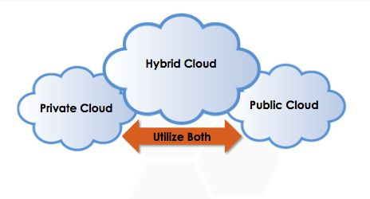
Cloud Deployment Models

Slide 11


Slide 12
Amazon Web Services
1st public cloud computing platform
Chris Pinkman and Benjamin Black described what Amazon infrastructure should like and how it could be sold as a service
Simple Queue Service (SQS) launched in 2004
S3 & EC2 (AWS) launched in 2006
Largest public cloud provider with millions of customers
Gartner 2015: AWS 10x larger than next 14 largest cloud providers combined
Amazon.com runs on top of AWS (though on completely separate infrastructure)

Slide 13
Why AWS?
AWS platform contains all of the services needed to reinforce concepts in this course
IT professionals should understand how to use the most popular cloud platform
Students receive educational credits for using AWS
Course lectures based on AWS Solution Architect Certification training

Slide 14
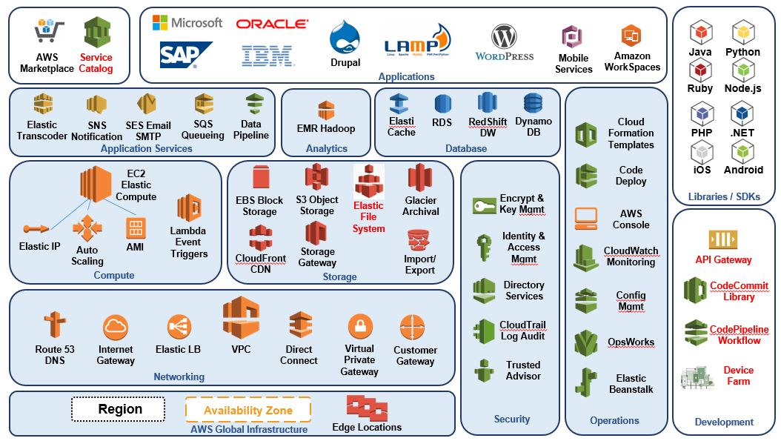
AWS Ecosystem

Slide 15
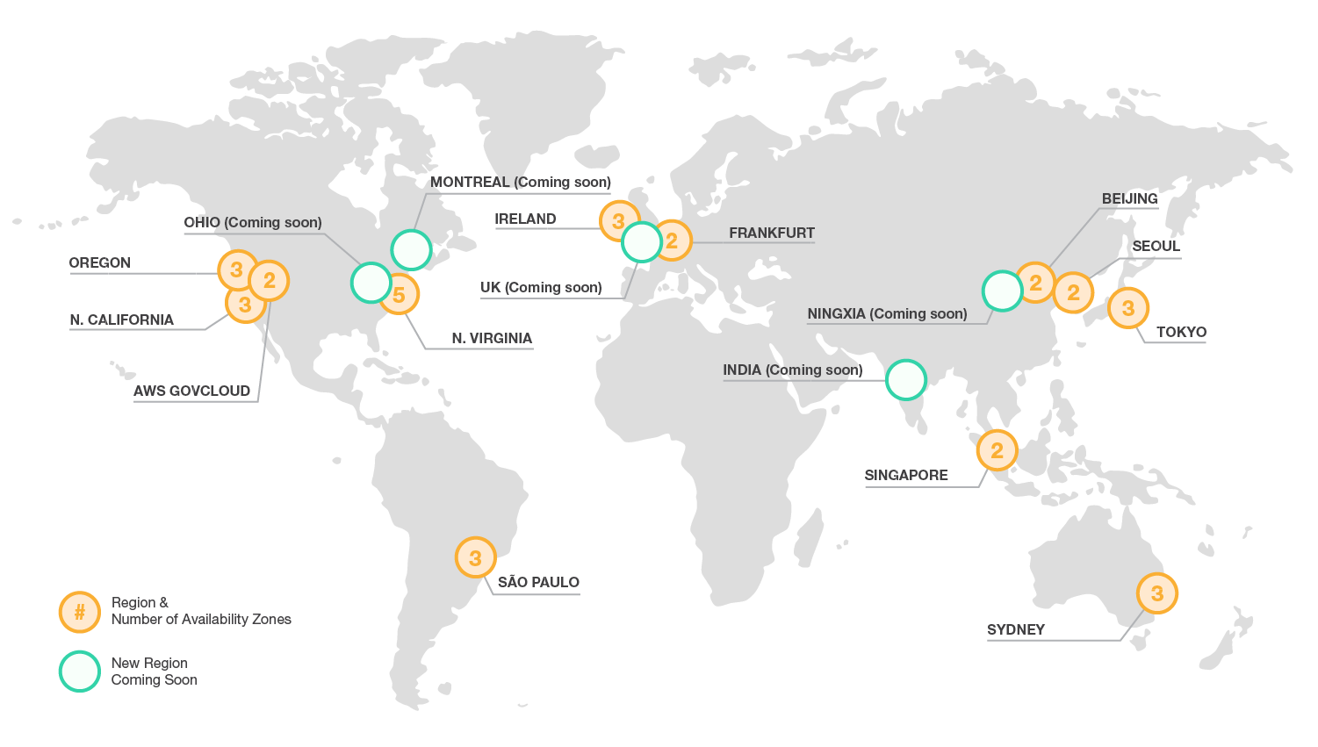
Global Infrastructure

Slide 16
AWS Regions & Zones
AWS Infrastructure partitioned into many regions, each of which contains one or more availability zones (AZs)
Regions are in completely separate physical parts of the world
AZs represent datacenters within a particular region
Note: Not all services are available in every region
Region: us-east
Region: us-west
Availability Zone
Availability Zone
Availability Zone
Availability Zone
Availability Zone
Availability Zone

Slide 17

Identity & Access Management (IAM)
IAM allows organizations to create users and manage their access to AWS resources
Provides granular governance controls and federated access
Password expiration/strength
Login via Active Directory, Facebook, etc
Signup account (root account) is your master account, best practice is not to use it for day-to-day management

Slide 18
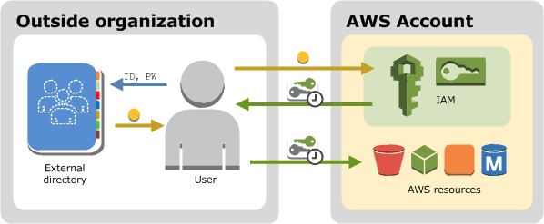
IAM

Slide 19
IAM Terms
User: an individual setup with an account in IAM
Group: a set of users sharing similar access privileges
Role: access privileges that may be assigned to AWS resources
Lets resources act like users with specific privileges
Policy: a document containing one or more defined privileges

Slide 20

IAM Hands-on
IAM is global, any changes we make impact all regions
All activities we do on the web console may also be done via command line or SDK
IAM users sign-in link is the web login URL for users (and it may be customized)
IAM Security Status shows important security steps (recommend turning on MFA)

Slide 21
IAM Hands-on
Create new user
Each user has a user name, password, access key ID, and secret access key
User name and password required to log into web console
Access key and secret access key required to use AWS API (** KEEP THESE SAFE!!)
Create a new group
Each group has one or more policies attached
Policies define access privileges for group members
Account Settings
Define password strength/expiration requirements
Roles
Allow a resource to access other resources with set privileges
Example: Allow webserver on EC2 to retrieve files stored on S3

Slide 22

Simple Storage Service (S3)
Secure, durable, highly-scalable object storage
Object based and stored as a key/value + metadata
Key = filename
Value = file data
Version ID = version of the file
Metadata = various descriptive information about the file
Standard S3 data is stored across multiple AZs in a region (11 9’s durability: 99.999999999%)
Highly available: 4 9’s availability (99.99%)
Unlimited storage
Individual files may be 0 bytes to 5TB
You cannot install a file system on S3 or use for database storage!

Slide 23
S3
S3 storage namespace partitioned into buckets in each region
Files are stored in a bucket
Bucket name is global and must be unique
Limit of 100 buckets per account (but can be increased)
Data consistency
New objects = Read after Write consistency
Updated or deleted objects = Eventual consistency
If you update an object and then try to immediately read it again, you might get the old version.

Slide 24
S3
Security
Set access control policies on a bucket level or a per-file level
Encrypt data-at-rest for greater security (AES-256)
Transmit data via SSL/TLS
Create logs tracking all access to buckets and files
Cost
Pay for storage space per GB, number of requests (GET, PUT, etc.) and data transmission
No fee for incoming data
Additional S3 features
Tiered storage options for increased performance or lower cost
Lifecycle management to automatically delete or archive data
Versioning to track changes to file

Slide 25
S3 Storage Tiers
Standard S3: default storage tier appropriate for most requirements
Durability: 99.999999999% (11 9’s)
Availability: 99.99% (4 9’s)
S3-IA (Infrequently Accessed): data which isn’t accessed frequently, but must be available immediately
Durability: 99.999999999% (11 9’s)
Availability: 99.9% (3 9’s)
RRS (Reduced Redundancy Storage): storage for non-critical or easily reproduced data
Durability: 99.99%
Availability: 99.99%
Glacier: inexpensive data archiving, 3-5 hours to restore data

Slide 26
S3 Hands-on
Create a new bucket
Bucket name must be globally unique and associated with a specific region
https://s3-us-east-1.amazonaws.com/ust123
Permissions: set bucket-level access policy
Static website hosting: host a website using a set of files in a bucket
Events: trigger notifications based on file changes
Versioning: track file changes
Lifecycle: automate file archiving or deletion
Tags: create unique metadata for tracking

Slide 27
S3 Hands-on
Add a new file
Upload a file through web console or API/SDK
File changes via HTTP PUT or DELETE
Each file has a set of metadata
Each file has a unique web link
Can set storage class and encryption on a per-file basis

Slide 28
S3 Hands-on
Versioning
Enabled on a per-bucket basis
Once versioning on a bucket is enabled, it cannot be disabled only suspended
S3 tracks the version of each file
Files are hidden (delete markers) and not deleted
Great for protecting and tracking files, but consumes more storage space
Cross region replication: requires versioning to be enabled on the source bucket

Slide 29
S3 Hands-on
Lifecycle Management
Automatically transition files from one storage tier to another after a specified amount of time
Permanently delete files based on a set schedule
Benefits:
Convenient way to enforce organizational data retention policies
Reduce storage costs by moving older data to cheaper tiers of storage

Slide 30

CloudFront
Global Content Distribution Network (CDN)
Cache S3 files at over 50 edge locations throughout the world
Edge location = point of presence in a datacenter
Don’t confuse edge locations with regions
Distribution: set of S3 files that are cached
Benefit: Website visitor is automatically directed to closest file cache, decreasing download latency and improving website response time.
Note: it can be expensive to remove (invalidate) cached objects. Most people just add new versions of their files to the distribution.

Slide 31
Storage Gateway
A software solution to connect data storage within an enterprise to S3
Three different options:
Store all files on S3, but cache frequently-accessed files locally
Store all files locally, but replicate some or all files on S3
Treat S3 like a virtual tape library when using backup software
Benefits:
Backup data in a highly-resilient secondary location
Leverage unlimited storage available on S3

Slide 32
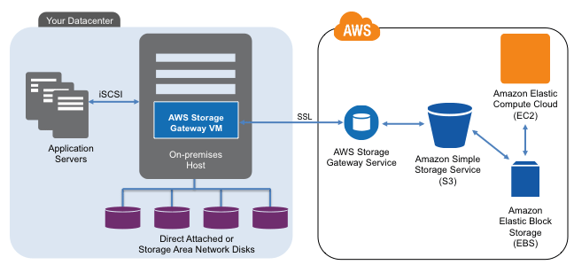
Storage Gateway

Slide 33
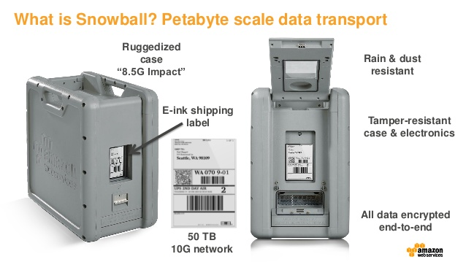
Snowball

Slide 34
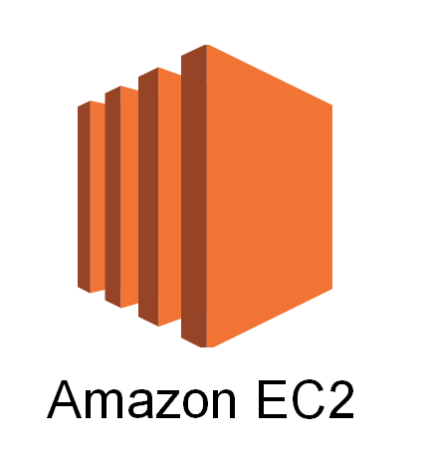
Elastic Compute Cloud (EC2)
Service that provides resizable compute capacity in the cloud
Core computing infrastructure building block that supports many other AWS services
It’s basically a cloud-based virtual machine (AWS calls them instances) running on top of the Xen hypervisor.

Slide 35
EC2 Deployment Options
On Demand: pay a fixed rate for the EC2 instance on an hourly basis (default)
Short-term unpredictable workloads
Customer controls start/termination because the application cannot be interrupted
Reserved: reserve a certain amount of computing capacity for 1-to-3 years at a discounted rate
Long-term, predictable workloads with known capacity requirements
Spot: make a bid for computing capacity that’s not currently being used
Very short-term workloads
AWS may terminate the instance at any time if the spot prices increases over the bid price

Slide 36
EC2 Instance Types
Type | Purpose
T2 | Low cost, general purpose computing, small web server or test/dev server
M3 & M4 | General purpose computing, typical application server
C3 & C4 | Compute optimized, CPU intensive applications
R3 | Memory optimized, in-memory caching or database systems
G2 | Graphics optimized (GPU), video transcoding and machine learning
I2 | High speed storage optimized, database systems
D2 | Dense storage system, file servers, Hadoop
* Easy way to compare instance features and pricing: http://www.ec2instances.info/

Slide 37
EC2 Amazon Machine Image (AMI)
You create an EC2 instance using an AMI (template).
An AMI defines the base OS, applications, networking and storage components for an EC2 instance.
AMI sources:
Amazon curated images
Community provided images
Commercial images on the Amazon Marketplace
Your own private images
AMIs only exist within a specific region (you can copy to other regions if necessary).

Slide 38
Elastic Block Storage (EBS)
Service that allows you to create disk storage volumes that can be attached to EC2 instances.
A volume is like a hard drive for your instance.
EBS volumes are block storage and support file systems and databases.
Each volume replicated within the AZ to provide high availability
Its delivered like a volume from a SAN.
EC2 instance sees it as a physically attached drive.

Slide 39
EBS Volume Types
General Purpose SSD (GP2)
5 9’s availability (99.999%)
3 IOPS per GB, up to 10,000 IOPS
Provisioned IOPS SSD (IO1)
Very high IOPS capacity for disk I/O intensive applications requiring > 10,000 IOPS
Magnetic
Cheapest storage option with lowest performance

Slide 40
EBS Snapshots
A snapshot is a point-in-time copy of an EBS volume stored on S3.
Snapshots are incremental, only saving data that changed since the previous snapshot.
You pay for snapshot storage at S3 rates.
Benefits:
Quickly backup data periodically or before making big changes
Roll back system changes by reverting to previous snapshots
Notes:
Initial snapshots will take longer
You should stop a root volume before taking a snapshot to ensure consistency.

Slide 41
Instance Store
Another data storage option for EC2 instances
Actually, the original storage option!
Instance data is stored on a physical hard drive attached to the host server versus a networked volume.
The storage is ephemeral, if the instance is stopped the data is gone forever.
You can still reboot the instance without loosing data though.
Why ephemeral storage?
Cheap
Data persistence may not matter in certain architectures

Slide 42
Security Groups
Security groups provide a security layer around EC2 instances
Define a set of IP addresses and protocols that can send data to and from servers.
It’s like a basic layer-4 firewall system.
Default security group
All inbound traffic blocked
All outbound traffic allowed
Security groups are stateful meaning that responses from allowed connections are valid
Server can initiate outbound web request and receive an inbound response even if port 80 (http) incoming traffic is blocked.

Slide 43
Security Groups
SG can contain any number of EC2 instances
An EC2 instance may be associated with up to 5 different security groups
0.0.0.0/0 represents “everywhere”
Web Security Group
DB Security Group
Instance
Instance
Instance
Instance
Instance
Instance
Incoming port 80 from 0.0.0.0/0
Incoming port 443 from 0.0.0.0/0
Outgoing any to 0.0.0.0/0
Incoming port 3306 from Web SG
Incoming port 22 from Web SG
Outgoing port 80 to Web SG
VPC

Slide 44
EC2 Hands-on
Launch a new EC2 instance
Select an Amazon Linux AMI
Choose an instance type
Add/modify storage
Tag instance
Log into EC2 instance
Add a new security group (webservers)
Make sure ssh port is open in SG
Update server packages
Show instance meta-data capability:
curl http://169.254.169.254/latest/meta-data/
Show AWS CLI (aws help)
Snapshot instance volume
Create AMI from instance
Terminate EC2 instance

Slide 45
Homework
Assignment 4
Read Architecting for the Cloud: AWS Best Practices (February 2016)

