Slide 1
DevOps & Cloud Infrastructure SEIS 6XX Week 12
Jason Baker
Adjunct Instructor
Graduate Programs in Software
University of St. Thomas
St. Paul, MN

Slide 2
Agenda
Weekly reading (edit)
DevOps 101
Continuous integration & deployment
Deployment strategies
Jenkins

Slide 3
CI/CD
Continuous Integration/ Continuous Deployment
Build/ Integrate/ Test/ Deploy

Slide 4
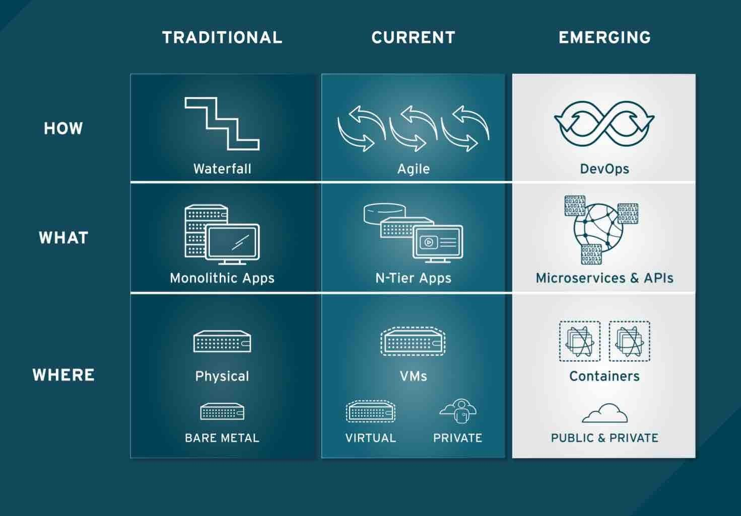

Slide 5
Deployment strategies
Question: Once an application is built, how do we deploy it to distributed infrastructure?
Strategy for deploying to 1 server very different than 100’s
Trade-offs between deployment speed and risk
Cloud elasticity and pricing model supports new strategies

Slide 6
Deployment strategies
Single Server Deployment
Application is deployed to a single server
Very common for testing and small production applications
Benefits:
Easy and quick to deploy app on a single server
Problems:
Service outage occurs during app deployment
No ability to test app in production before deployment
Rolling back app requires complete reinstallation
Build
Server

Slide 7
Deployment strategies
Big Bang Deployment
Application is deployed to all servers at once
Common for a small set of servers (2-5)
Benefits:
Quick to deploy app on multiple servers, though requires orchestration
Problems:
Service outage occurs during app deployment
No ability to test app in production before deployment
Rolling back app requires complete reinstallation
Server
Build
Server
Server

Slide 8
Deployment strategies
Minimum-in-service Deployment
Application is deployed in multiple stages with a minimum set of servers supporting service
Benefits:
Supports large environments
No downtime
Fast, most systems updated
Deployments are tested in production
Problems:
Requires significant automation and orchestration capabilities
May require rollback
2 server minimum-in-service
1
2
3
4
5
6
----Updating---
1
2
3
4
5
6
Updating
1
2
3
4
5
6
1
2
3
4
5
6

Slide 9
Deployment strategies
Rolling (Canary) Deployment
Application is deployed to a specified number of servers at each stage
Benefits:
Low risk strategy
Maintains health of service
Minimize user impact through early service issue detection
Problems:
Requires significant automation and orchestration capability
Slow, depending on number of servers updated at each stage
2 server rolling deployment
1
2
3
4
5
6
Updating
1
2
3
4
5
6
Updating
1
2
3
4
5
6
Updating
1
2
3
4
5
6

Slide 10
Deployment strategies
Blue Green Deployment
Application is deployed to a completely new production environment in parallel
Benefits:
Maintains health of service
Rapid cut-over deployment
Ability to test complete deployment in production
Easy to perform full rollback
Problems:
Requires significant automation and orchestration capability
Extra cost, but manageable with cloud instances
App.com Domain
1
2
3
1
2
3
App.com Domain
1
2
3
1
2
3

Slide 11
Homework
Assignment X
Read How Cloud Has Changed the Data Center Architect
Read 6 Models Of The Modern Data Center

