Slide 1
SEIS 6XX IT Infrastructure Week 2
Jason Baker
Adjunct Instructor
Graduate Programs in Software
University of St. Thomas
St. Paul, MN

Slide 2
Agenda
Review readings
Linux fundamentals
Package management
Shell scripting

Slide 3
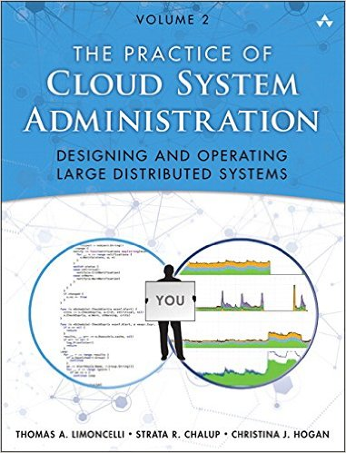
Readings
CSA Chapter 12: Automation
Automation is a critical component of DevOps and modern IT practices
Automation pipeline:
Changes are made to files in version control system
New files picked up by software delivery platform and tested
New files deployed to production systems

Slide 4
Readings
Automation approaches:
Left-Over Principle: automate everything possible
Easy/rare = manual
Easy/frequent = automate
Difficult/rare = manual (document)
Difficult/frequent = automate (but maybe acquire)
Compensatory Principle
People aren’t infinitely versatile machines
Machines do some things better than people and vice-versa
Example: machines better at polling remote hosts every 5 minutes for performance metrics

Slide 5
Readings
Automation approaches:
Complementarity Principle
The more a system is automated, the less people understand how the system works
Try to strike a balance between automation and future growth in learning
Tool building vs. automation
Tools improve a manual task so that it can be done better
Self-service web interface allowing user to launch a new server
Automation eliminates the need to perform a manual task
Auto-scaling service that automatically launches a server based on predefined trigger

Slide 6
Readings
Goals of automation:
Help scaling: one person performs the work of many
Improve accuracy/ repeatability: perform task same way every time
Save time: perform task faster than human
Make processes safer: eliminate mistakes
Empower users: let’s less experienced people perform complex tasks

Slide 7
Readings
Creating automation
Majority of IT team’s time should be spent on automation
Identify and fix the biggest bottleneck first (Theory of Constraints)
Start small and work incrementally, don’t try to automate everything at once
How to automate
Shell scripts, scripting languages, configuration management

Slide 8

Linux
Why Linux?
Most common platform for modern distributed applications
Automation starts at the command line, not the GUI
Caveat: It’s not possible to learn Linux in a few hours. Plan to invest meaningful time outside of class if you aren’t already familiar with it.

Slide 9
Linux
History
Started by Linus Torvalds in 1991
Inspired by Unix, developed at AT&T in 1970s
Linux is not Unix, but uses same concepts
Open Source Software (General Public License)
Runs on cells phones to largest supercomputers
Perfect for supporting service-based application architecture in the cloud

Slide 10
Linux
We will use Amazon Linux running on AWS in this course
Rolling release maintained in an AWS AMI
Designed for the AWS ecosystem
Based on Red Hat Enterprise Linux/ CentOS
Most basic OS concepts are the same across Linux distributions (i.e., Ubuntu, SUSE, etc)
Key differences in package and service management

Slide 11
Linux Hands-on
Requirements:
Amazon Linux EC2 micro instance running in a public subnet
Public/Private access keys for the instance
SSH Client
Windows -> PuTTY (www.putty.org)
MacOS -> Terminal (built-in) or iTerm2 (www.iterm2.com)
Linux vm -> xterm or other terminal

Slide 12
Linux Hands-on
Launching a Linux instance on AWS EC2
Connecting to instance via terminal
Mac & Windows
Linux Hands-on Guide

Slide 13
Git Flow
Git is designed to scale from teams of one to teams of thousands
Git Flow is a popular workflow for categorizing work and controlling releases
Not promoting this as the only or best Git workflow
Based around several branches:
master = deployed code in production
develop = current development code base
feature = experimental code for specific feature
release = point-in-time code release
hotfixes = emergency fixes to production code

Slide 14

http://nvie.com/posts/a-successful-git-branching-model/

Slide 15
Homework
Assignment 2: Linux and Git
Read Practice of Cloud Systems Administration Chapter 1
Read Web Operations Chapter 15
Finish reading Linux Hands-on Guide
** Remember to use Slack channel for questions!

