Slide 1
Library Management System
Visuals and Key Tables for SQL Project

Slide 2
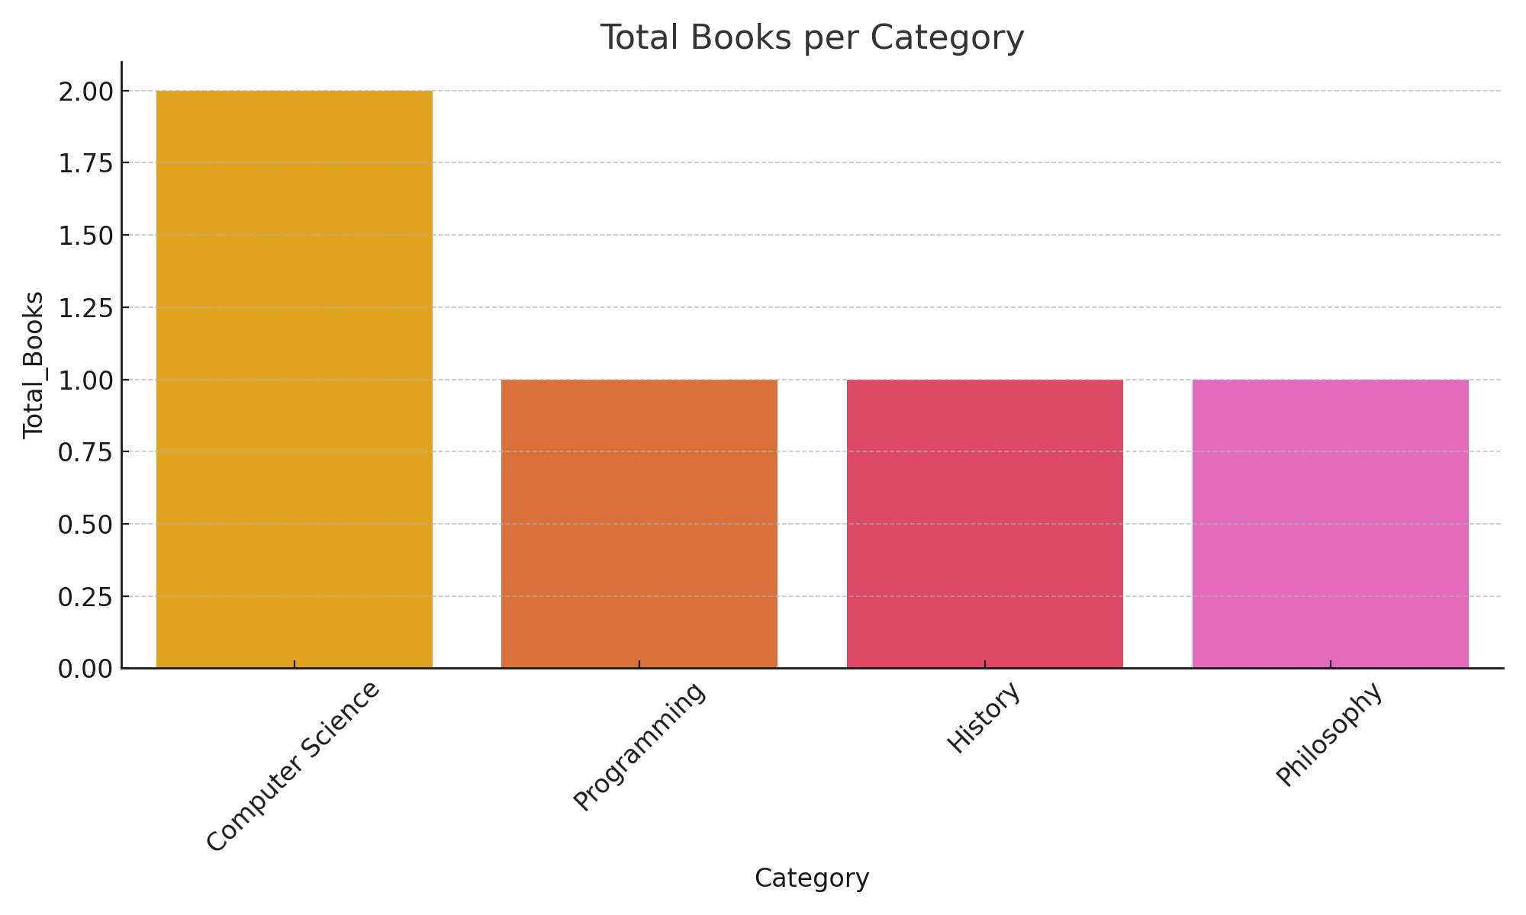
Total Books per Category

Slide 3
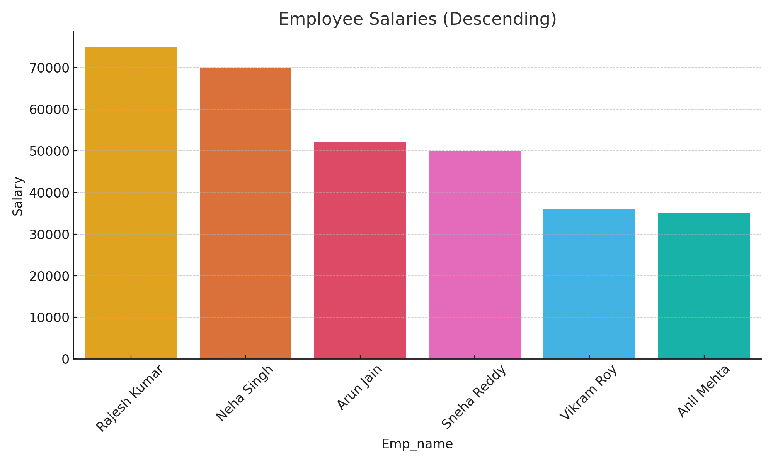
Employee Salaries

Slide 4
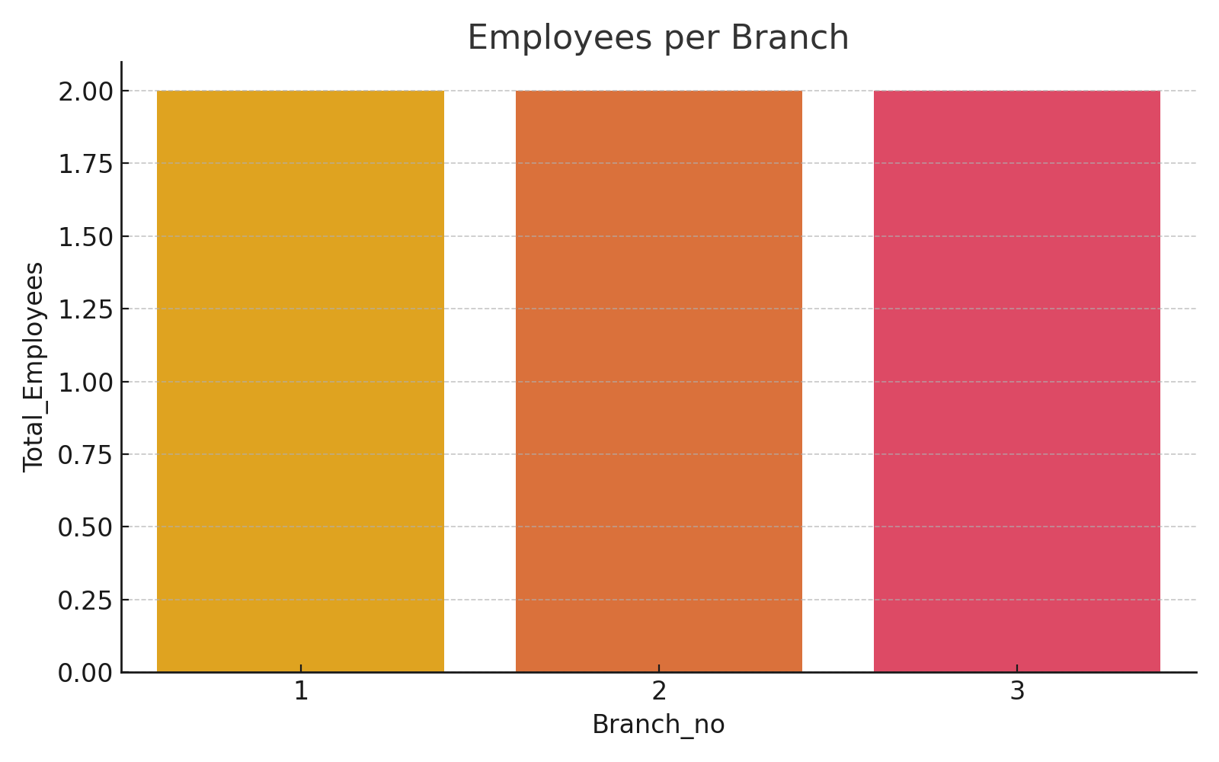
Employees per Branch

Slide 5
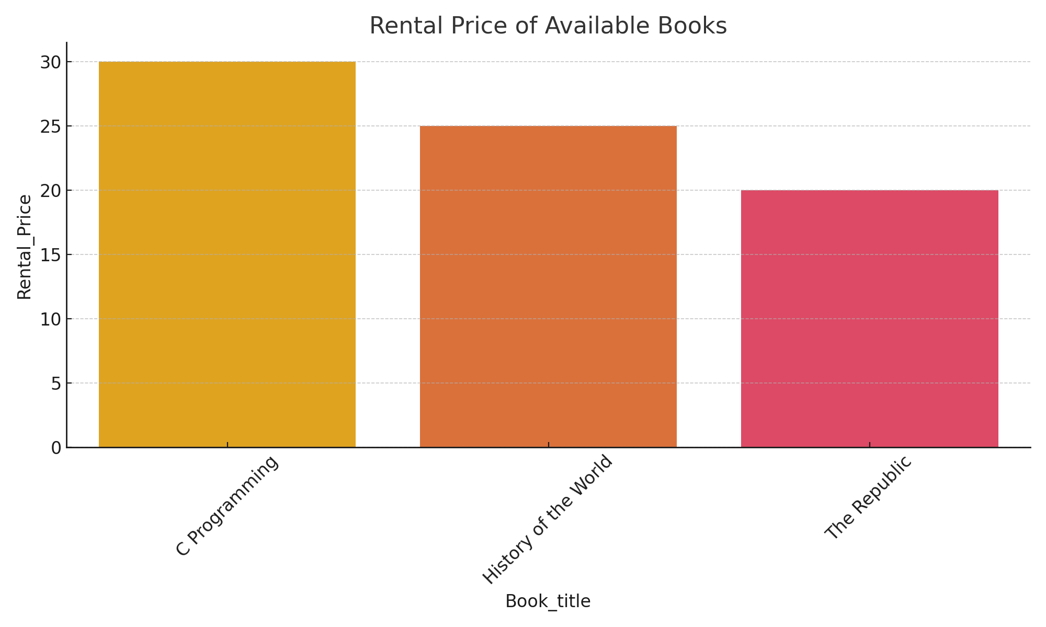
Rental Prices of Available Books

