Slide 1
Financial Sample Power BI Project
Portfolio Dashboard Overview

Slide 2
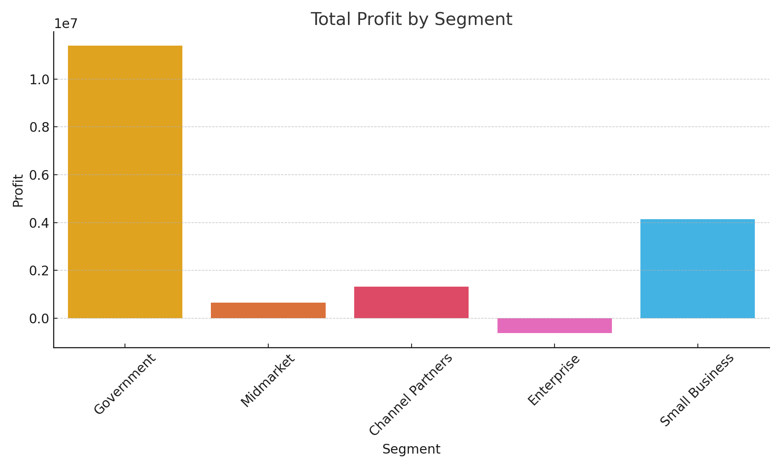
Profit by Segment

Slide 3
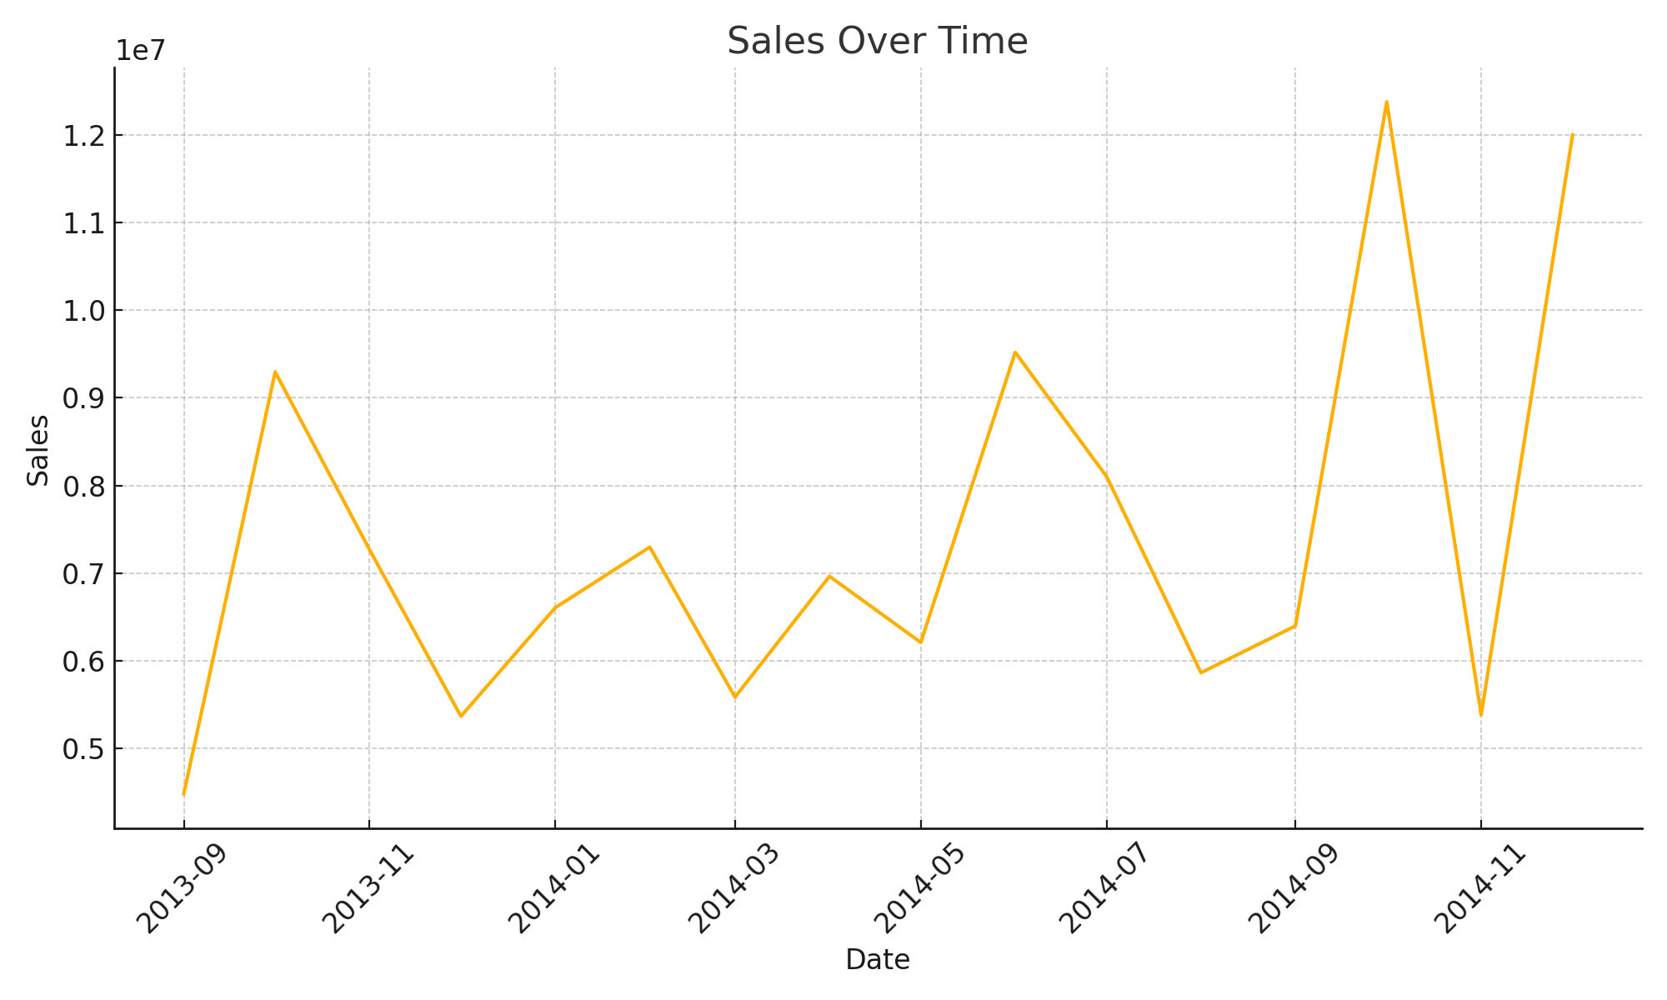
Sales Over Time

Slide 4
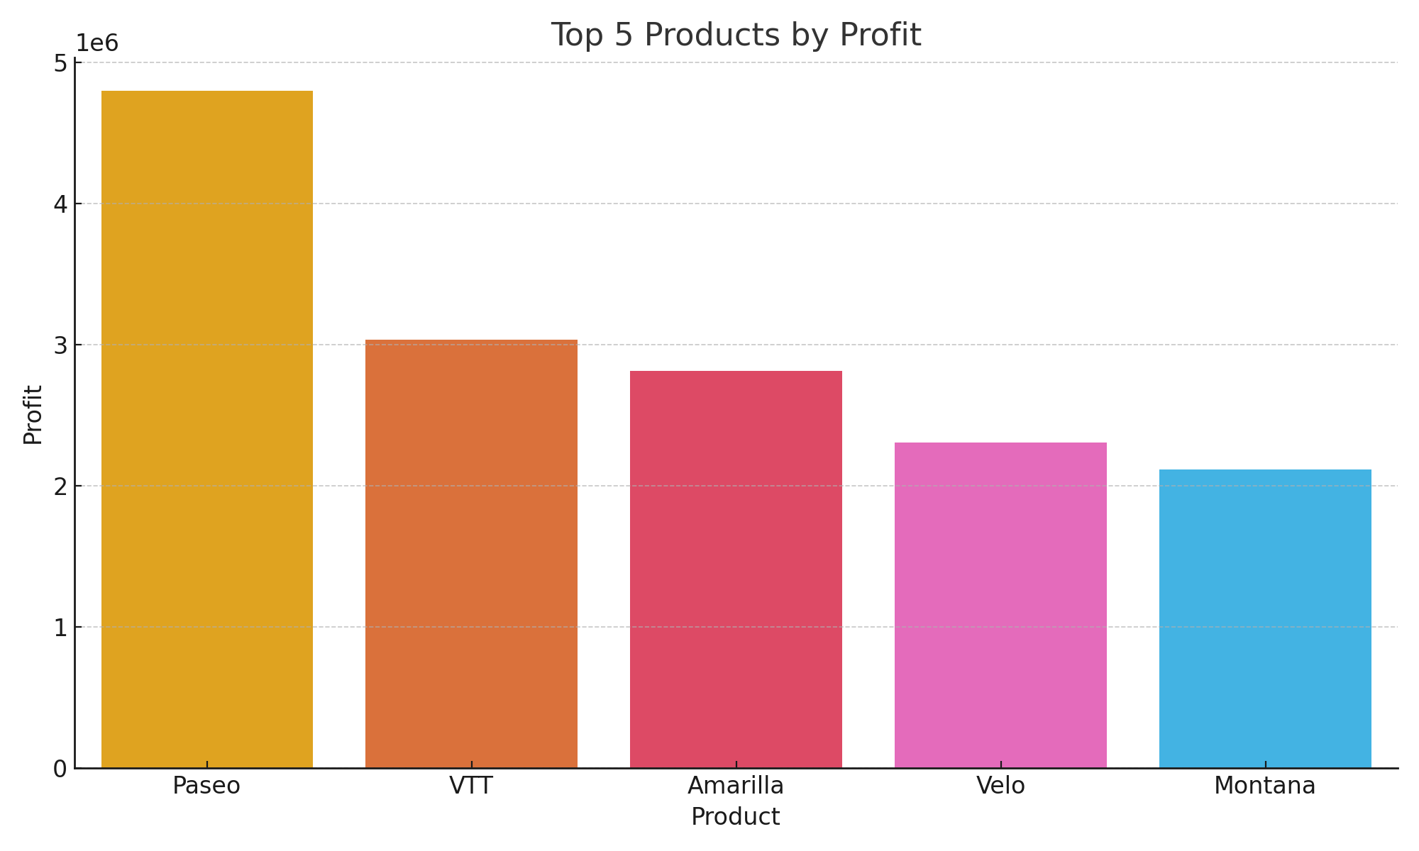
Top 5 Products by Profit

Slide 5
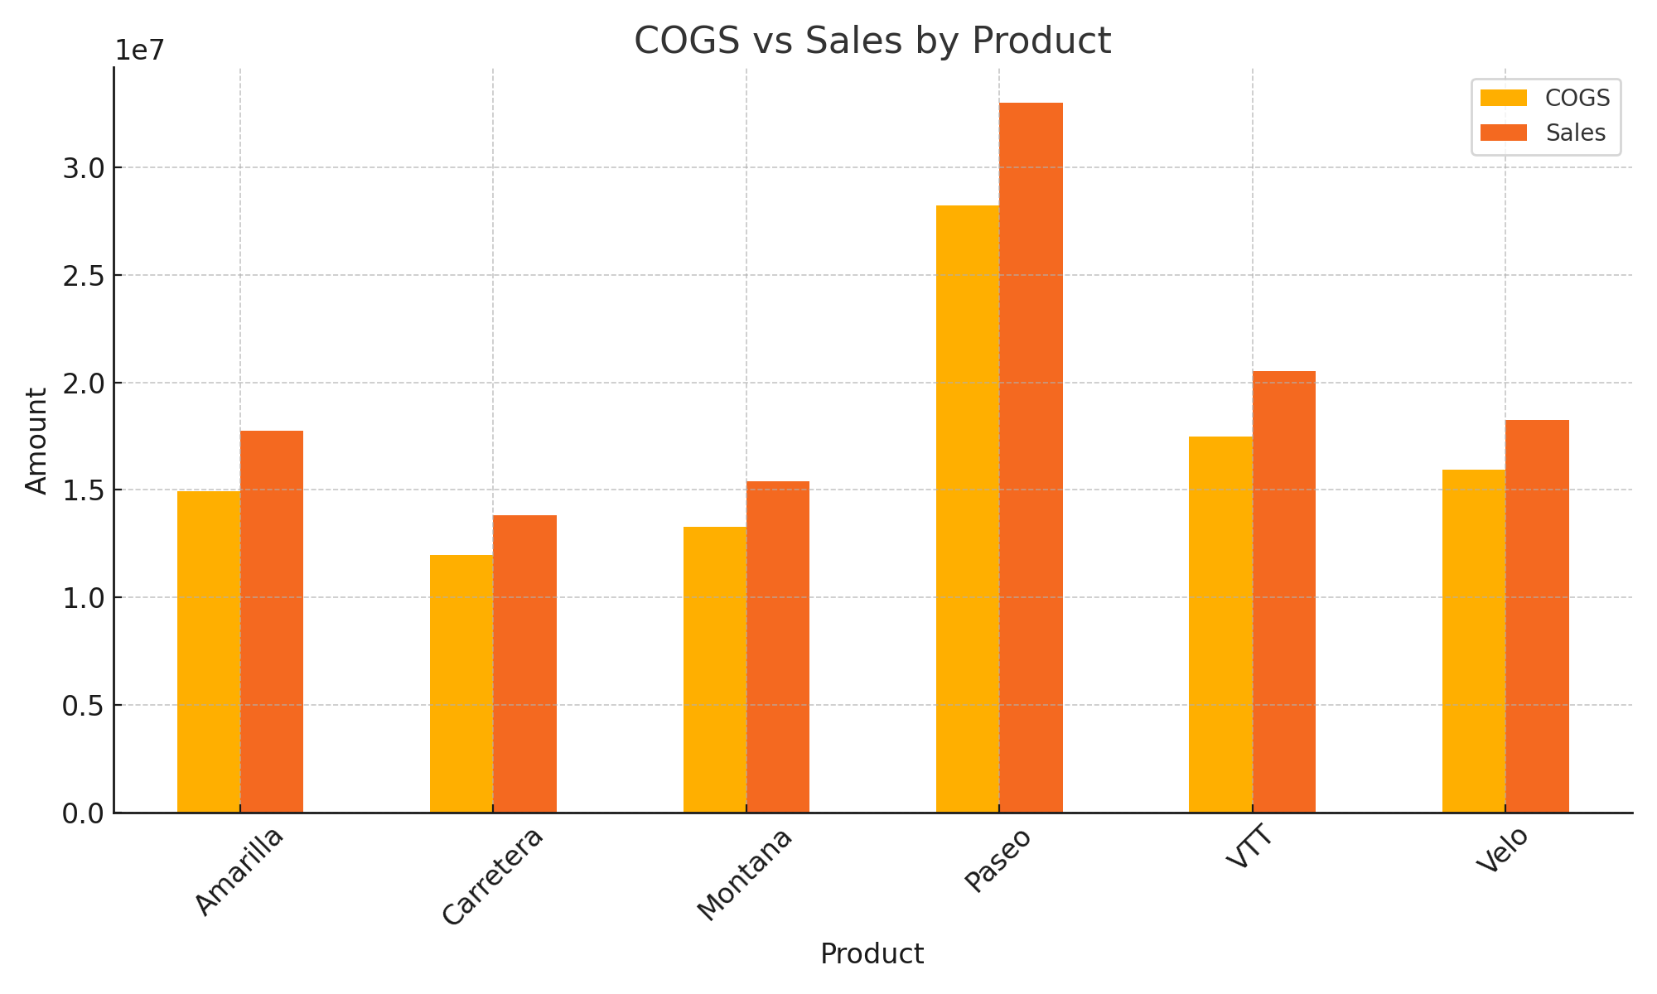
COGS vs Sales by Product

Slide 6
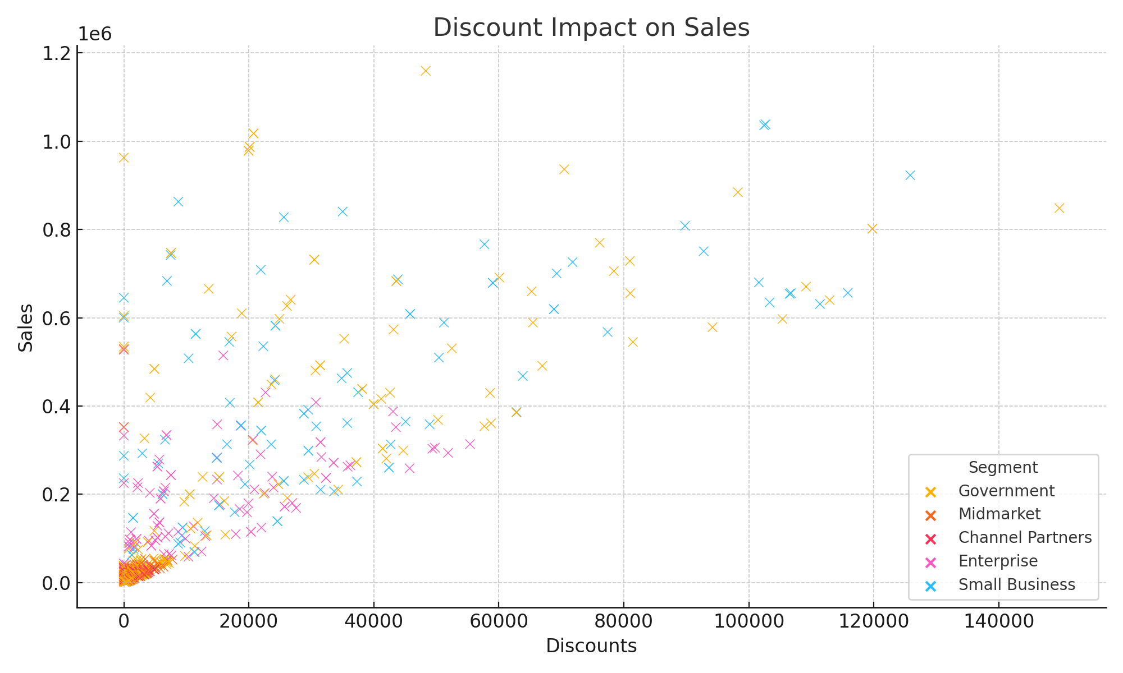
Discount Impact on Sales

Slide 7
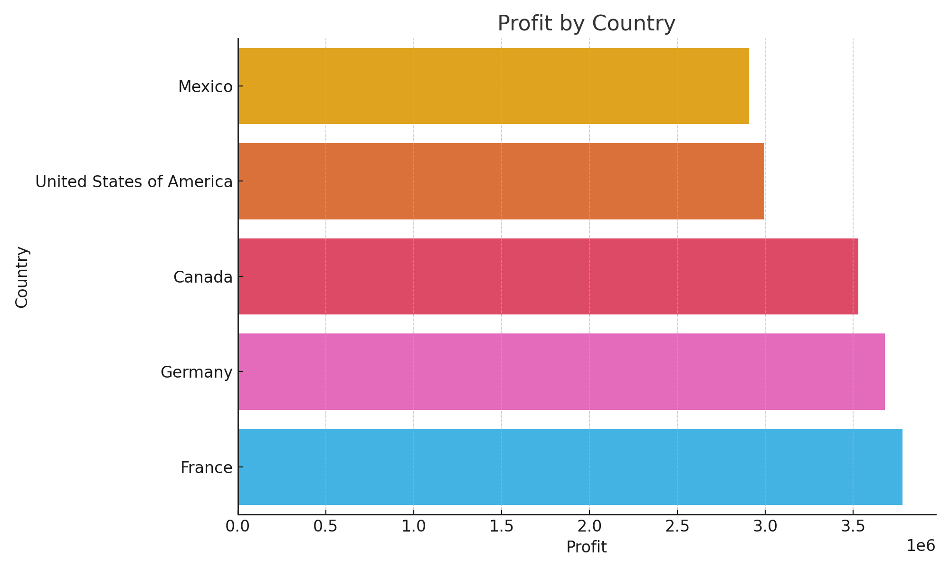
Profit by Country

Slide 8
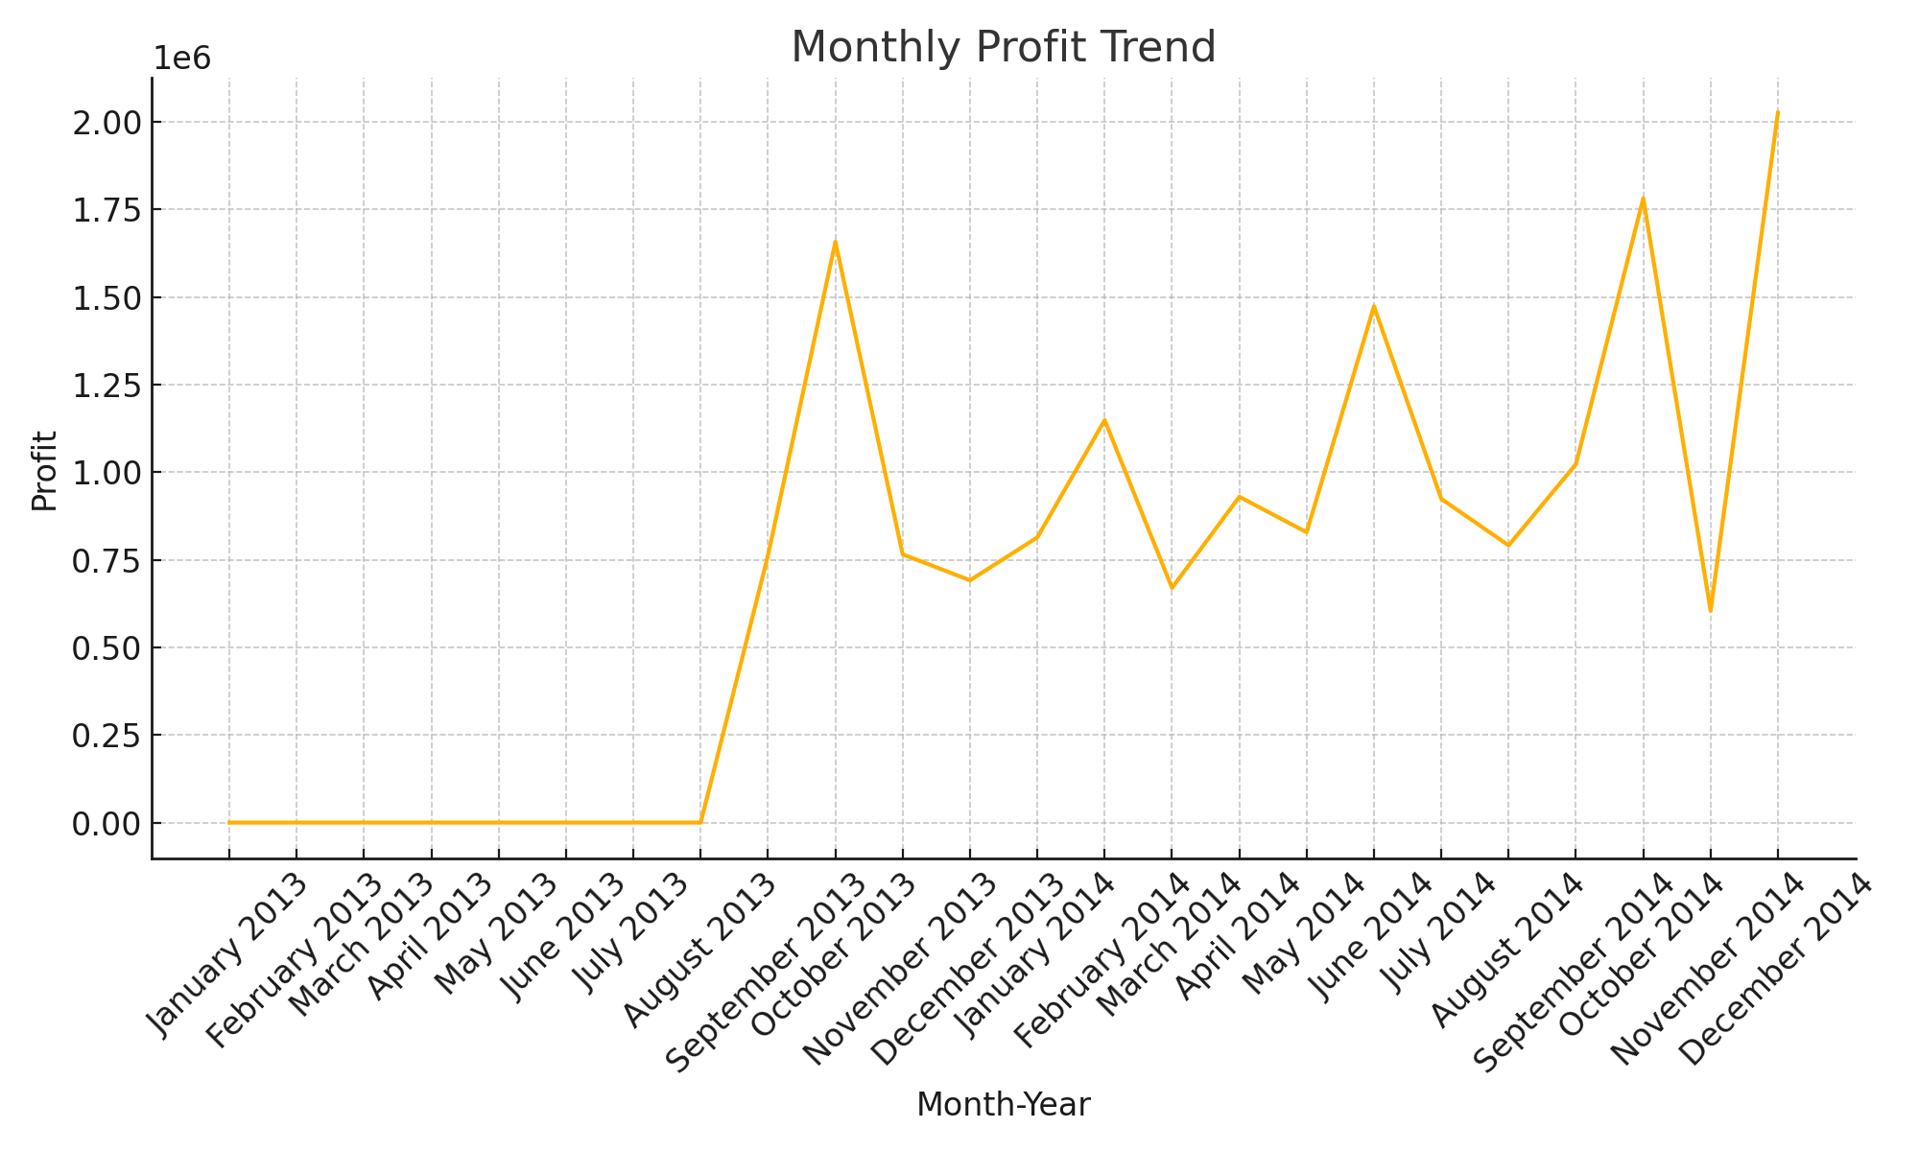
Monthly Profit Trend

