Slide 1

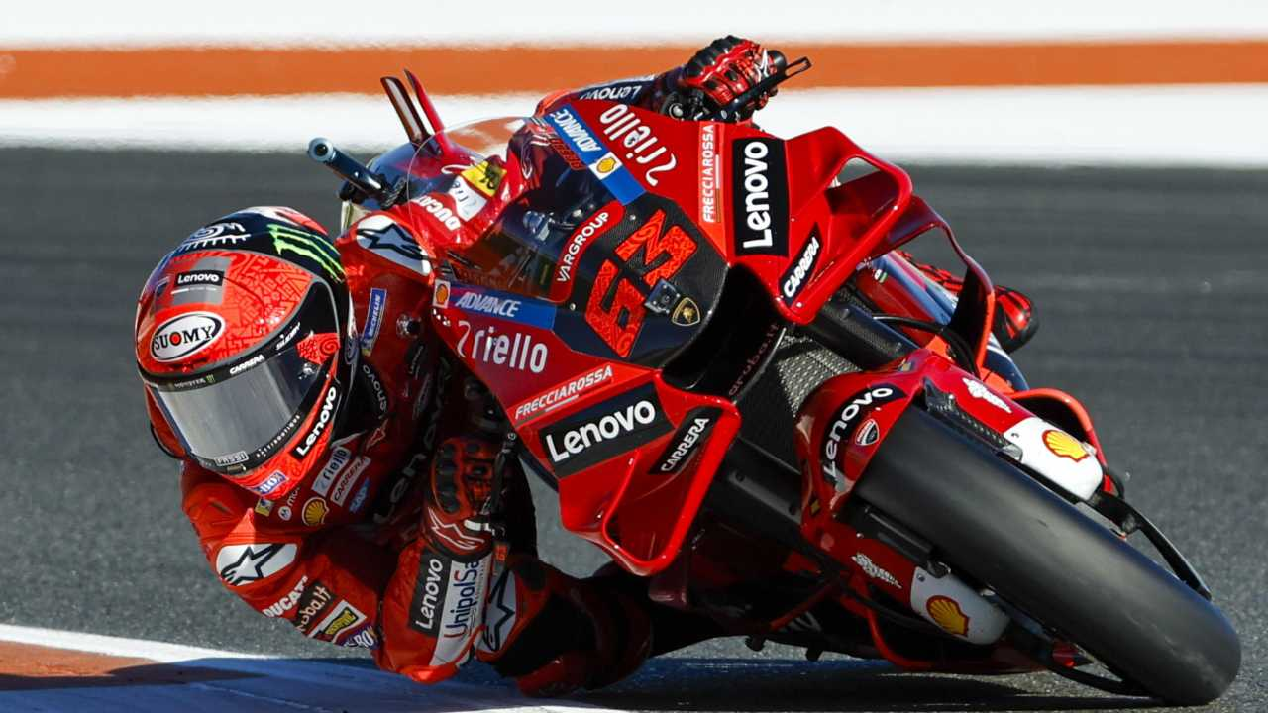
Roll/Pitch Angle Measurement of a Motorcycle
Authors : Alfio locatelli & Edoardo airoldi
Course of Advanced measuraments system for control application
July 2023

Slide 2
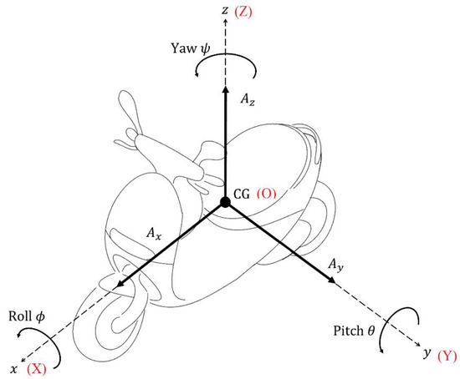
What’s the problem Are we facing?

Slide 3
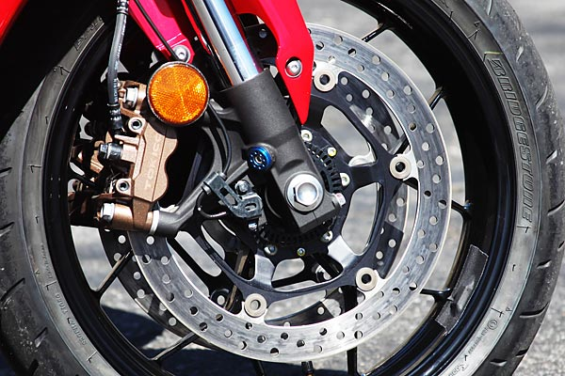
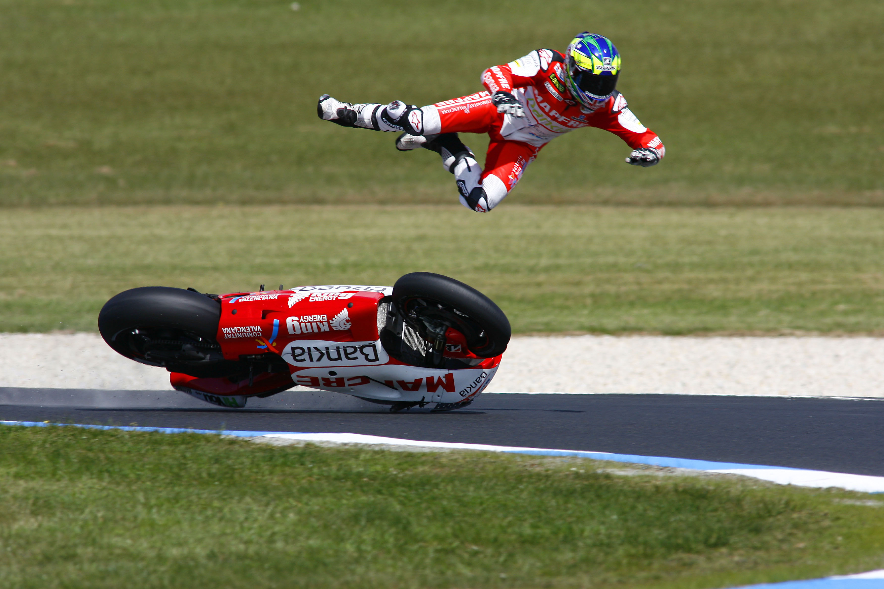
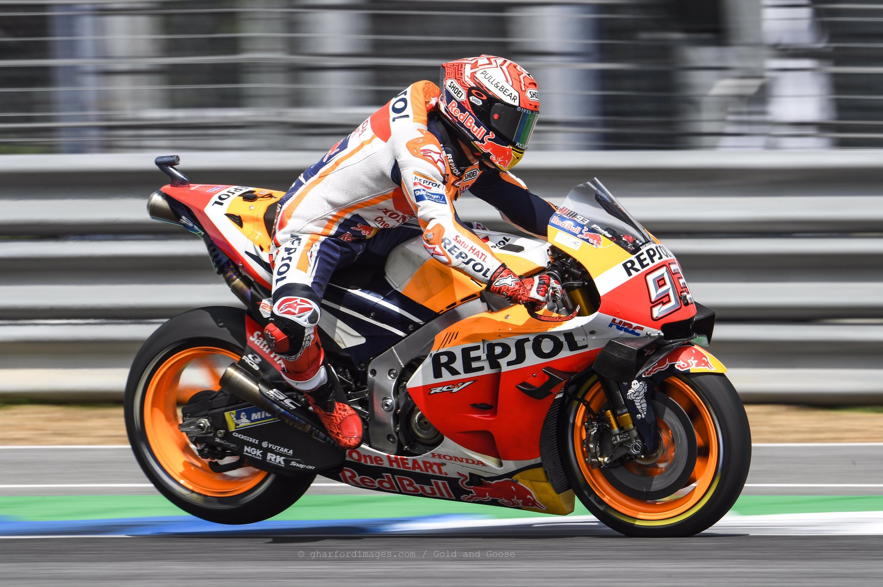
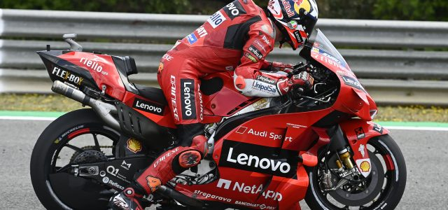
What’s the porpouse to measure these angles?
Traction Control (TC)
Anti-Lock Braking System (ABS)
Roll-Over and Launch Control

Slide 4
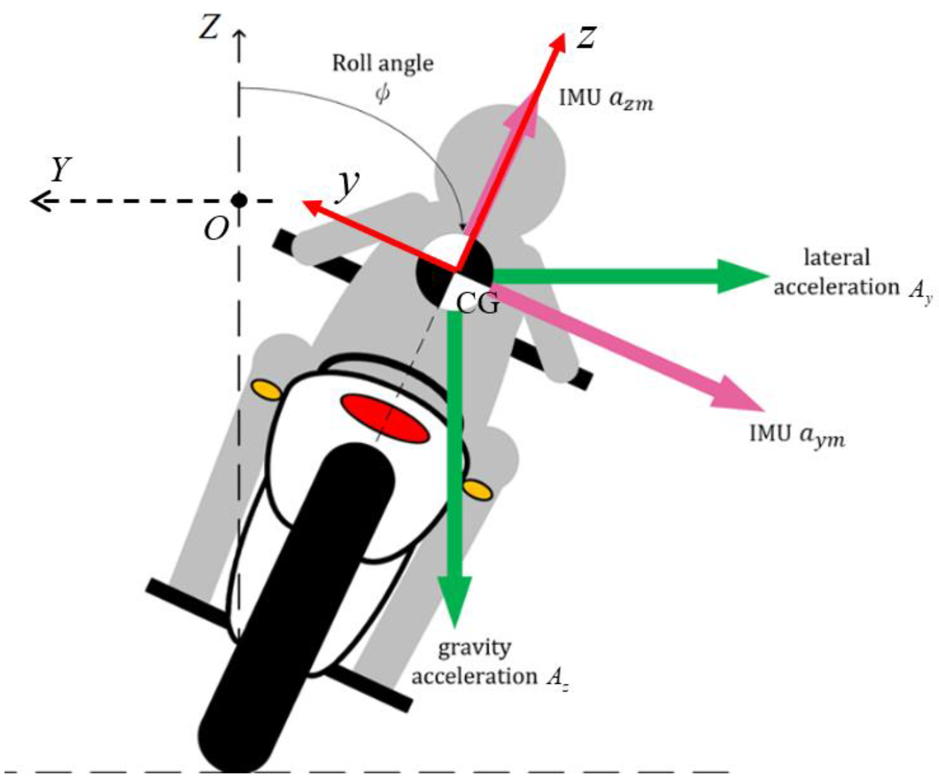
MPU6050?

Slide 5
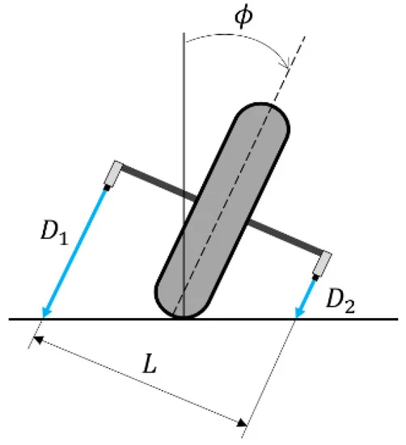
What’s our Solution?

Slide 6
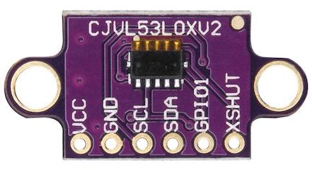
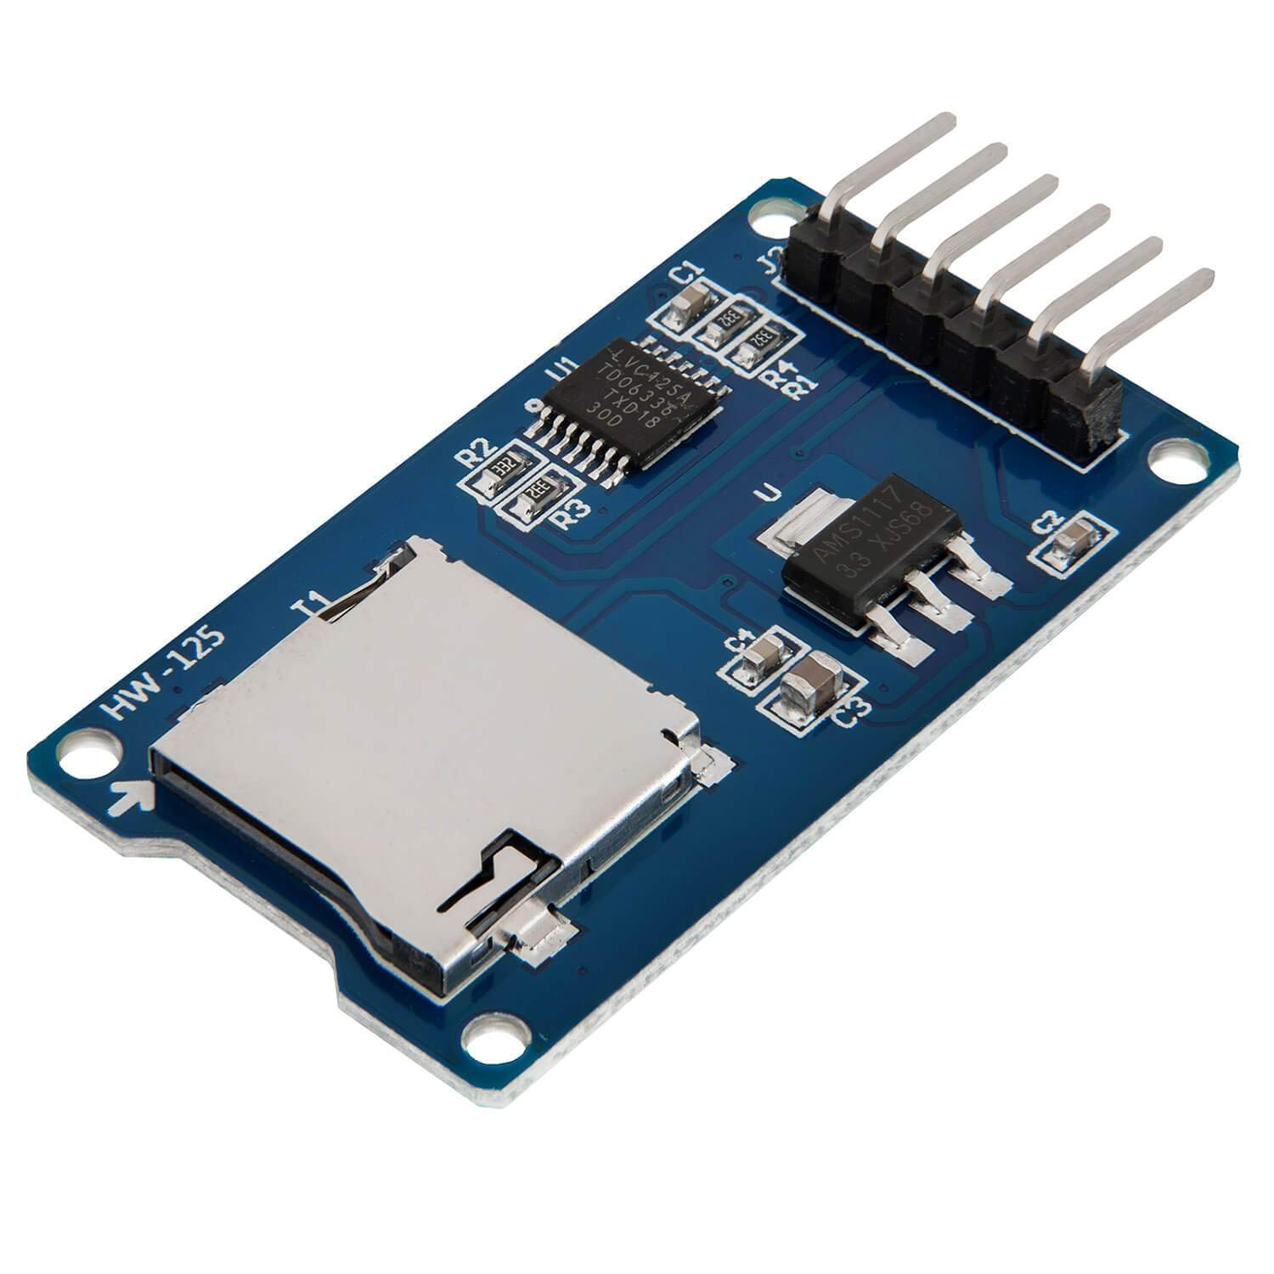
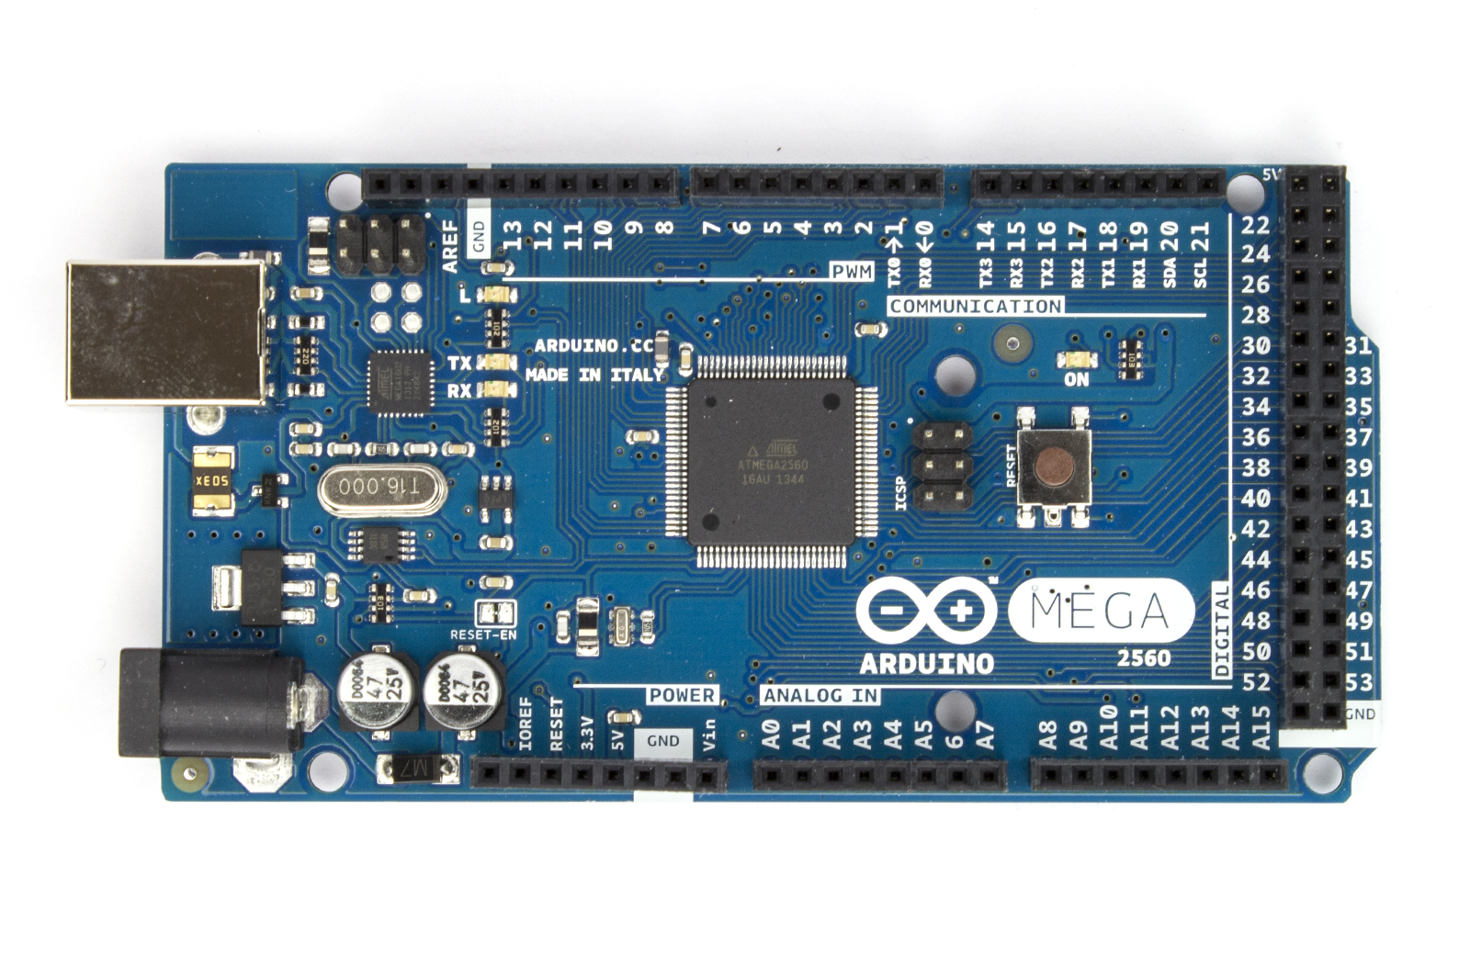
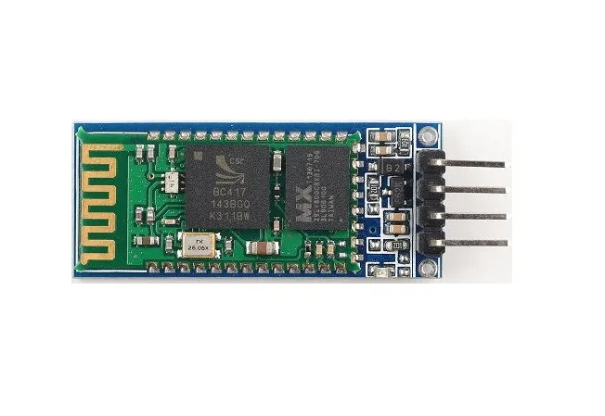
What’s our electronics?

Slide 7
The core of this progect : Tof sensors

Slide 8
Data acquisition (Static test)

Slide 9
Uncertanty, gum aPPROACH

Slide 10
Results and plots, (static test)

Slide 11
Data acquisition (Dynamic test)

Slide 12
Results and plots of real test on track

Slide 13
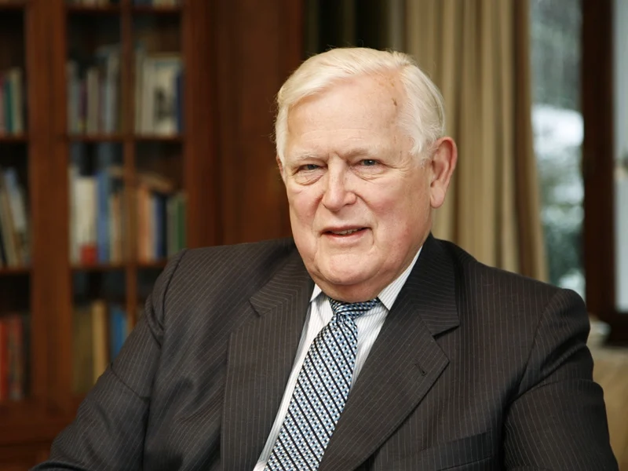
Conclusions
What’s the real approach in this field? (Like motogp or super sport motorcycles)
Are the measurements really uncorrelated?
How to manage road profile?
Slow Reading of Arduino, approx. 1 Hz, solution?

