Slide 1
URL
https://www.essemagazine.it/

Slide 2


Slide 3
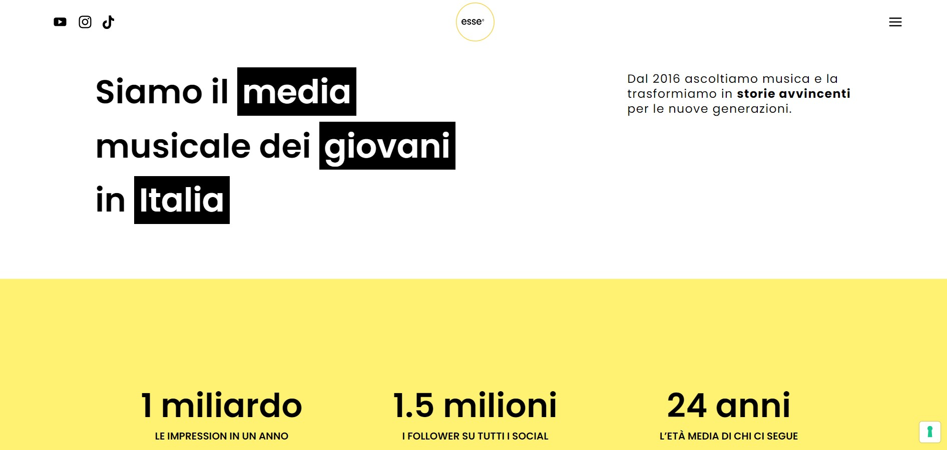

Slide 4
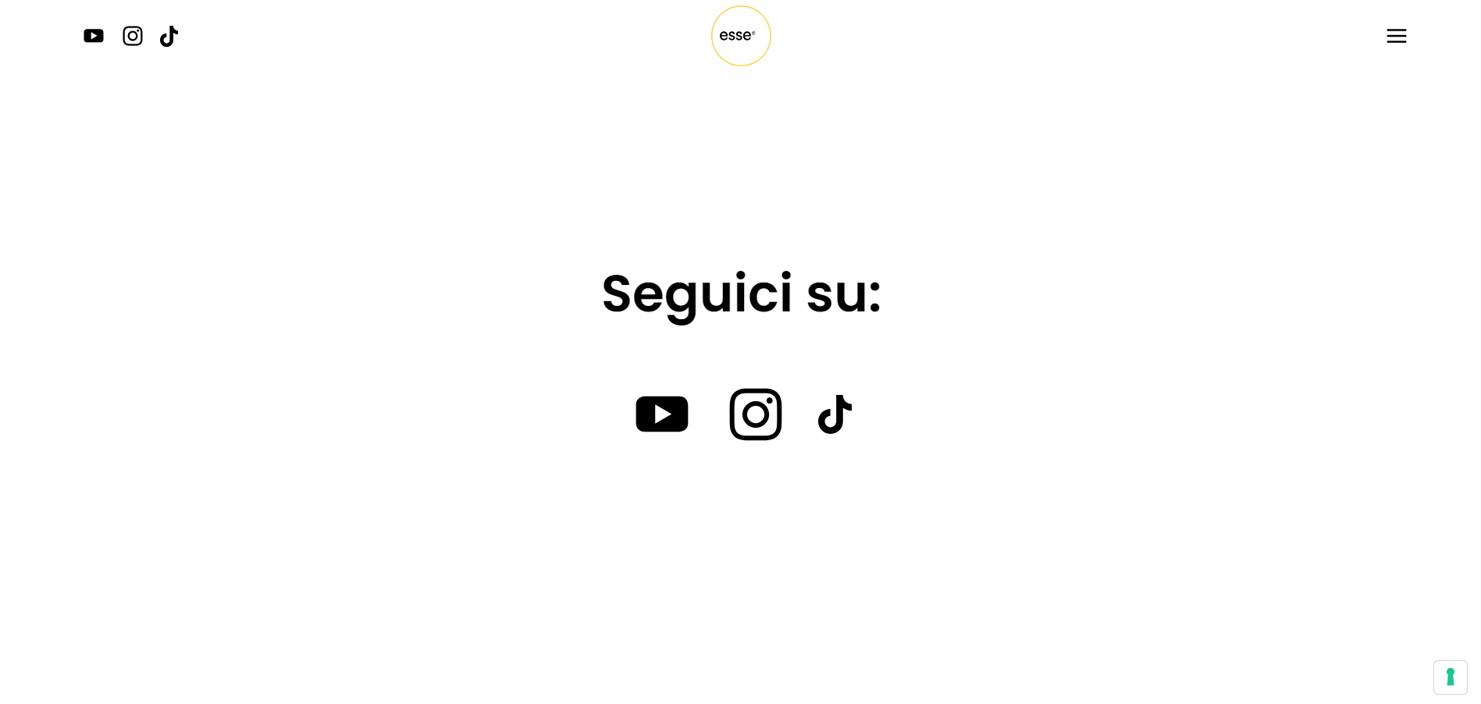

Slide 5
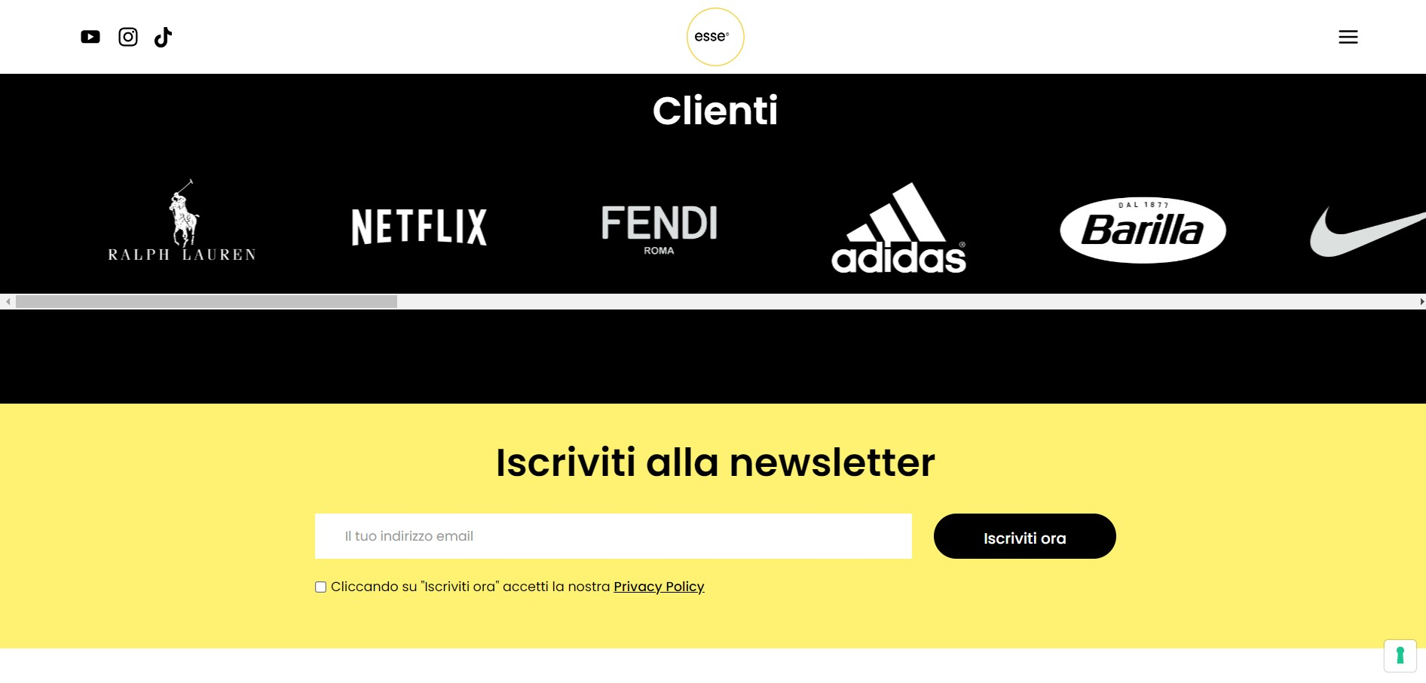

Slide 6
