Slide 1
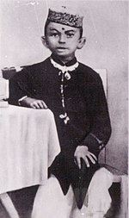
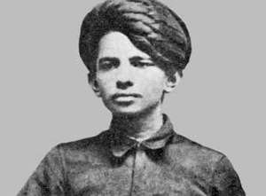
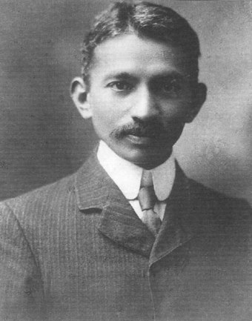
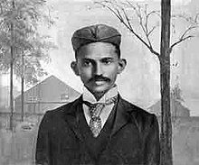
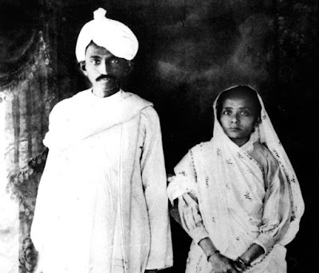
Life Journey of Mahatma Gandhi: 1869-1948
1883
1888
1891
Attempting to establish a career in India
1915
Returning to India
1893
Gandhi in South Africa
Married 14 years old Kasturbai
Go to Landon to study law at university college

