Slide 1
Explaining Patient-Similarity Models on MIMIC-IV
Group [Name] — [Member names]
AI and Visualization Lab WS26 — Task and model proposal — October 2026
Notes:
We propose to visually explain a patient-similarity model, the kind used to match patients to clinical trials, using diabetes patients from MIMIC-IV.

Slide 2
Outline
1
Motivation
Patient matching in a healthcare startup
2
Task and data
Diabetes complication cohorts in MIMIC-IV
3
Models
Count-based KNN vs. CLMBR-T-base embeddings
4
Phase I and II
How the models behave, and what they learned
5
Plan
Hypotheses, AI4VIS, risks and timeline
Notes:
Quick roadmap of the proposal.

Slide 3
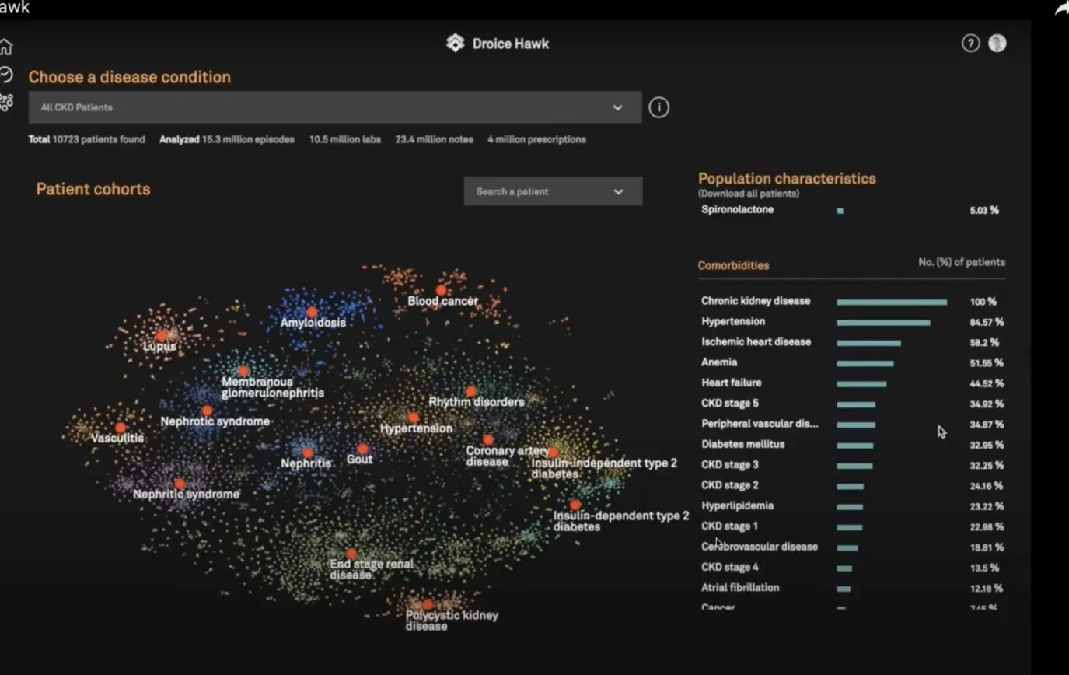
Motivation: patient matching in practice
Idea taken from my work at a healthcare startup (Droice Labs)
How it is used
Patients are embedded and clustered into cohorts
K-nearest neighbors finds comparable patients for clinical-trial recruitment
Our question
Can we trust which patients the model calls “similar”, and why does it pick them?
Droice Hawk: patient cohorts of chronic kidney disease patients, clustered by similarity
Notes:
At Droice Labs, cohort views like this clustered patients by similarity, and KNN was used to find comparable patients for clinical trials. The open question we want to explore: can we trust which patients a model calls similar? We reuse only the idea, not company code or data.

Slide 4
Task: patient-similarity retrieval
Given a diabetes patient, return the 10 most similar patients
Patient record
Model
10 neighbors
Check
Diagnoses, labs, medications, admissions
Embed the patient, run k-nearest-neighbor search
The most similar patients in the cohort
Do they share the later complication pathway?
Complication pathways
A clear ground truth makes failures measurable, and it mirrors real trial recruitment.
Kidney
Cardiovascular
Eye
None
Notes:
The task is well-defined: a neighbor set is good when its patients share the query patient's later complication pathway. That gives us ground truth to find failures.

Slide 5
Data: MIMIC-IV
De-identified hospital records, Beth Israel Deaconess Medical Center, Boston
~65,000
2008–2019
100
Access plan
patients in MIMIC-IV
years covered
patients in the free OMOP demo
1
CITI course: “Data or Specimens Only Research”
Cohort and features
2
PhysioNet credentialing, every member
Adults with a diabetes diagnosis (ICD-9 250.x, ICD-10 E10–E14) and 2+ admissions
Diagnoses, labs (HbA1c, eGFR, glucose, lipids), prescriptions, admissions
Limitation: hospital-only data, so eye disease is underrepresented
3
Sign the MIMIC-IV data use agreement
4
Meanwhile: build the pipeline on the OMOP demo
Notes:
MIMIC-IV covers roughly 2008 to 2019. We filter to adults with a diabetes code and at least two admissions. Access requires PhysioNet credentialing for every member; meanwhile we prototype on the free 100-patient OMOP demo.

Slide 6
Models: a transparent baseline vs. a foundation model
Both feed the same k-nearest-neighbor step, so differences come from the representation
A
Count-based KNN
B
CLMBR-T-base + KNN
Vector of code counts: diagnoses, labs, drugs, plus age
Every distance can be traced to features
Strong, simple baseline from the EHRSHOT benchmark
768-dimensional patient embedding
141M-parameter transformer pretrained on 2.57M Stanford patient records
Learned internals to open in Phase II
Same for both: k = 10 neighbors, the same diabetes cohort, the same evaluation against later complications
Notes:
Model A is our transparent baseline: every distance traces back to features. Model B uses CLMBR-T-base embeddings, which gives Phase II real internals to open.

Slide 7
Why CLMBR-T-base is the best fit
Three candidates with papers that work with MIMIC-IV
Model | Input | Trade-off | Role
CLMBR-T-base | Structured EHR codes (OMOP) | Needs OMOP conversion + Stanford non-commercial agreement | Chosen
EHRMamba | Structured EHR (MIMIC-IV FHIR) | Trained on MIMIC-IV, but needs our own GPU training | Considered
Bio_ClinicalBERT | Clinical notes (text) | Easiest setup (MIT license), but text only | Fallback
Bonus: CLMBR-T-base was pretrained at Stanford, not Boston. How well it transfers to MIMIC-IV is itself a finding to test.
Notes:
CLMBR-T-base works on structured codes and gives patient embeddings directly usable for KNN. It needs an OMOP conversion and a non-commercial Stanford agreement, fine for a course. Bio_ClinicalBERT is our fallback.

Slide 8
Phase I: how do the models behave?
Black box closed: inputs and neighbors only. Projections use input features, never embeddings
1
Scatter plot, one variable per channel
2
Reordered confusion matrix
x = neighbor agreement, y = HbA1c or eGFR, color = sex, small multiples = pathway
Majority vote of neighbors vs. actual pathway; blocks show clinically sensible errors
3
Projection with drill-down
4
Paths over admissions
UMAP of input features colored by agreement; drill down, summarize, annotate failures
Connect each patient's admissions into a path; watch neighbors change over time
Synthetic inputs: perturbations (HbA1c 7% → 9%) and counterfactuals (same record, other sex or age), shown as a “neighbor flip” chart
Notes:
We use the three investigative tools from the practical-examples session, plus paths over admissions. Perturbations and counterfactuals test our hypotheses directly.

Slide 9
Phase II: what did the models learn?
Black box open: every view tests one Phase I observation
Phase I observation
Phase II explanation
Neighbors differ by demographic group
Probing
Linear classifiers on embeddings test what is encoded: age, sex, insurance, kidney function
Some regions of patient space fail
Embedding projection
UMAP of model B's space, colored by pathway, then by hospital unit and admission year
One lab change flips many neighbors
Distance decomposition
Which features drive each neighbor distance in model A
Neighbors change as disease progresses
Embedding trajectories
Admissions as paths through embedding space
Notes:
Each Phase II view links back to a Phase I finding, so the final story reads: what we saw, then why it happens.

Slide 10
Expected outcomes
Hypotheses we will test; a negative result is still a finding
H1
H2
H3
H4
Better neighbors
Rare pathway fails
Hidden shortcuts
Imperfect transfer
Model B finds more clinically consistent neighbors than A for kidney and cardiovascular pathways
Both models do worse for eye complications, which are rare in hospital data
Some neighbors are chosen by demographics or admission year, which would bias trial cohorts
Model B's embedding encodes Stanford-specific patterns that transfer imperfectly to MIMIC-IV
Deliverable: an interactive visual analysis comparing both models, with evidence for each finding.
Notes:
Beyond the course, this analysis shows how to audit patient-matching tools before they are used for real trial recruitment.

Slide 11
AI4VIS and data safety
Using generative AI responsibly with credentialed patient data
AI4VIS workflow
Data-safety rules
Per phase: two members design with AI help, two without, then swap
Log key prompts and which suggestions we accepted, rejected or refined, and why
Report failure patterns and emerging best practices
Never paste real patient rows into AI tools; use synthetic or aggregated examples
Public GitHub repo holds code only: no data, cohorts, embeddings or neighbor lists
Required files: team-info.json and workload.json
Why it matters: the MIMIC-IV data use agreement forbids sharing data with third-party online services
Notes:
The MIMIC data use agreement forbids sending data to online AI services, and our repo is public. We will report how this constraint shaped our AI use as a best-practice finding.

Slide 12
Risks and mitigations
Risk
Mitigation
MIMIC-IV approval is slow
Apply this week; prototype on the free OMOP demo
Stanford agreement for CLMBR-T-base delayed
Switch model B to Bio_ClinicalBERT on discharge notes
OMOP conversion takes too long
Use the OHDSI ETL as is; limit to diagnoses, labs, drugs
Too few repeat-admission patients
Widen cohort to any admission with a diabetes code
Not enough compute
Inference only for CLMBR-T-base; no pretraining
Notes:
Each risk has a concrete fallback so the timeline holds.

Slide 13
Timeline
No deadline extensions: every milestone has an owner
28.10
04.11
11.11
02.12
09.12
Model selection
Pipeline running
Midpoint
Phase II done
Final deadline
Moodle entry, GitHub repo, all credentialing
OMOP demo; both models return neighbors
Phase I visualizations on full MIMIC-IV
Projections, probing, trajectories
Report, AI4VIS log, presentation
Roles: data lead · model lead · Phase I lead · Phase II lead (to assign)
Notes:
Model selection 28.10, midpoint 11.11, final 09.12, then the mandatory presentation.

Slide 14
Key papers and resources
Wornow et al., NeurIPS 2023
EHRSHOT: an EHR benchmark for few-shot evaluation of foundation models (CLMBR-T-base)
Fallahpour et al., ML4H 2024
EHRMamba: generalizable and scalable foundation models for EHRs
Alsentzer et al., NAACL ClinicalNLP 2019
Publicly available clinical BERT embeddings (Bio_ClinicalBERT)
Yu et al., 2025
Benchmarking foundation models with multimodal public EHRs (MIMIC-IV)
Hinterreiter et al., 2021
Projection Path Explorer: visual patterns in projected decision-making paths
Notes:
All links are in the shared proposal document.

Slide 15
Thank you!
Questions?
Group [Name] — [Member names]

