Slide 1
STM32—timer/counter

Slide 2
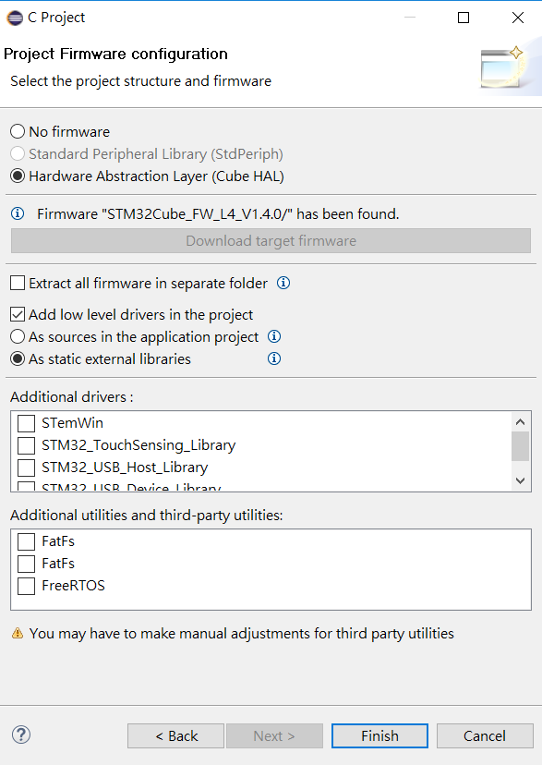
Where is stm32l476xx.h
Choose one to get
the files
Download the package and include the header files you want
I have attached the header files in e3 lab7 announce
…
…
…
stm32l476xx.h

Slide 3
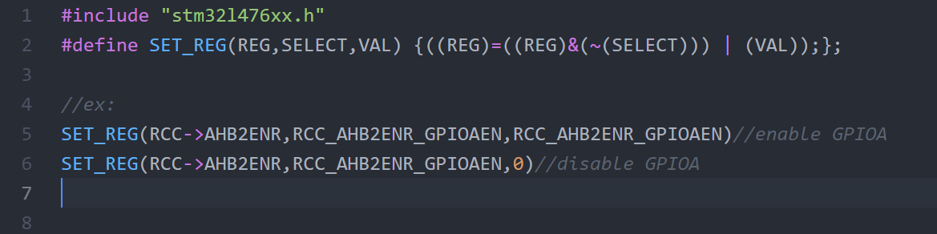
How to use stm32l476xx.h’s define

Slide 4
Lab7.1
更改系統clock觀察led閃爍變化(1,6,10,16,40 MHz)
Use PLLCLK with clock source(MSI) as system clock
f(VCO clock) = f(PLL clock input) × (PLLN / PLLM)
System clock=f(PLL_R) = f(VCO clock) / PLLR
即System clock=f(PLL clock input) × (PLLN / PLLM) / PLLR

Slide 5
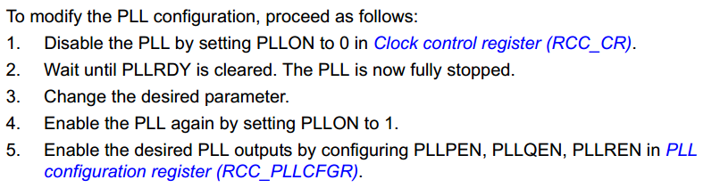
Lab7.1
RCC_AHB2ENR
RCC_CFGR
RCC_CR
RCC_PLLCFGR

Slide 6
Lab7.2
設計一計時器利用7-SEG LED顯示，從0.00開始計時至大於等於TIME_SEC時停止，請使用polling方式取得timer counter資訊
RCC_APB1ENR1
TIMX_
初始化時，設定count數,是否自動update等等
polling時，檢查count數,是否已經有update event

Slide 7
Lab7.3
利用timer的pwm功能驅動buzzer，並使用keypad控制buzzer產生不同頻率的聲音。(可使用TIM2)
連接buzzer的gpio pin需要在以下reg設定，才可將pwm訊號傳至該pin
GPIOX_MODER 設為Alternate function mode
GPIOX_AFRL or GPIOX_AFRH 設為 AF1(tim1/tim2)

Slide 8
Lab7.3
Set TIMX start=off
Set TIMX enable
Set TIMX prescaler , reload value, count_dir
Set TIMX capture/compare enable
Set TIMX capture/compare as output
Set TIMX capture/compare as pwm mode
Set TIMX capture/compare reg’s count value
Set TIMX re-initialize counter=on
Set TIMX update interrupt enable
Set TIMX start=on

Slide 9
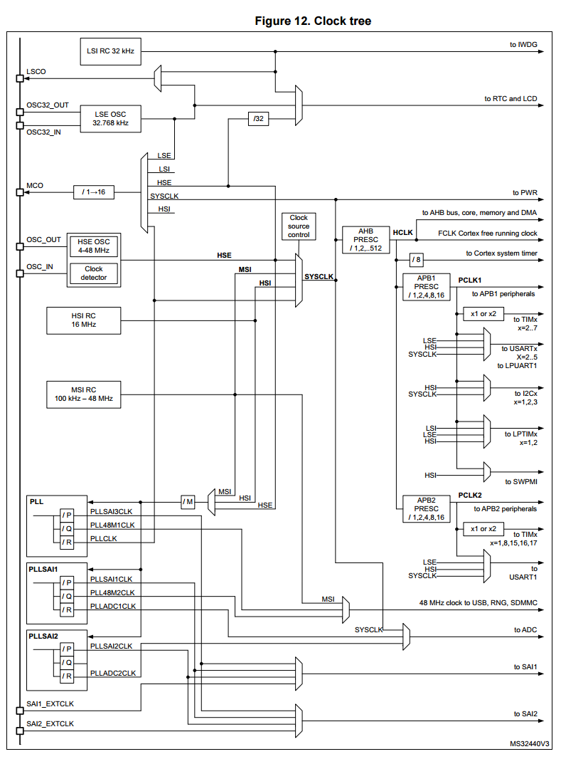
System Clock—Clock tree
Four different clock sources can be used to drive the system clock (SYSCLK):
HSI16 (high speed internal)16 MHz RC oscillator clock
MSI (multispeed internal) RC oscillator clock
HSE oscillator clock, from 4 to 48 MHz
PLL clock
The MSI is used as system clock source after startup from Reset, configured at 4 MHz.

Slide 10
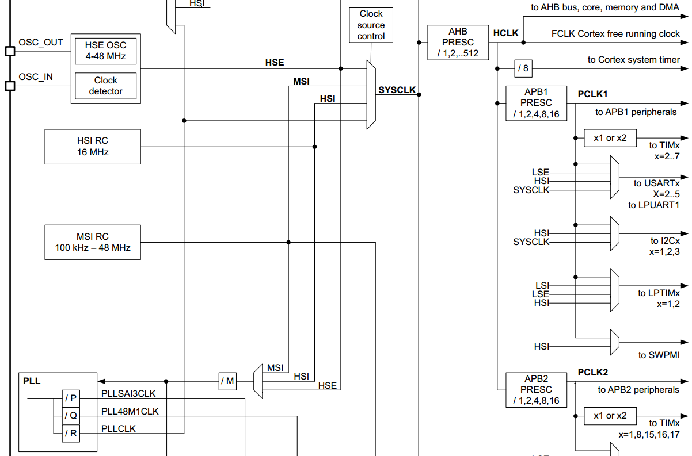
System Clock—Clock tree
Default system clock
4MHz

Slide 11
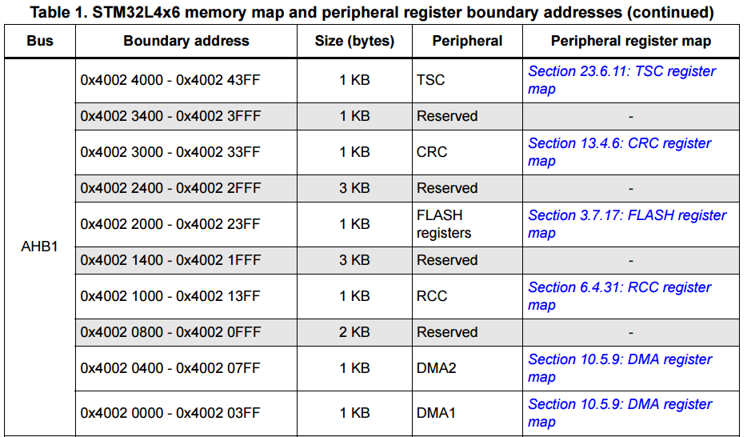
RCC memory address

Slide 12
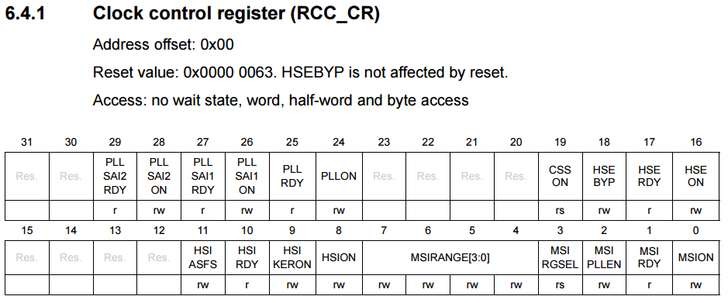
RCC registers—CR
1➔Clock ON, 0➔Clock OFF
1➔Clock Ready, 0➔Clock not ready

Slide 13
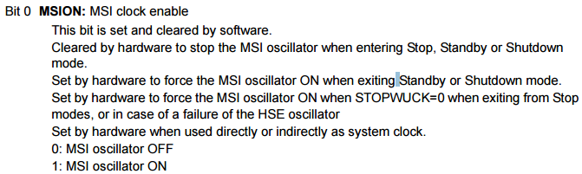
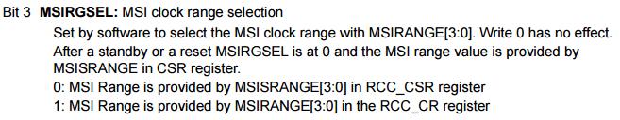
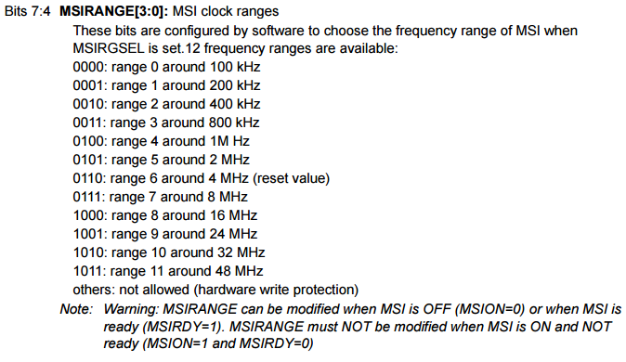
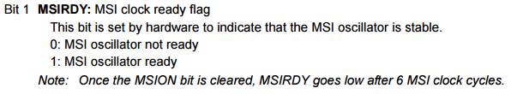
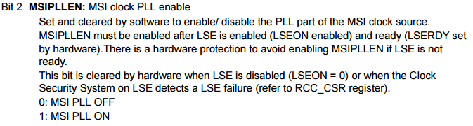
RCC_CR– MSI

Slide 14
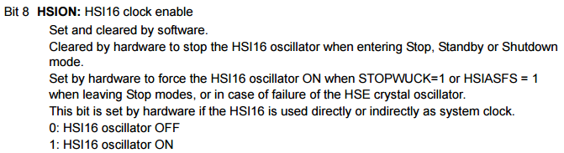
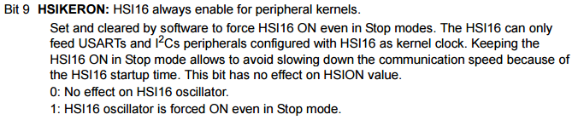
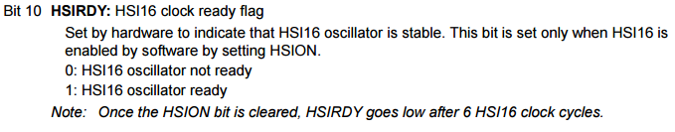
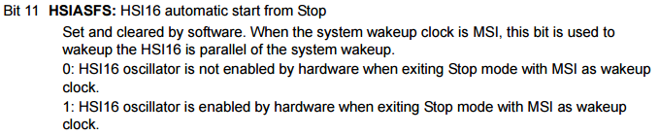
RCC_CR– HSI

Slide 15
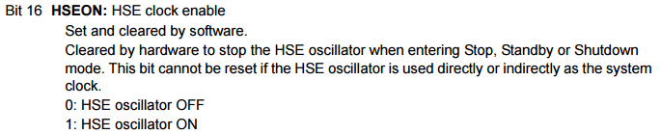
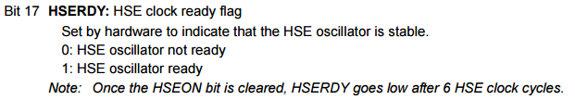
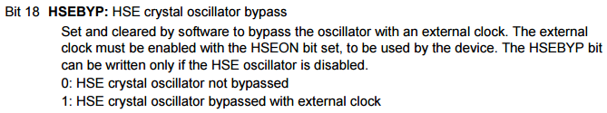
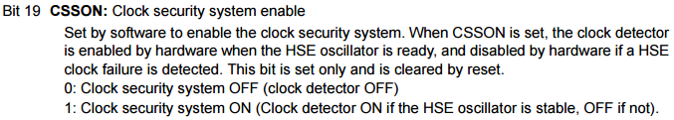
RCC_CR– HSE

Slide 16
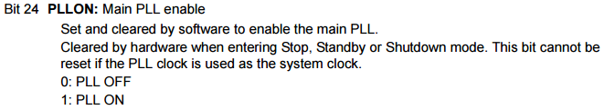
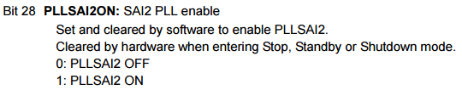


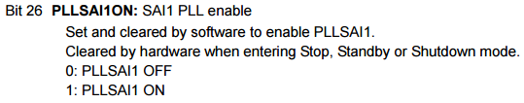

RCC_CR– PLL

Slide 17
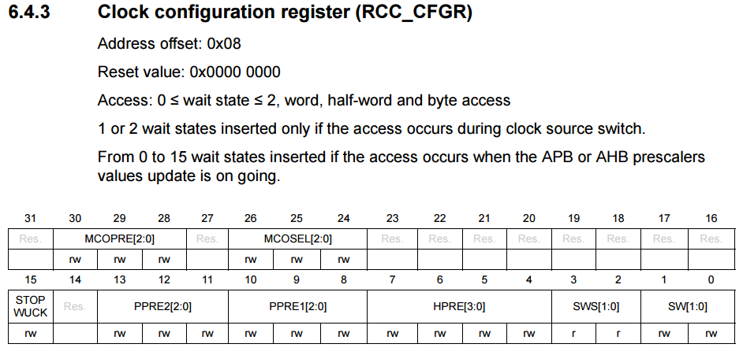
RCC registers—CFGR

Slide 18
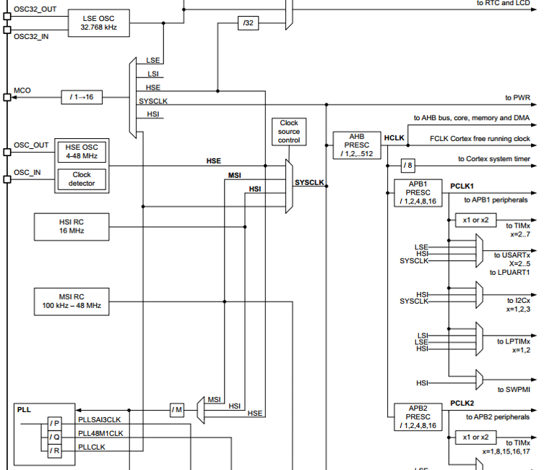
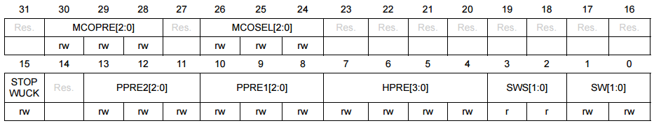
RCC_CFGR

Slide 19
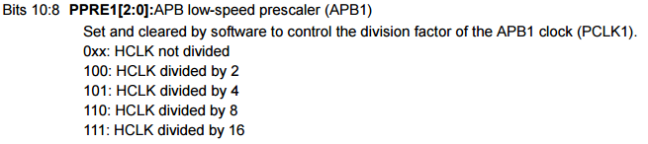
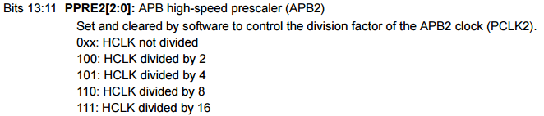
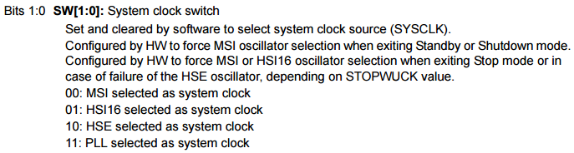
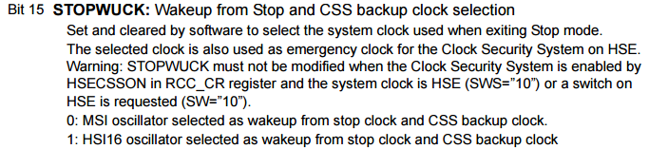
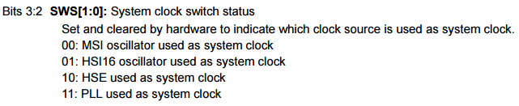
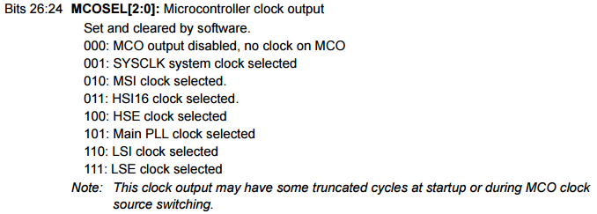
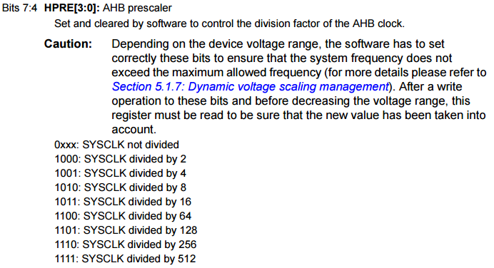
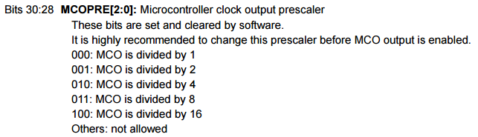
RCC_CFGR

Slide 20
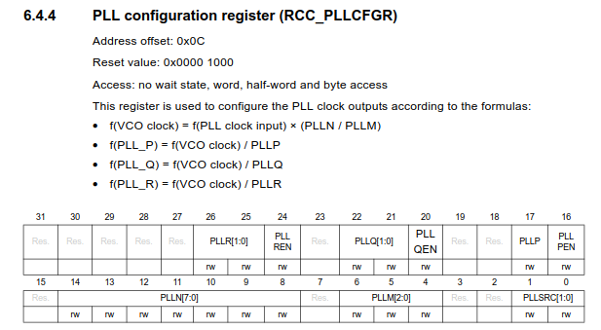

Slide 21
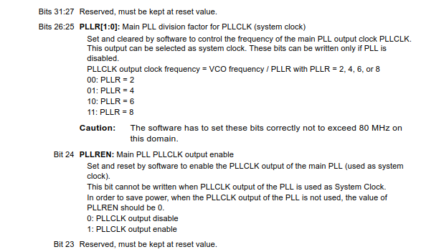

Slide 22
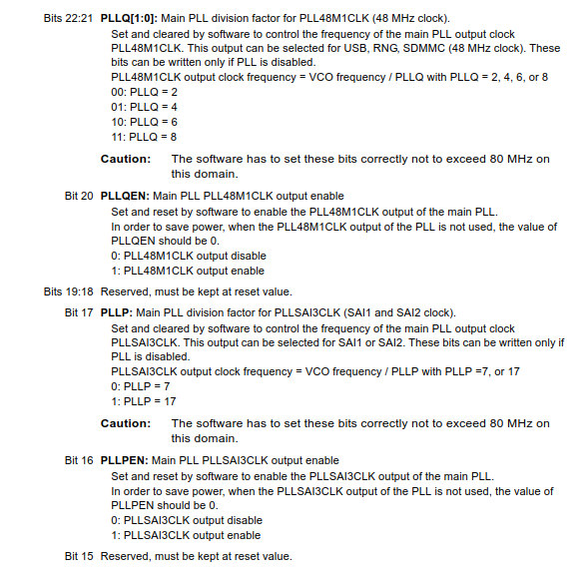

Slide 23
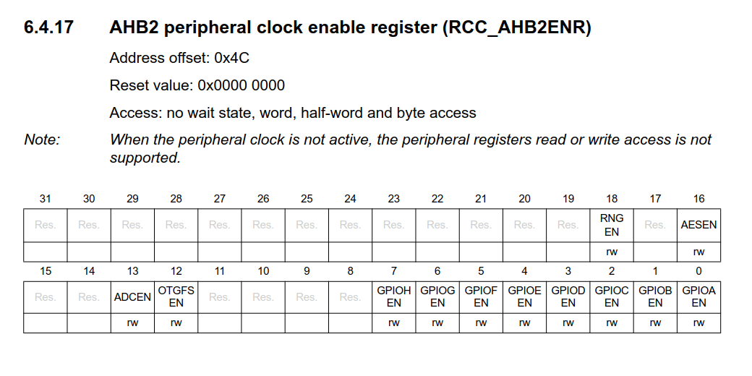

Slide 24
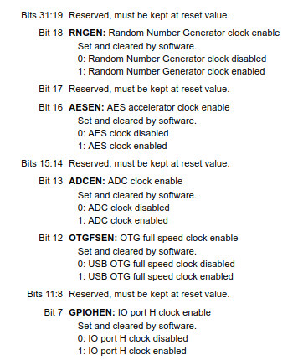
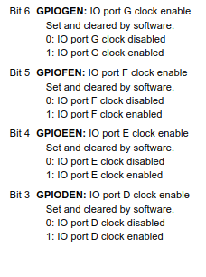

Slide 25
Timer
The timer clock frequencies are automatically defined by hardware. There are two cases:
If the APB prescaler equals 1, the timer clock frequencies are set to the same frequency as that of the APB domain.
Otherwise, they are set to twice (×2) the frequency of the APB domain

Slide 26
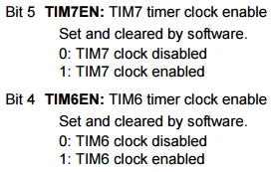
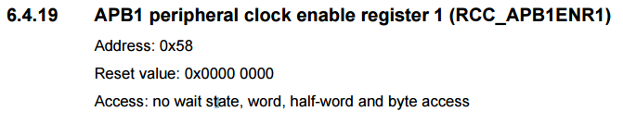
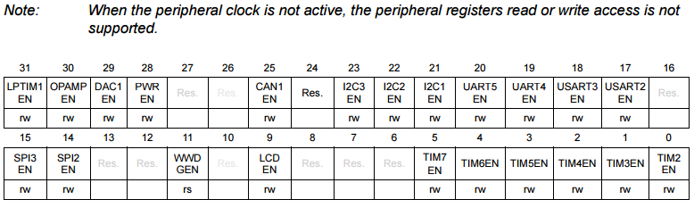
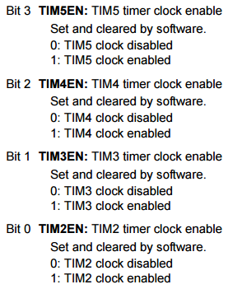
RCC_APB1ENR1
Enable timer

Slide 27
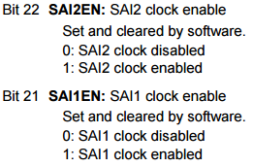
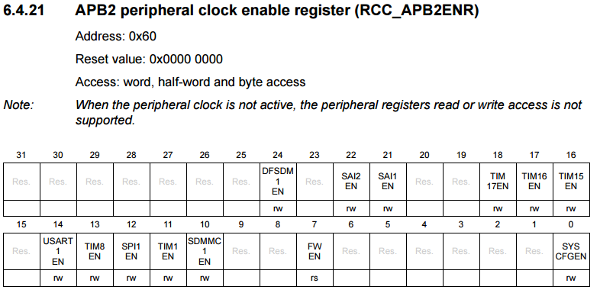
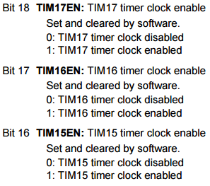


RCC_APB2ENR

Slide 28
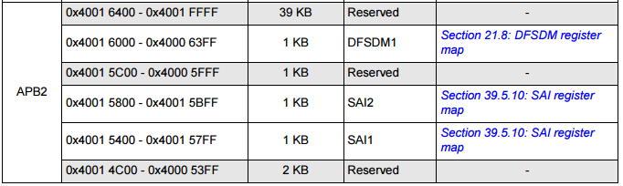
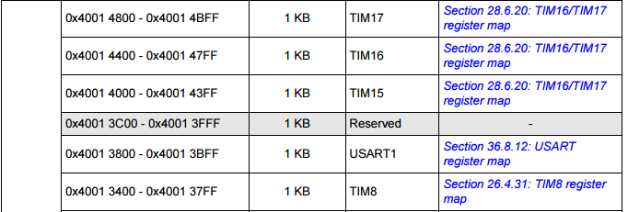
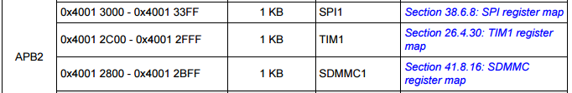
Timer memory map address

Slide 29


Timer memory map address
…

Slide 30






TIMx_CR1

Slide 31




TIMx_CR1

Slide 32

TIMx_PSC

Slide 33

TIMx_ARR

Slide 34


TIMx_CNT

Slide 35


TIMx_EGR—UG

Slide 36

Basic timers –TIM6/TIM7
16-bit auto-reload upcounter
16-bit programmable prescaler used to divide (also “on the fly”) the counter clock frequency by any factor between 1 and 65535
Synchronization circuit to trigger the DAC
Interrupt/DMA generation on the update event: counter overflow
ARR

Slide 37
General-purpose timers—TIM2/TIM3/TIM4/TIM5
16-bit (TIM3, TIM4) or 32-bit (TIM2 and TIM5) up, down, up/down auto-reload counter.
16-bit programmable prescaler used to divide (also “on the fly”) the counter clock frequency by any factor between 1 and 65535.
Up to 4 independent channels for:
Input capture, Output compare, PWM generation(Edge- and Center-aligned modes), One-pulse mode output
Synchronization circuit to control the timer with external signals and to interconnect several timers
Interrupt/DMA generation on the following events:
Update: counter overflow/underflow, counter initialization (by software orinternal/external trigger)
Trigger event (counter start, stop, initialization or count by internal/external trigger)
Input capture
Output compare
Supports incremental (quadrature) encoder and hall-sensor circuitry for positioning purposes
Trigger input for external clock or cycle-by-cycle current management

Slide 38


Slide 39
General-purpose timers—TIM15
16-bit auto-reload upcounter
16-bit programmable prescaler used to divide (also “on the fly”) the counter clock frequency by any factor between 1 and 65535
Up to 2 independent channels for:
Input capture, Output compare, PWM generation (edge mode), One-pulse mode output
Complementary outputs with programmable dead-time (for channel 1 only)
Synchronization circuit to control the timer with external signals and to interconnect several timers together
Repetition counter to update the timer registers only after a given number of cycles of the counter
Break input to put the timer’s output signals in the reset state or a known state
Interrupt/DMA generation on the following events:
Update: counter overflow, counter initialization (by software or internal/external trigger)
Trigger event (counter start, stop, initialization or count by internal/external trigger)
Input capture
Output compare
Break input (interrupt request)

Slide 40


Slide 41
General-purpose timers—TIM16/TIM17
16-bit auto-reload upcounter
16-bit programmable prescaler used to divide (also “on the fly”) the counter clock
frequency by any factor between 1 and 65535
One channel for:
Input capture, Output compare, PWM generation (edge-aligned mode), One-pulse mode output
Complementary outputs with programmable dead-time
Repetition counter to update the timer registers only after a given number of cycles of the counter
Break input to put the timer’s output signals in the reset state or a known state
Interrupt/DMA generation on the following events:
Update: counter overflow
Trigger event (counter start, stop, initialization or count by internal/external trigger)
Input capture
Output compare
Break input

Slide 42


Slide 43
Advanced-control timers—TIM1/TIM8
16-bit up, down, up/down auto-reload counter.
16-bit programmable prescaler allowing dividing (also “on the fly”) the counter clock frequency either by any factor between 1 and 65536.
Up to 6 independent channels for:
Input Capture (but channels 5 and 6), Output Compare, PWM generation (Edge and Center-aligned Mode), One-pulse mode output
Complementary outputs with programmable dead-time
Synchronization circuit to control the timer with external signals and to interconnect several timers together.
Repetition counter to update the timer registers only after a given number of cycles of the counter.
2 break inputs to put the timer’s output signals in a safe user selectable configuration.
Interrupt/DMA generation on the following events:
Update: counter overflow/underflow, counter initialization (by software or internal/external trigger)
Trigger event (counter start, stop, initialization or count by internal/external trigger)
Input capture
Output compare
Supports incremental (quadrature) encoder and Hall-sensor circuitry for positioning purposes
Trigger input for external clock or cycle-by-cycle current management

Slide 44


Slide 45
Low-power timer
16 bit upcounter
3-bit prescaler with 8 possible dividing factor (1,2,4,8,16,32,64,128)
Selectable clock
Internal clock sources: LSE, LSI, HSI16 or APB clock
External clock source over ULPTIM input (working with no LP oscillator running, used by Pulse Counter application)
16 bit ARR autoreload register
16 bit compare register
Continuous/one shot mode
Selectable software/hardware input trigger
Programmable Digital Glitch filter
Configurable output: Pulse, PWM
Configurable I/O polarity
Encoder mode

Slide 46
Low-power timer
The LPTIM is a 16-bit timer that benefits from the ultimate developments in power consumption reduction. Thanks to its diversity of clock sources, the LPTIM is able to keep running in all power modes except for Standby mode. Given its capability to run even with no internal clock source, the LPTIM can be used as a “Pulse Counter” which can be useful in some applications. Also, the LPTIM capability to wake up the system from low-power modes, makes it suitable to realize “Timeout functions” with extremely low power consumption.

Slide 47


Slide 48

Flash Read Access Latency

Slide 49


Flash Read Access Latency
When changing the CPU frequency, the following software sequences must be applied in order to tune the number of wait states needed to access the Flash memory

Slide 50


FLASH ACR

Slide 51
Reference
http://www.st.com/resource/en/reference_manual/dm00083560.pdf

