Slide 1
Keypad

Slide 2
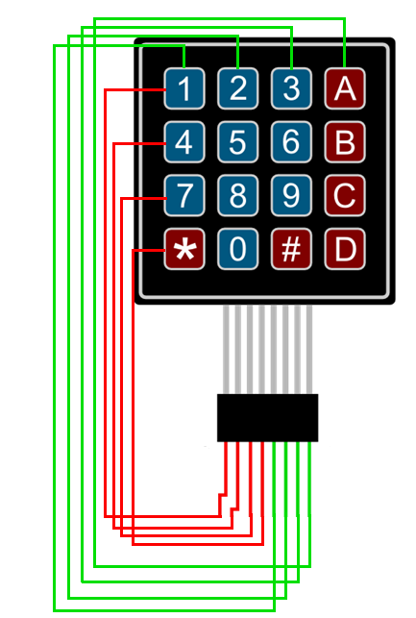

Slide 3
1 0 0 0
OUTPUT

Slide 4
1 0 0 0
OUTPUT
0
0
0
1
INPUT

Slide 5
1 0 0 0
OUTPUT
0
0
0
1
INPUT

