Slide 1
Keypad

Slide 2
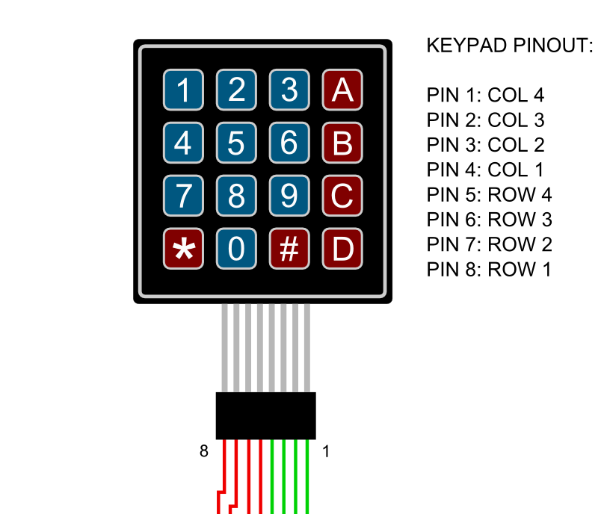
Col 1
Col 4
X0 X1 X2 X3
Row 1: Y3
Row 2: Y2
Row 3: Y1
Row 4: Y0

Slide 3
OUTPUT
1 0 0 0
Col 1
Col 4
X0 X1 X2 X3
Row 1: Y3
Row 2: Y2
Row 3: Y1
Row 4: Y0
INPUT

Slide 4
OUTPUT
1 0 0 0
Col 1
Col 4
X0 X1 X2 X3
0
0
0
1
Row 1: Y3
Row 2: Y2
Row 3: Y1
Row 4: Y0
INPUT

Slide 5
OUTPUT
1 0 0 0
Col 1
Col 4
X0 X1 X2 X3
0
0
0
1
Row 1: Y3
Row 2: Y2
Row 3: Y1
Row 4: Y0
INPUT

