Slide 1
Micro Controller lab final project led rgb ambient light
Group 1 0416324

Slide 2
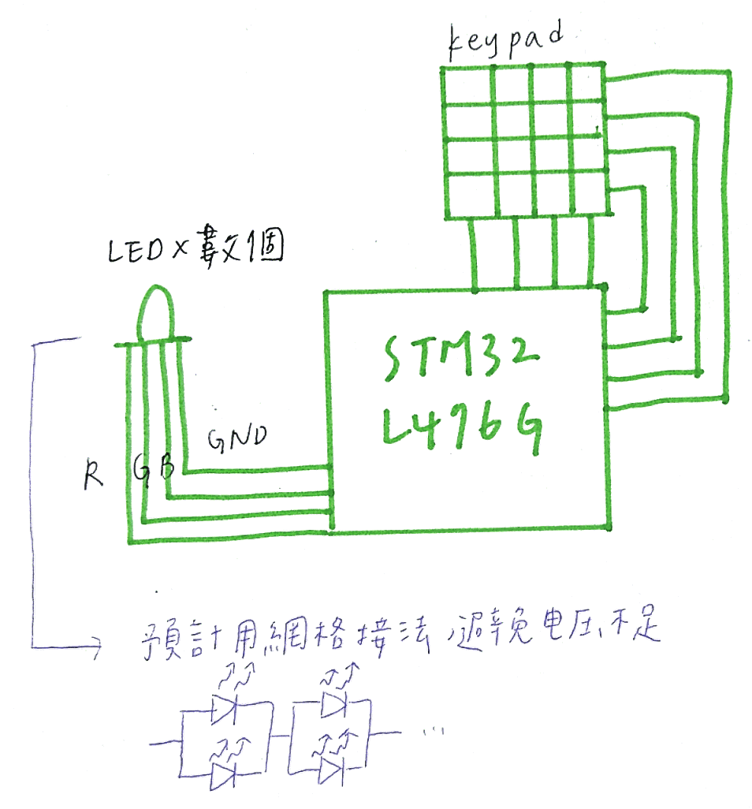
Prototype of the project
Connect the keypad to STM32 board
There are some part of the button described for the functions for ambient light as follow
It can be implemented as the night light in room, club and café as well
R+ | G+ | B+ | CTRL
R- | G- | B- | CYCLE
RED | GREEN | BLUE | LIGHT
ORANGE | PURPLE | YELLOW | DARK

Slide 3
Extend from prototype to more functions
Light intensity interact with music
Breathable light mode(呼吸燈)

Slide 4


