Slide 1
Machine Learning Final Project
The price prediction of the used cars in Germany since 2015
0416324 胡安鳳
0416308 林正偉
0316323 薛世恩

Slide 2
Responsibility assignment
0416324 Finding the appropriate dataset, preprocessing(filter the unnecessary data with pandas)
KNN Regressor analysis, report
0416308 DecisionTreeRegressor analysis, random data generation, cov calculation
0316323 PDF Plotting, Finding dataset and SVM analysis
0416024 Naïve Bayes (if naïve cant do continuous, youi should log and round by yourself 羿豐)

Slide 3
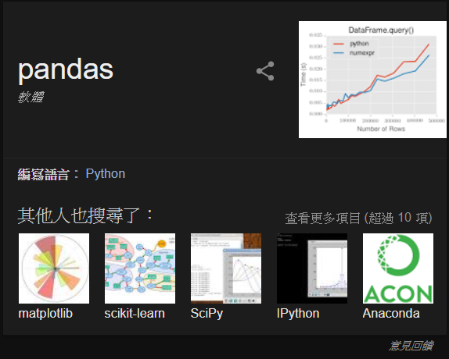
Implementation tools
Pandas for data processing
Sklearn for ML models
Matplotlib for graphing
Python with Anaconda
Jupyter Notebook for writing the real-time code checking

Slide 4
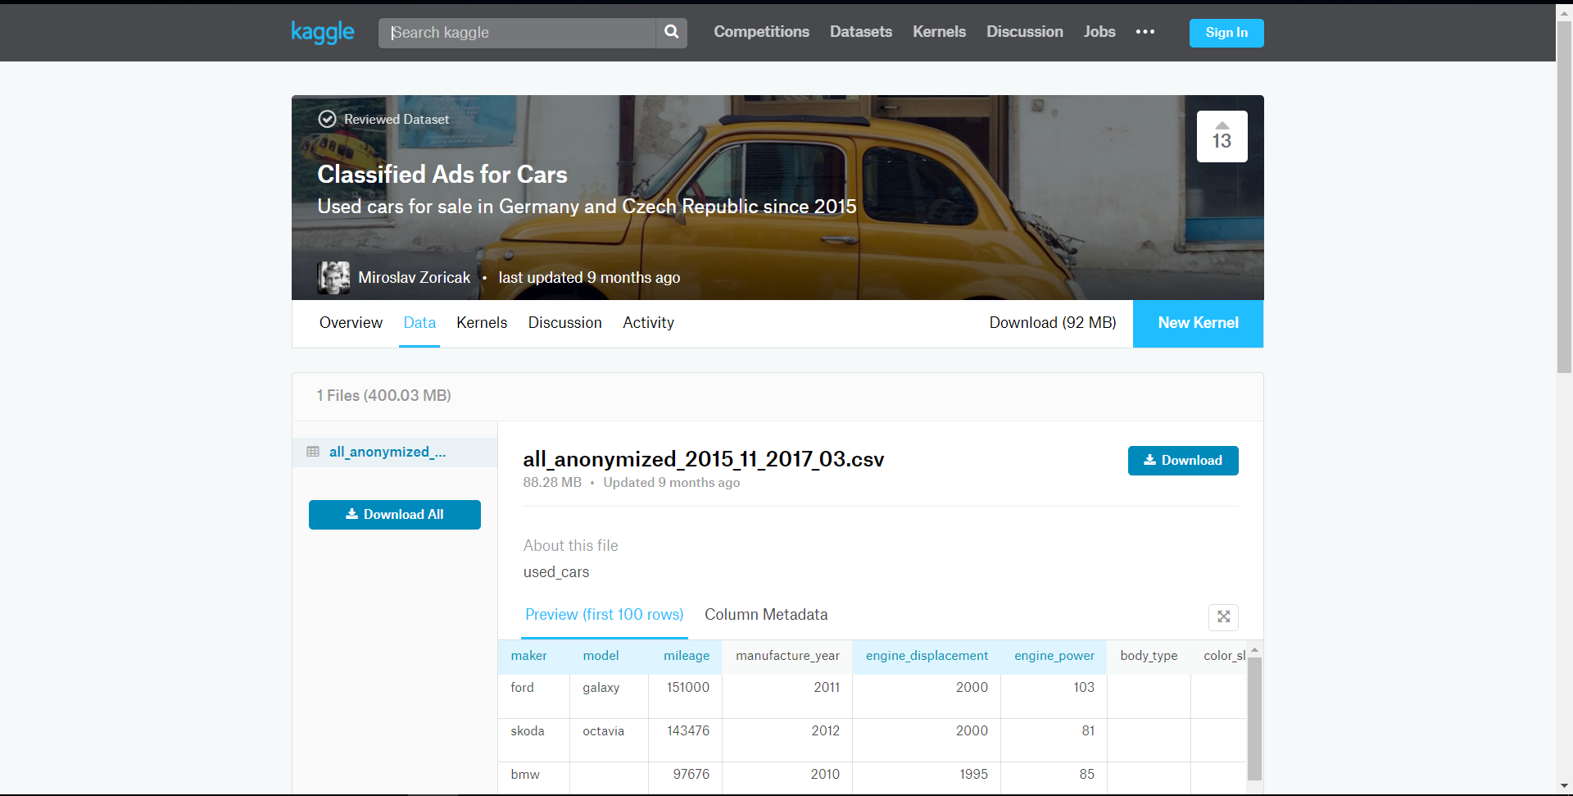
Data Source from Kaggle

Slide 5
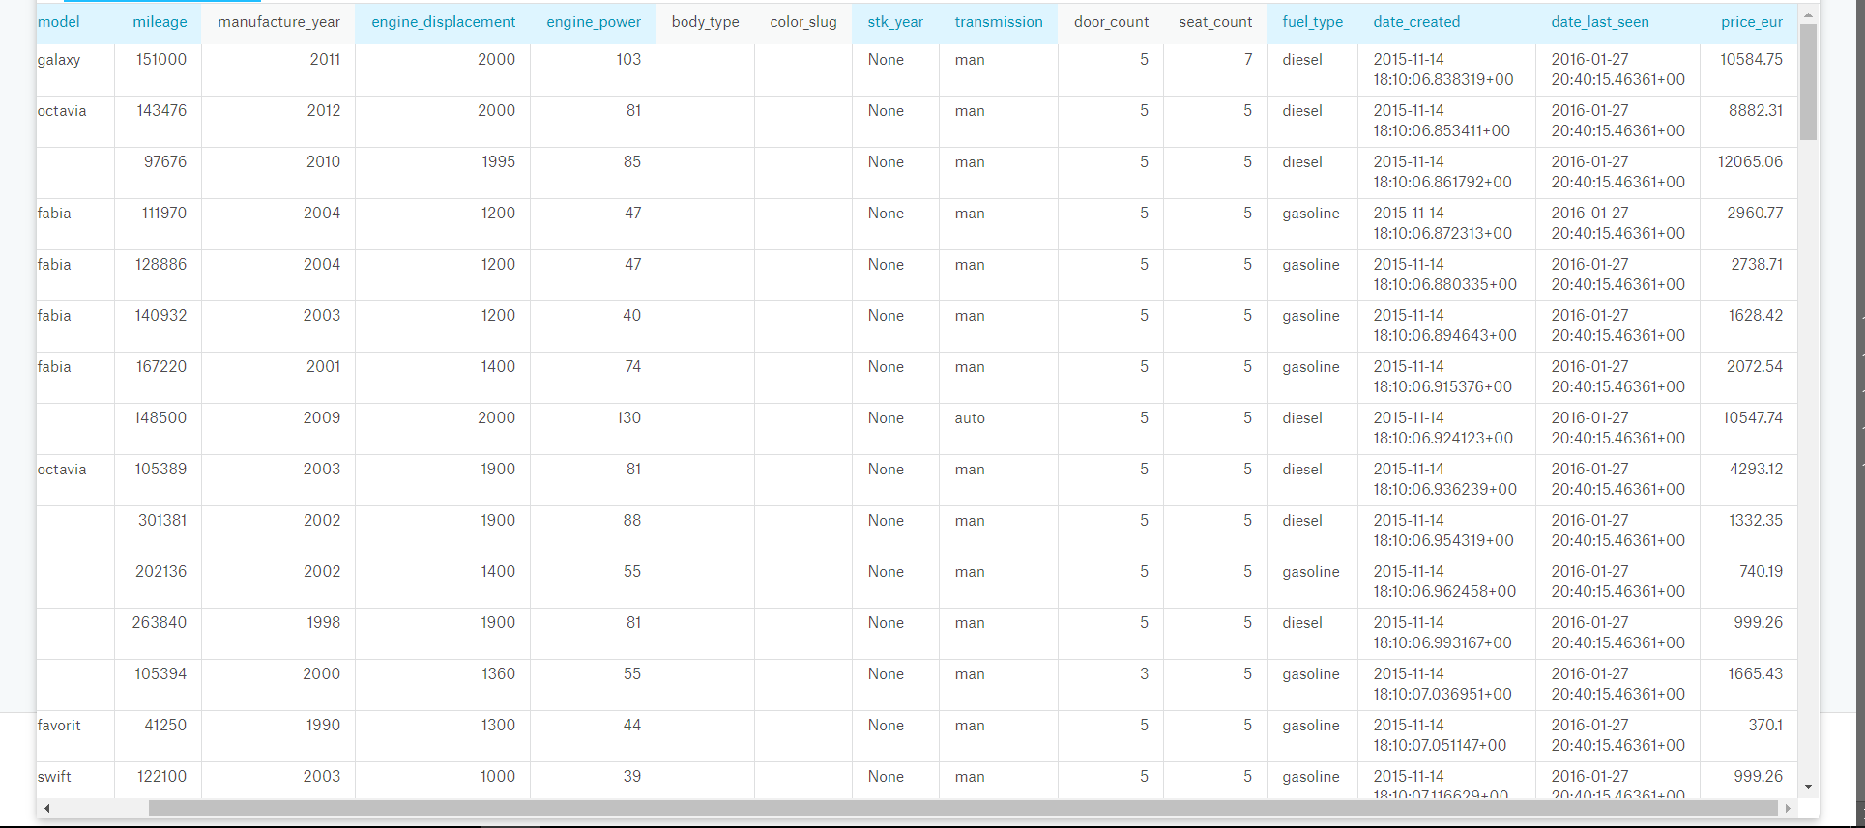
What attributes to filter and left?

Slide 6
As we can see from last page
Body_type and color_slug all contain the empty data
Most (about99%)of the stk_year are None, which is useless in analysis
As prediction only for car price but not for the time-serial data, attributes with time can be eliminated but manufactured_year

Slide 7
Remained attribute explanation
Attributes that may affect the price
Maker: The manufacturer of that car
Model: Model of the car
Mileage: Distance the car has been driven
Engine_displ: swept volume of all the pistons inside the cylinders of a reciprocating engine
Engine_power: HP of such engine
Door and seat count
Fuel_type: diesel or gasoline?
Transmission : man or auto

Slide 8
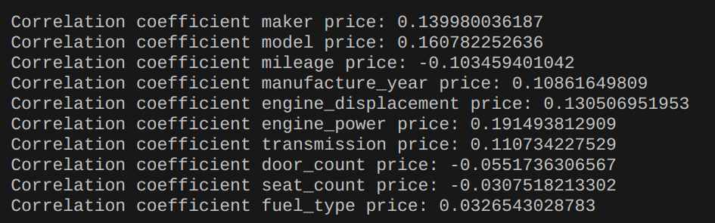
More detailed ,analyze COV to see what does we REALLY NEED
Attribute-covariance analysis credit to 0416308 David Lin

Slide 9
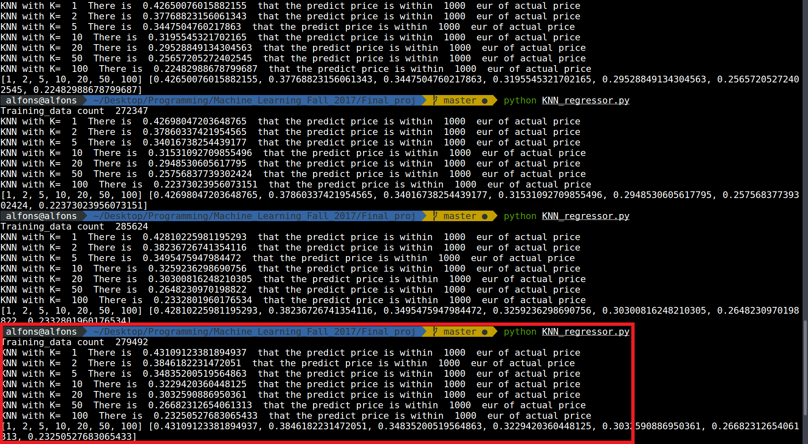
Model1 KNN Regressor by0416324

Slide 10
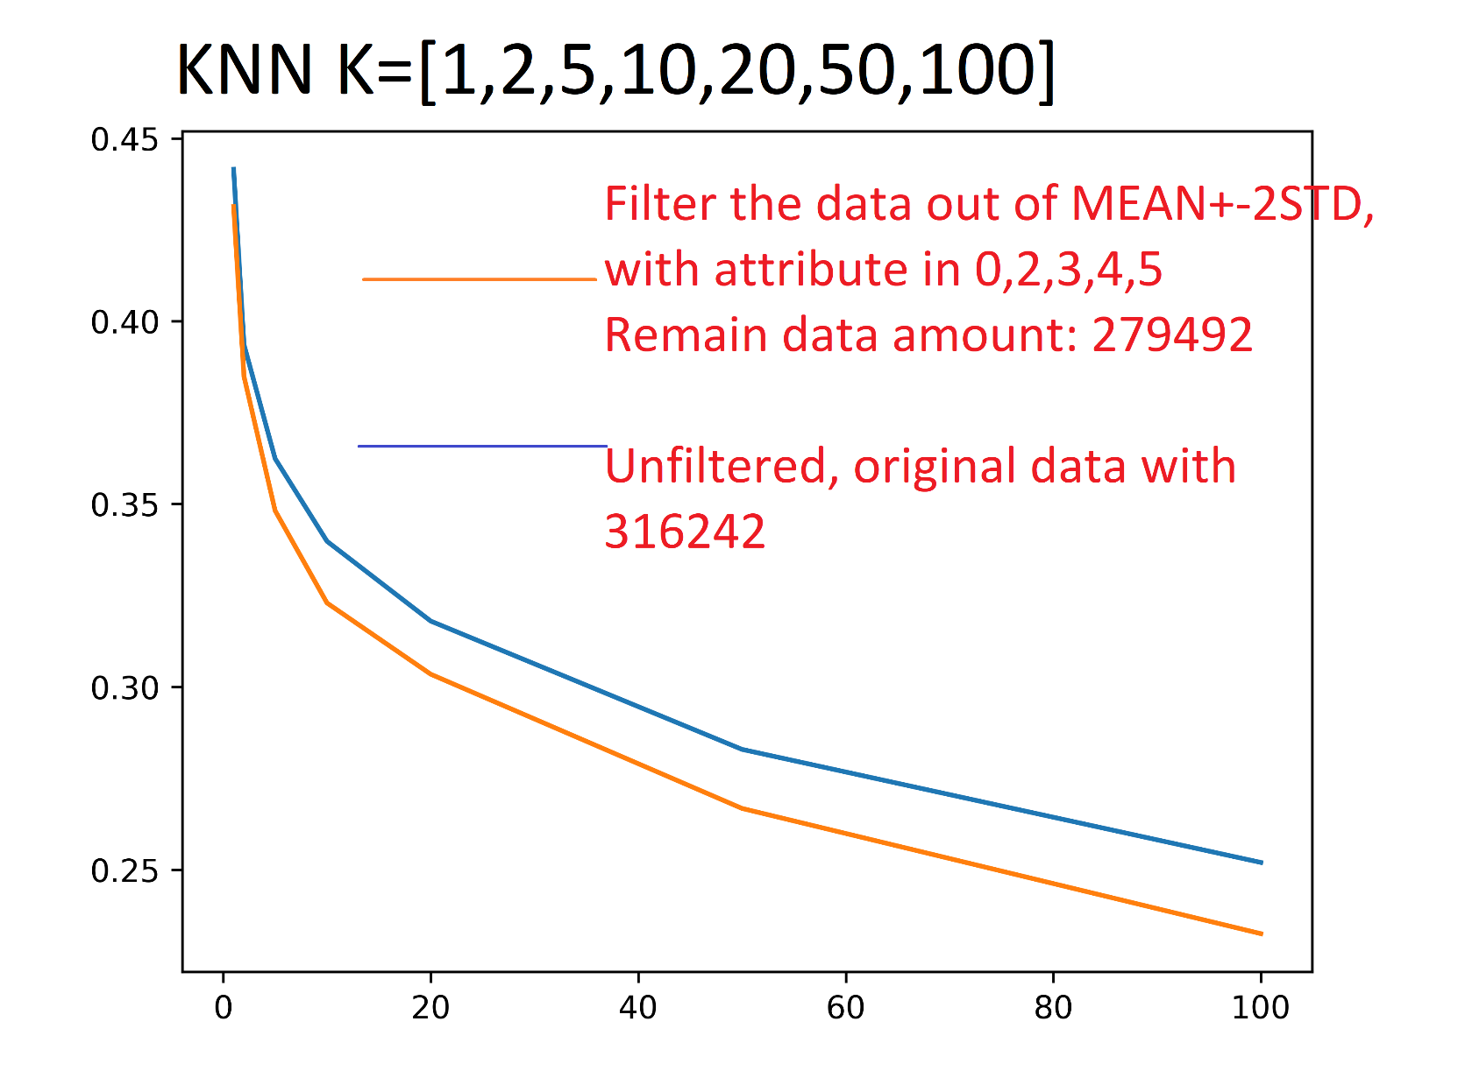
Model1 KNN Regressor by0416324
The contribution of one training sample-accuracy from
0.441/316242 = 1.39e-6
To
0.431/279492 = 1.542e-6
Enhance the accuracy of unit training sample.

Slide 12
Model 2 DT Regressor

Slide 13
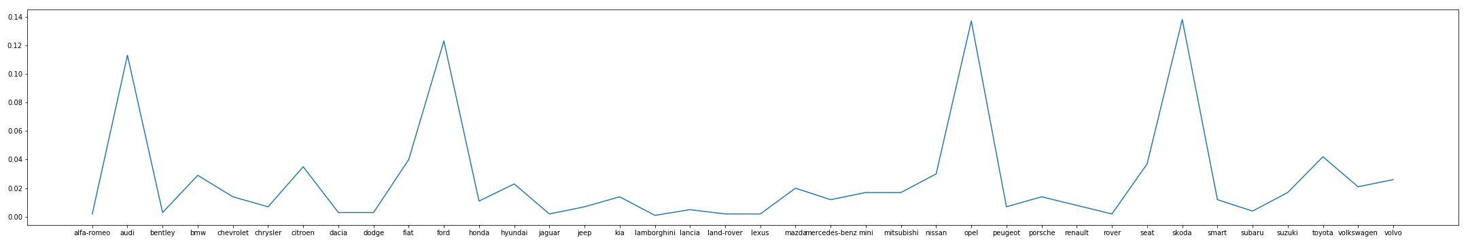
PDF of maker

Slide 14
PDF of maker

Slide 15
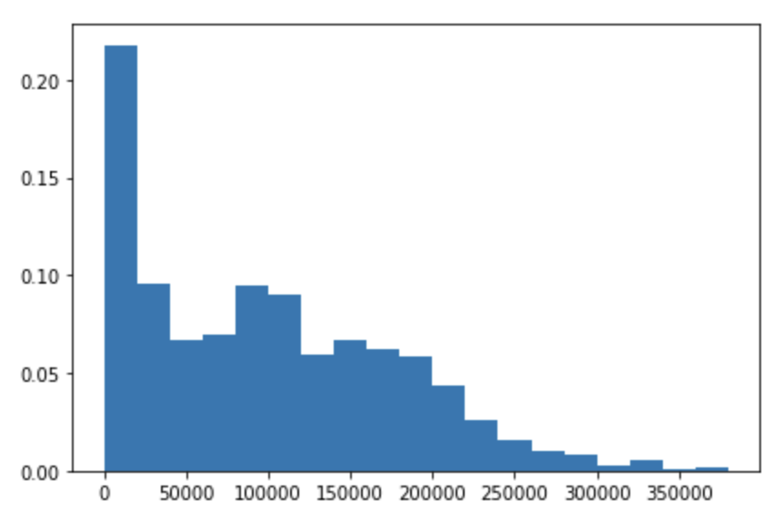
PDF of mileage

Slide 16
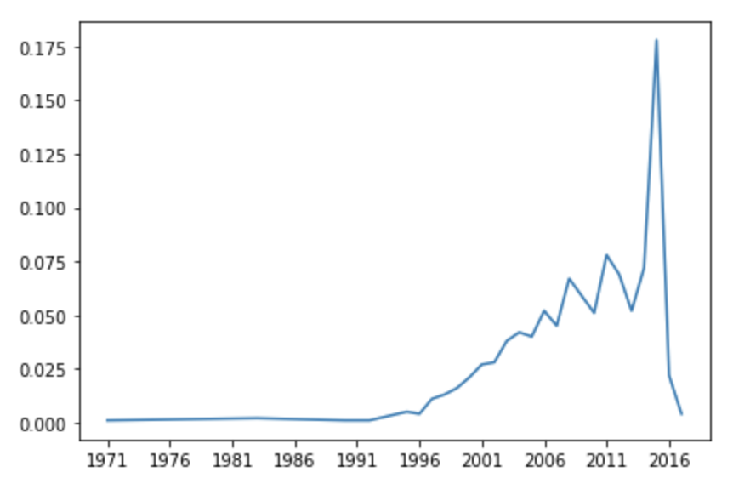
PDF of manufacture year

Slide 17
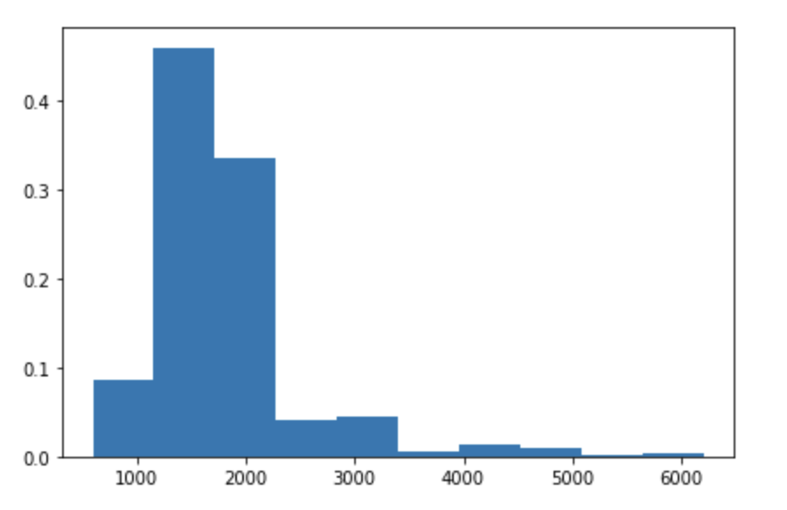
PDF of engine displacement

Slide 18
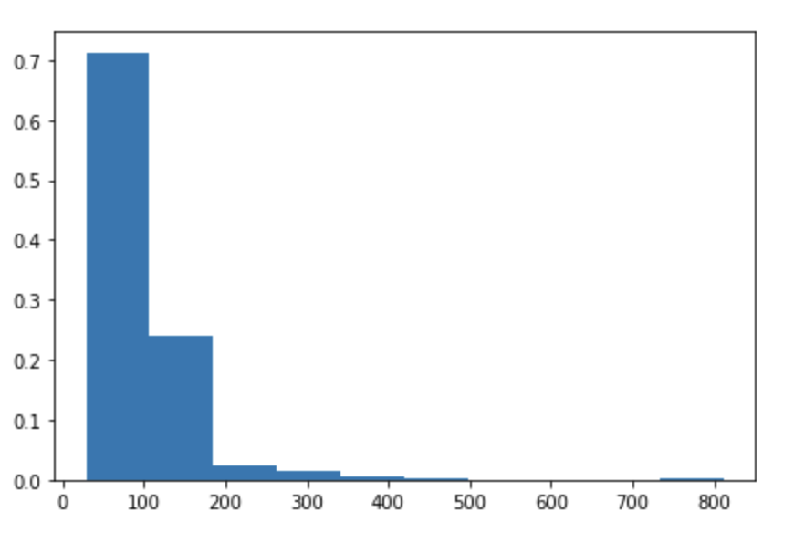
PDF of engine power

Slide 19
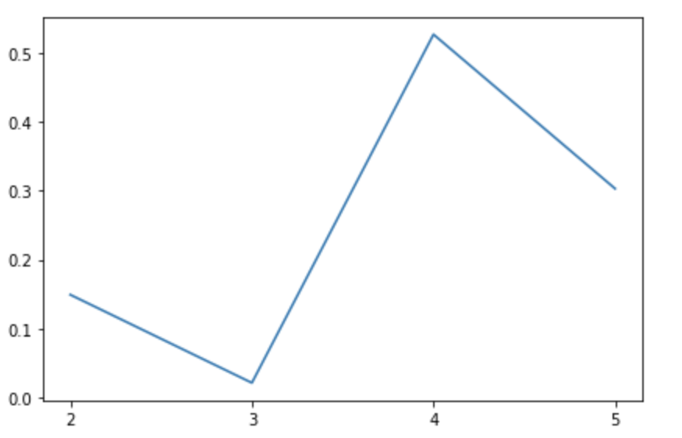
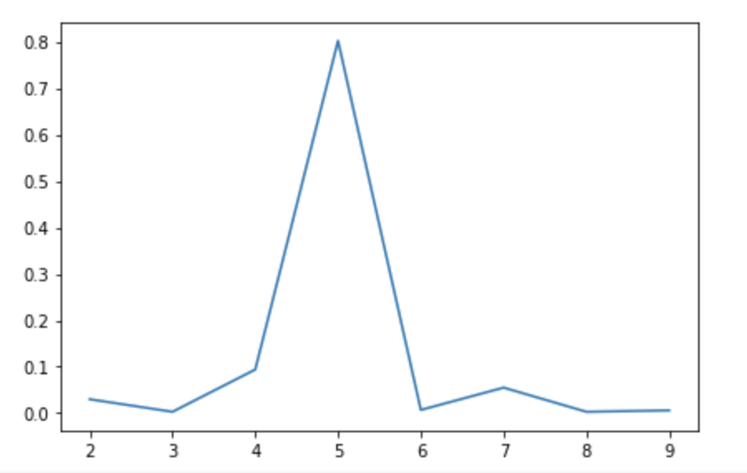
PDF of Door and Seat

Slide 20
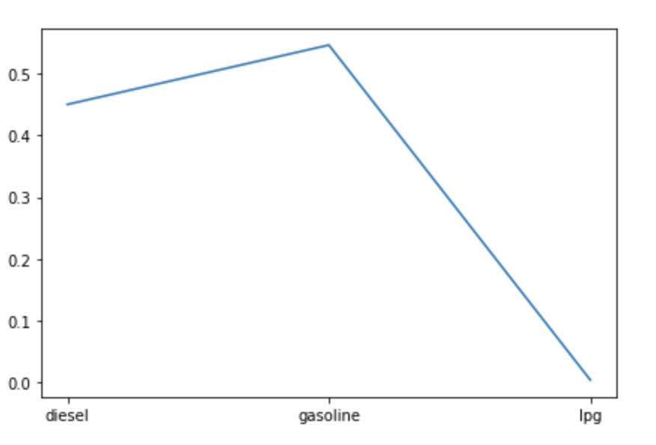
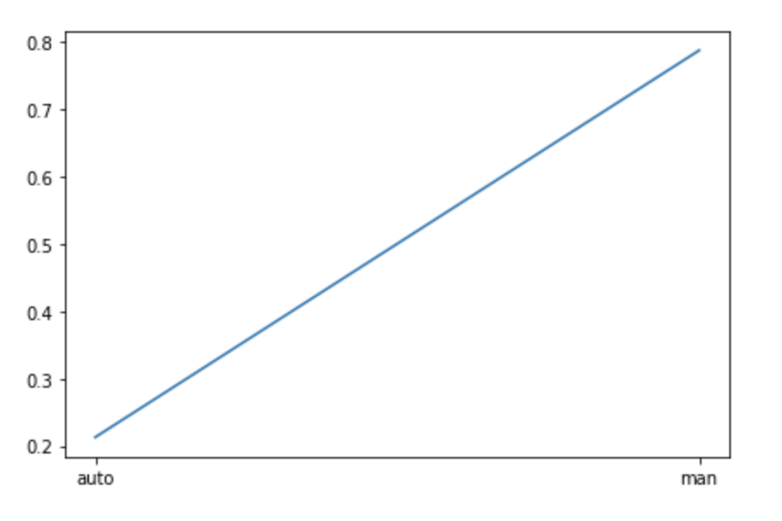
PDF of Fuel and transmisson

Slide 21
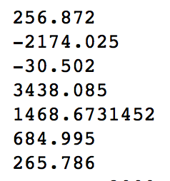
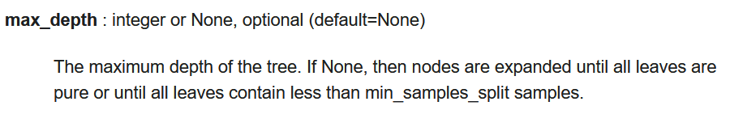
Model 3 Random Forest Regressor

Slide 22
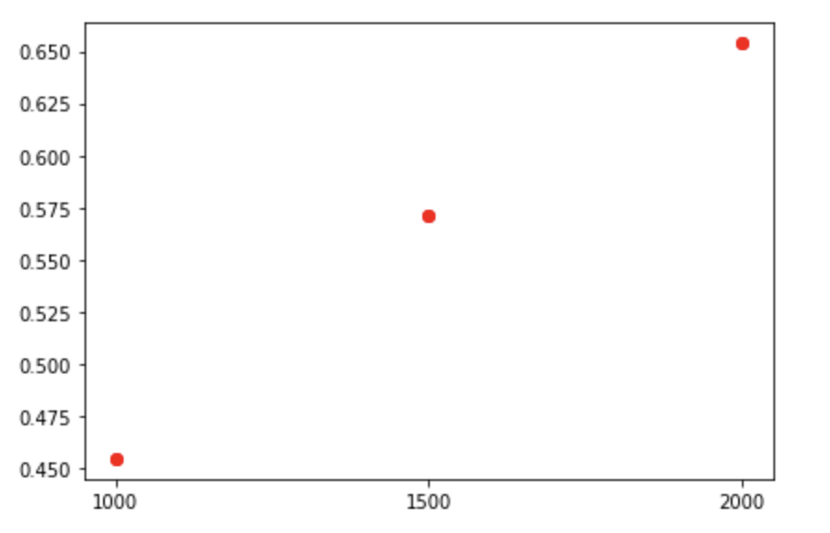
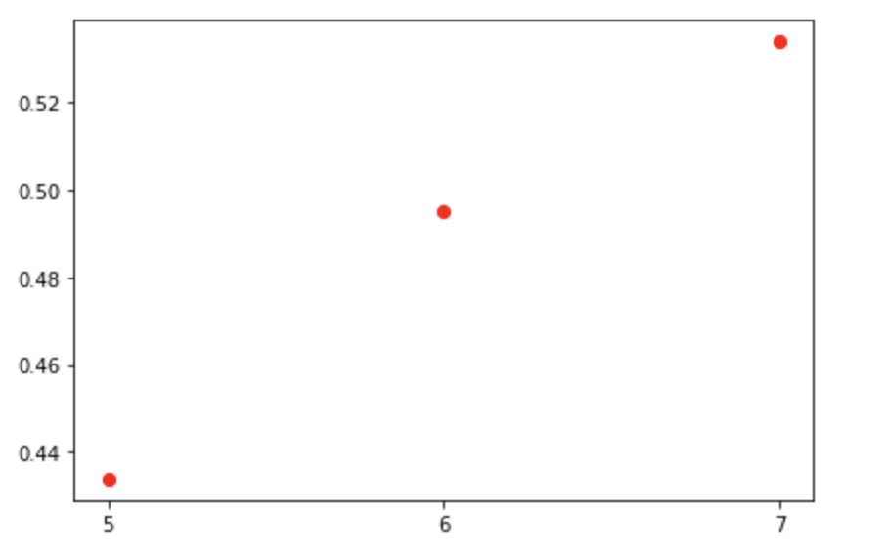
Model 3 Random Forest Regressor
誤差價格內準確率
Max depth 對準確率影響

Slide 23
Model 4 Naïve Bayes Classifier

Slide 24
Regressor vs Classifier?

