Slide 1
Machine Learning Final Project
The price prediction of the used cars in Germany since 2015
(Top3 major brands)
0416324 胡安鳳
0416308 林正偉
0316323 薛世恩

Slide 2
Responsibility assignment
0416324 Finding the appropriate dataset, preprocessing(filter the unnecessary data with pandas)
KNN Regressor analysis, report
0416308 DecisionTreeRegressor analysis, random data generation, cov calculation
0316323 PDF Plotting, Finding dataset and SVM analysis
0416024 Naïve Bayes (if naïve cant do continuous, youi should log and round by yourself 羿豐)

Slide 3
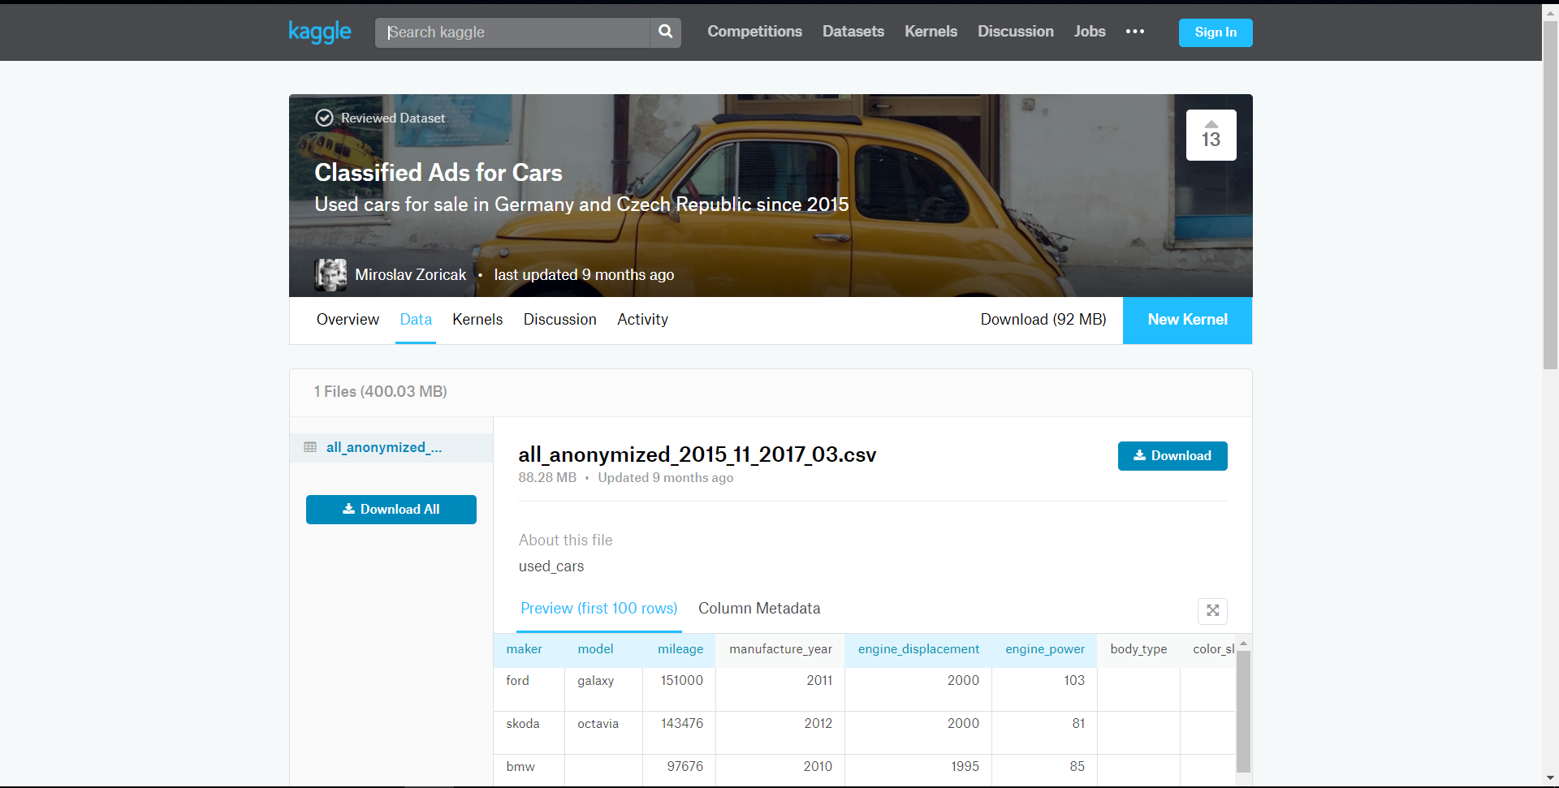
Data Source from Kaggle

Slide 4
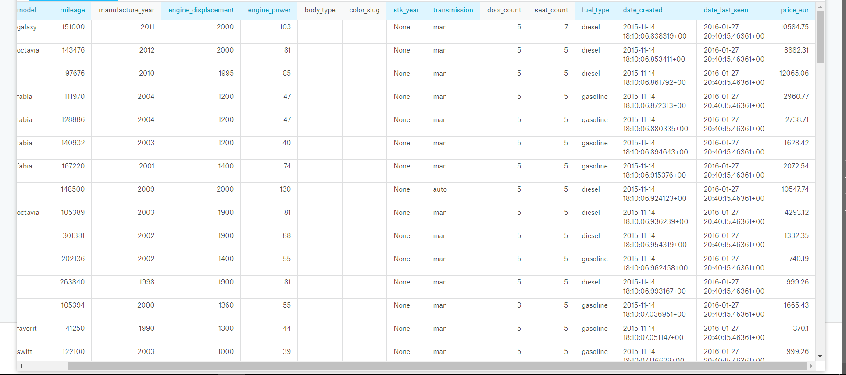
What attributes to filter and left?

Slide 5
As we can see from last page
Body_type and color_slug all contain the empty data
Most (about99%)of the stk_year are None, which is useless in analysis
As prediction only for car price but not for the time-serial data, attributes with time can be eliminated but manufactured_year

Slide 6
Remained attribute explanation
Attributes that may affect the price
Maker: The manufacturer of that car
Model: Model of the car
Mileage: Distance the car has been driven
Engine_displ: swept volume of all the pistons inside the cylinders of a reciprocating engine
Engine_power: HP of such engine
Door and seat count
Fuel_type: diesel or gasoline?

Slide 7
More detailed ,analyze COV
Attribute-covariance analysis credit to 0416308 David Lin

Slide 8
Model1 KNN Regressor

Slide 9
標題及含圖表的內容版面配置

Slide 10
含表格的兩項內容版面配置
第一個項目符號
第二個項目符號
第三個項目符號
類別 | 群組 1 | 群組 2
類別 1 | 82 | 95
類別 2 | 76 | 88
類別 3 | 84 | 90

Slide 11
含 SmartArt 的兩項內容版面配置
第一個項目符號
第二個項目符號
第三個項目符號
工作 1
工作 2
工作 3

Slide 12
新增投影片標題 - 1

Slide 13
新增投影片標題 - 2

Slide 14
新增投影片標題 - 3

Slide 16
新增投影片標題 - 4

Slide 17
新增投影片標題 - 5

