Slide 1
Machine Learning Final Project
The price prediction of the used cars in Germany since 2015
0416324 胡安鳳
0416308 林正偉
0316323 薛世恩
0416024 陳羿豐
Notes:
<number>

Slide 2
Responsibility assignment
胡安鳳 Finding the appropriate dataset, preprocessing(filter the unnecessary data with pandas)
KNN Regressor analysis, report
林正偉 DecisionTreeRegressor analysis, random data generation, cov calculation
薛世恩 PDF Plotting, Finding dataset and SVM analysis
陳羿豐 Naïve Bayes
Notes:
<number>

Slide 3
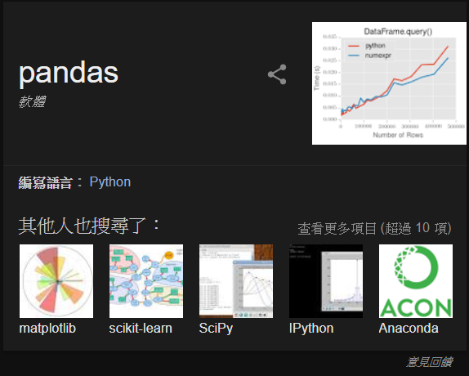
Implementation tools
Pandas for data processing
Sklearn for ML models
Matplotlib for graphing
Python with Anaconda
Jupyter Notebook for writing the real-time code checking

Slide 4
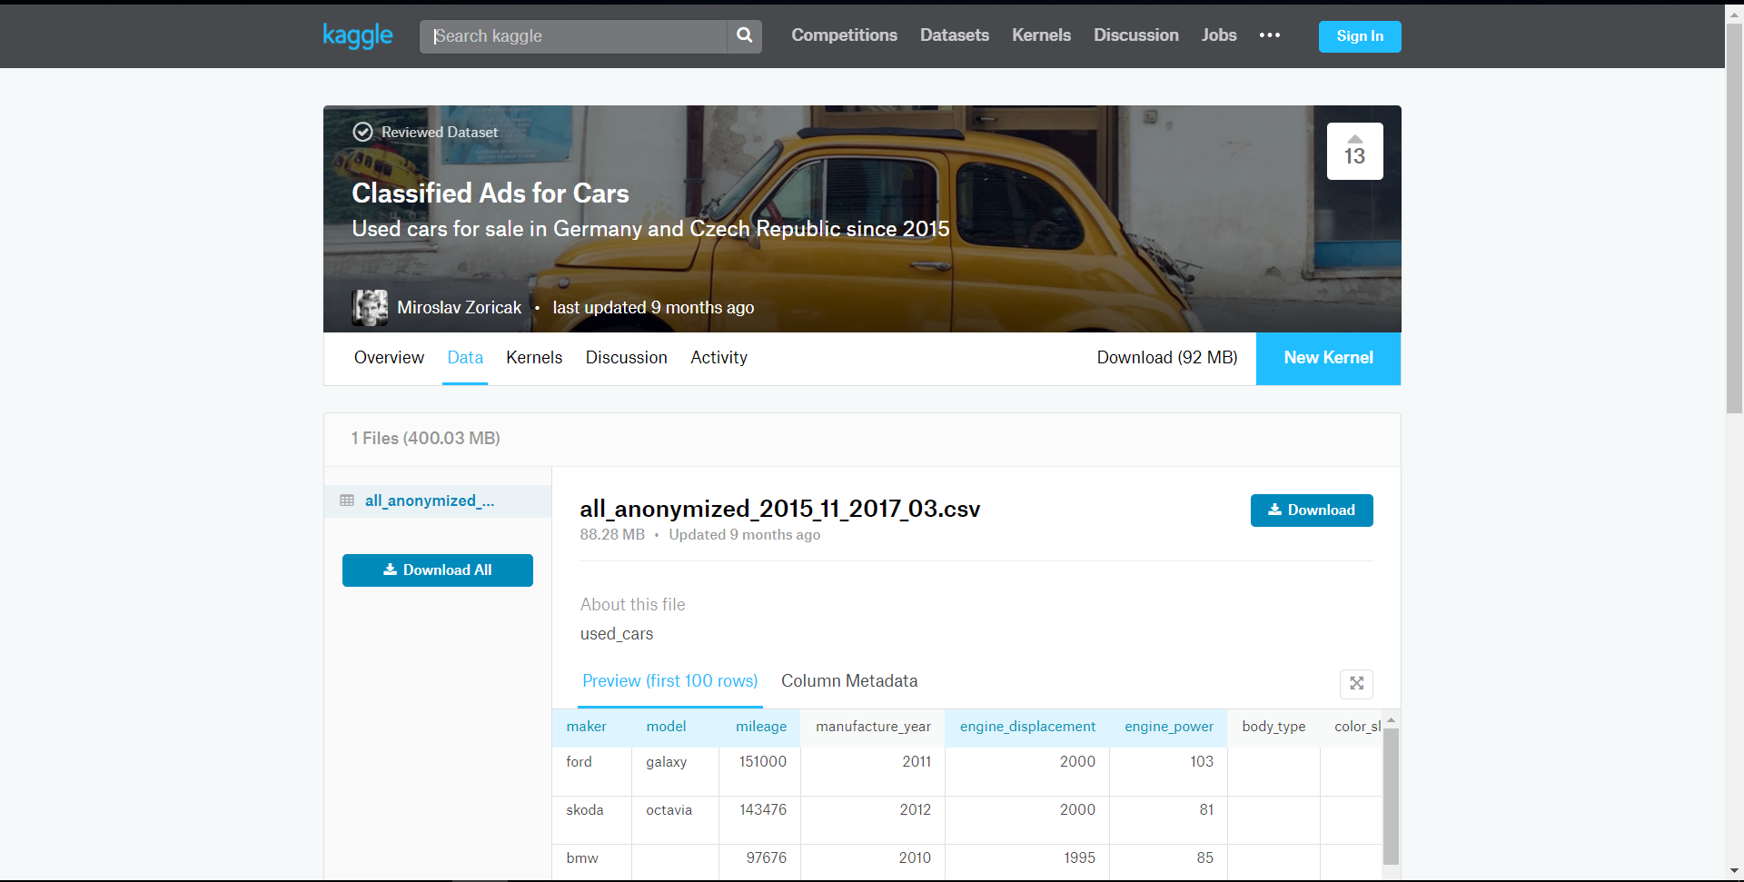
Data Source from Kaggle

Slide 5
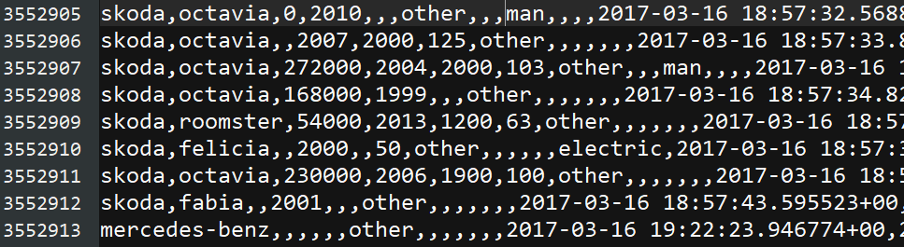

SO MUCH DATA!!!
Data matrix being row=3552912 col=16

Slide 6
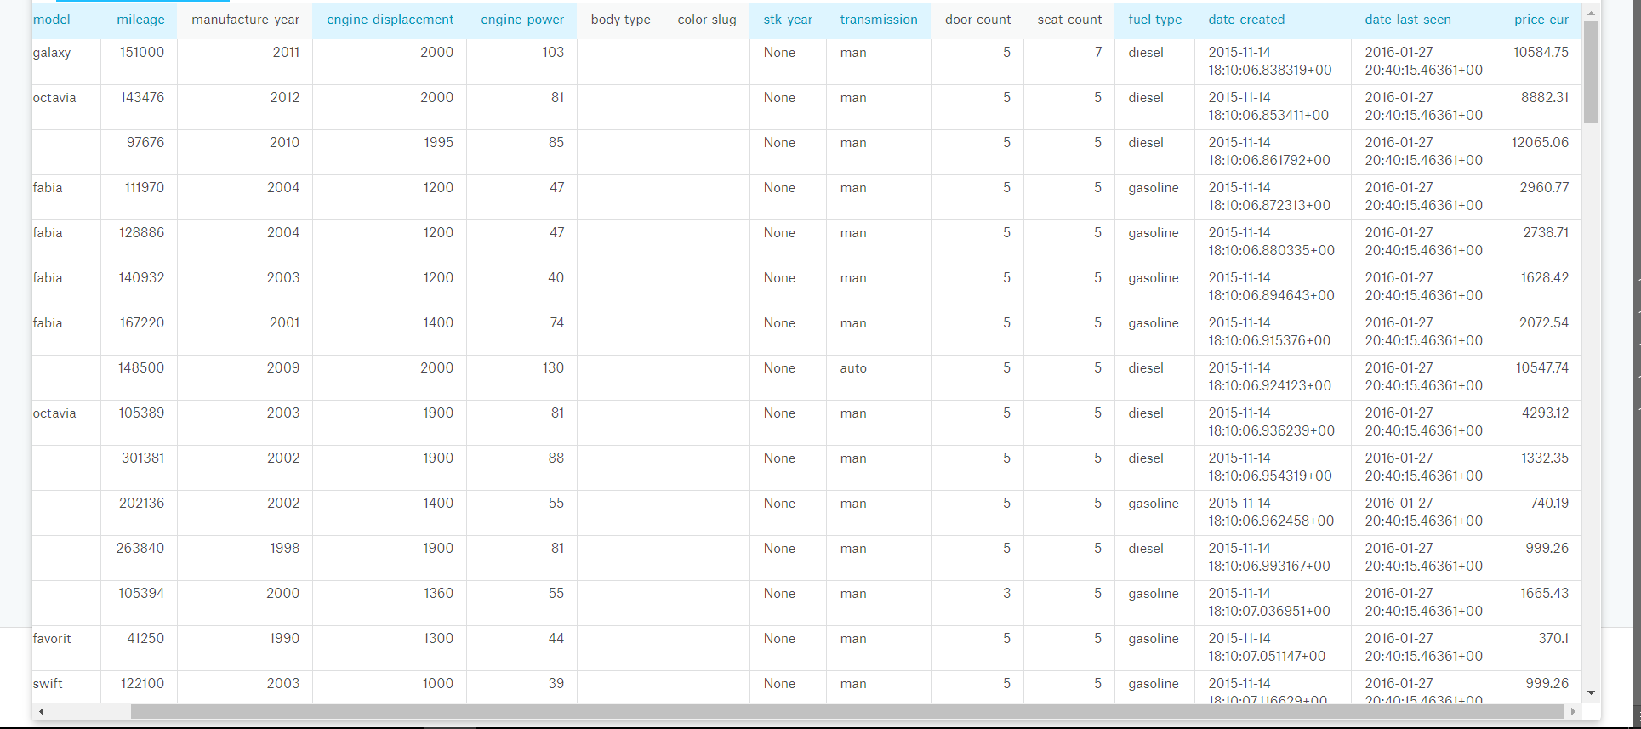
What attributes to filter and left?

Slide 7
As we can see from last page
Body_type and color_slug all contain the empty data
Most (about99%)of the stk_year are None, which is useless in analysis
As prediction only for car price but not for the time-serial data, attributes with time can be eliminated but manufactured_year

Slide 8
Remained attribute explanation
Attributes that may affect the price
Maker/manf’d year: The manufacturer of that car and such year being manufactured
Model: Model of the car
Mileage: Distance the car has been driven
Engine_displ: swept volume of all the pistons inside the cylinders of a reciprocating engine
Engine_power: HP of such engine
Door and seat count
Fuel_type: diesel or gasoline?
Transmission : man or auto

Slide 9
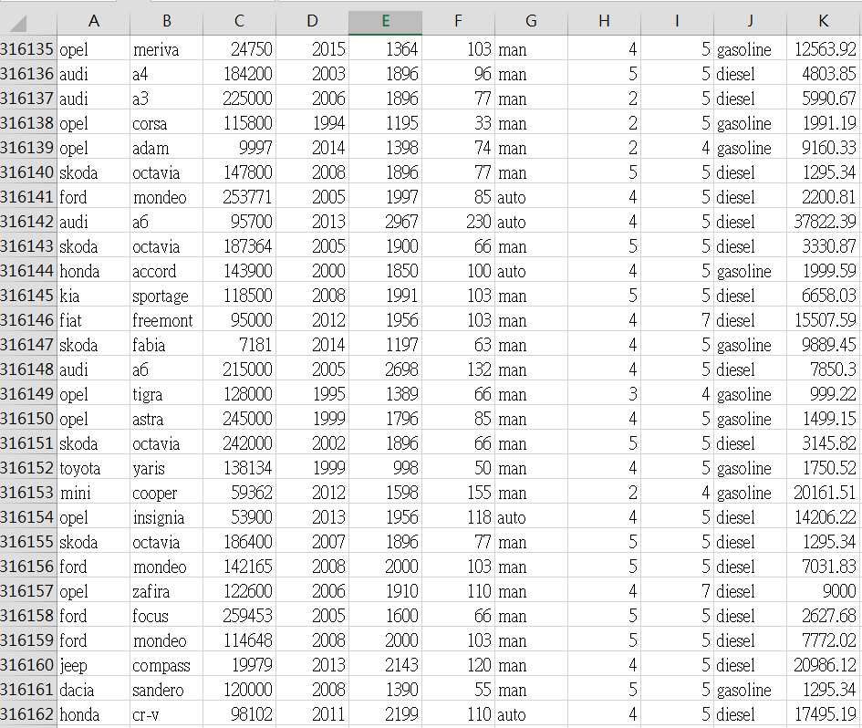
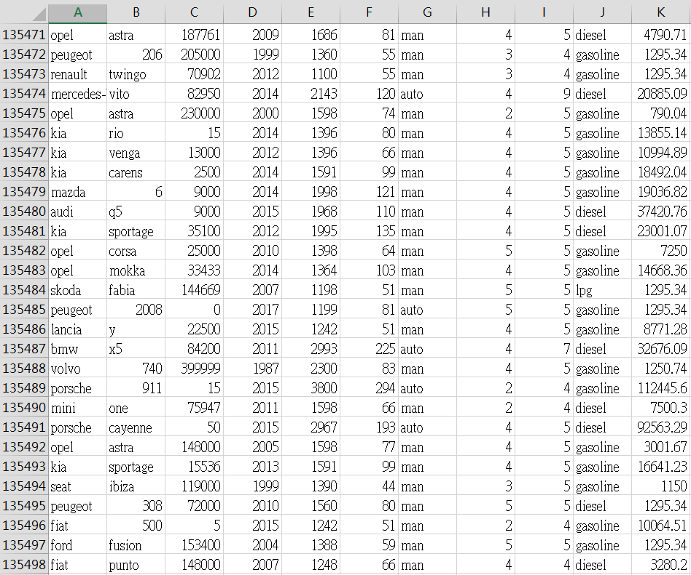
After data preprocessing
Amount of train = 316162 ,amount of test = 135498 (7:3) col=10

Slide 10
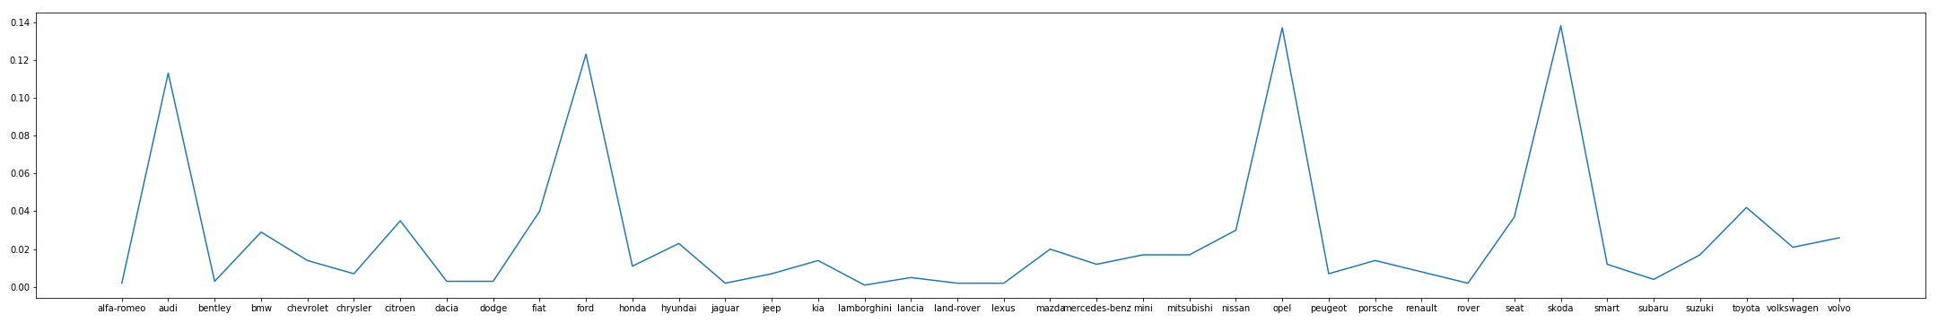
PDF of maker

Slide 11
PDF of maker

Slide 12
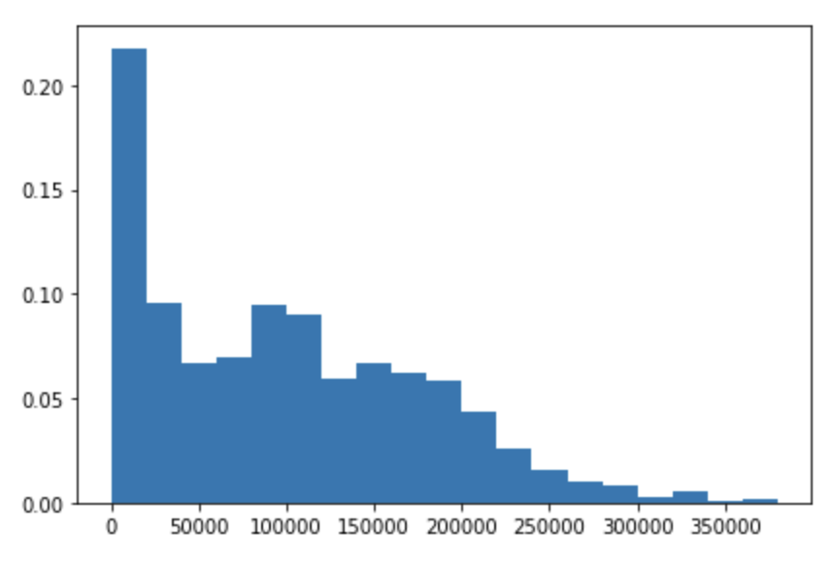
PDF of mileage

Slide 13
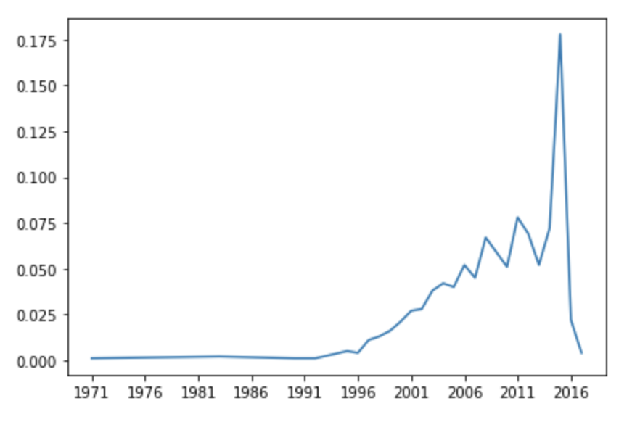
PDF of manufacture year

Slide 14
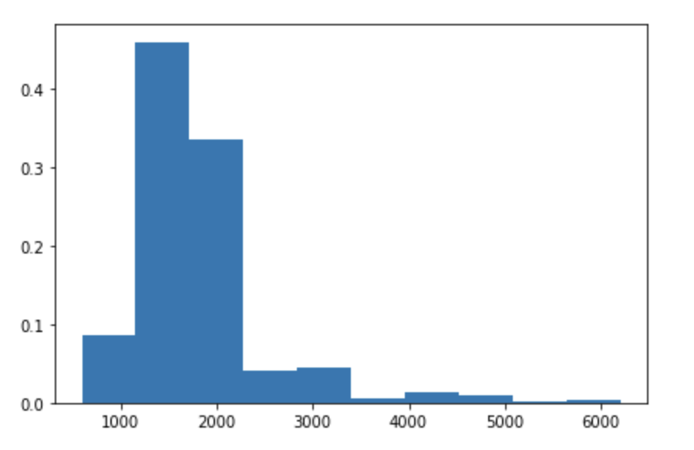
PDF of engine displacement

Slide 15
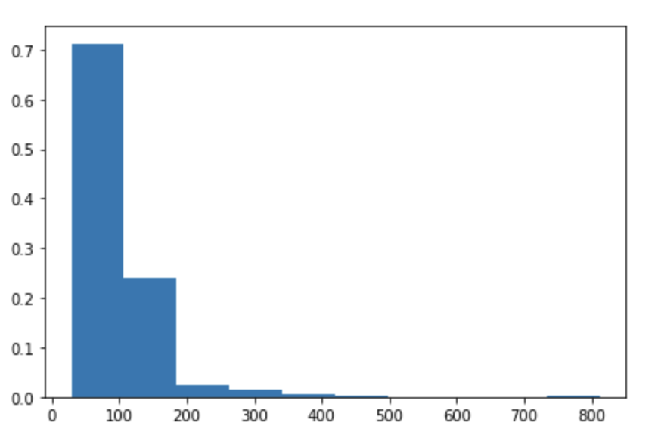
PDF of engine power

Slide 16
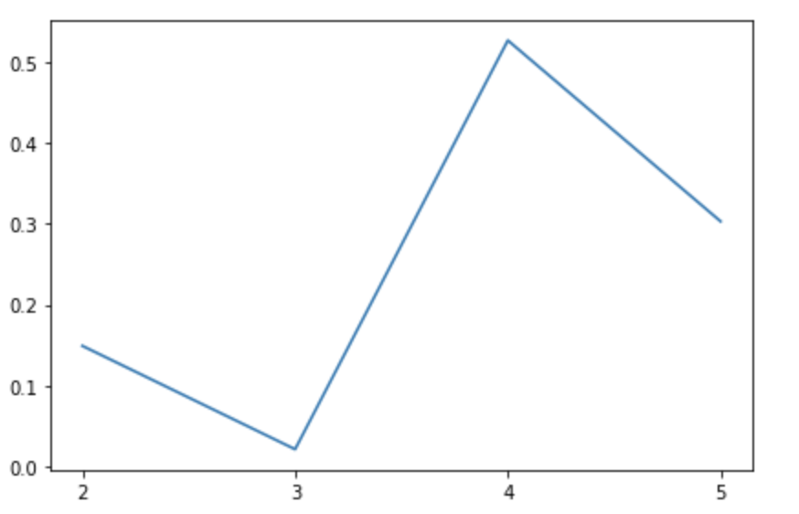
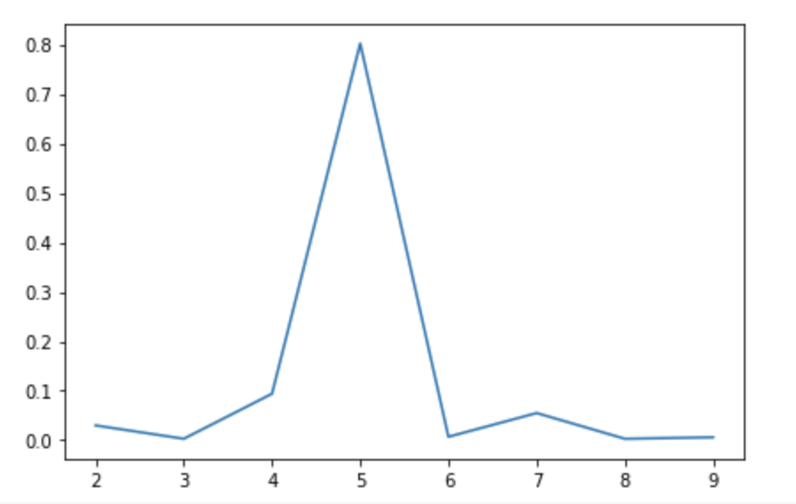
PDF of Door and Seat

Slide 17
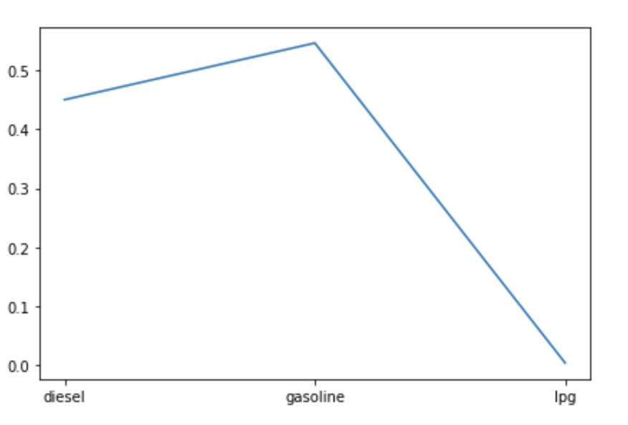
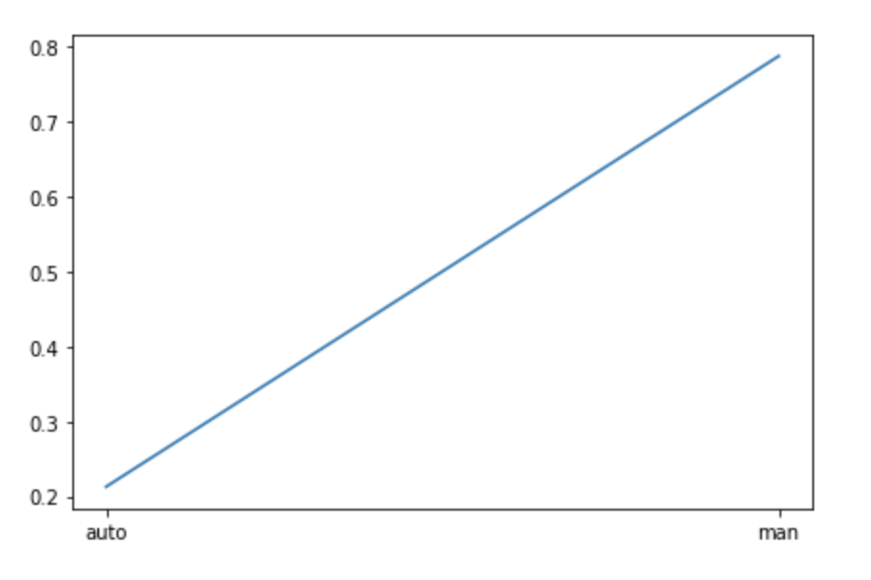
PDF of Fuel and transmisson

Slide 18
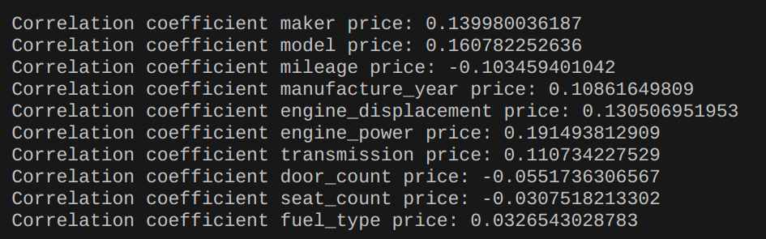
More detailed ,analyze COV to see what does we REALLY NEED
Attribute-covariance analysis credit to 0416308 David Lin

Slide 19
Regressor vs Classifier?
Continuous output – Regressor
Discrete output - Classifier

Slide 20
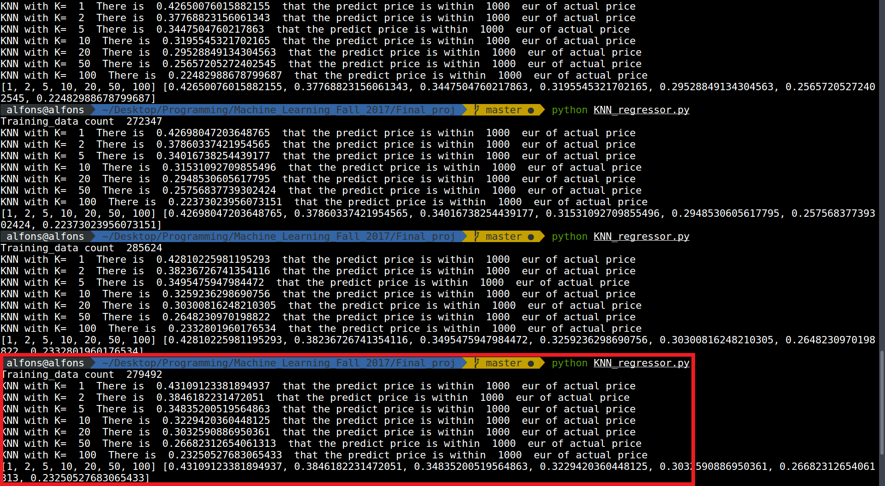
Model1 KNN Regressor by 胡安鳳

Slide 21
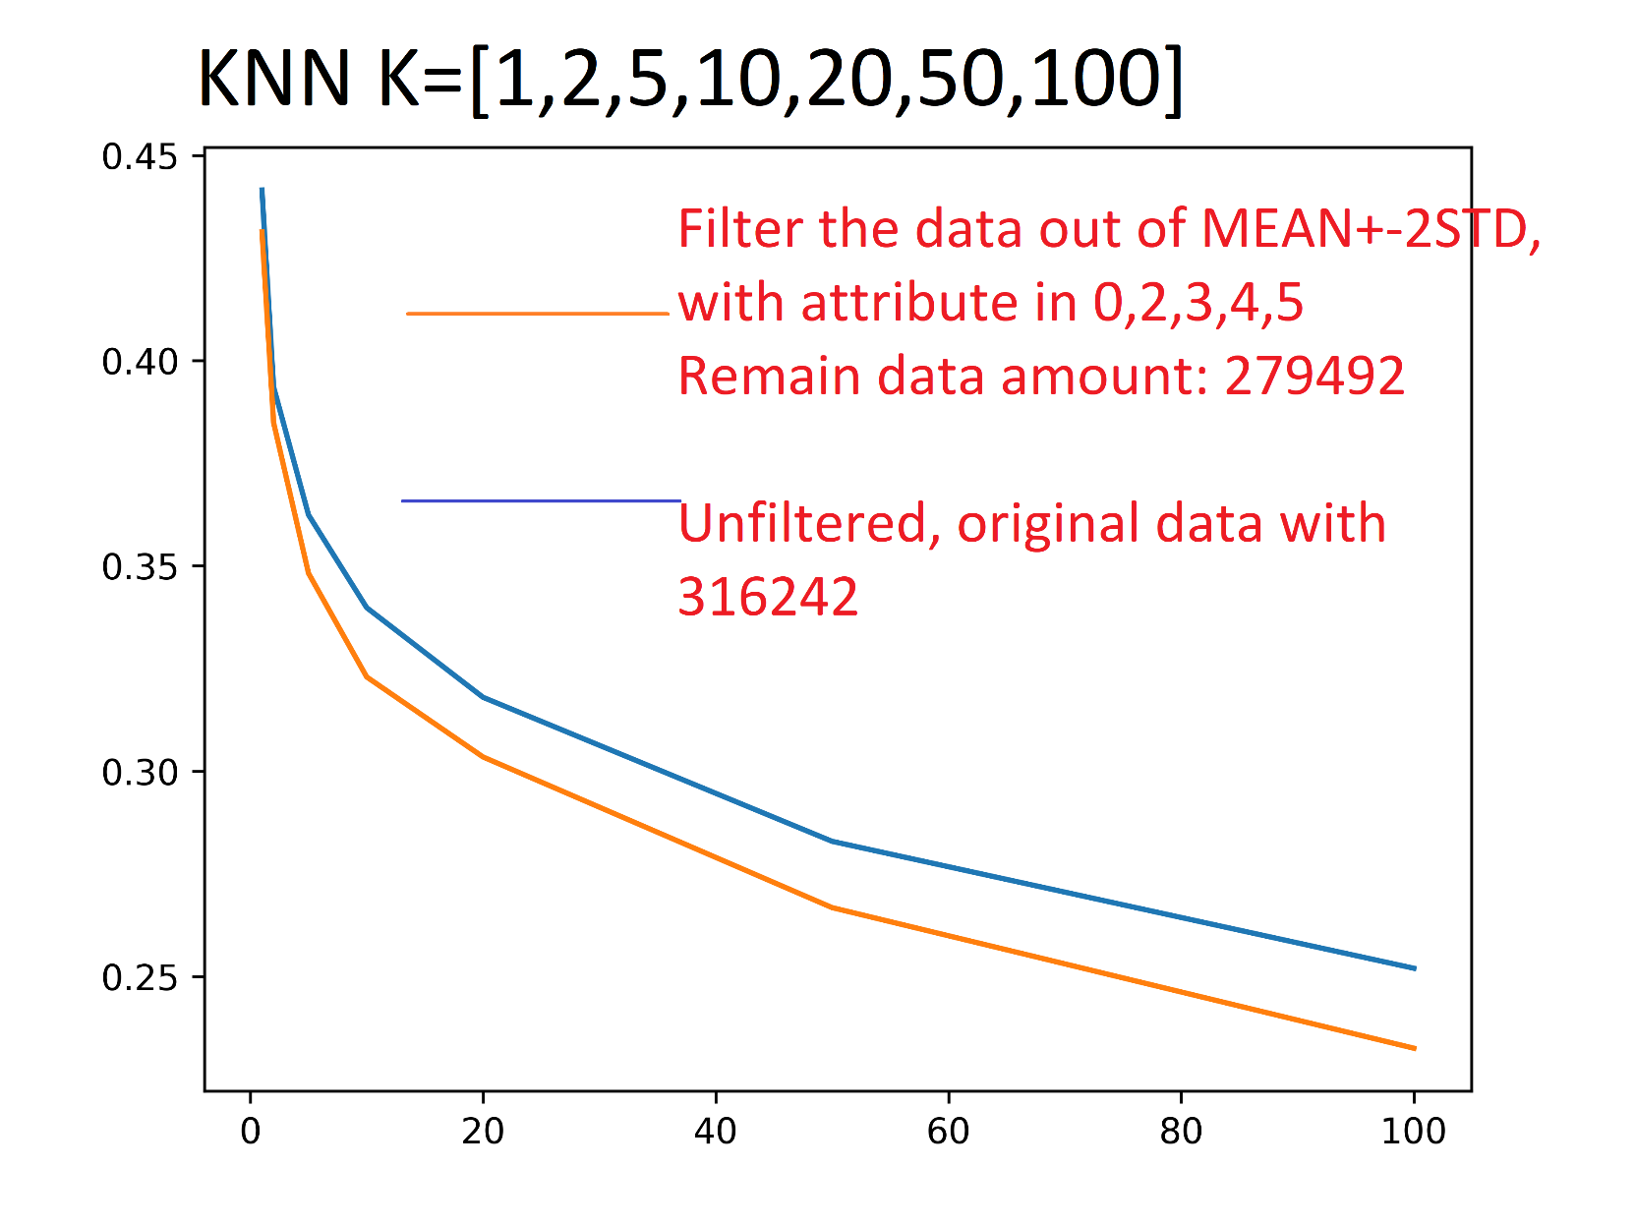
Model1 KNN Regressor by 胡安鳳
The contribution of one training sample-accuracy from
0.441/316242 = 1.39e-6
To
0.431/279492 = 1.542e-6
Enhance the accuracy of unit training sample.

Slide 22
Model 2 DT Regressor by 林正偉

Slide 23
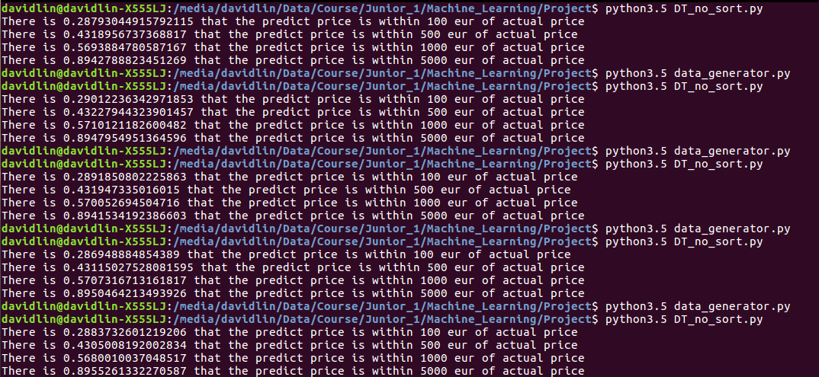

Slide 24
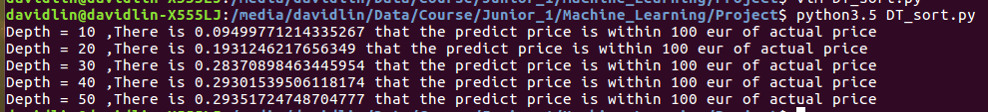
Max Depth

Slide 25
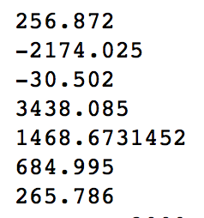
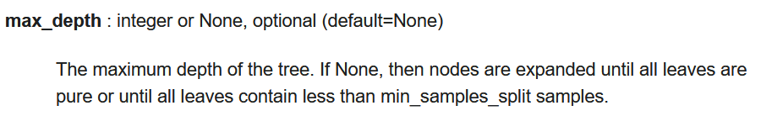
Model 3 Random Forest Regressor by薛世恩

Slide 26
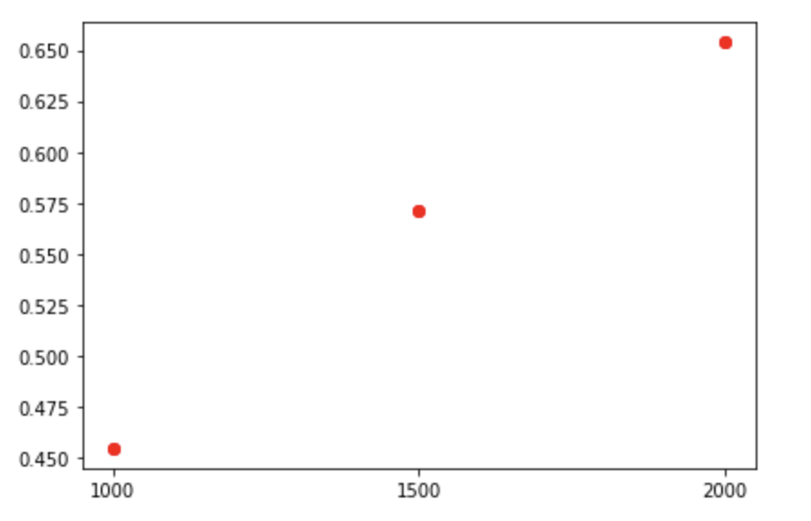
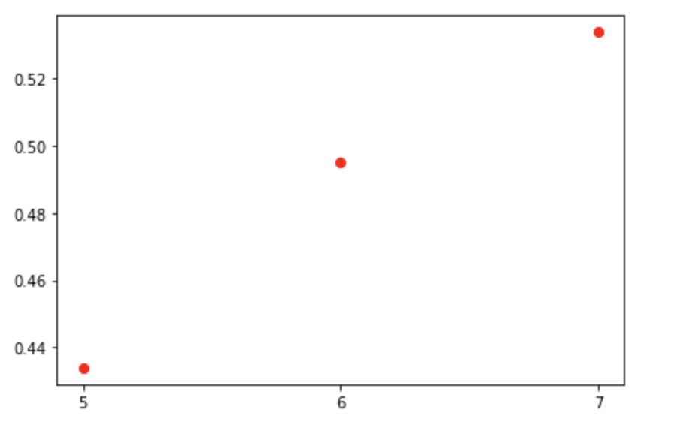
Model 3 Random Forest Regressor
誤差價格內準確率
Max depth 對準確率影響

Slide 27
Model 4 Naïve Bayes Classifier by 陳羿豐
因為 Naive Bayes 不能產生連續型輸出(不能作為 regressor)，所以我就把價格按照位數做分類。
我發現價格最便宜的還不到 1 歐元，最貴的超過一百萬歐元。所以我就分類成：不到1、1～10、10～100、……、十萬～一百萬、超過一百萬，共 8 類
因為上一份作業，我用 scikit-learn 套件做 Naive Bayes ，結果非常的糟。我覺得我被套件雷了……
於是我下定決心，要寫一個自己的 Naive Bayes，而且要用最強大的―― Java！

Slide 28
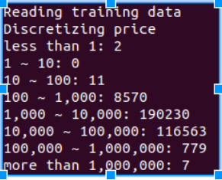
Functionalities
我的程式可處理連續型和離散型特徵。使用到的特徵：
離散型：製造商、車的型號、門的數量、座椅數量、燃料種類、變速器種類（自排/手排）
連續型：里程數、製造年份、引擎 cc 數、引擎馬力
我假設連續型特徵符合常態分佈
做出來的準確度是 0.826913，不過不怎麼有用
因為大部分的車子都是 1,000 ~ 100,000 歐元，即使全部猜 1,000 ~ 10,000 歐元，準確率也有 60%

Slide 29
Thank you for listening
Source code can be found at:
https://github.com/Alfons0329/Machine_Learning_Fall_2017/tree/master/Final_proj
README.md will be added later in winter vacation.
Great thanks to all the teammate who contribute passionately to this final project.

