Slide 1
DArk Matter Particle Explorer
Alfonso Cavallo

Slide 2
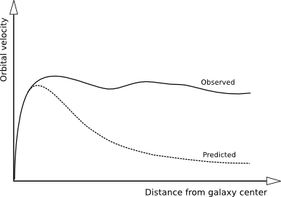
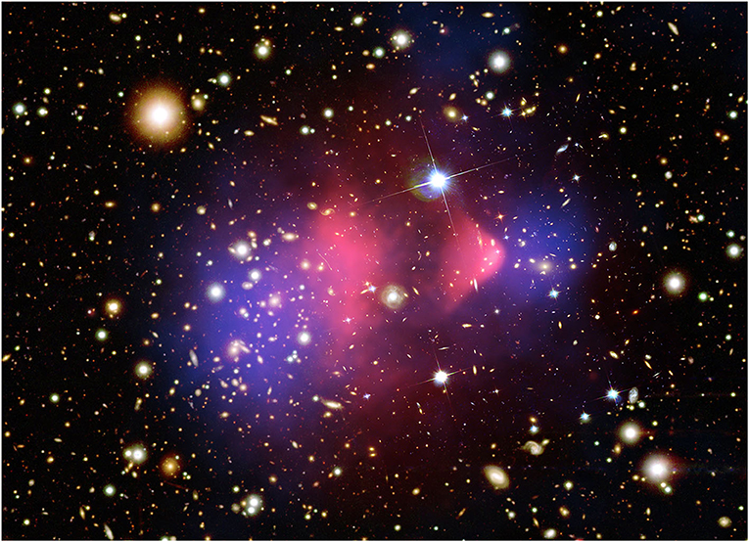
Dark Matter
Galaxy Arms Speed
Unexpected errors in the estimate of galaxies’ arm speed can only be explained by DM
Universe Structure
Cosmological Structures’ theory hold only if DM is taken into account
visible mass
Gravitational Lensing
DM mass
Only DM can explain the Bullet Cluster’s gravitational lensins

Slide 3




Ways of Detecting Dark Matter
Direct Detection
Dark Matter directly interacts with the detector and the produced energy can be measured
$$SM$$
$$SM$$
Indirect Detection
Production
Dark Matter interactions produce energy. Products from void areas can be a hint of Dark Matter existence.
Interactions in particle colliders generate DM
$$χ$$
$$χ$$

Slide 4

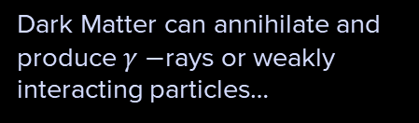

The Messengers’ Connection
Dark Matter can annihilate and produce $γ−$rays or weakly interacting particles…
$$γ, ν$$
$e^{+},\overline{p}$,…
… or generate charged particles which may travel long paths and be deflected by interactions with matter

Slide 5
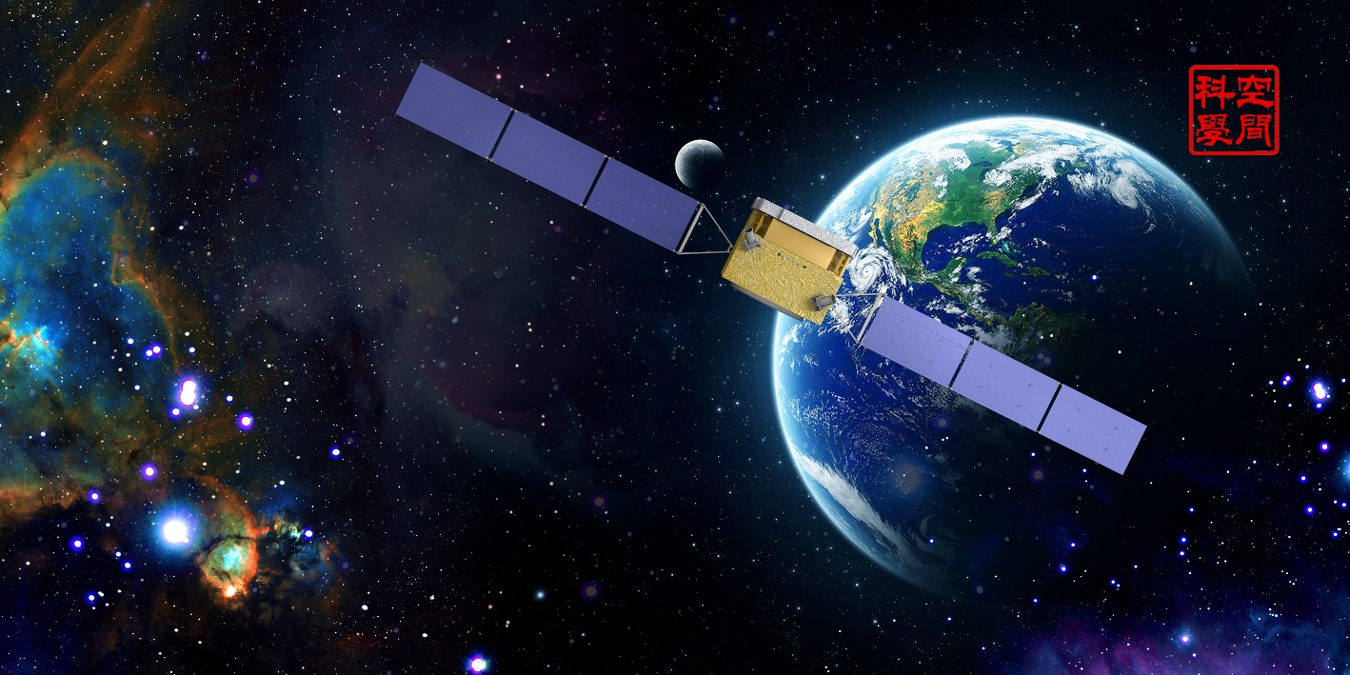



DAMPE
Dark Matter Particle Explorer

Slide 6
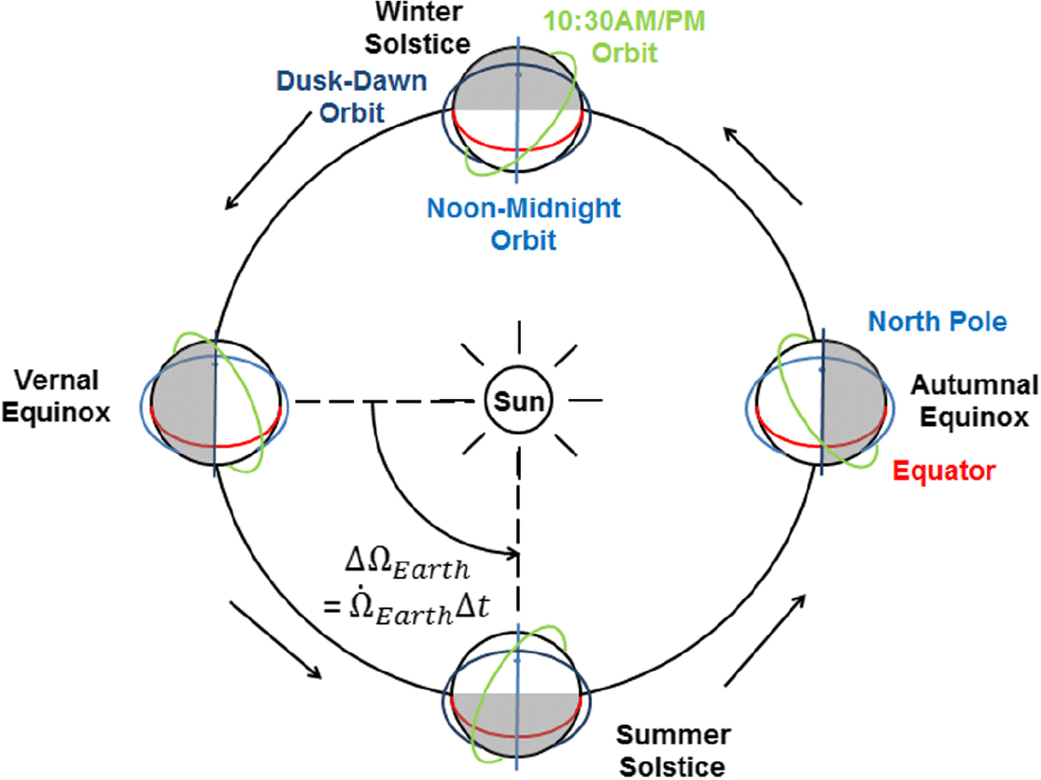
Sun-Synchronous Orbit

Slide 7
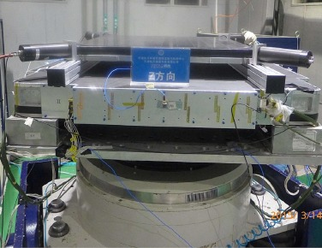
Plastic Scintillator Detector (PSD)
8mm
PMT
10mm
884mm
28mm
Position Resolution: 6mm
Charge Resolution: 0.25 for Z=1
https://arxiv.org/abs/1703.00098

Slide 8
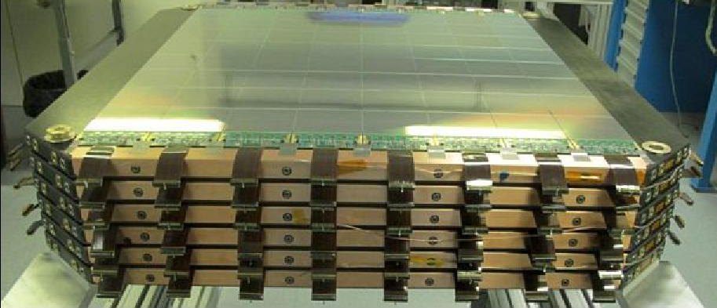
Silicon-Tungsten Tracker (STK)
121µm
121µm
320µm
~7 m²
Tungsten
γ-ray conversion
9.5cm
9.5cm
9.5cm
9.5cm
X
Position Resolution: 80µm
Angular Resolution: 0.2° for E=10GeV
Y

Slide 9
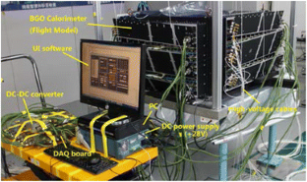
Bismuth-Germanium Oxide calorimeter (BGO)
Each layer is a plane of 22 BGO bars with a section of 2.5cm x 2.5cm and a 60 cm long.
Each bar is read by PMT.
14 alternated layers (divided in X and Y direction).
Electromagnetic Energy Resolution: ~1.5% above 100GeV
Hadronic Energy Resolution: ~40% above 800 GeV

Slide 10
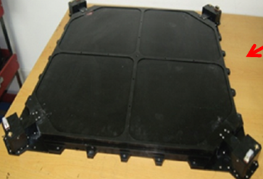
Neutral Detector (NUD)
Boron-loaded plastic
The NUD is designed to detect delayed neutrons which normally arrive 2µs after the shower collides with the BGO
PMT
Improved Electromagnetic and Hadronic showers separation

Slide 11
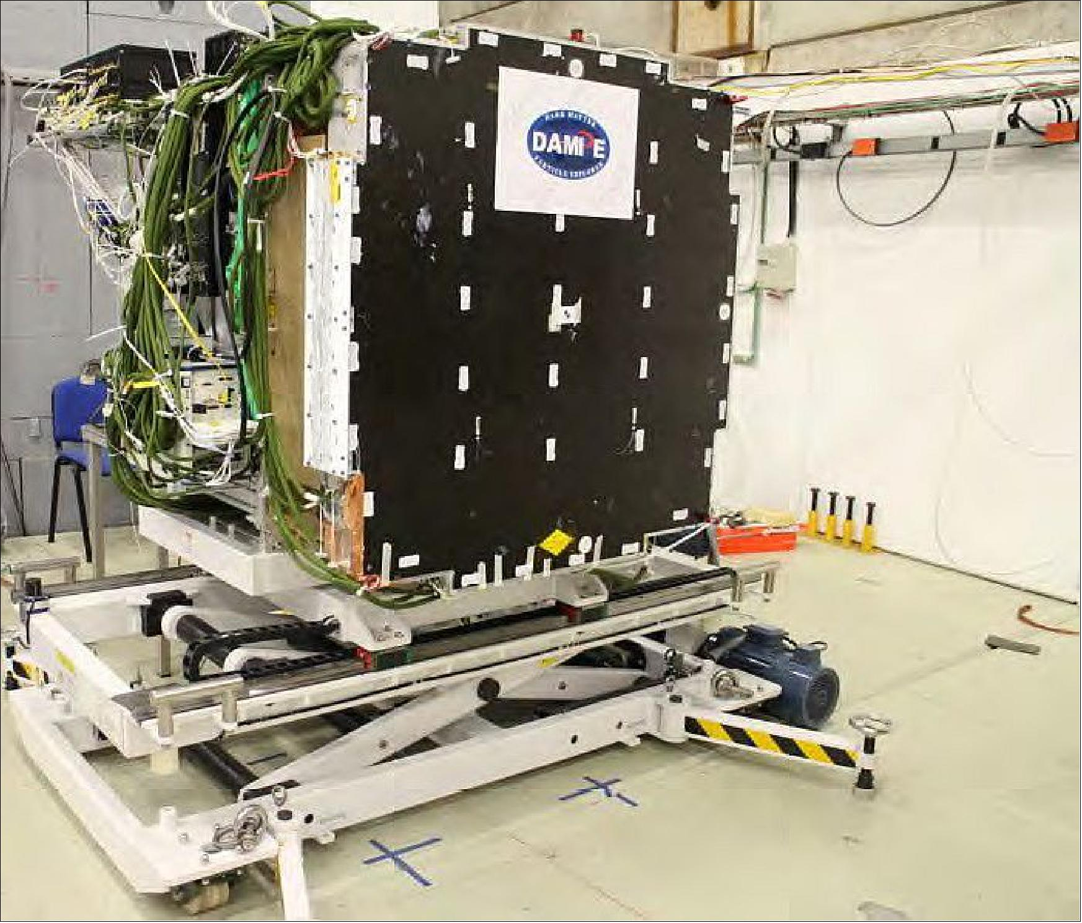
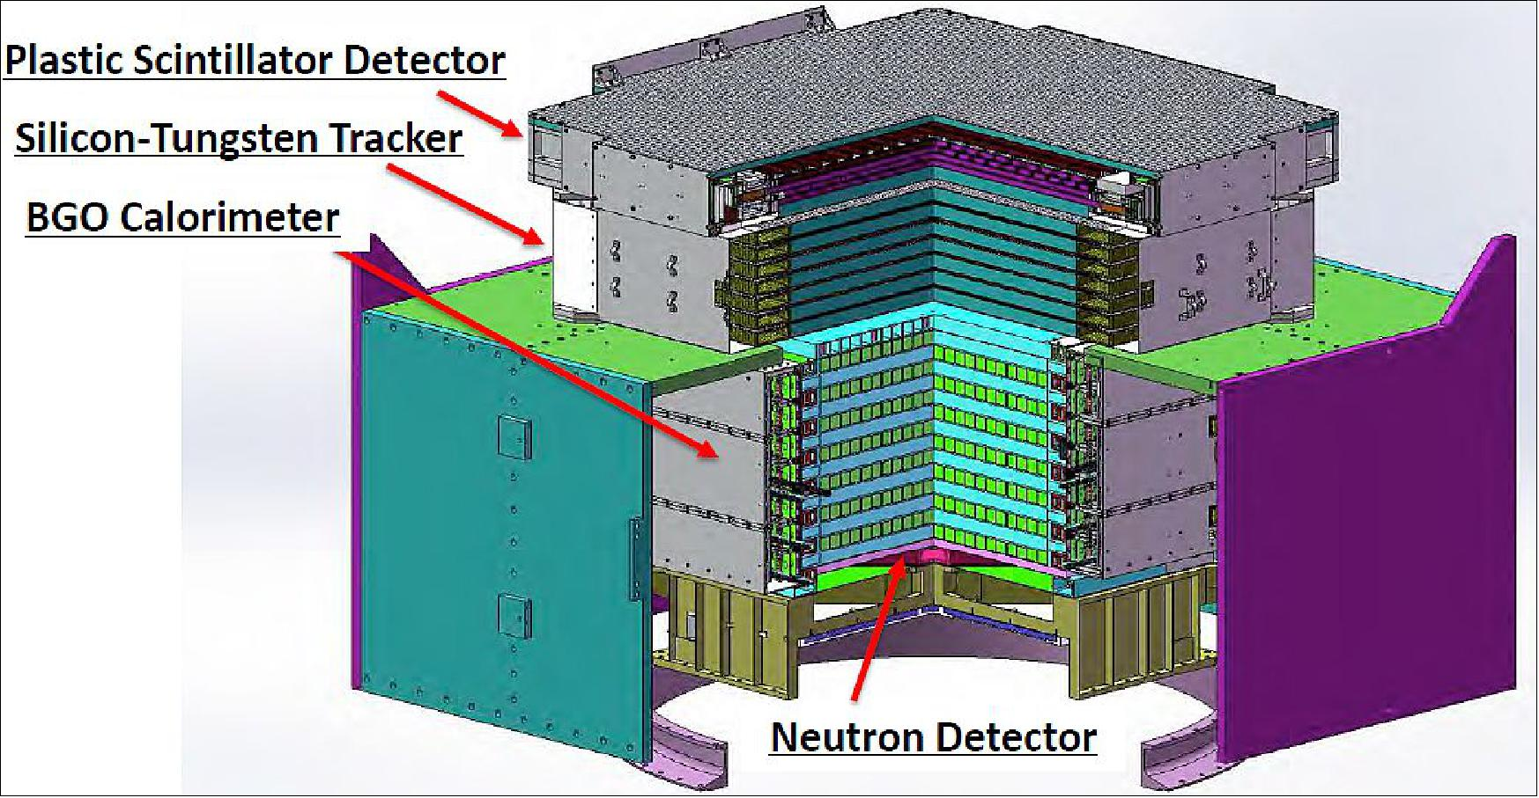
Fully-Assembled System
Mass: 1900Kg (Payload 1,480 kg)
Power: 850W
Downlink Data rate: 12 GB/day
Expected lifespan: 3 years

Slide 12
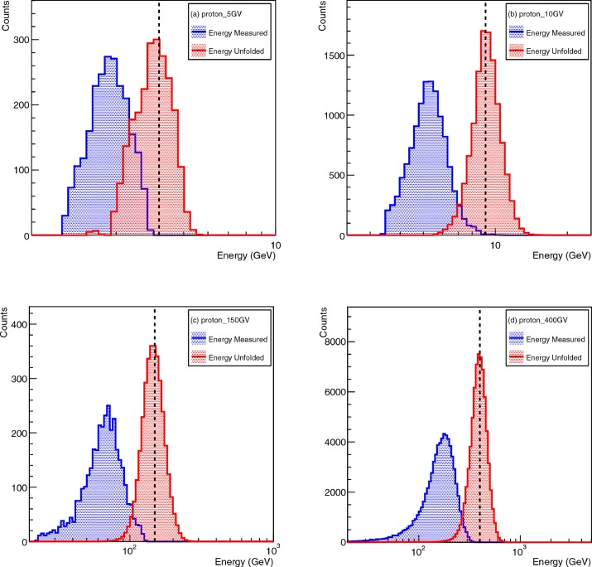
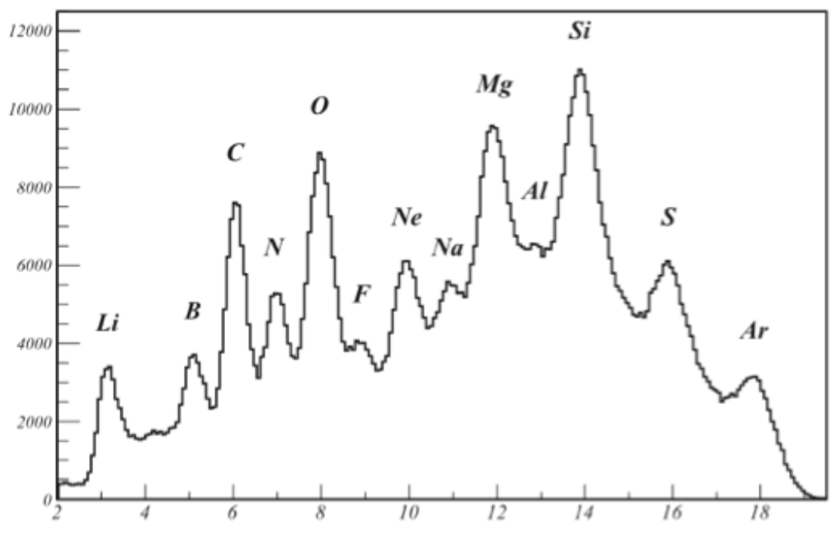
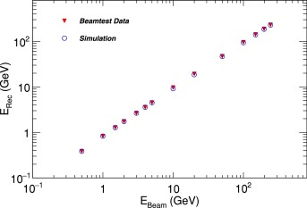
Ground Calibration Tests
Argon Beam fragments’ charge measurement test (PSD)
Electron’s Energy reconstruction test
Proton’s Energy reconstruction test from BGO heat (5, 10, 150, 400 GeV/c)

Slide 13
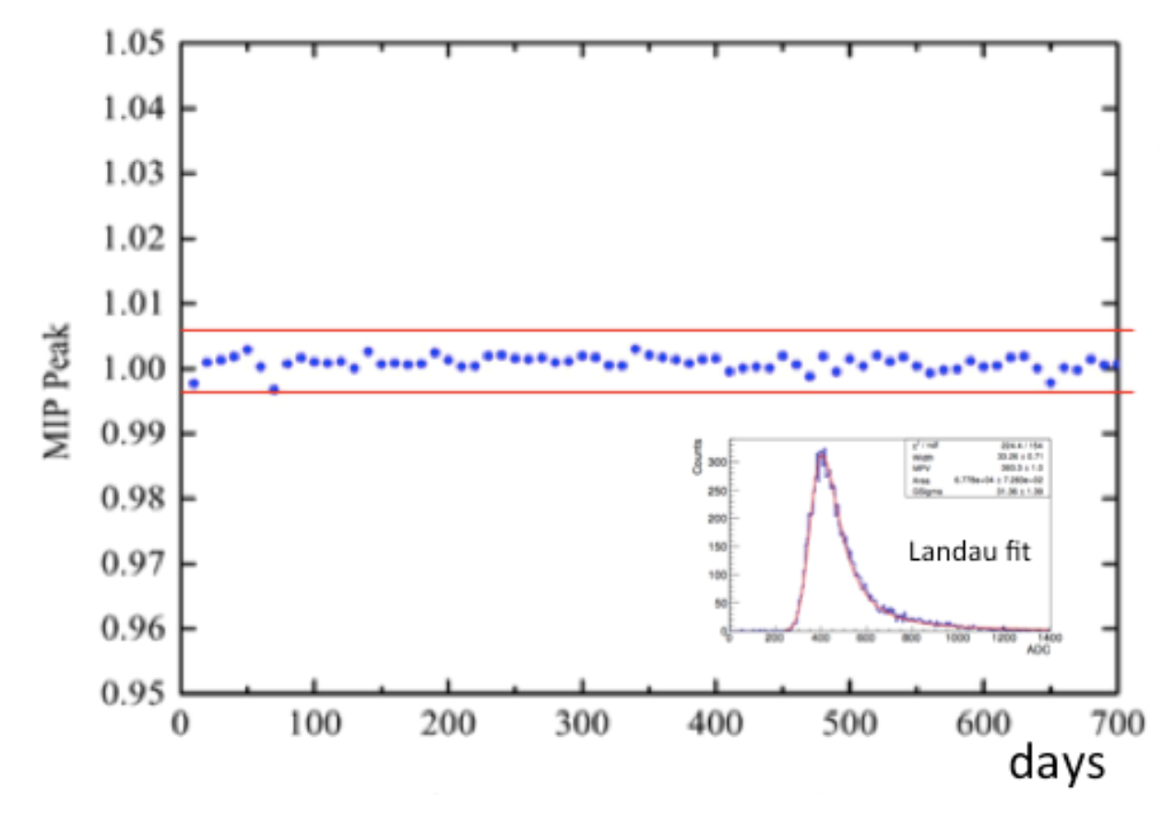
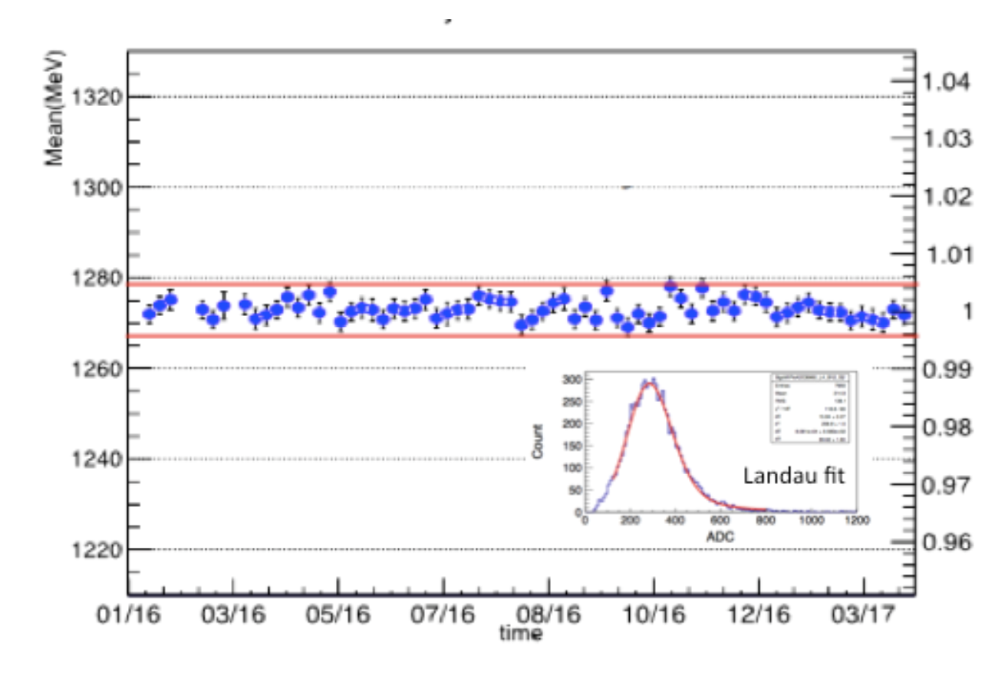
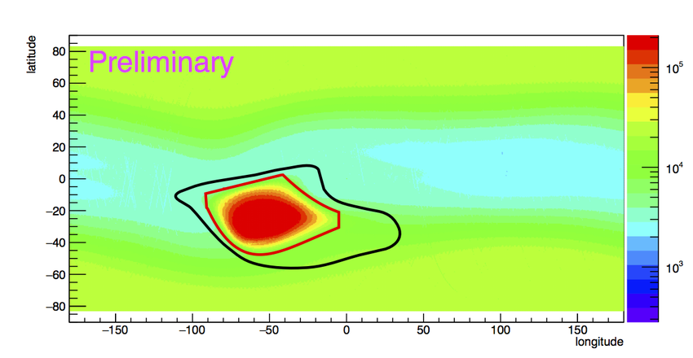
In-Flight Performance Test
South Atlantic Anomaly
PSD deposited energy for proton
BGO deposited energy for Helium
Trigger Detection w.r.t lat/lon

Slide 14
GCR Measurement (Time Filtering)
The total time considered is $1.08×10^{8}s$ (roughly 1157 days of acquisition) an it is
Approximately 76.2% of the total operative time
Dead Time | On-Orbit Calibration | Solar Flare | South Atlantic Anomaly
Time required for processing | Time required for calibration | Exceptional Event (09/09/2017-13/09/2017) | Time spent passing over the SSA
~17.2% | ~1.7% | ~0% | ~4.9%

Slide 15






GCR Measurement (Pre-Selection)
$E$ of the layers 1 and 2 shall be greater than the $E$ in the layer 3 and 4.
Filters out all GCRs not coming from the direciton of observation
$$E > 13 E_{MIP}(p)≈23MeV/layer$$
$E >2.4 E_{MIP}$ $(p)$
$$E>20GeV$$
Minimum Energy for a resolution in $[28\%, 34\%]$ in the band $[1TeV, 50TeV]$
Fixes geomagnetic
cut-off
$$E<0.35\sum_{layer=1}^{13}{E_{layer}}$$
Effectively removal of particles coming from the side
BGO

Slide 16


GCR Measurement (STK Selection)
PSD
$$Error\left(Proj_{BGO}, Proj_{STK}\right)<90mm$$
For all the layers of the PSD
BGO Projected Track
STK Projected Track
STK
BGO
$$Error\left(Proj_{STK}, Centroid_{BGO}\right)<25mm$$
For the first 4 layers of the BGO
1
2
3
4
Filtering out the tracks with less than 3 hits
Selection of the fittest track
Verification of coherence with the BGO track
Verification that the track is fully contained in the PSD, STK, BGO

Slide 17
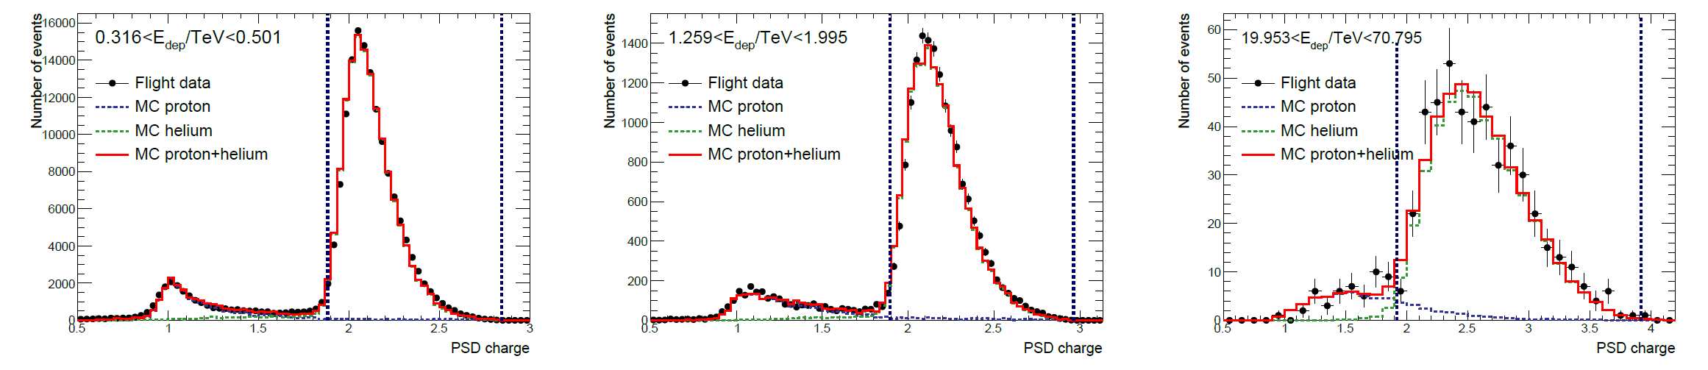

GCR Measurement (Helium Filtering)
The isolation of Helium charges is carryed out by selecting only charges at the first STK hit that are measured to be at least higher than 2.5 the proton MIP-equivalente signal.
A further selection in both the PSD layers (X and Y) was performed to take into account energy-dependency at different particle energy ranges:
$1.85+0.02⋅\log{\frac{E_{dep}}{10 GeV}}<Z_{X\left(Y\right)}<$ $2.8+0.007⋅{\left(\log{\frac{E_{dep}}{10 GeV}}\right)}^{4}$

Slide 18
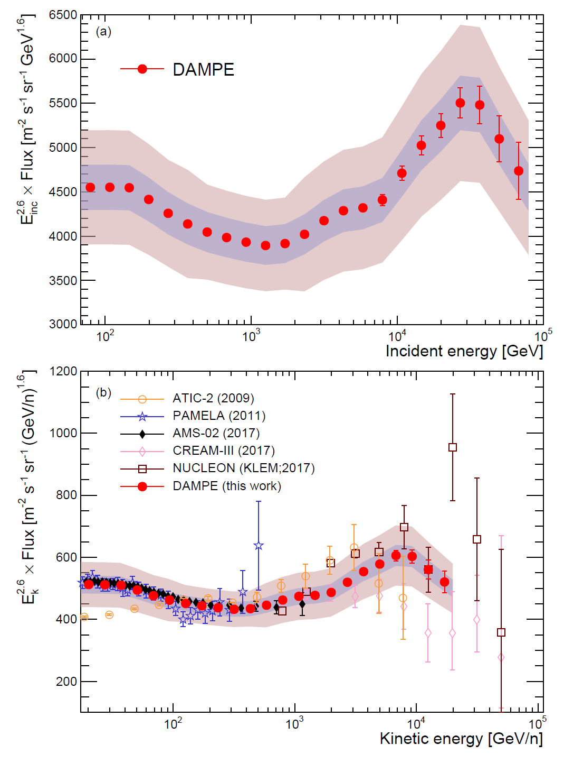
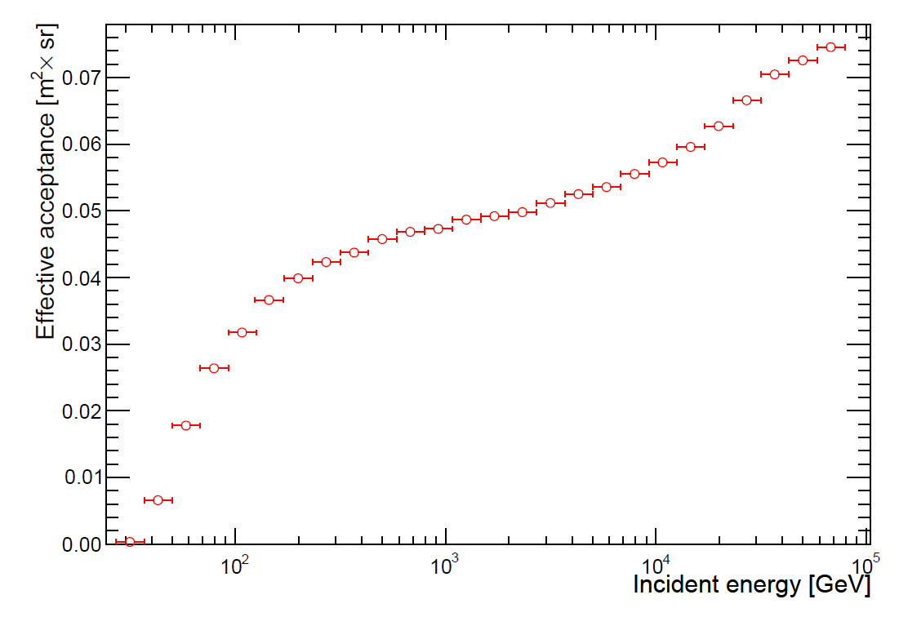

GCR Measurement (Results)
An hardening of the Helium spectrum was predicted with high uncertainties at ~ TeV.
Was able to perform direct measurements of that spectrum, confirming the results.
As it can be noticed in the plots there is an actual hardening of the Helium Spectrum at ~0.9 TeV with a softening at ~ 30 TeV.
This results have huge value for GCR research.
$$Φ\left(E_{i},E_{i}+ΔE_{i}\right)=\frac{N_{inc,i}}{ΔE_{i}A_{eff,i}Δt}$$

Slide 19
DAMPE directly confirms the Helium spectral break!

Slide 20
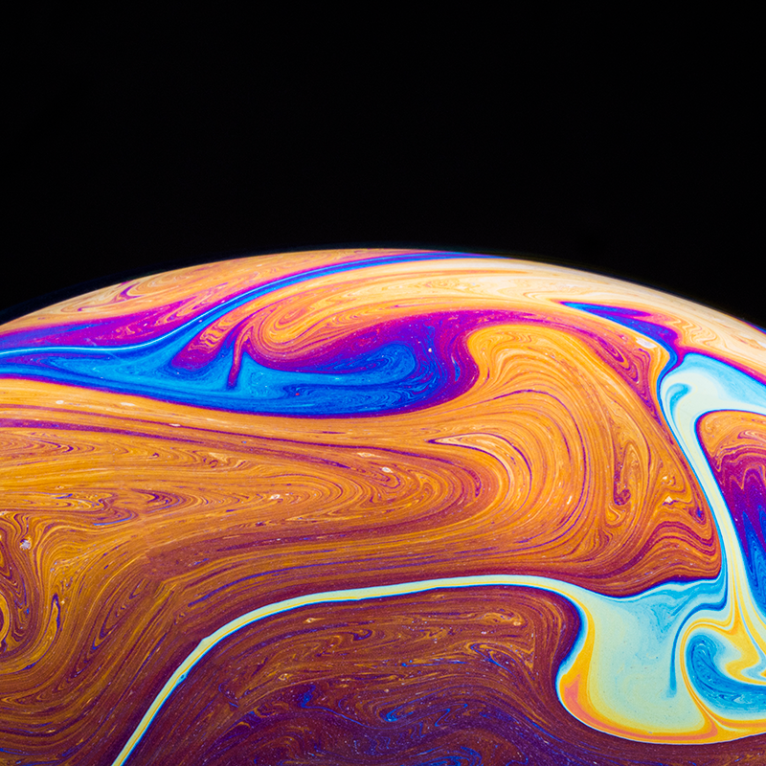
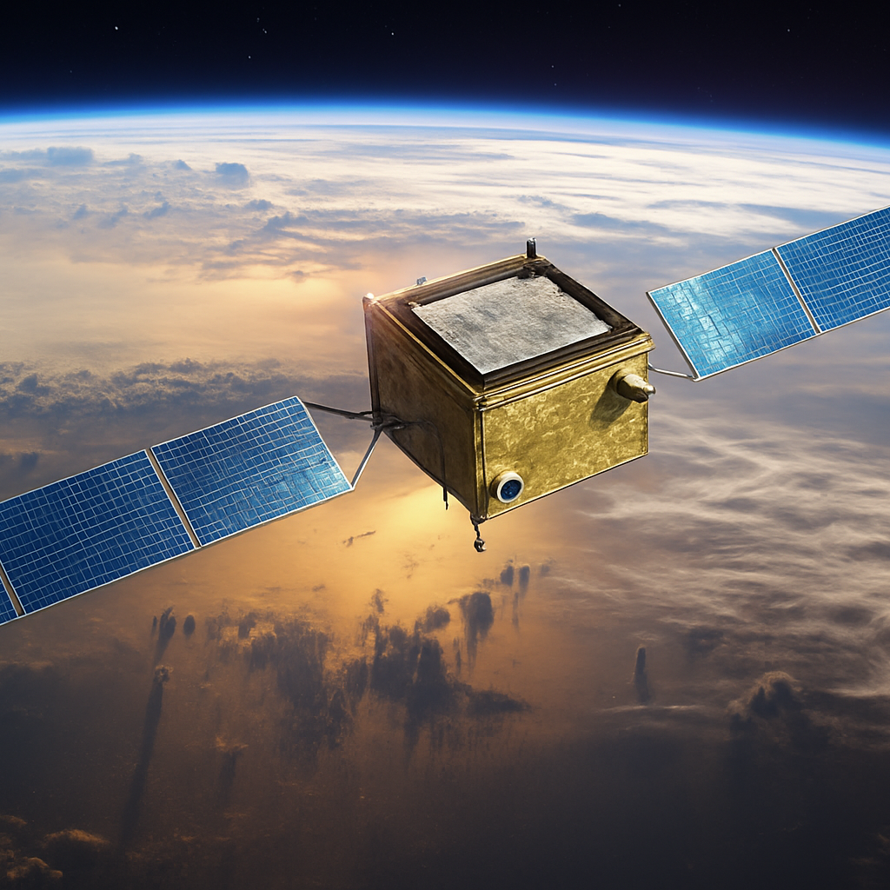
Other Contributions of DAMPE
During its many years of operativity, DAMPE has provided data about many different phenomena, including but not limited to:
Electron/Positron spectrum measurements;
Cosmic Rays Charge Measurement;
Helium Spectrum measurement (25 GeV – 4.6 TeV);
Geminga and Vela Pulsars’ periodicity measurement (1-100 GeV);

Slide 21
THANKS FOR YOUR ATTENTION

