Slide 1
Global Positioning System
Alfonso Cavallo

Slide 2
What is GPS?
GPS is a Global Navigation Satellite System that provides the capability of detecting a global tridimensional position from the Earth.

Slide 3
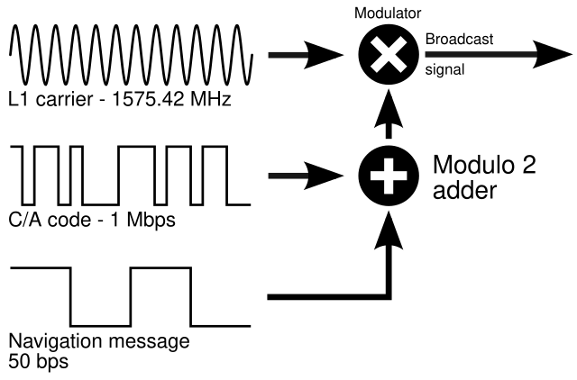
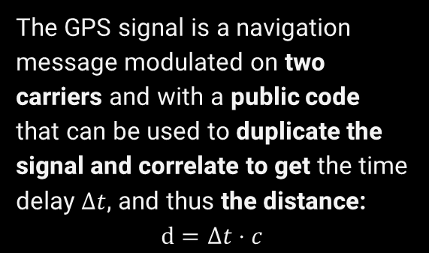



How does GPS work?
$$d_{2}$$
$$d_{1}$$
$$d_{3}$$
The GPS signal is a navigation message modulated on two carriers and with a public code that can be used to duplicate the signal and correlate to get the time delay $Δt$, and thus the distance:
$$d=Δt⋅c$$
L1: 1575.42 MHz
L2: 1227.60 MHz
C/A Code: 1.023 MHz
P Code: 10.23 MHz
$$d_{i}=\sqrt{{\left(X−X_{i}\right)}^{2}+{\left(Y−Y_{i}\right)}^{2}+{\left(Z−Z_{i}\right)}^{2}}$$

Slide 4
01
Modelling Errors

Slide 5





Clock Biases
$$δt_{S}$$
Both the Satellite and the Receiver have intrinsic delays due to clock biases with respect to the actual reference time. The actual time difference is affected as:
$$Δt=\left(t_{R}−t_{S}\right)−δt_{R}+δt_{S}$$
$$δt_{R}$$

Slide 6

Orbit Biases
Gravity Field
Solar Wind
$$(ΔX_{S},ΔY_{S},ΔZ_{s})$$
Satellites’ position can be influenced by many phenomena: gravity fields, solar wind, anomaly rotations of the Earth, loadings, solid tides etc.
Earth Anomalies

Slide 7



Atmospheric Biases
In a medium different from the vacuum, electromagnetic waves are bent proportionally to the diffraction index.
$$s=∫n ds$$
$$n=\frac{c}{v}$$
The lower the elevation the greater the error
$$δd=∫(n−1) ds$$

Slide 8

Inospheric Bias
The ionosphere is a dispersive medium that impact the signal differently across the frequency spectrum. The lower the frequency and the higher the Total Electron Content of the Ionosphere the greater the error.
$$δd_{P}^{ION}=\frac{C}{f^{2}}∫n_{e}ds=\frac{C}{f^{2}}TEC$$

Slide 9
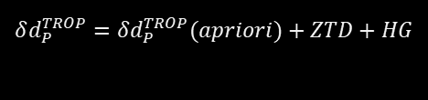
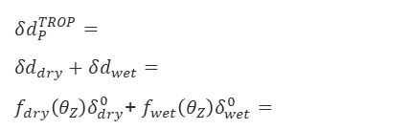
Tropospheric Bias
The troposphere induces scattering and refracted into electromagnetic waves due to dry air molecules and water vapor. Vapor density is very variable temporally and spatially and so it is very hard to model. In addition this error is influenced by elevation and horizontal gradients:
$$δd_{P}^{TROP}= \\ {δd}_{dry}+δd_{wet}=$$ $f_{dry}\left(θ_{Z}\right)δ_{dry}^{0}$+ $f_{wet}\left(θ_{Z}\right)δ_{wet}^{0}=$
$$δd_{P}^{TROP}=δd_{P}^{TROP}(apriori)+ZTD+HG$$

Slide 10



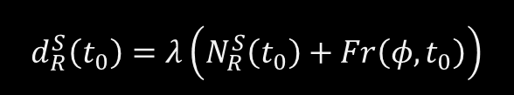
Phase Ambiguity and Phase Center Variations
$$N_{R}^{S}(t_{0})$$
$$Fr(φ,t_{o})$$
At a certain time $t_{0}$, it is possible to get the offset $Fr(φ,t_{o})$ with respect to the phase of the satellite’s signal. However, the distance is function of the number of repetition of the phase which is an unknown phase ambiguity.
…
…
$$δd_{P}^{TROP}= \\ {δd}_{dry}+δd_{wet}=$$ $f_{dry}\left(θ_{Z}\right)δ_{dry}^{0}$+ $f_{wet}\left(θ_{Z}\right)δ_{wet}^{0}=$
$$d_{R}^{S}\left(t_{0}\right)=λ\left(N_{R}^{S}\left(t_{0}\right)+Fr\left(φ,t_{0}\right)\right)$$
Furthermore, the center of emission is not a geometrical point but a physical point that may vary with the frequency and other properties.

Slide 11
02
Measurement Errors

Slide 12
Cycle Slip
Given an unknown phase ambiguity, one can keep tracking the number of cycles for accurate relative measures. The error caused by missing the count of some cycles due to signal lost or other phenomena is called cycle slip error.

Slide 13
Multipath
A signal can be reflected many times before reaching the receiver. Each indirect path can be perturbed in several ways.

Slide 14
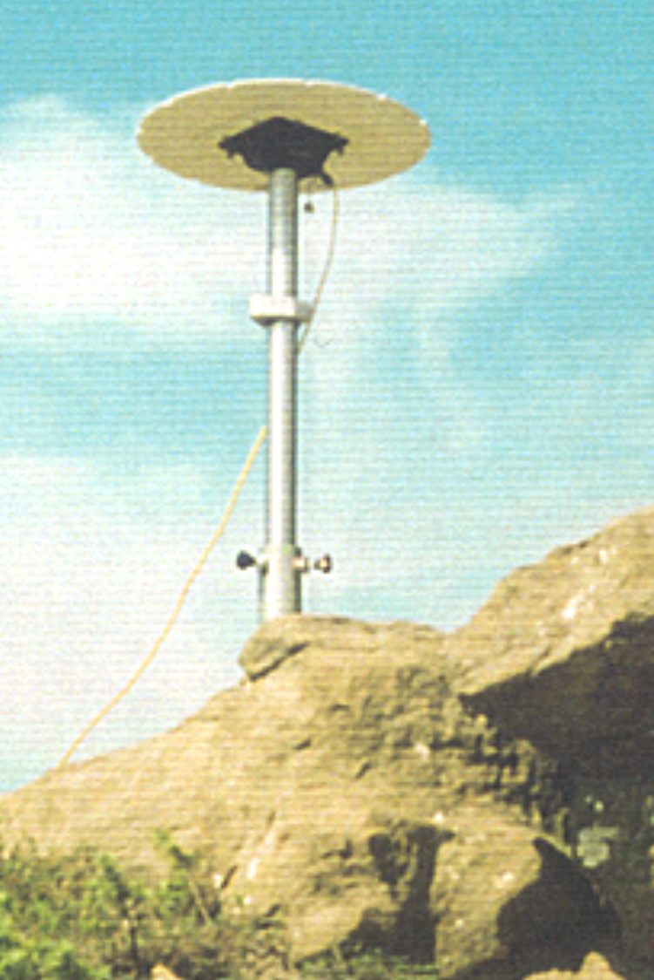
Monumentation
Any mechanical instability of the support structure and the underlying ground can cause unwanted shift in the position of the receiver. A proper installation is required to avoid this error.

Slide 15
03
Processing Errors

Slide 16
Processing Software and Mitigation Strategies
The accuracy of the measures is both dependent on the scientific/commercial application employed to process the measures and the mitigation strategies adopted to reduce the aforementioned errors.

Slide 17
04
Error Correction

Slide 18



Single Differences
1
2
1
a
a
b
$$∇φ^{12}=$$
$$Δφ_{ab}=$$
$$\frac{f}{c}d_{a}^{(1)}−f\left(δt_{a}−δt^{\left(1\right)}\right)+N_{a}^{\left(1\right)}−δ_{a}^{(1)}(ION)+δ_{a}^{\left(1\right)}(TROP)−$$
$$\frac{f}{c}d_{a}^{(1)}−f\left(δt_{a}−δt^{\left(1\right)}\right)+N_{a}^{\left(1\right)}−δ_{a}^{(1)}(ION)+δ_{a}^{\left(1\right)}(TROP)−$$
$$\frac{f}{c}d_{a}^{(2)}−f\left(δt_{a}−δt^{\left(2\right)}\right)+N_{a}^{\left(2\right)}−δ_{a}^{(2)}(ION)+δ_{a}^{\left(2\right)}(TROP)=$$
$$\frac{f}{c}d_{b}^{(1)}−f\left(δt_{b}−δt^{\left(1\right)}\right)+N_{b}^{\left(1\right)}−δ_{b}^{(1)}(ION)+δ_{b}^{\left(1\right)}(TROP)=$$
$$\frac{f}{c}\left(d_{a}^{\left(1\right)}−d_{a}^{\left(2\right)}\right)+f\left(δt^{\left(1\right)}−δt^{\left(2\right)}\right)+\left(N_{a}^{\left(1\right)}−N_{a}^{\left(2\right)}\right)+∇δ_{a}^{\left(1,2\right)}\left(ION\right)+∇δ_{a}^{\left(1,2\right)}\left(TROP\right)$$
$$\frac{f}{c}\left(d_{a}^{\left(1\right)}−d_{b}^{\left(1\right)}\right)−f\left(δt_{a}−δt_{b}\right)+(N_{a}^{\left(1\right)}−N_{b}^{(1)})$$

Slide 19

Double Differences
1
2
a
b
$$∇Δφ_{ab}^{12}=Δφ_{ab}^{\left(1\right)}−Δφ_{ab}^{\left(2\right)}=$$
$$\frac{f}{c}\left(d_{a}^{\left(1\right)}−d_{b}^{\left(1\right)}\right)−f\left(δt_{a}−δt_{b}\right)+\left(N_{a}^{\left(1\right)}−N_{b}^{\left(1\right)}\right)−$$
$$\frac{f}{c}\left(d_{a}^{\left(2\right)}−d_{b}^{\left(2\right)}\right)−f\left(δt_{a}−δt_{b}\right)+\left(N_{a}^{\left(2\right)}−N_{b}^{\left(2\right)}\right)=$$
$$\frac{f}{c}\left(\left(d_{a}^{\left(1\right)}−d_{b}^{\left(1\right)}\right)−\left(d_{a}^{\left(2\right)}−d_{b}^{\left(2\right)}\right)\right)+\left(\left(N_{a}^{\left(1\right)}−N_{b}^{\left(1\right)}\right)−\left(N_{a}^{\left(2\right)}−N_{b}^{\left(2\right)}\right)\right)$$

Slide 20




Triple Differences
2
2
$$t_{2}$$
1
$$t_{1}$$
1
a
b
a
b
$$δ∇Δφ_{ab}=∇Δφ_{ab}^{12}(t_{1})−Δφ_{ab}^{12}(t_{2})=$$
$$\frac{f}{c}\left(\left(d_{a}^{\left(1\right)}(t_{1})−d_{b}^{\left(1\right)}(t_{1})\right)−\left(d_{a}^{\left(2\right)}(t_{1})−d_{b}^{\left(2\right)}(t_{1})\right)\right)+\left(\left(N_{a}^{\left(1\right)}−N_{b}^{\left(1\right)}\right)−\left(N_{a}^{\left(2\right)}−N_{b}^{\left(2\right)}\right)\right)−$$
$$\frac{f}{c}\left(\left(d_{a}^{\left(1\right)}(t_{2})−d_{b}^{\left(1\right)}(t_{2})\right)−\left(d_{a}^{\left(2\right)}(t_{2})−d_{b}^{\left(2\right)}(t_{2})\right)\right)+\left(\left(N_{a}^{\left(1\right)}−N_{b}^{\left(1\right)}\right)−\left(N_{a}^{\left(2\right)}−N_{b}^{\left(2\right)}\right)\right)=$$
$$\frac{f}{c}\left(\left(d_{a}^{\left(1\right)}(t_{1})−d_{b}^{\left(1\right)}(t_{1})\right)−\left(d_{a}^{\left(2\right)}(t_{1})−d_{b}^{\left(2\right)}(t_{1})\right)\right)−\left(\left(d_{a}^{\left(1\right)}(t_{2})−d_{b}^{\left(1\right)}(t_{2})\right)−\left(d_{a}^{\left(2\right)}(t_{2})−d_{b}^{\left(2\right)}(t_{2})\right)\right)$$

Slide 21
Other Mitigation Methods
Receiver Clock Bias | Adding one satellite adds one equation to solve the ambiguity.
Ionospheric Bias | Working with two different frequencies (L1,L2) can help solving the ambiguity.
Tropospheric Bias | Observing the troposphere’s properties can help reduce the uncertainty
Satellites’ Clock and Orbit Biases | Processing data with IGS products can help reduce the error. Better IGS are released later than real-time products but provide better measures.
Multipath | Avoiding reflecting surfaces and proper antenna choice can mitigate the multipath effect
Monumentation | A proper installation of the antenna can make the receiver more stable.

Slide 22
05
GPS Application

Slide 23
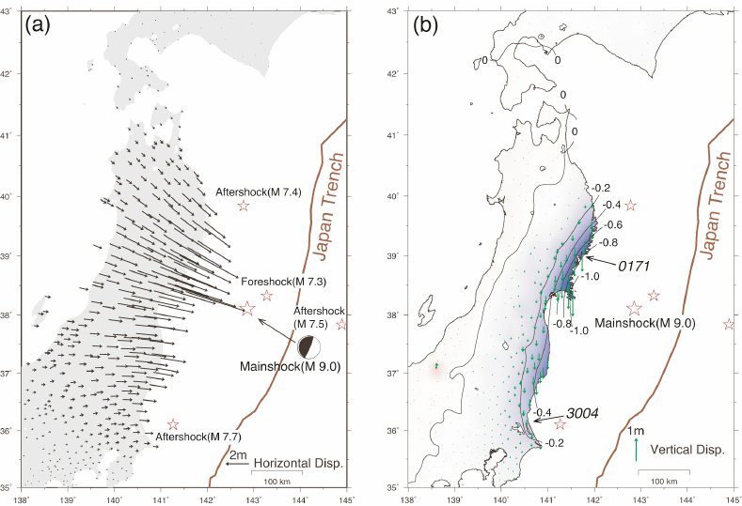
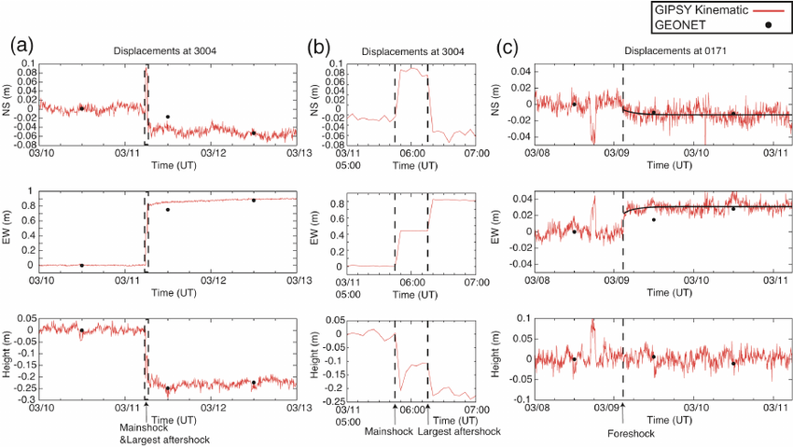
GPS for Geological Monitoring
Tohoku Earthquake

Slide 24
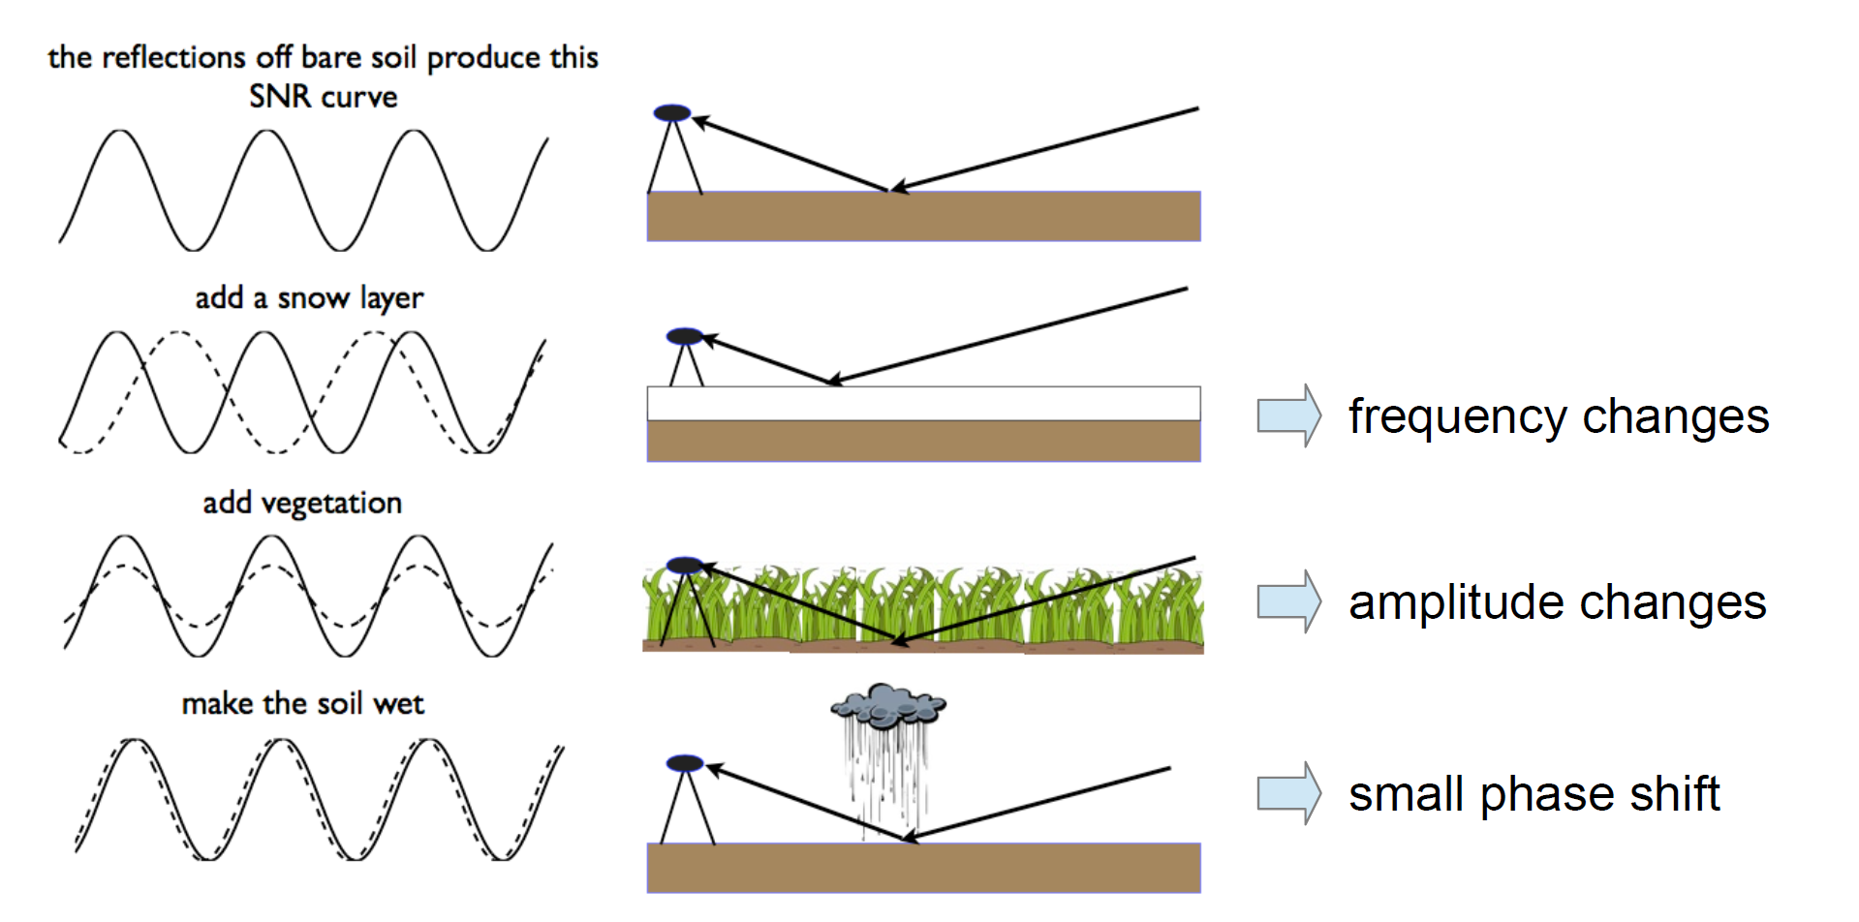
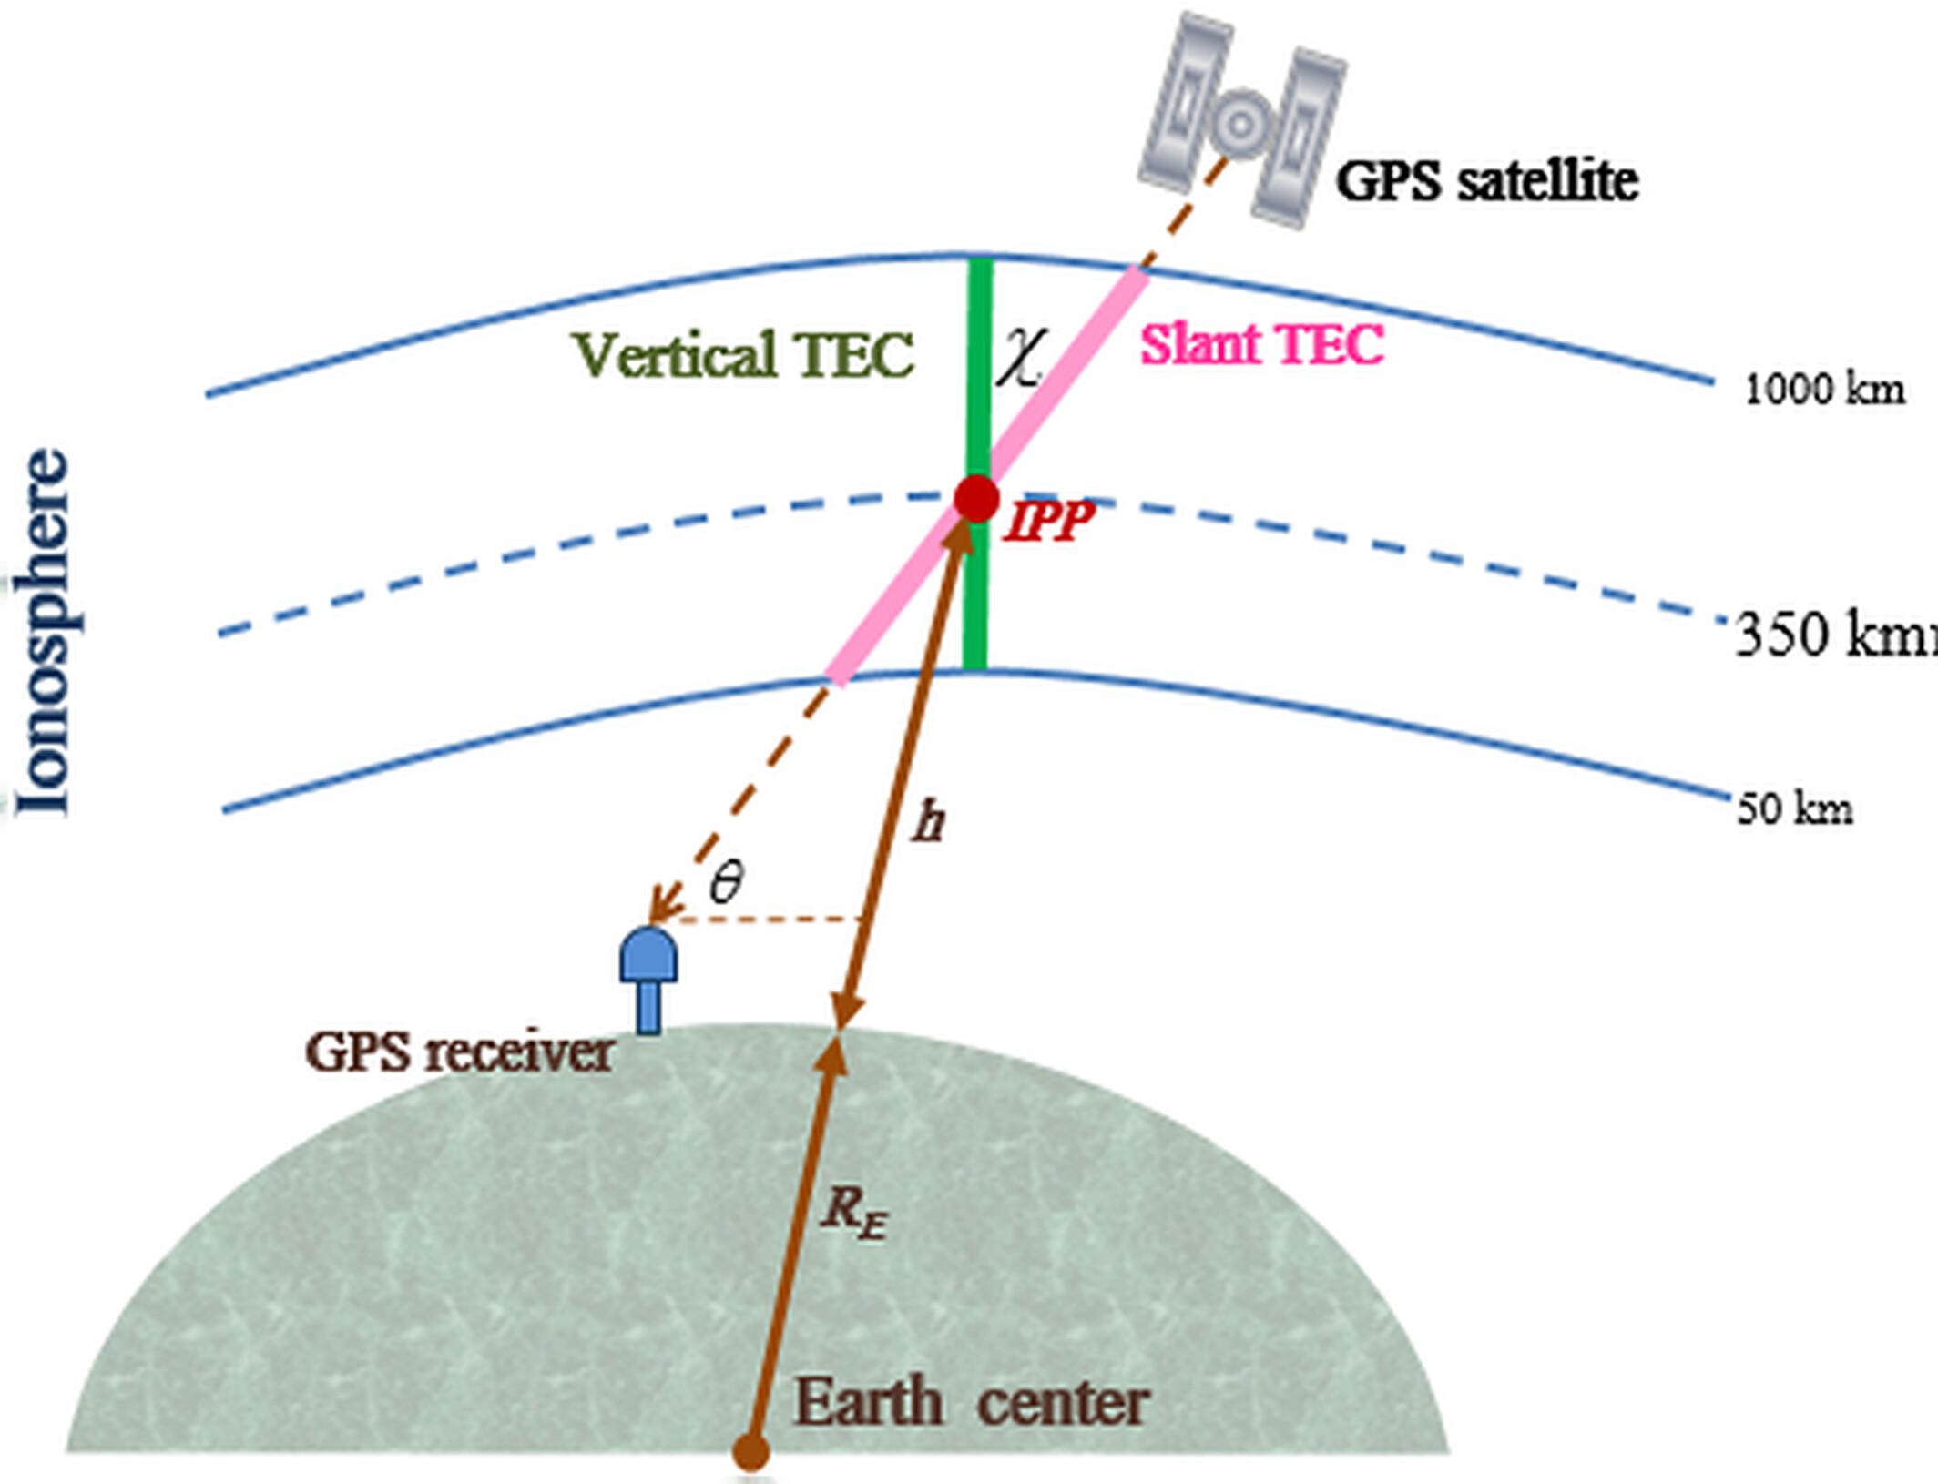
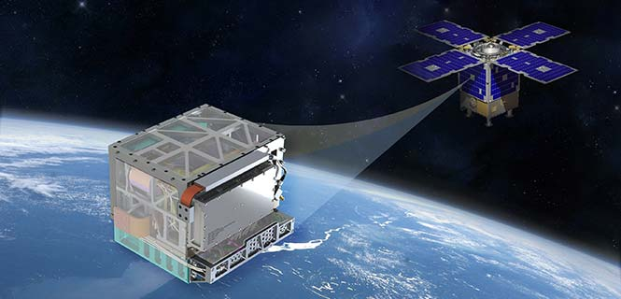
GPS non-conventional uses

Slide 25
Thanks for your Attention

