Slide 1

Life of a Droplet
Alfonso Cavallo

Slide 2
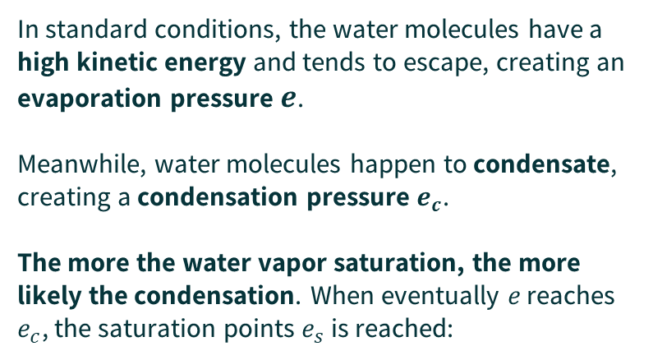



Saturation
In standard conditions, the water molecules have a high kinetic energy and tends to escape, creating an evaporation pressure $e$.
Meanwhile, water molecules happen to condensate, creating a condensation pressure $e_{c}$.
The more the water vapor saturation, the more likely the condensation. When eventually $e$ reaches $e_{c}$, the saturation points $e_{s}$ is reached:
$$e$$
$$e_{c}$$
$$e=e_{c}=e_{s}$$

Slide 3
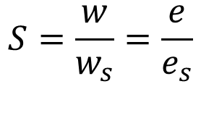
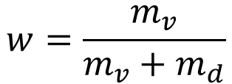
Saturation
$$w=\frac{m_{v}}{m_{v}+m_{d}}$$
Humidity
$$S=\frac{w}{w_{s}}=\frac{e}{e_{s}}$$
Saturation

Slide 4
What is Nucleation
Moist Particles Spontaneusly Aggregate into a Liquid/Solid Embryos
Particle Agitation creates collisions which Break this fragile equilibrium

Slide 5
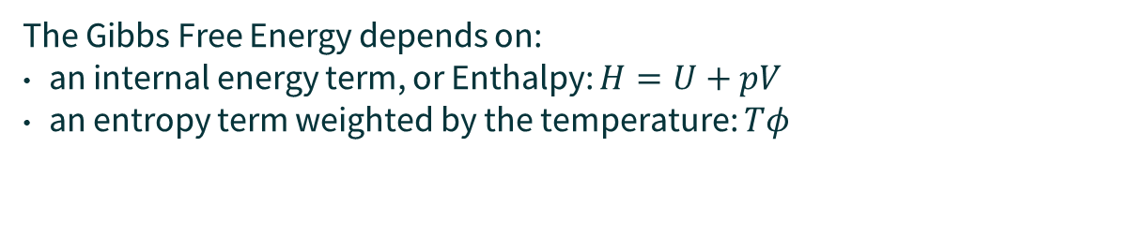

Gibbs Free Energy
$$G=U+pV−Tφ$$
Gibbs Free Energy
Potential Energy
Pressure Energy
Entropy Term
The Gibbs Free Energy depends on:
an internal energy term, or Enthalpy: $H=U+pV$
an entropy term weighted by the temperature: $Tφ$

Slide 6
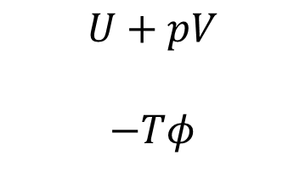

Gibbs Free Energy
There is a favored direction for physical energetic transitions:
$$U+pV$$ $$−Tφ$$
Internal energy tends to be released
Entropy tends to increase (so its negate decreases)
Given both terms tend to prefer reducing over time, one physical process can be spontaneous only if it decreases their sum, which is the Gibbs Free Energy:
$$ΔG<0 → Spontaneous$$

Slide 7
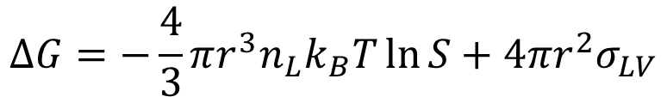
Formation of a droplet
In order to form a liquid/solid boundary with the air, a droplet must spend energy:
$$ΔG=−\frac{4}{3}πr^{3}n_{L}k_{B}T\ln{S}+4πr^{2}σ_{LV}$$

Slide 8
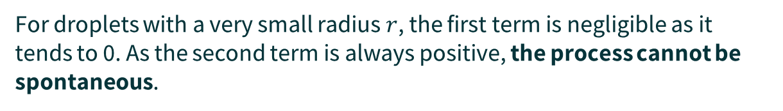
Formation of a droplet
In order to form a liquid/solid boundary with the air, a droplet must spend energy:
$$ΔG=−\frac{4}{3}πr^{3}n_{L}k_{B}T\ln{S}+4πr^{2}σ_{LV}$$
For droplets with a very small radius $r$, the first term is negligible as it tends to 0. As the second term is always positive, the process cannot be spontaneous.

Slide 9
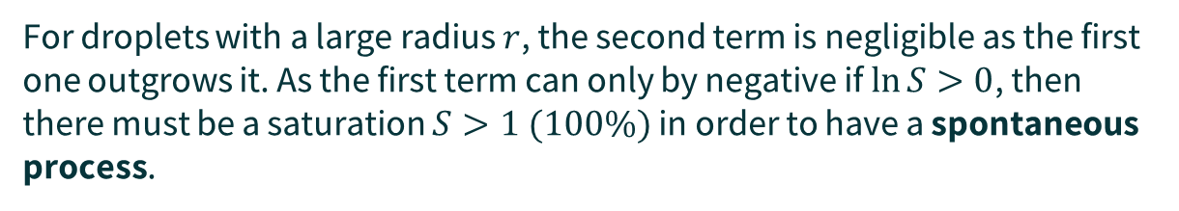
Formation of a droplet
In order to form a liquid/solid boundary with the air, a droplet must spend energy:
$$ΔG=−\frac{4}{3}πr^{3}n_{L}k_{B}T\ln{S}+4πr^{2}σ_{LV}$$
For droplets with a large radius $r$, the second term is negligible as the first one outgrows it. As the first term can only by negative if $\ln{S}>0$, then there must be a saturation $S>1 (100\%)$ in order to have a spontaneous process.

Slide 10
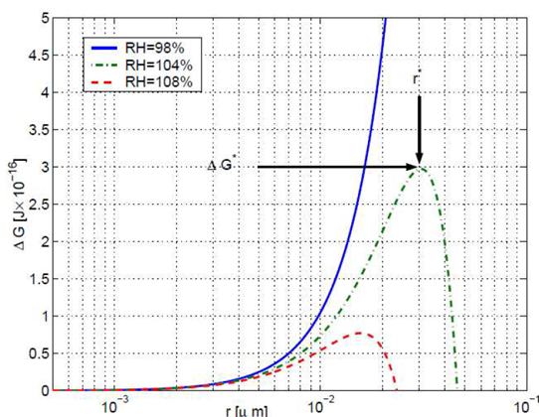
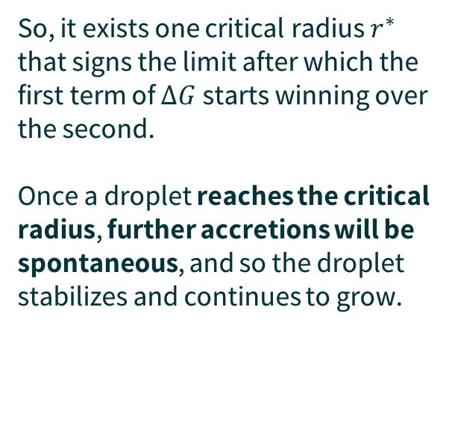
Critical Radius
So, it exists one critical radius $r^{∗}$ that signs the limit after which the first term of $ΔG$ starts winning over the second.
Once a droplet reaches the critical radius, further accretions will be spontaneous, and so the droplet stabilizes and continues to grow.
First term
is winning
Second term
Starts winning

Slide 11




Critical Radius
$$S≈1$$
It is possible to reduce the critical values, and so «anticipate» the droplet’s stabilization by increasing the saturation of the gas.
$$S′>S$$
$ΔG$ lower $⇒$ more spontaneous
$r^{∗}$ lower $⇒$ easier to reach

Slide 12
Homogeneous Nucleation
Research has discovered that lowering the critical radius for a droplet born out of homogeneous nucleation (purely made of water) to spontaneously reach stability through fluctuations would require a critical saturation of 400%.
In nature, this never applies for pure water.

Slide 13
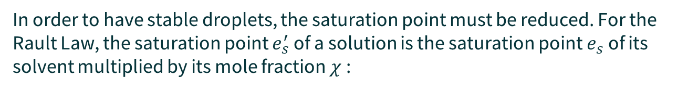

Heterogeneous Nucleation
In order to have stable droplets, the saturation point must be reduced. For the Rault Law, the saturation point $e_{s}^{′}$of a solution is the saturation point $e_{s}$of its solvent multiplied by its mole fraction $χ$:
$$e_{s}^{′}=e_{s}χ=\frac{N_{w}}{N_{w}+N_{s}}e_{s}$$
In other words:
The higher the quantity of a solute in the water
The lower the vapor pressure, and thus the saturation point

Slide 14
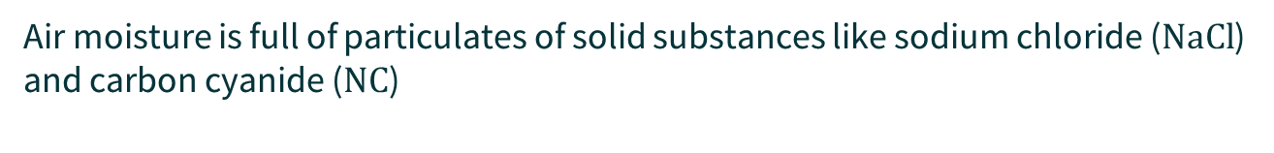
Heterogeneous Nucleation
Air moisture is full of particulates of solid substances like sodium chloride ($NaCl$) and carbon cyanide ($NC$)
$$e_{s}^{′}=e_{s}χ=\frac{N_{w}}{N_{w}+N_{s}}e_{s}$$
In other words:
The higher the quantity of a solute in the water
The lower the vapor pressure, and thus the saturation point

Slide 15
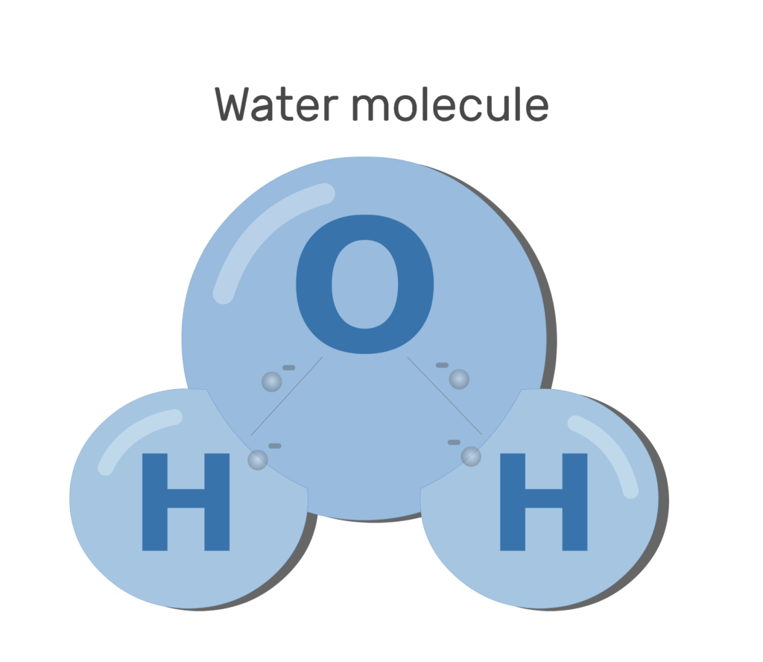
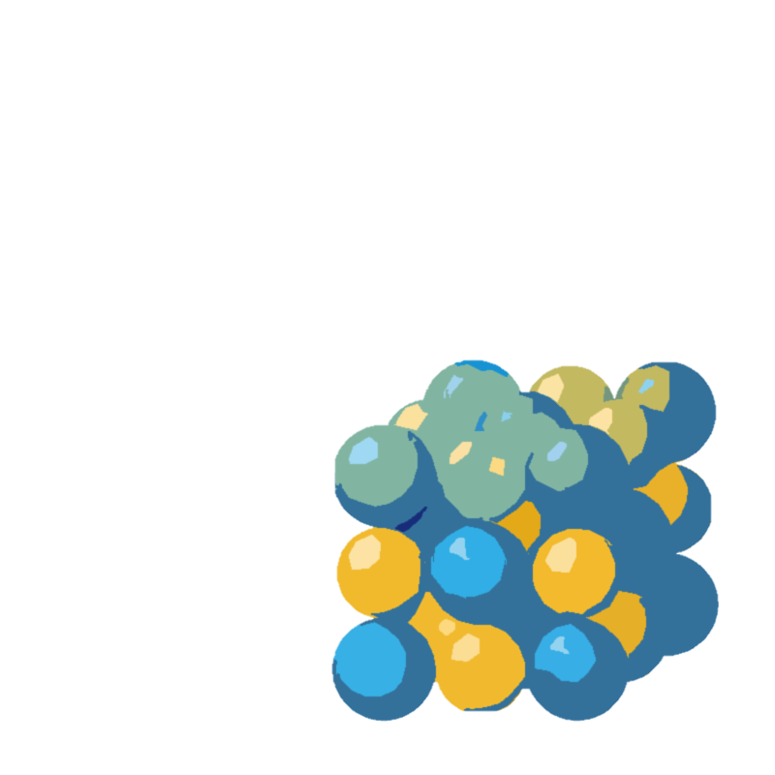
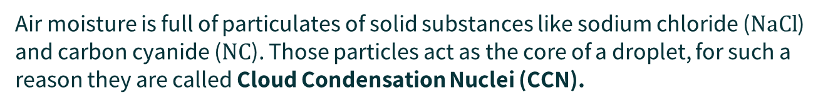
Heterogeneous Nucleation
Air moisture is full of particulates of solid substances like sodium chloride ($NaCl$) and carbon cyanide ($NC$). Those particles act as the core of a droplet, for such a reason they are called Cloud Condensation Nuclei (CCN).

Slide 17
Precipitation
As soon as droplets have reached a certain density, they start precipitating under the gravitational pull

Slide 18

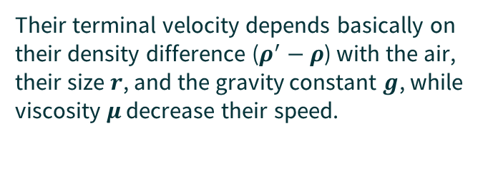
Precipitation
Their terminal velocity depends basically on their density difference ($ρ^{′}−ρ$) with the air, their size $r$, and the gravity constant $g$, while viscosity $μ$ decrease their speed.
Stokes Approximation
$$v_{T}=\frac{2}{9}r^{2}g\frac{ρ^{′}−ρ}{μ}$$

Slide 19
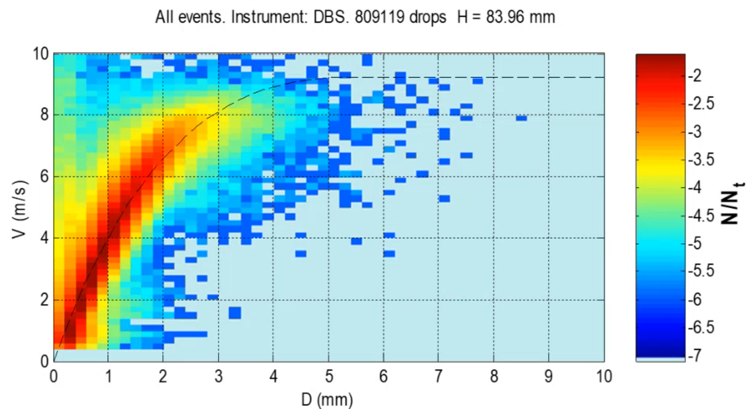

Precipitation
This approximation holds only for small droplets, as bigger droplets’ surface undergoes a more turbulent flux. Their velocity formula can only be empirically calculated:
$$v_{T}\left(D\right)=9.35−10.3e^{0.6D}$$

Slide 20
Precipitation
However this is an approximation as their motion is highly chaotic and unpredictable.

Slide 21
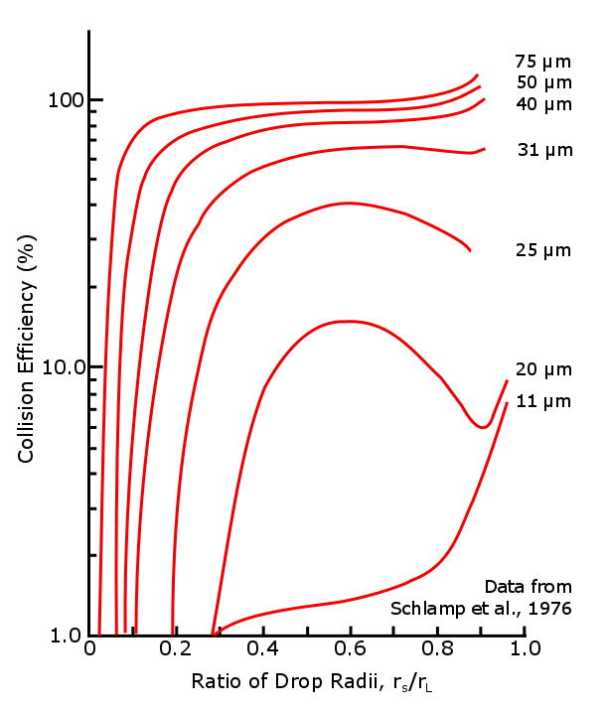




Collisions
The bigger the collected drop, the bigger its inertia and «resistance» to the streamline, which means it is less likely to «dodge» the bigger droplet
$$r_{L}$$
$$r_{S}$$
$$v_{S}$$
$$v_{L}$$

Slide 22
Break Up
As the surface increases, friction induces increasingly turbulent currents inside the droplet, and it starts oscillating. Eventually, the surface tension will not be able to hold the droplet anymore and breaks it into many smalled droplets.
4.5mm is the usual break up radius

Slide 23

Thank You For Your Attention

