Slide 1


Space X-RAY TELESCOPES
Alfonso Cavallo

Slide 2
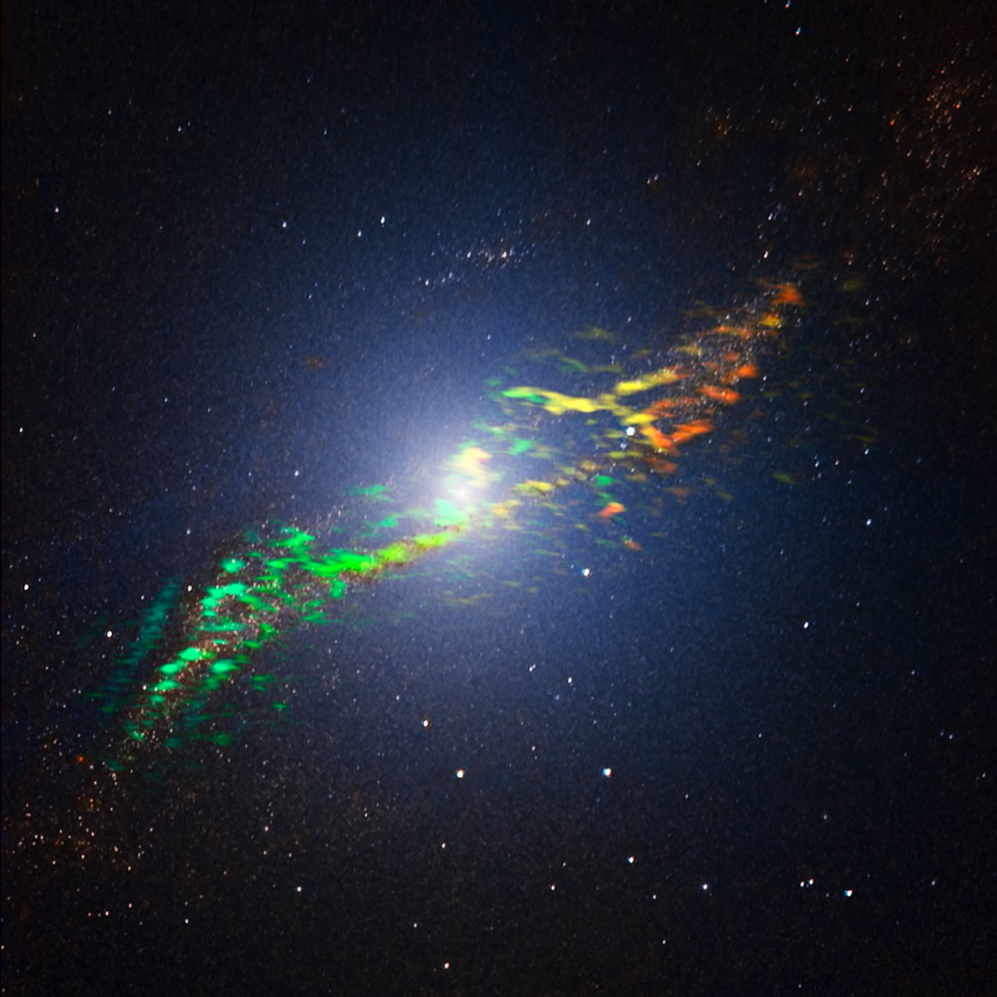
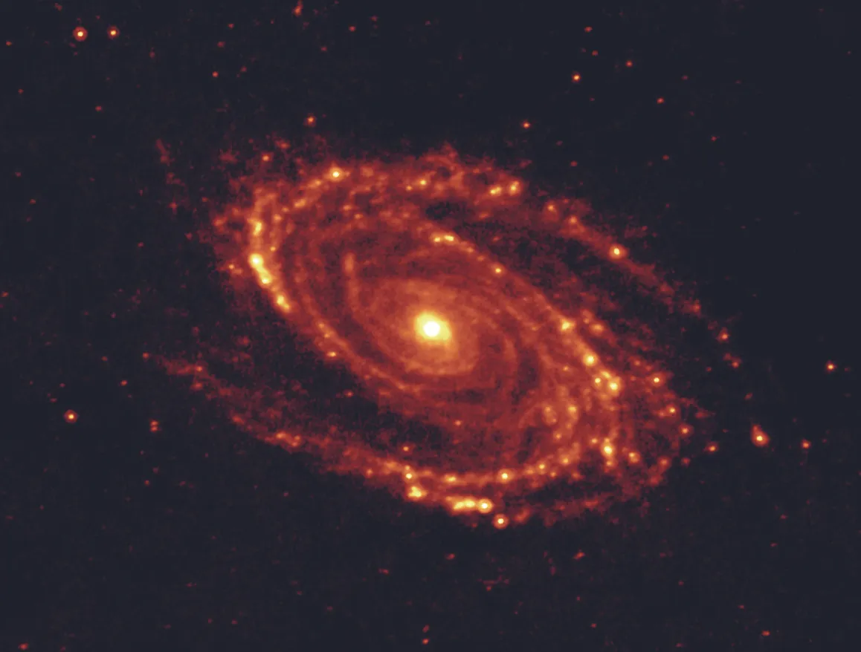
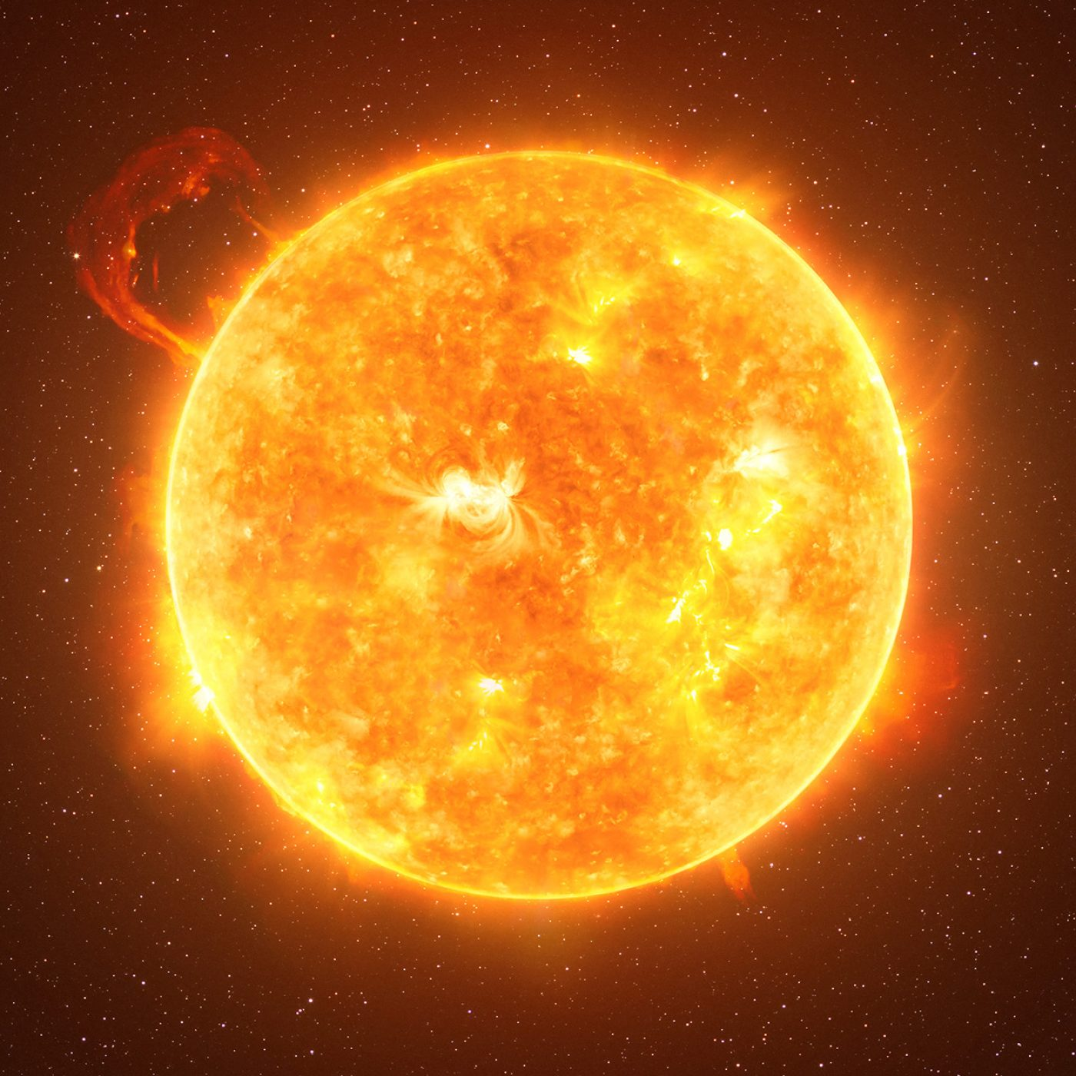
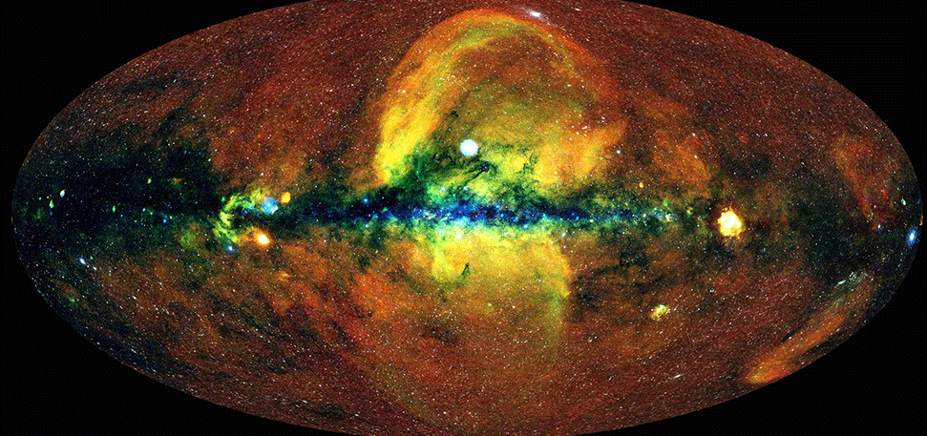
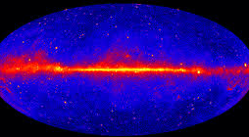

INTRODUCTION TO X-RAY
X-Rays are photons holding energy in the range 2 keV< E < 200 keV. X-Ray radiation is ionizing, which means it has enough energy to rip multiple electrons off their atomic nuclei.
Radio
MicroWaves
Infra-Red
Optical
UV
X-Ray
$γ$-Ray
30GHz
10cm
300GHz
1mm
400THz
750nm
790THz
380nm
30PHz
10nm
30EHz
10pm

Slide 3
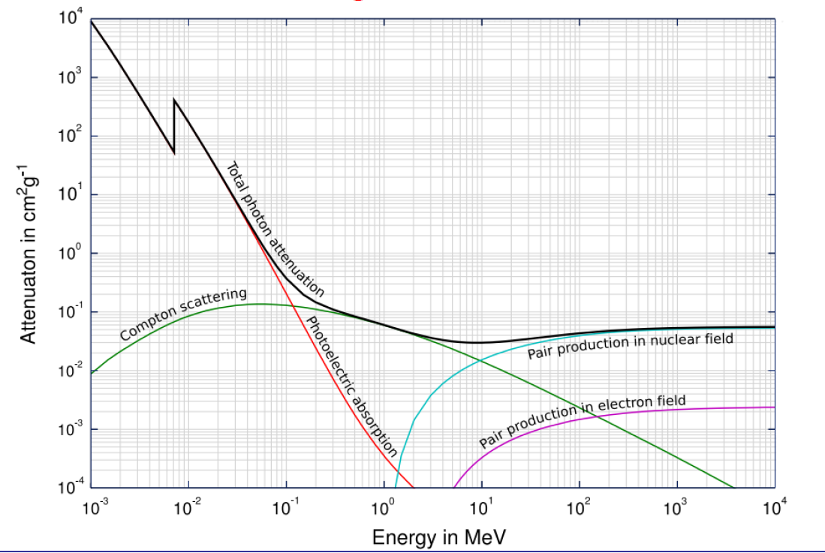
X-RAY ATTENUATION
High-energy photons undergo a weaker attentuation from interaction with matters. The most effective attenuation effect is derived by the production of a pair.

Slide 4




PRIMARY X-RAY INTERACTIONS
$$E$$
-
+
-
+
P
N
+
+
-
-
+
+
-
-
-
+
+
-
$$E’<E$$
$$−$$
$$+$$
Gas Ionization
Scintillator Absorption
Semiconductor Absorption

Slide 5
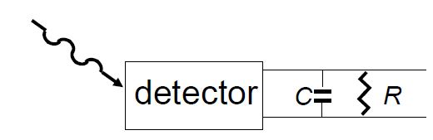


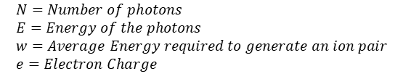



X-RAY DETECTION
Photon
Interaction
Output of the interaction
Detection
Current Mode Detection
Pulse Mode Detection
$$I\left(t\right)=\frac{1}{T}\int_{t}^{t+T}{i\left(t′\right)dt}′$$
$$Q=\int_{0}^{t_{c}}{i\left(t\right)dt}$$
$$I=N⋅\frac{E}{w}⋅e$$
$$N=\int_{E_{0}}^{E_{1}}{\left(\frac{dN}{dE}\right)dE}$$
$$N=Number of photons \\ E=Energy of the photons \\ w=Average Energy required to generate an ion pair \\ e=Electron Charge$$
$$t=RC≫t_{c}$$

Slide 6
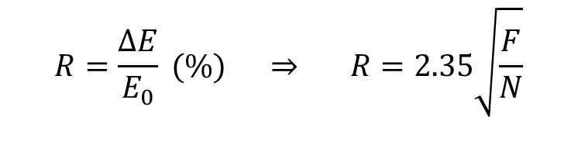





SPECTRAL RESOLUTION
$$\frac{dN}{dE}$$
Ideal
Real
$$R=\frac{ΔE}{E_{0}} (\%) ⇒ R=2.35\sqrt{\frac{F}{N}}$$
$$ΔE$$
$$E_{0}$$
$$E$$
$$ΔE=2.35σ_{w}$$

Slide 7
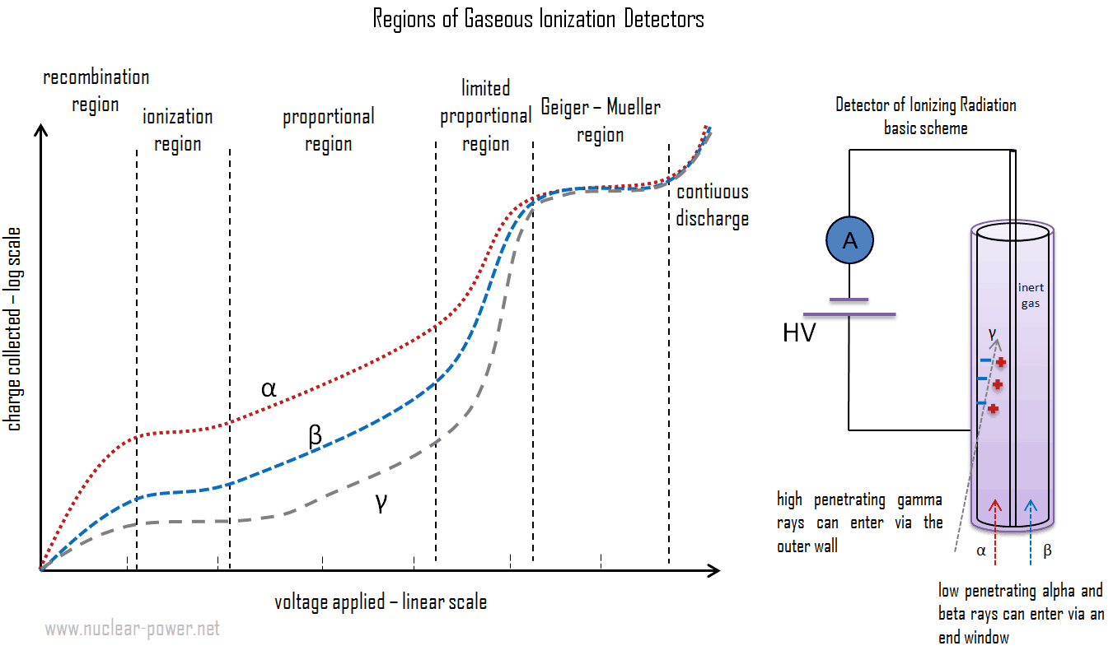

GAS-BASED DETECTION
+
+
+
+
+
+
+
+
+
+
+
-
+
+
+
+
+
+
X-Ray Ionization
-
-
-
-
-
-
-
-
-
-
-
-
-
-
-
-

Slide 8
GAS-BASED DETECTION
+
+
+
+
+
+
+
+
+
+
+
-
+
+
+
+
+
+
No detected voltage due two poor attraction of ionized particles that are quickly re-absorbed.
-
-
-
-
-
-
-
-
-
-
-
-
-
-
-
-
Ions Reabsorbed before reaching the Anode/Catode

Slide 9
GAS-BASED DETECTION
+
+
+
+
+
+
+
+
+
+
+
-
+
+
+
+
+
+
The voltage Measured is stable (not very used)
-
-
-
-
-
-
-
-
-
-
-
-
-
-
-
-

Slide 10
GAS-BASED DETECTION
Electron Avalanche Ionization
+
-
The voltage amplifies the ionization, with the ions further ionizing more atoms in a chain reaction proportional to the energy of the incoming photons
-
-
-
-
-
-
-
-
-
-
-

Slide 11
GAS-BASED DETECTION
Electron Avalanche Ionization
X-Ray Avalanche Ionization
+
-
The voltage is so high that each ionization event generates, in turn, an huge chain of multiple ionization events.
-
-
-
-
-
-
-
-
-
-
-
-
-
-
-
-
-
-
-
-

Slide 12
PROPORTIONAL COUNTERS
GEIGER-MUELLER TUBES
Avalanche and Measured Voltage is proportional to the Energy of the incoming Ray.
Useful for precise measurements.
Even one single photon can cause a chain reaction that produces a huge amount of ionization events.
Voltage dependency on the incoming photon energy is lost.
Can detect even single photons collision events.
It has long dead times so it is not usable to for accurate measures and high fluxes quickly saturate the device.

Slide 13



INDIRECT SOLID DETECTION
Scintillation is the process by which particle of certain material that are excited by an Ionization event, produce light* as a result of de-excitation in at a longer wavelength. (Re-emitted photons cannot be re-abosrbed again by the material)
$$E$$
Inorganic material are more indicated for energy spectroscopy.
Organic materials have shorter decay time and are more indicated for real-time applications.
$$E’<E$$
Scintillator
*Re-emitted photons cannot be re-absorbed by the material.
P
N
P
N
P
N
P
N
Photodiodes or PMT
(Detectable band includes $E’$ but not $E$)
$$Stokes Shift= |E’−E|$$

Slide 14


DIRECT SOLID DETECTION
Semiconductors are materials in which the energy required for a valence electron to pass to the conduction band is very low. By applying a reverse bias it is possible to attract electron and holes respectivelty toward the catode and the anode and create a stable depliton region. When this happens, a change into the applied voltage can be measured
$$E$$
Semiconductors provides multiple advantages over other technologies:
Single compact devices;
Higher SNR and Response Times;
Allow pixelated geometrical compositions for position resolution
P
N
Solid State
Direct Detectors
+
+
-
+
-
-
+
-
$$−$$
$$+$$

Slide 15
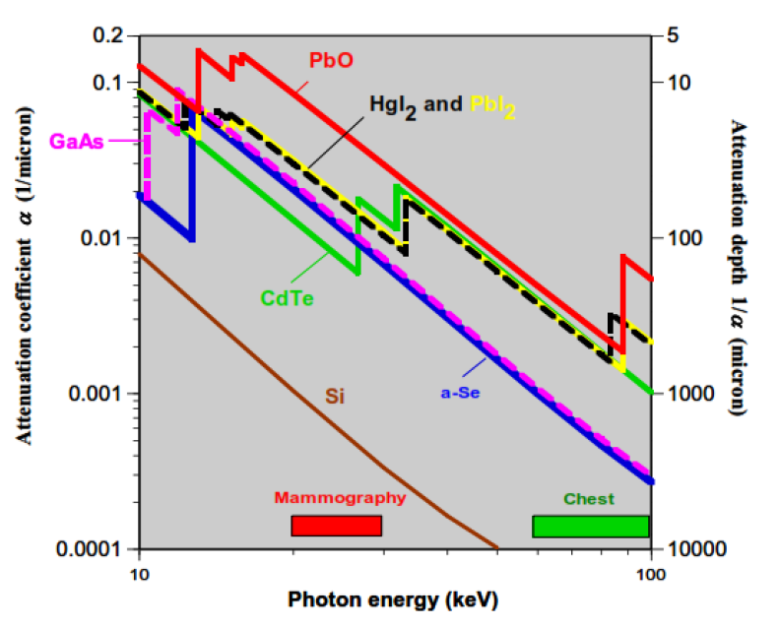
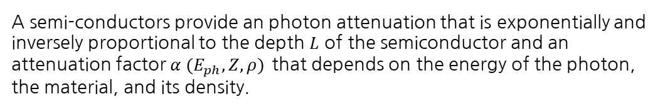
DIRECT SOLID DETECTION
A semi-conductors provide an photon attenuation that is exponentially and inversely proportional to the depth $L$ of the semiconductor and an attenuation factor $α (E_{ph},Z,ρ)$ that depends on the energy of the photon, the material, and its density.
$$A_{QE}=1−e^{−αL}$$
$$E$$
P
N
Solid State
Direct Detectors
+
+
-
+
-
-
+
-
$$−$$
$$+$$

Slide 16
COMPARISON BETWEEN DIFFERENT DETECTORS
TYPE OF DETECTOR | IONIZATION POTENTIAL (Typical Value) | NUMBER OF e-h PAIRS or PHOTONS GENERATED PER INCOMING PHOTON | NUMBER OF PHOTOELECTRONS GENERATED PER PHOTON | FANO FACTOR | RESOLUTION
PROPORTIONAL GAS COUNTERS | 25eV | 8000/25=320 | - | 0.2 | 6%
SCINTILLATOR + PMT | 50eV | 8000/50=160 | 160×0.1*=16 | 1 | 60%
SEMICONDUCTOR (GE) | 3eV | 8000/3=2700 | - | 0.08 | 1%
*Conversion Efficiency

Slide 17
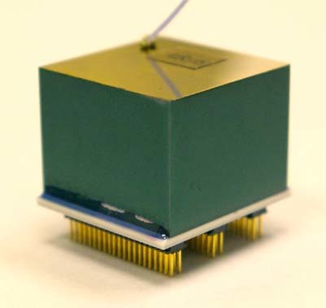
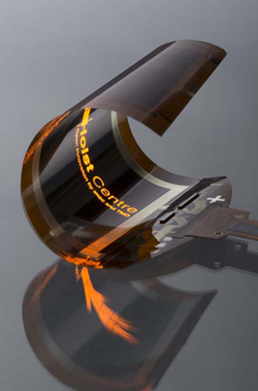
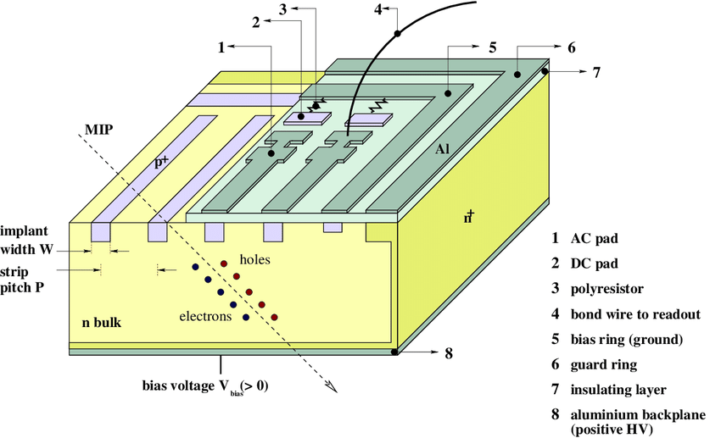
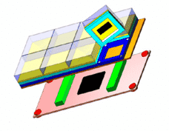
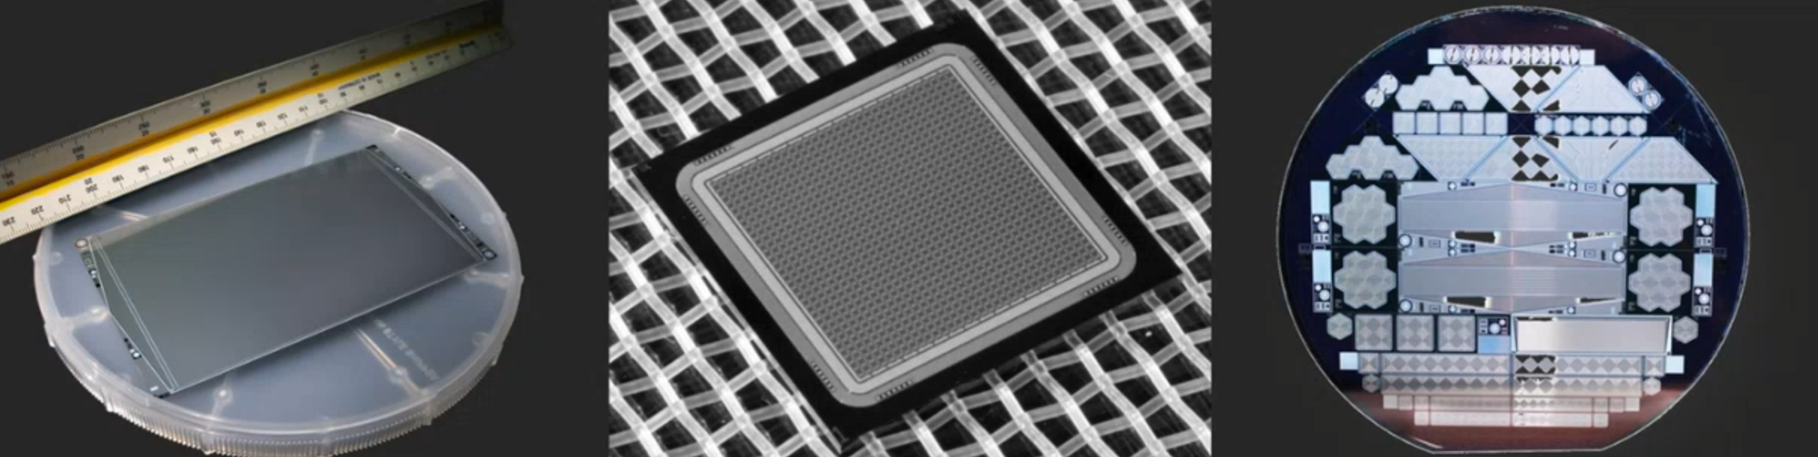
STATE-OF-THE-ART TECHNOLOGY
Solution Deposited Materials
(i.e. Perovskites)
Silicon (Si) Detectors
Printable Detectors
Cadmium-Zinc-Telluride (CZT) Detectors

Slide 18
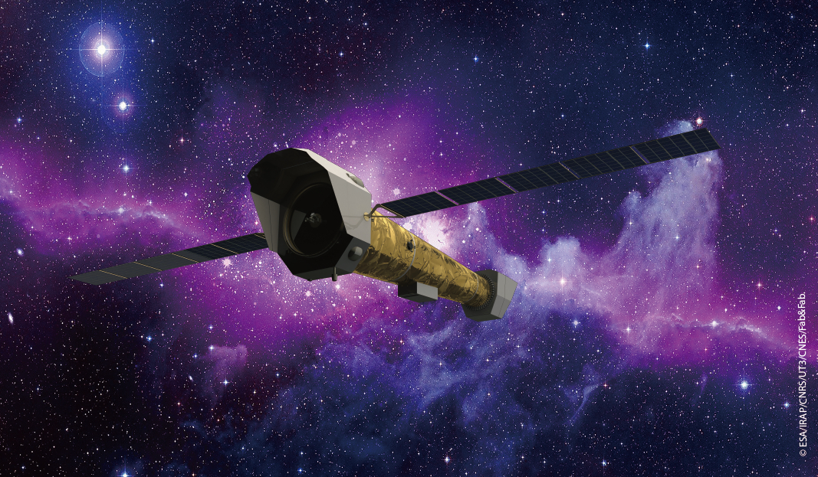
THANK YOU FOR YOUR ATTENTION

