Slide 1

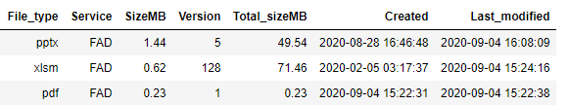
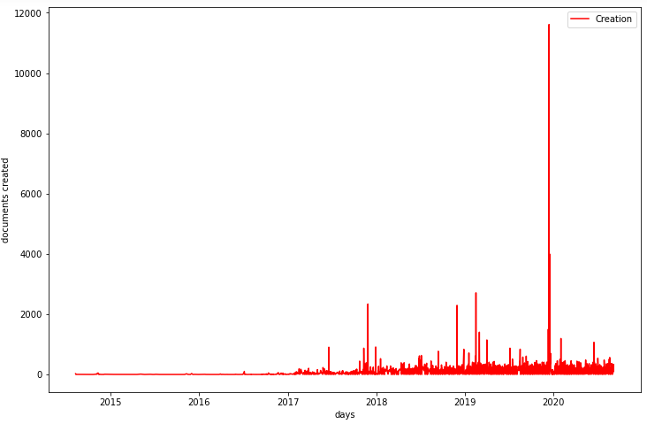
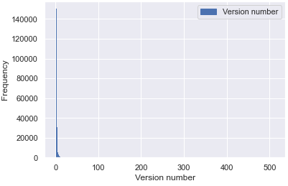
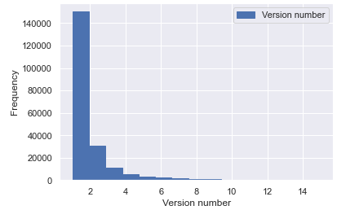
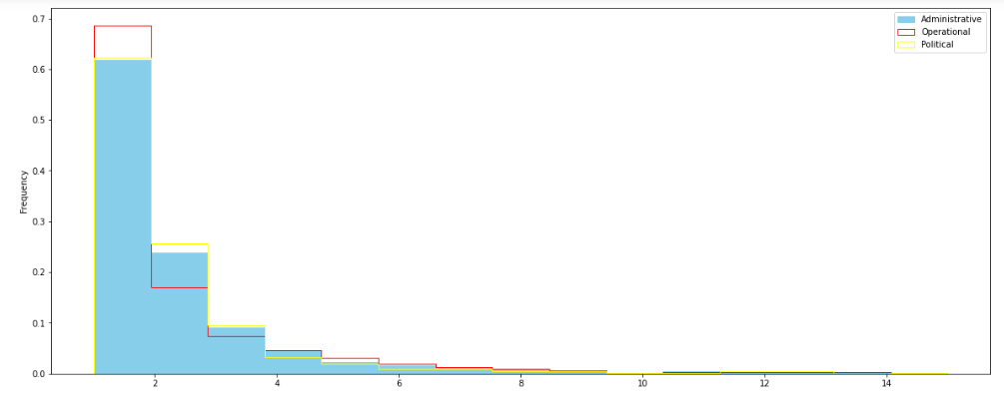
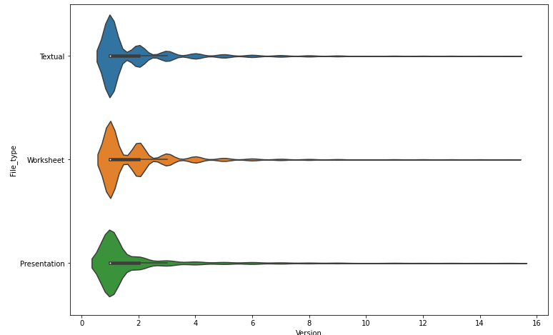
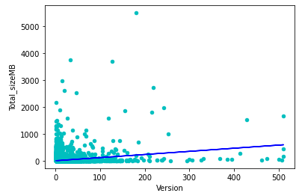
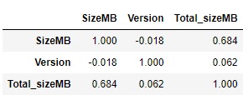
Collaboration within
SharePoint platform
Alfonso Garcia Miguel
Information Management Adviser. ICRC
Summary
SharePoint has been deployed as the documentary repository of the institution to promote collaboration among teams.
The original intention is that staff not only store their documents in the platform, but that they create and update them there.
Collaboration can be measured through “Version” of document: Version number indicates the times a document has been updated.
The tool is used by around 200 services worldwide and contains today >2 Mio. documents
Services can be considered having three different natures, Operational, Administrative and Political
Usage of the tool is not compulsory. However, storing documents there offer some advantages (publication, retrieval, archiving)
It was never assessed if collaboration has been achieved. This is the purpose of this test
Data description
Data has been extracted in excel through the SharePoint extraction tool, covering 5 different services representing the three different natures of work (operational, administrative and political). The sample contains around 200K documents and needs heavy cleaning.
The data set has 8 colums:
1. Overall versioning
3. Versioning by nature of work
5. Mann Whitney test among Services populations
(Do services work differently?)
null hypothesis H0: Distributions of both populations are equal
P-Value Administrative vs Operational populations:
P-Value Administrative vs Political populations:
P-Value Operational vs Political populations:
H0 can be rejected. Services work differently and thus there is different levels of collaboration.
7. Correlations
(Version / Size):
Findings / Procedures / Tests
2. Dumping of
documents
4. Versioning
by file type
6. Mann Whitney test among Files populations
(Does collaboration depend on the type of document?)
null hypothesis H0: Distributions of both populations are equal
P-Value Text vs Worksheet populations:
P-Value Text vs Presentation populations:
P-Value Presentation vs Worksheet populations:
H0 can be rejected. Working is different depending on the file type.
No real collaboration. (~20% of docs version 3 or above)
Correlation between version and total size shows that updates are corrections (size remain stable) and not additions
Services and file types can be analyzed separately
Conclusions

