Slide 1

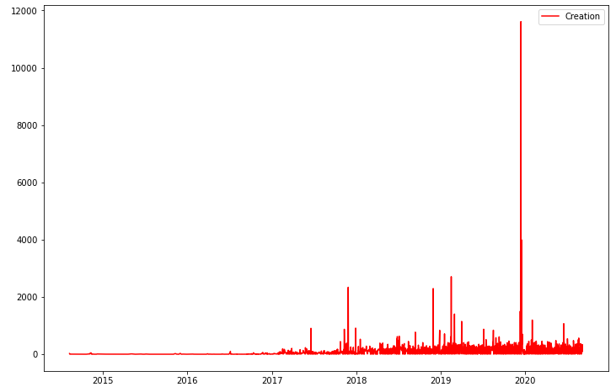
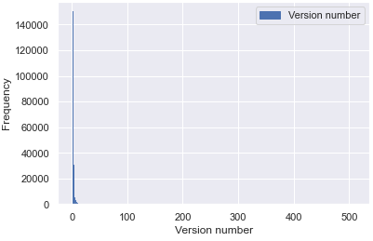
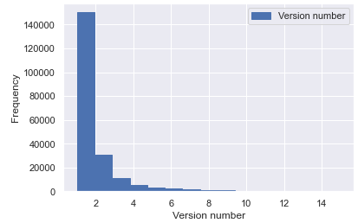
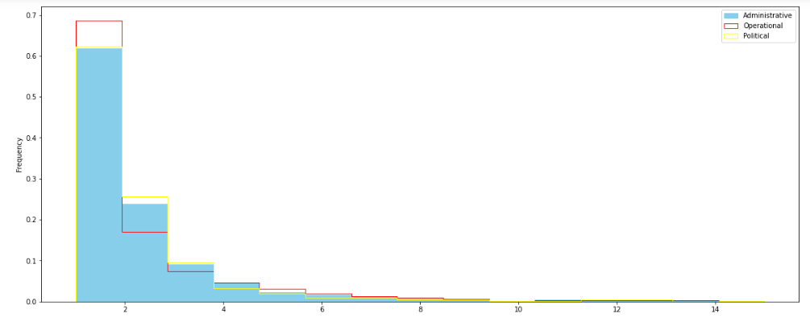
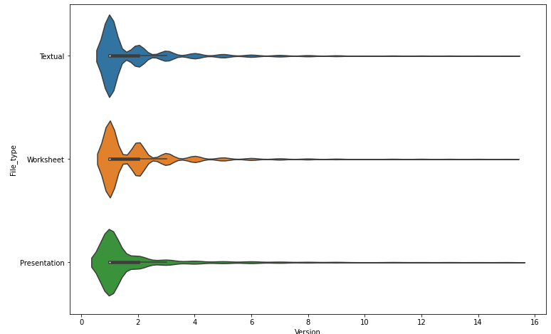
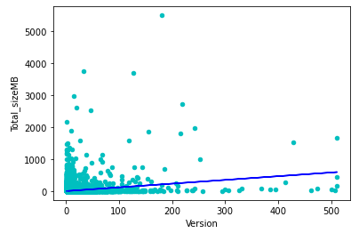
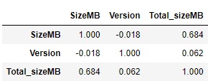
Collaboration within
Sharepoint platform
Alfonso Garcia Miguel
Information Management Adviser. ICRC
Summary
SharePoint has been installed in 2014 as the documentary repository of the institution to promote collaboration among teams.
The original intention is that teams not only store in the platform their documents, but that they create and update them there.
Collaboration can be measured through “Version” of document: Version number indicates the times a document has been updated
The tool is used by around 200 services worldwide and contains today >2 Mio. Documents
Services can be considered having three different natures, Operational, Administrative and Political
Usage of the tool is not compulsory. However, storing documents there offer some advantages (publication, retrieval, archiving)
It was never assessed if collaboration has been achieved. This is the purpose of this test
Data description
Data has been extracted through the native Sharepoint extraction tool, sharegate, which produces an excel file
A sample of 5 different services has been selected to cover the three different natures: Two operational, two administrative and one political. In total, the sample contains around 200K documents. (10% of the total population)
Data needs heavy cleaning before usage.
1. Overall versioning
3. Versioning by nature of work
5. Mann Whitney test among Services populations
(Do services work differently?)
null hypothesis H0: Distributions of both populations are equal
P-Value Administrative vs Operational populations:
P-Value Administrative vs Political populations:
P-Value Operational vs Political populations:
H0 can be rejected. Services work differently and thus there is different levels of collaboration.
7. Correlations
(Version / Size):
Findings / Procedures / Tests
2. Dumping of
documents
4. Versioning
by file type
6. Mann Whitney test among Files populations
(Does collaboration depend on the type of document?)
null hypothesis H0: Distributions of both populations are equal
P-Value Text vs Worksheet populations:
P-Value Text vs Presentation populations:
P-Value Presentation vs Worksheet populations:
H0 can be rejected. Working is different depending on the file type.
Conclusions

