Slide 1

Basic web application with Firebase
Web based technologies
Alfonso López Ruiz

Slide 2
How to create a new project in Firebase
Basic operations: CRUD
Try out a basic web application with Firebase

Slide 3

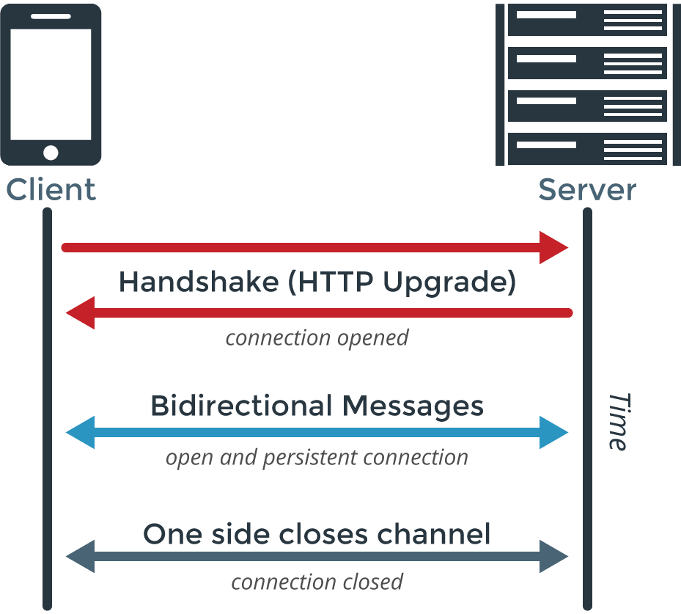
Introduction
What is firebase?
In this tutorial we’ll use Firebase as a Realtime Database, which means we’ll get real time data.
That’s achieved by using WebSockets instead of HTTP calls.
This is what lets us get real time data, since we’re not following a Request-Response pattern as HTTP does.
Also, because we don’t have to make a request before we get any data, WebSockets are much faster.

Slide 4
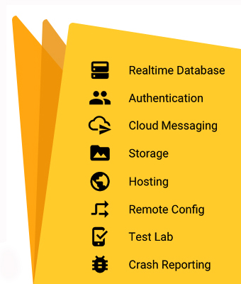
Introduction
What is firebase?
Actually, Firebase is much more than a Realtime database:
We can upload files, mostly images, directly from the client (Storage)
Email / Password authentication system. It also supports authentication for Google, Github… (Authentication)
Notifications to users (Cloud Messaging)
…

Slide 5
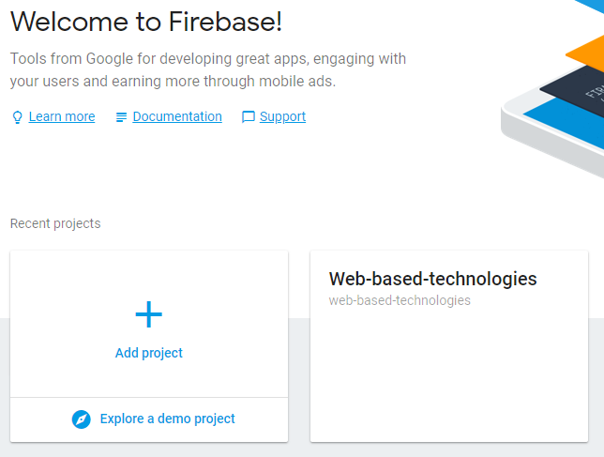
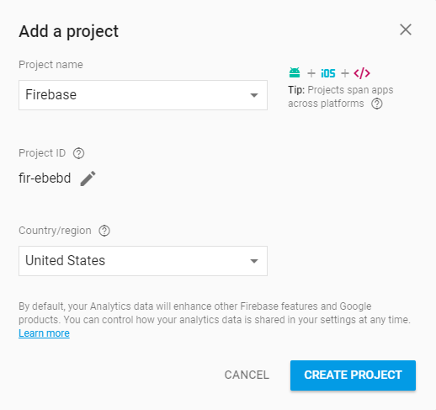
How to create a project in Firebase
The page where we can manage our projects is https://console.firebase.google.com (we can access with our Google account).

Slide 6
How to create a project in Firebase
Once our project is created we get a piece of code like the following one:
<script src="https://www.gstatic.com/firebasejs/4.10.1/firebase.js"></script> <script> var config = { apiKey: "<API_KEY>", authDomain: "<PROJECT_ID>.firebaseapp.com", databaseURL: "https://<DATABASE_NAME>.firebaseio.com", storageBucket: "<BUCKET>.appspot.com", messagingSenderId: "<SENDER_ID>", }; firebase.initializeApp(config); </script>
We must place this Javascript code in our application: in the HTML code or in a Javascript file referenced by our application.
This piece of code references our database, so we can initialize and manipulate it.

Slide 7
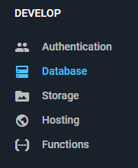
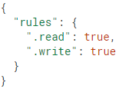
How to create a project in Firebase
From now on, we’ll use the tab Database at the Firebase console.
In this tab we can access the Rules of our database, which determine the Read and Write rights of the users, as well as the structure of our database and indexes.
For developing purposes we must mark the Read and Write properties as true. It means that anyone can read or write in our database, so we must set it as necessary once the developing process is over.
In this tab we can also access the data from our database…

Slide 8



How to create a project in Firebase
In contrast to a SQL database, Firebase has no tables or registers. Firebase uses a JSON tree to save the data, where the values of our entities will be nodes at that tree structure.
Our tree structure must be as flat as possible. This way, if we want to get the chat ‘one’, we don’t get all the messages related to that chat.
{ "chats": { "one": { "title": "Historical Tech Pioneers", }, "two": { ... }, },
"messages": { "one": { "m1": { "message": "The relay seems to be malfunctioning.", }, "m2": { ... }, }, "two": { ... }, } }
{ "chats": { "one": { "title": "Historical Tech Pioneers", "messages": { "m1": { "message": "Relay malfunction found. Cause: moth." }, "m2": { ... }, } }, "two": { ... } } }

Slide 9
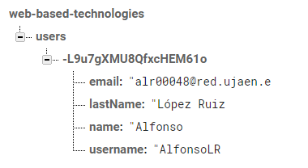
Basic operations: CRUD
From now on, our database consist of users, and we’ll see how to read and modify the database (insert, update and delete).
We don’t have auto increment properties, but we got strings that we can use as a key for our users.
Once we copy the previous piece of code in our application, we can save an instance of our database:
var db = firebase.database()

Slide 10
Basic operations: CRUD
How can we insert users?
Database path
In case we know the tree path, we can do it as follows:
If the user wants to modify the username, this approach is not the best, since we need to delete the user and create a new one.
db.ref('users/' + username).set({ name: name,
lastName: lastName, email: email, });
var users = db.ref('users');
var data = {
username: username,
name: name,
lastName: lastName,
email: email
}
users.push(data);
We can automatically generate a key for the new user with ‘push’.

Slide 11
Basic operations: CRUD
How can we read users?
Because of that bi-directional communication we’ve already talked about, our queries can be triggered more than once, so we can get events like updates, insertions or deletions.
As we’re used to see, queries are only ‘executed’ once, and we can get this behaviour in Firebase too.
var userRef = db.ref(‘users/' + userId); userRef.once('value', function(snapshot) { // Do something });
We could also make a query that listens to events, and remove that listener once our query is executed.
Once we know how to listen to events, we’ll see how to remove those listeners.

Slide 12
Basic operations: CRUD
Let’s suppose the next situation: we need to show all our users in our page in realtime, so we can listen for insertions, updates and deletions.
What events can we associate to a query?
Event | Description
child_added | This event is triggered once per existing element and once again when a new element is inserted.
child_changed | This event detects any change in a secondary node, including the descendants from those nodes.
child_removed | This even is triggered when a secondary node is removed.
child_moved | This event detects changes in the order of an ordered list.
We’ll see how to insert, update and remove users.

Slide 13
Basic operations: CRUD
So, how can we read users and display them?
We want to show all our users in our page, and we want this list to be updated in realtime, so we can accomplish that with the event ‘child_added’.
For example, in jQuery we can execute this piece of code once the document is ready.
db.ref().child('users').on('child_added', function(snapshot) {
addUser(snapshot.key, snapshot.val().name + ' ' + snapshot.val().lastName, snapshot.val().username, snapshot.val().email);
});
Automatically generated key
User associated to that key (only the attributes of that user (username, email…) – The behavior is not the same in ‘once’ queries!!
This will let us show the users that already exists as soon as the page is loaded, and will let us listen to insertions.

Slide 14
Basic operations: CRUD
How can we update users?
In our application (we’ll see later) we can update the users we’ve already created, including their username (that’s why we don’t use it as a key). We can update an user with ‘update’, taking into account we must have a reference to one of them.
We just want to update the information of an specific user once, that’s why we’ll use the ‘once’ query we saw previously.
var usernameRef = db.ref().child('users').orderByChild('username').equalTo(‘newUsername’).once('value', function(snapshot) {
var update = {
username: username
name: name,
lastName: lastName,
email: email
};
var userRef = db.ref('users/' + Object.keys(snapshot.val())[0]);
userRef.update(update);
});
We’re searching by the column ‘username’
Node from our database ~ User ‘table’
Reference to an user.
That’s an special case, ‘once’ queries returns the whole user: key + attributes, so we need to access only its key.

Slide 15

Basic operations: CRUD
How can we delete users?
The way to delete users is similar to the update process. We need to get those users with a certain username, and then execute the ‘remove’ order.
var usernameRef = db.ref().child('users').orderByChild('username').equalTo(‘newUsername’).once('value', function(snapshot) {
db.ref('users/' + Object.keys(snapshot.val())[0]).remove();
});
In order to make queries we’ve used methods like orderByChild or equalTo but there’s a lot of methods we can use:
limitToLast
limitToFirst
startAt
orderByKey
…
Reference to the Firebase query guide!

Slide 16
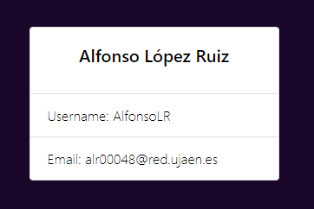
Basic operations: CRUD
We can insert, update and delete users, even listen to insert events, but if an update or a deletion occurs, our page won’t get updated…
As we did with ‘child_added’, we still need to listen for those events:
<div id=“keyIdentifier”> … </div>
Removes
db.ref().child('users').on('child_removed', function(snapshot) {
removeUser(snapshot.key);
});
Updates
db.ref().child('users').on('child_changed', function(snapshot) {
updateUser(snapshot.key, snapshot.val().name + ' ' + snapshot.val().lastName, snapshot.val().username, snapshot.val().email);
});

Slide 17
Basic operations: CRUD
We said that instead of using the ‘once’ query we could also make a query and then remove the listener associated to that query. Obviously it is not recommended to use if we can use the ‘once’ query, but it could be interesting to learn how to remove a listener.
var usernameRef = db.ref().child('users').orderByChild('username').equalTo(‘newUsername’).on(‘child_added', function(snapshot) {
var update = {
username: username
name: name,
lastName: lastName,
email: email
};
var userRef = db.ref('users/' + Object.keys(snapshot.val())[0]);
userRef.update(update);
});
db.ref().off(‘child_added’, usernameRef);
Any event, we’ll remove it later
Remove the listener

Slide 18
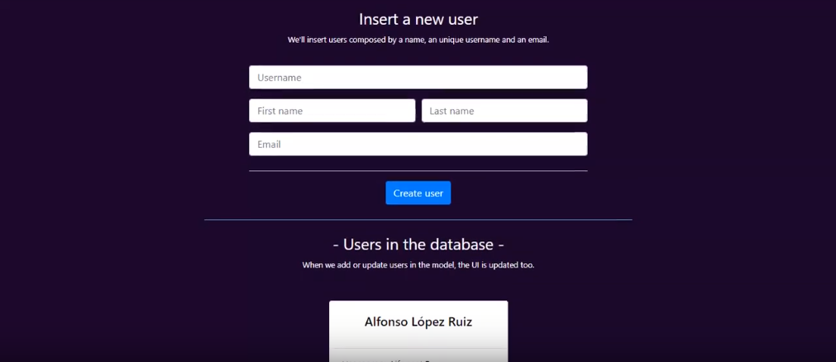

Try out a basic wep application with Firebase
We’ve created a web application in order to show an example of realtime data.
It consists only of users with username, name and email. Take into account that the username must be unique, even though it is not the key for the entity user.

Slide 19

You can check this project in Github!
Firebase project - AlfonsoLRz

Slide 20

Links to keep learning about Firebase:
Firebase web documentation
Firebase web queries
Getting started with Firebase on the Web (Video)
Firebase database for SQL developers (List of videos)
Firebase channel (Youtube)
Other resources:
Javascript library of particles animations.

