Slide 1

Basic web application with Firebase
Web based technologies
Alfonso López Ruiz

Slide 2
How to create a new project in Firebase
Basic operations: CRUD
Try out a basic web application with Firebase

Slide 3

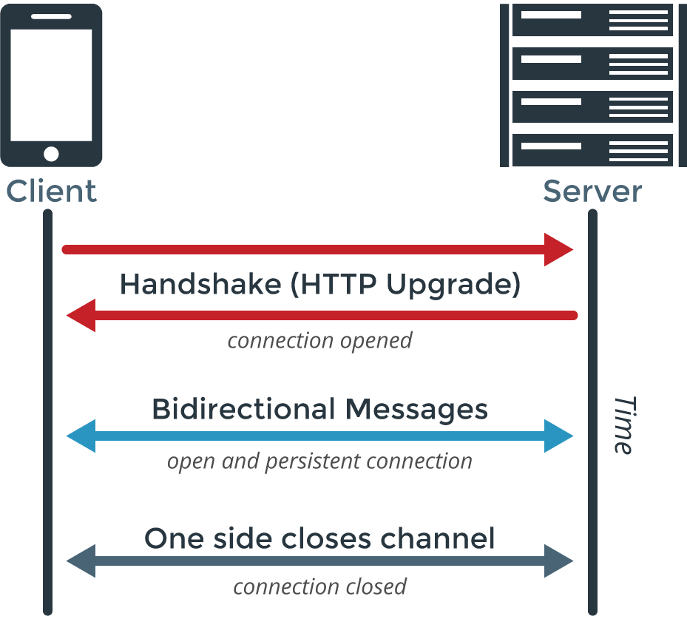
Introduction
What is firebase?
In this tutorial we’ll use Firebase as a Realtime Database, which means we’ll get real time data.
That’s achieved by using WebSockets instead of HTTP calls.
This is what lets us get real time data, since we’re not following a Request-Response pattern as HTTP does.
Also, because we don’t have to make a request before we get any data, WebSockets are much faster.

Slide 4
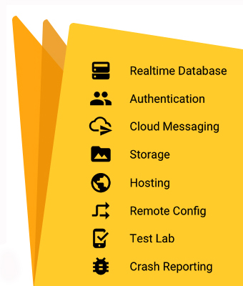
Introduction
What is firebase?
Actually, Firebase is much more than a Realtime database:
We can upload files, mostly images, directly from the client (Storage)
Email / Password authentication system. It also supports authentication for Google, Github… (Authentication)
Notifications to users (Cloud Messaging)
…

Slide 5
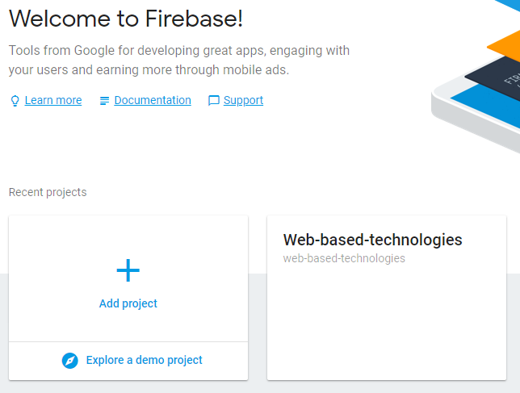
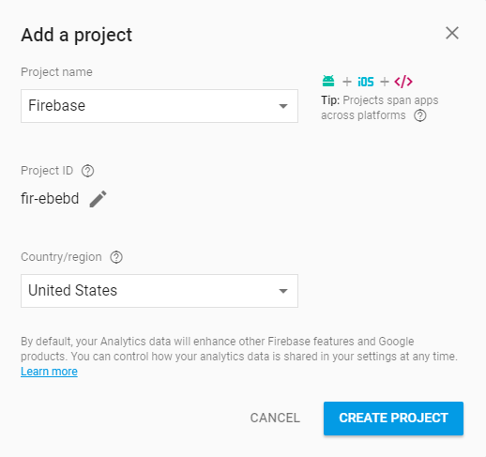
How to create a project in Firebase
The page where we can manage our projects is https://console.firebase.google.com (we can access with our Google account).

Slide 6
How to create a project in Firebase
Once our project is created we get a piece of code like the following one:
<script src="https://www.gstatic.com/firebasejs/4.10.1/firebase.js"></script> <script> var config = { apiKey: "<API_KEY>", authDomain: "<PROJECT_ID>.firebaseapp.com", databaseURL: "https://<DATABASE_NAME>.firebaseio.com", storageBucket: "<BUCKET>.appspot.com", messagingSenderId: "<SENDER_ID>", }; firebase.initializeApp(config); </script>
We must place this Javascript code in our application: in the HTML code or in a Javascript file referenced by our application.
This piece of code references our database, so we can initialize and manipulate it.

Slide 7
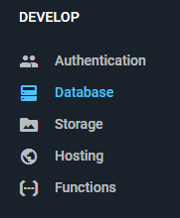
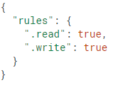
Introduction
From now on, we’ll use the tab Database at the Firebase console.
In this tab we can access the Rules of our database, which determine the Read and Write rights of the users, as well as the structure of our database and indexes.
For developing purposes we must mark the Read and Write properties as true. It means that anyone can read or write in our database, so we must set it as necessary once the developing process is over.
In this tab we can also access the data from our database…

Slide 8
How to create a project in Firebase
In contrast to a SQL database, Firebase has no tables or registers. Firebase uses a JSON tree to save the data, where the values of our entities will be nodes at that tree structure.
{ "chats": { "one": { "title": "Historical Tech Pioneers", }, "two": { ... }, },
"messages": { "one": { "m1": { "message": "The relay seems to be malfunctioning.", }, "m2": { ... }, }, "two": { ... }, } }
{ "chats": { "one": { "title": "Historical Tech Pioneers", "messages": { "m1": { "message": "Relay malfunction found. Cause: moth." }, "m2": { ... }, } }, "two": { ... } } }

Slide 9
TRANSITION HEADLINE
1.
Let’s start with the first set of slides

Slide 10
Quotations are commonly printed as a means of inspiration and to invoke philosophical thoughts from the reader.

Slide 11
THIS IS A SLIDE TITLE
Here you have a list of items
And some text
But remember not to overload your slides with content
Your audience will listen to you or read the content, but won’t do both.

Slide 12
BIG
CONCEPT
Bring the attention of your audience over a key concept using icons or illustrations

Slide 13
YOU CAN ALSO SPLIT YOUR CONTENT
White
Is the color of milk and fresh snow, the color produced by the combination of all the colors of the visible spectrum.
Black
Is the color of coal, ebony, and of outer space. It is the darkest color, the result of the absence of or complete absorption of light.

Slide 14
IN TWO OR THREE COLUMNS
Yellow
Is the color of gold, butter and ripe lemons. In the spectrum of visible light, yellow is found between green and orange.
Blue
Is the colour of the clear sky and the deep sea. It is located between violet and green on the optical spectrum.
Red
Is the color of blood, and because of this it has historically been associated with sacrifice, danger and courage.

Slide 15
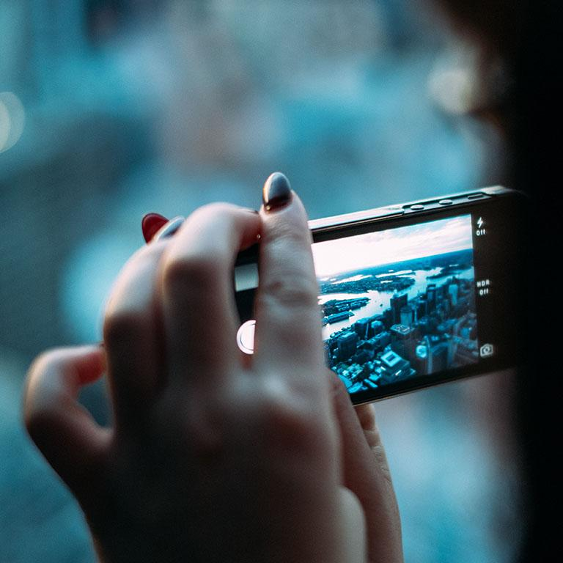
A PICTURE IS WORTH A THOUSAND WORDS
A complex idea can be conveyed with just a single still image, namely making it possible to absorb large amounts of data quickly.

Slide 16
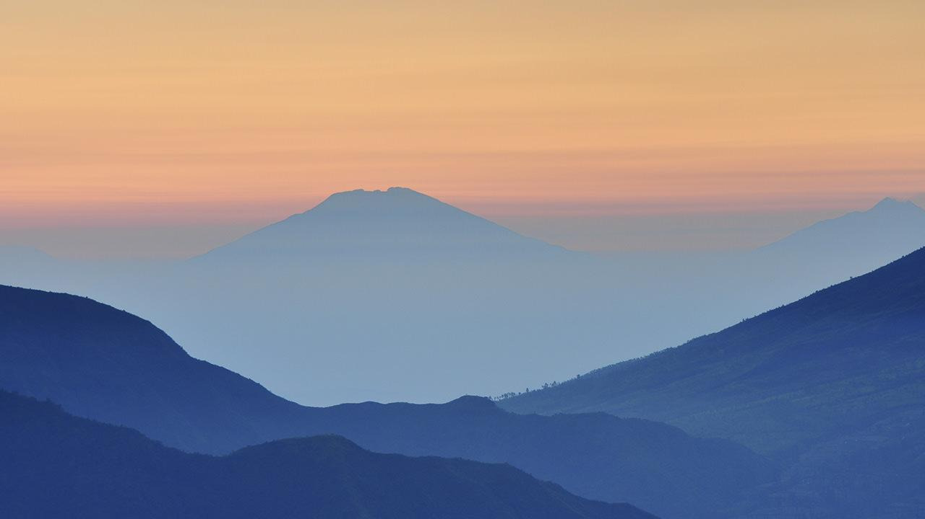
Want big impact?
USE BIG IMAGE.

Slide 17
USE CHARTS TO EXPLAIN YOUR IDEAS
White
Gray
Black

Slide 18
AND TABLES TO COMPARE DATA
 | A | B | C
Yellow | 10 | 20 | 7
Blue | 30 | 15 | 10
Orange | 5 | 24 | 16

Slide 19
MAPS
our office

Slide 20
89,526,124
Whoa! That’s a big number, aren’t you proud?

Slide 21
89,526,124$
185,244 users
100%
That’s a lot of money
And a lot of users
Total success!

Slide 22
OUR PROCESS IS EASY
first
second
last

Slide 23
Let’s review some concepts
Yellow
Is the color of gold, butter and ripe lemons. In the spectrum of visible light, yellow is found between green and orange.
Blue
Is the colour of the clear sky and the deep sea. It is located between violet and green on the optical spectrum.
Red
Is the color of blood, and because of this it has historically been associated with sacrifice, danger and courage.
Yellow
Is the color of gold, butter and ripe lemons. In the spectrum of visible light, yellow is found between green and orange.
Blue
Is the colour of the clear sky and the deep sea. It is located between violet and green on the optical spectrum.
Red
Is the color of blood, and because of this it has historically been associated with sacrifice, danger and courage.

Slide 24
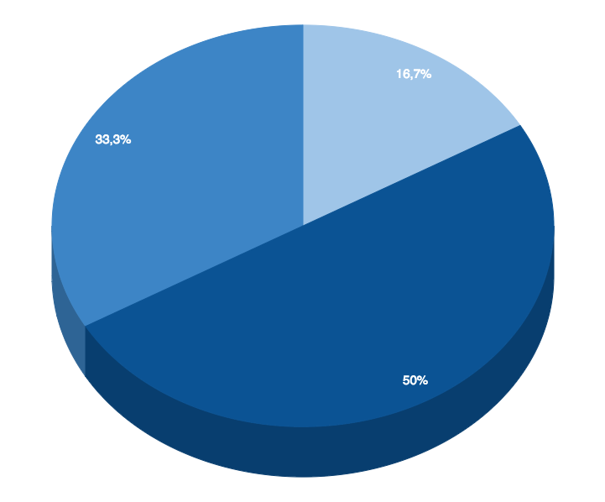
You can insert graphs from Google Sheets

Slide 25
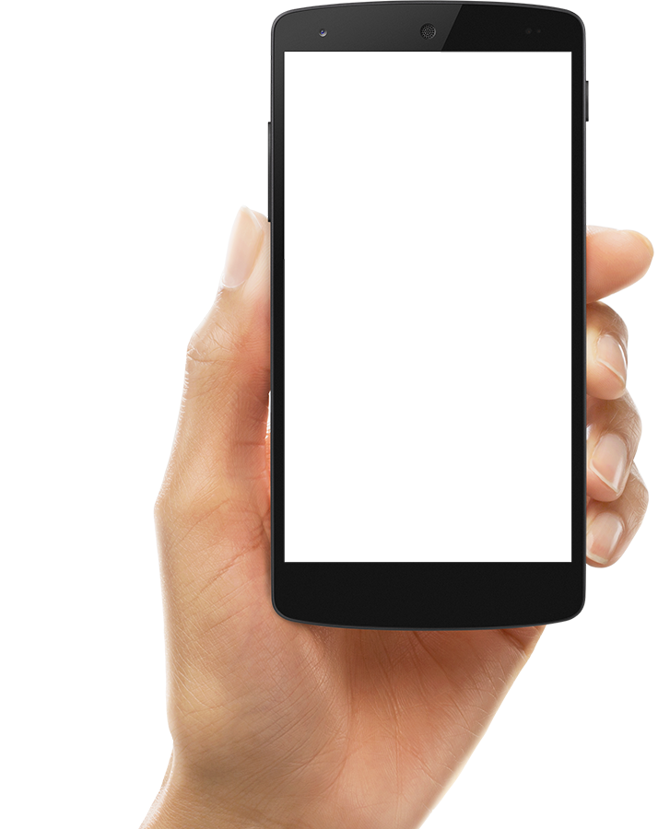
ANDROID PROJECT
Show and explain your web, app or software projects using these gadget templates.

Slide 26
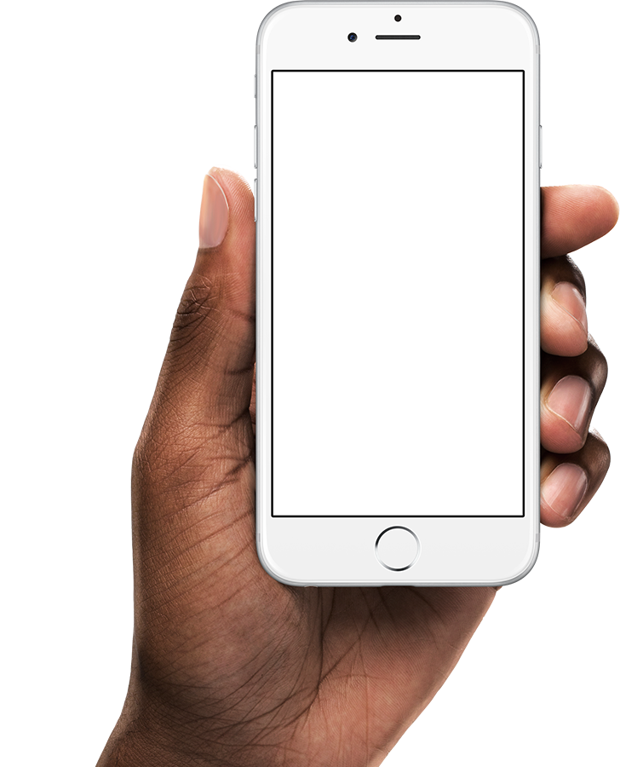
iPHONE PROJECT
Show and explain your web, app or software projects using these gadget templates.

Slide 27
Place your screenshot here
TABLET PROJECT
Show and explain your web, app or software projects using these gadget templates.

Slide 28
Place your screenshot here
DESKTOP PROJECT
Show and explain your web, app or software projects using these gadget templates.

Slide 29

THANKS!
Any questions?
You can find me at:
@username
user@mail.me

Slide 30
CREDITS
Special thanks to all the people who made and released these awesome resources for free:
Presentation template by SlidesCarnival
Photographs by Unsplash
Diverse device hand photos by Facebook Design Resources

Slide 31
PRESENTATION DESIGN
This presentation uses the following typographies and colors:
Titles: Montserrat
Body copy: Source Sans Pro
You can download the fonts on these pages:
https://www.fontsquirrel.com/fonts/montserrat
https://www.fontsquirrel.com/fonts/source-sans-pro
Sky Blue #00bef2 / Navy Blue #25516c
You don’t need to keep this slide in your presentation. It’s only here to serve you as a design guide if you need to create new slides or download the fonts to edit the presentation in PowerPoint®

Slide 32
SlidesCarnival icons are editable shapes.
This means that you can:
Resize them without losing quality.
Change fill color and opacity.
Change line color, width and style.
Isn’t that nice? :)
Examples:

Slide 33
😉
Now you can use any emoji as an icon!
And of course it resizes without losing quality and you can change the color.
How? Follow Google instructions https://twitter.com/googledocs/status/730087240156643328
✋👆👉👍👤👦👧👨👩👪💃🏃💑❤😂😉😋😒😭👶😸🐟🍒🍔💣📌📖🔨🎃🎈🎨🏈🏰🌏🔌🔑 and many more...

