Slide 1
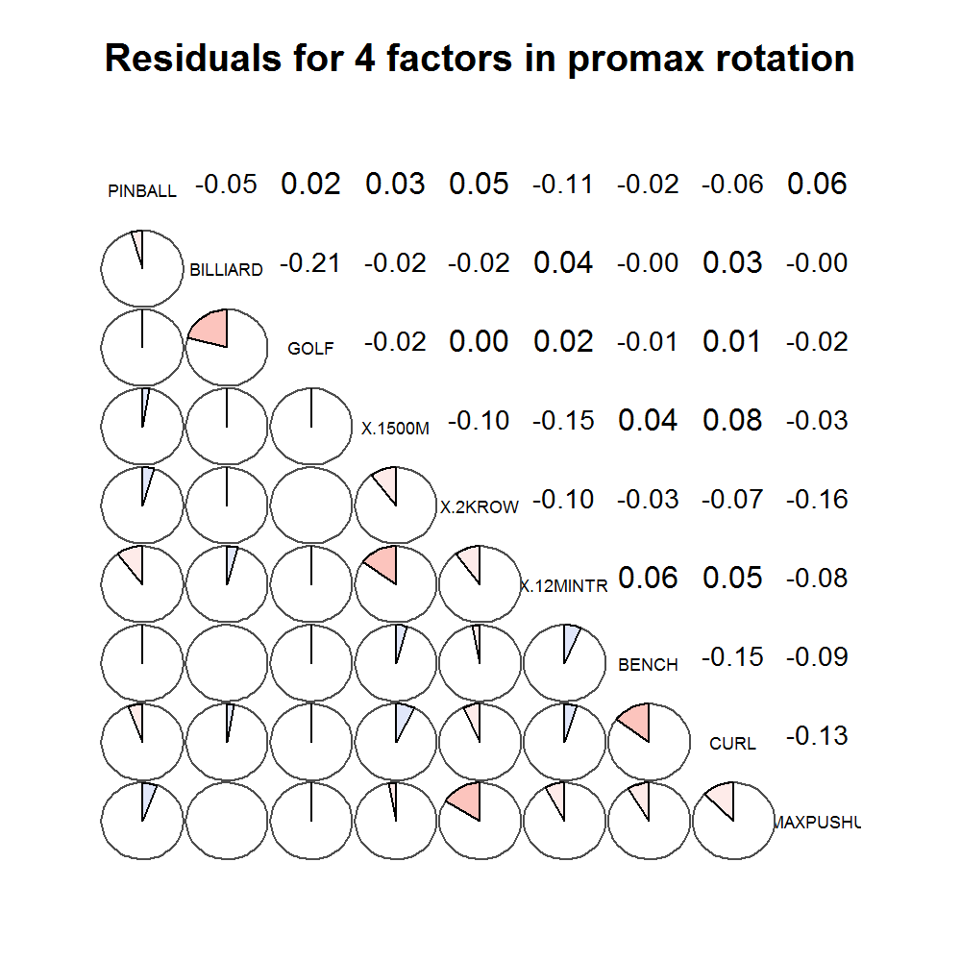
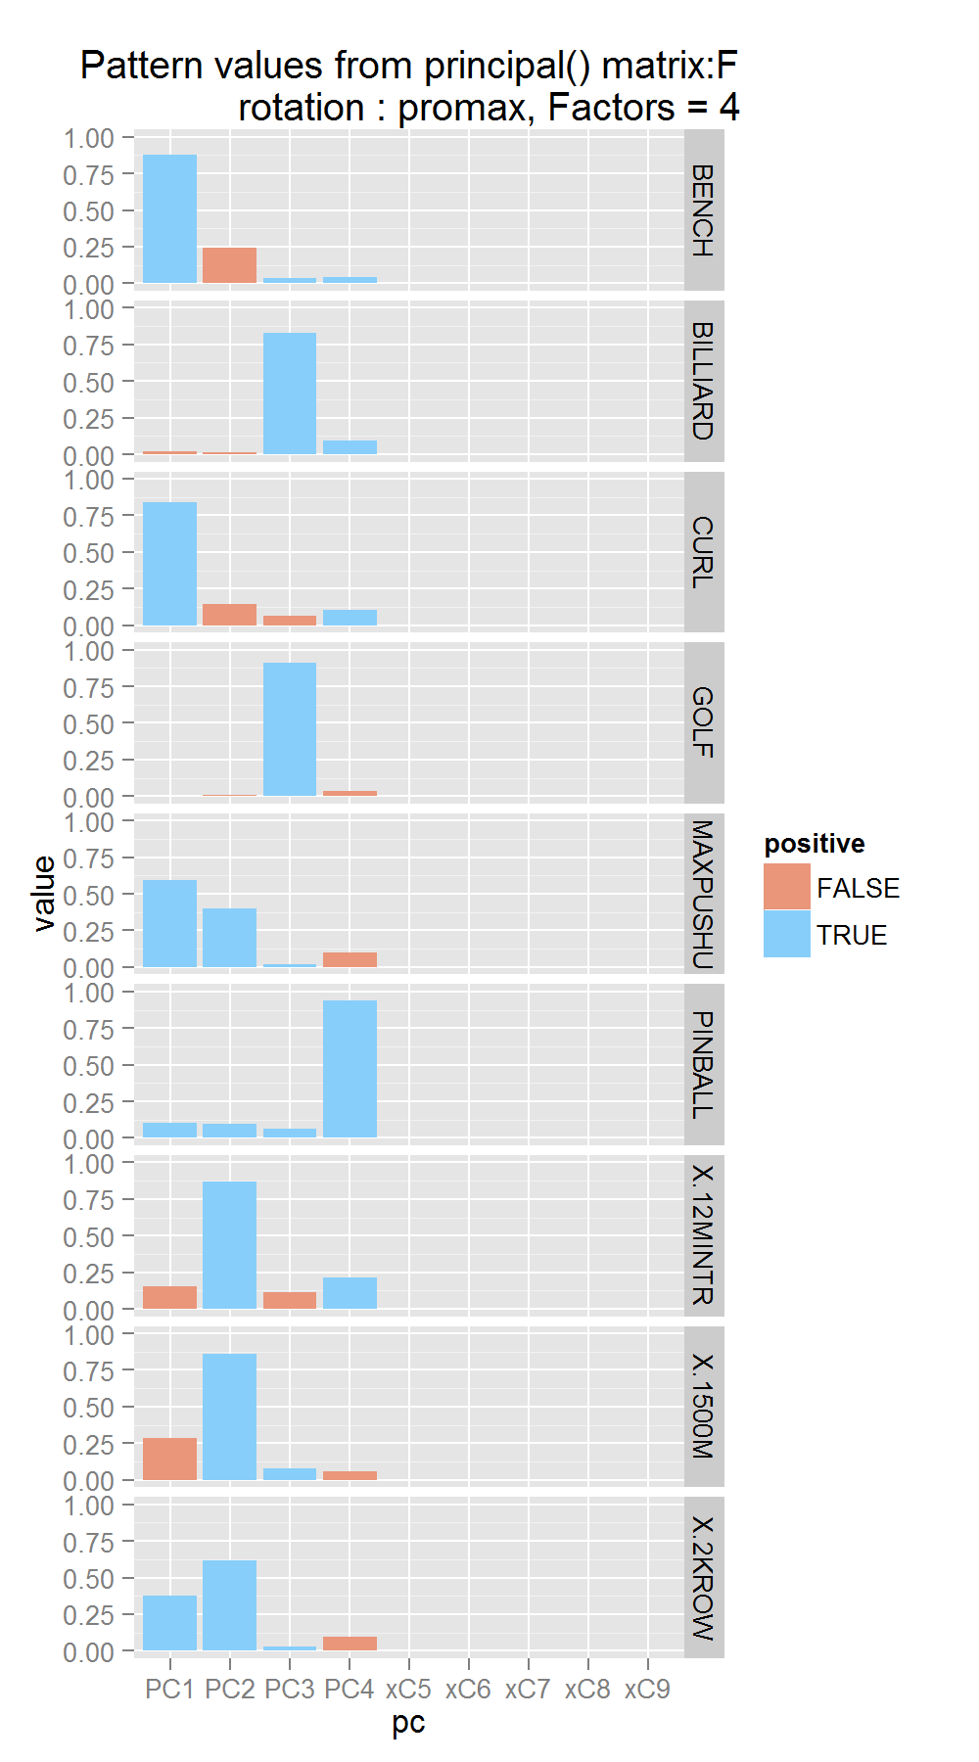
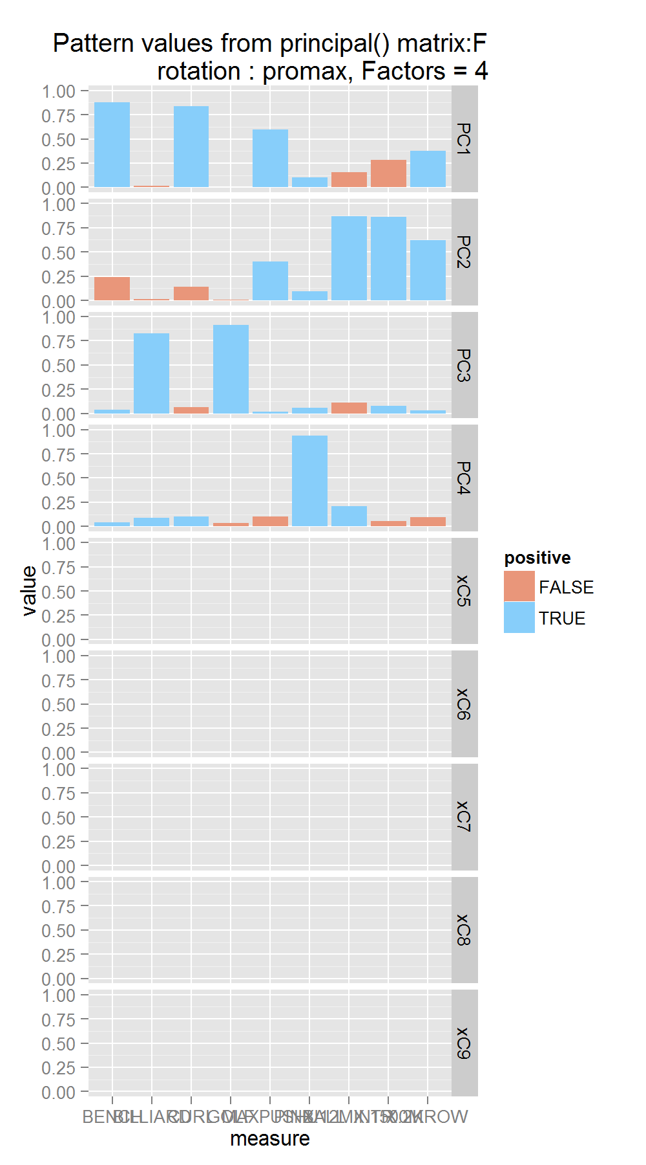
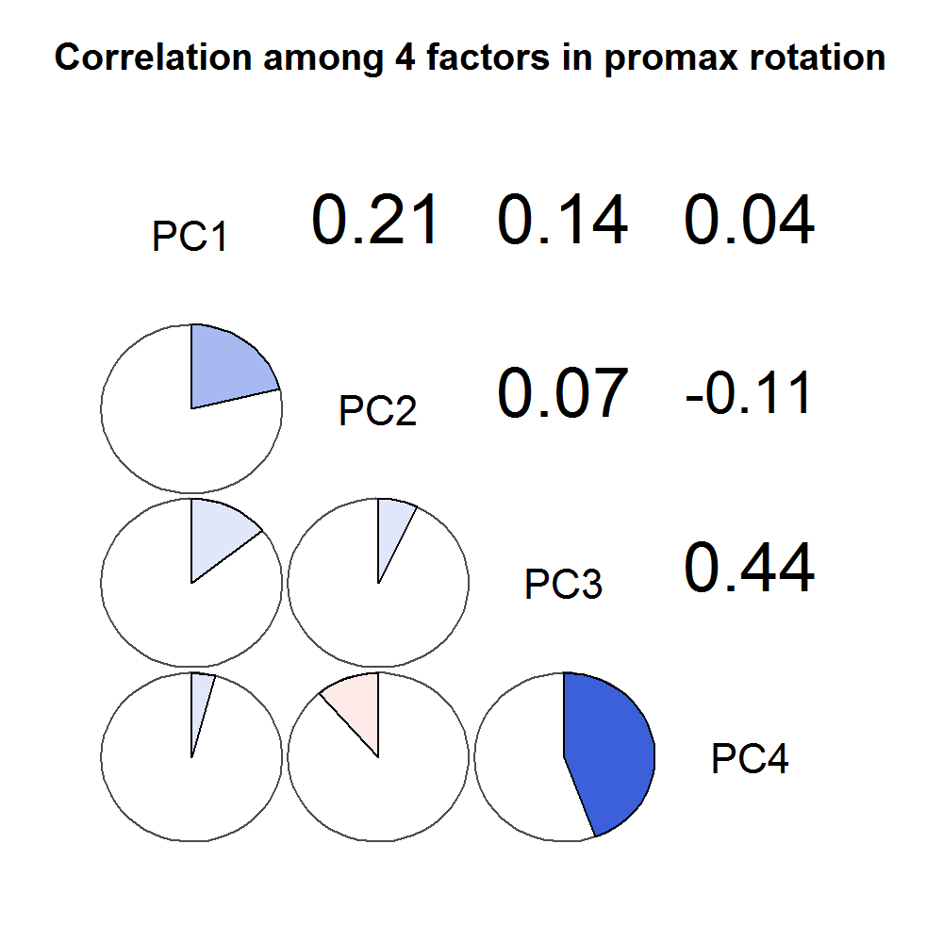
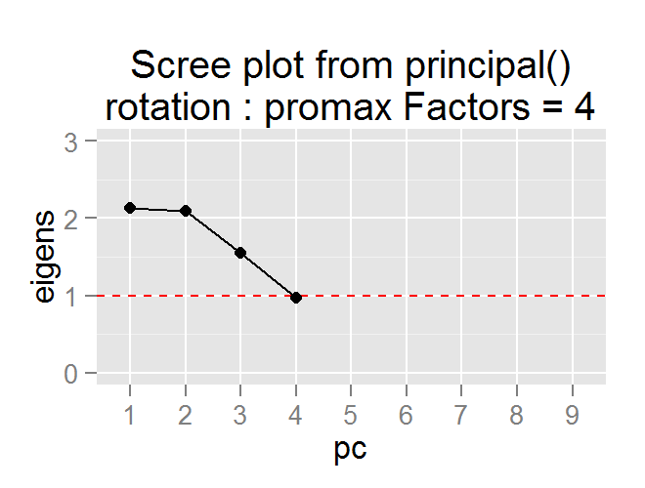
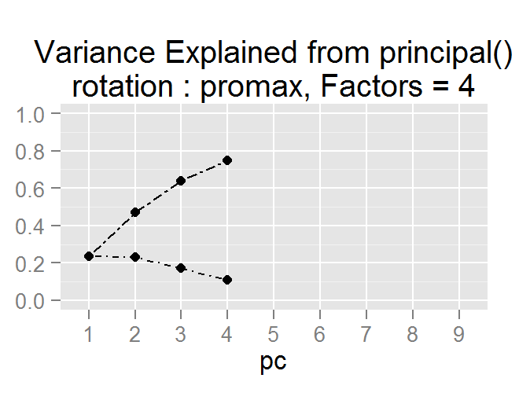
#
Factors
Rotation
none
1
varimax
2
quatimax
3
promax
4
oblimin
5
simplimax
6
cluster
7
8
9
Notes:
none

Slide 2
Notes:
varimax

Slide 3
Notes:
quatimax

Slide 4
Notes:
promax

Slide 5
Notes:
oblimin

Slide 6
Notes:
simplimax

Slide 7
Notes:
cluster

