Slide 1
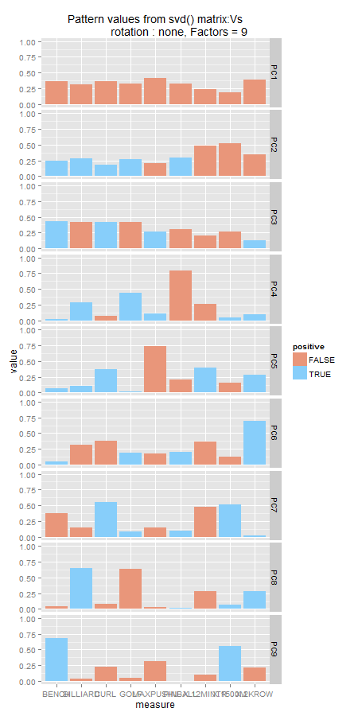
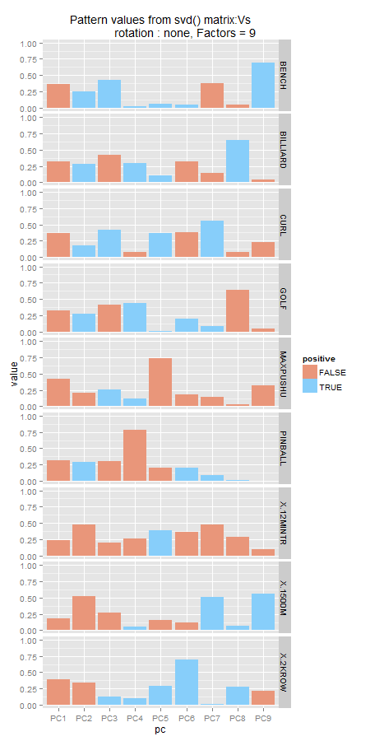
Fe
V
D
V’
U
D
V’
Fs

Slide 2


Fe
V
D
V’
U
D
V’
Fs

Slide 3
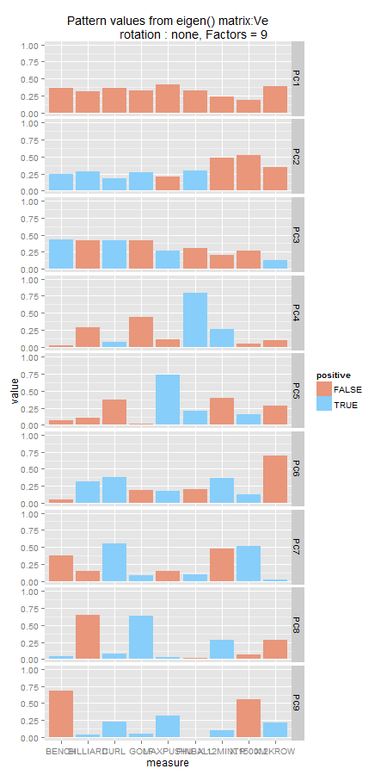
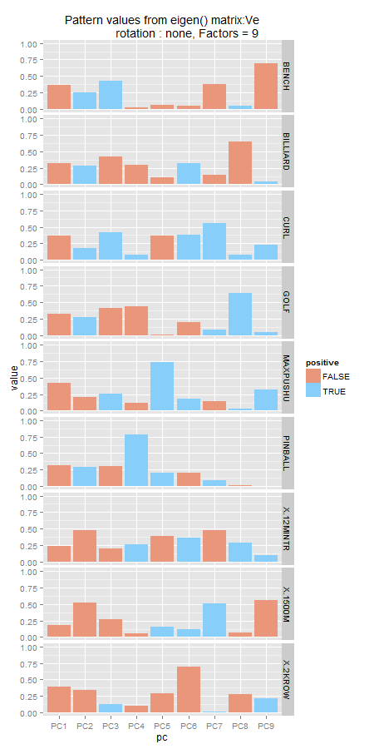
Fe
V
D
V’
U
D
V’
Fs

Slide 4
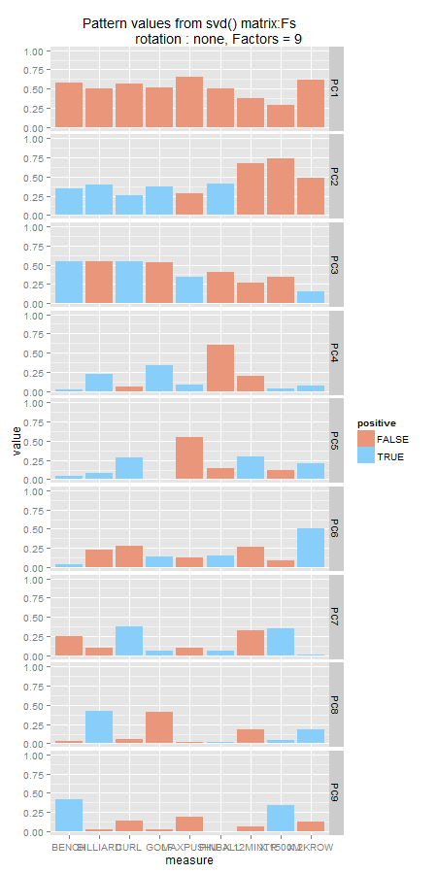
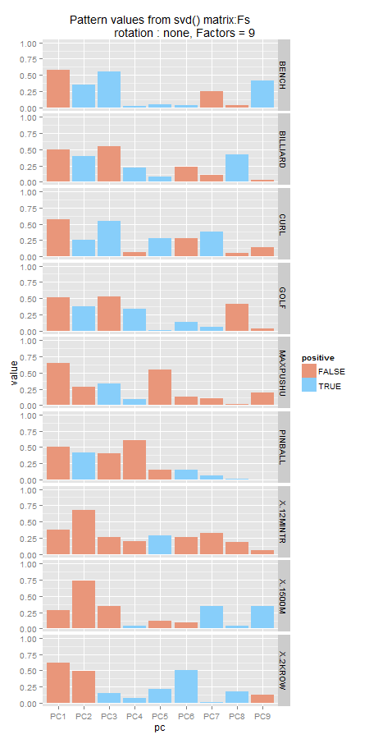
Fe
V
D
V’
U
D
V’
Fs

Slide 5
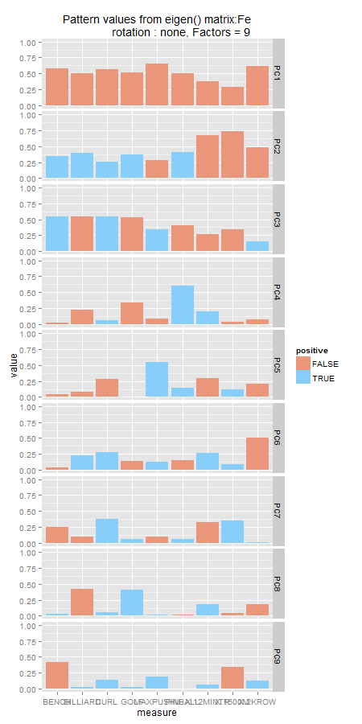
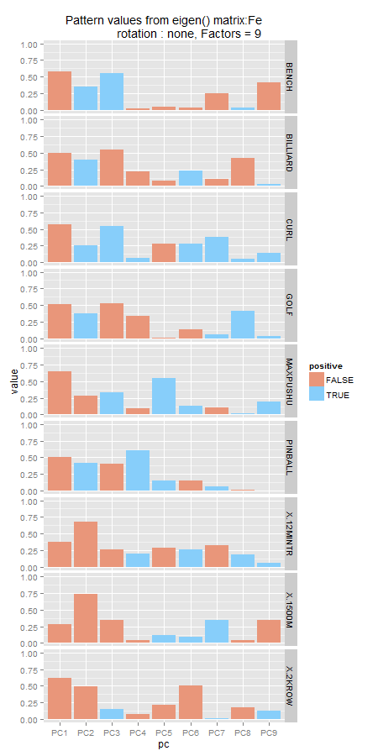
Fe
V
D
V’
U
D
V’
Fs

