Slide 1



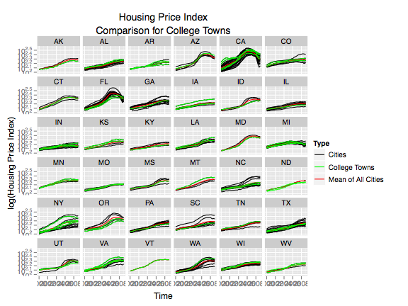
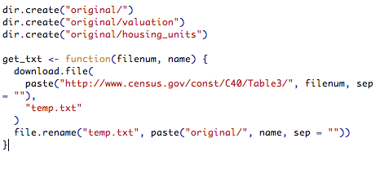
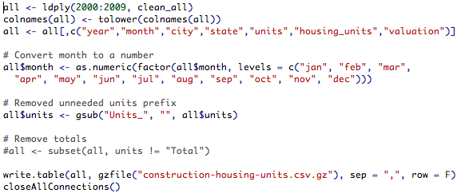
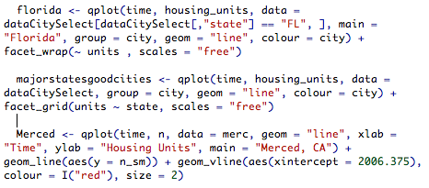
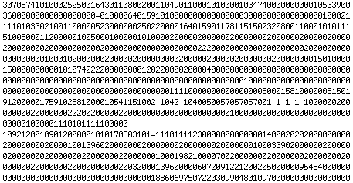
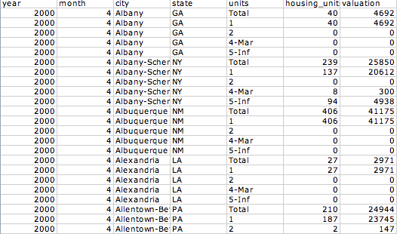
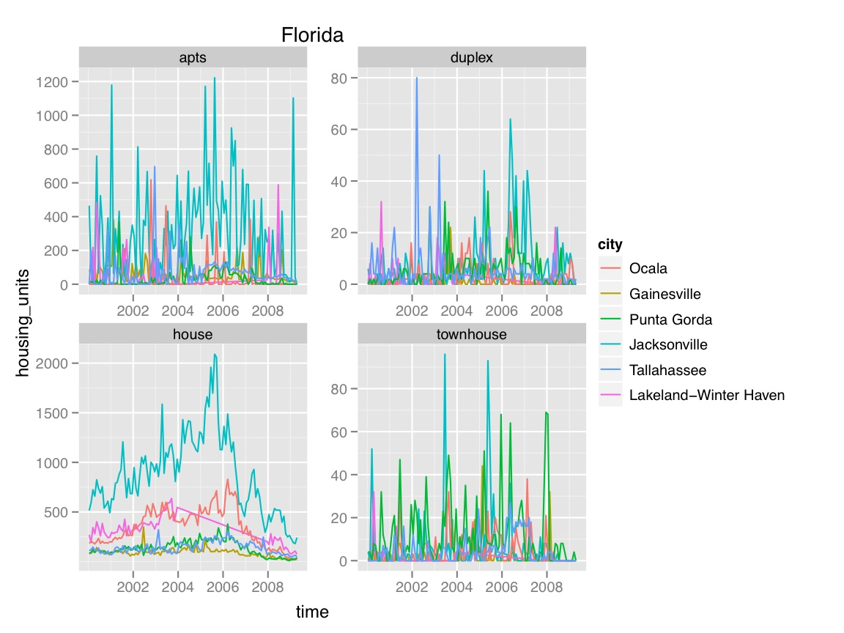
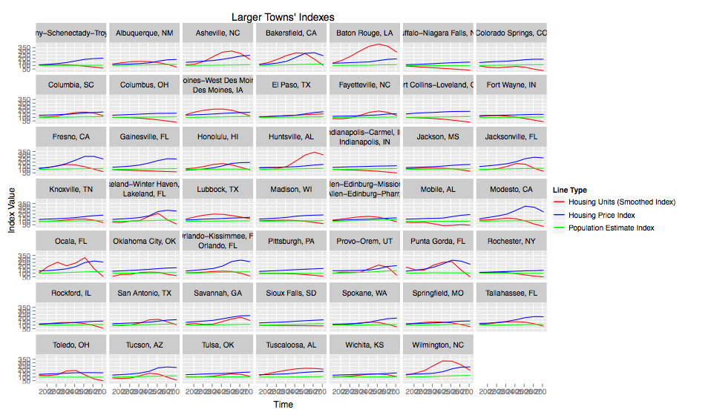
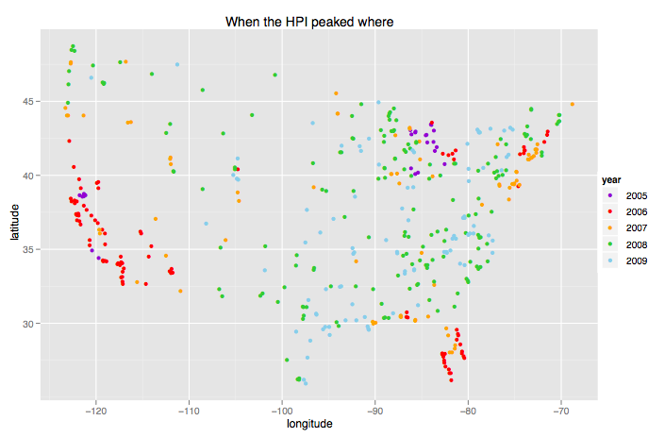
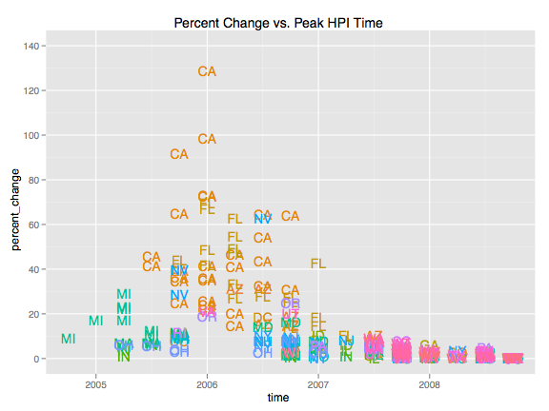
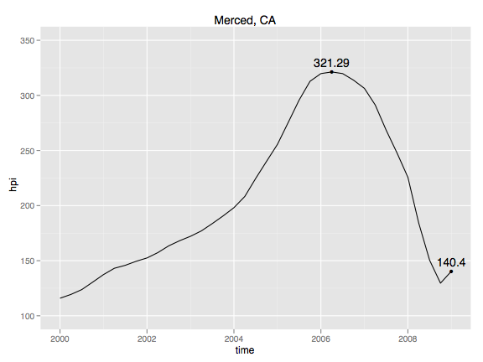
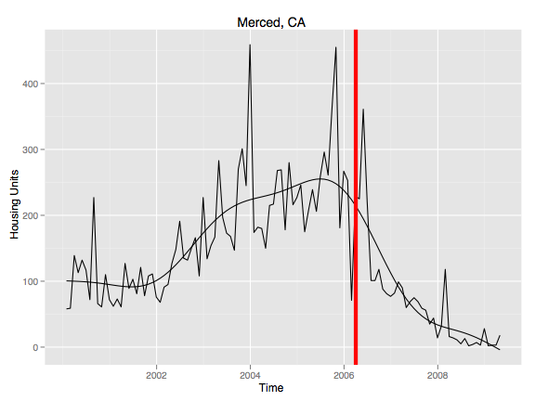
Visualization of Large Data Sets- The Housing Crisis
Dr. Hadley Wickham, Garrett Grolemund, Dexter Gannon, Gabi Quart, Barret Schloerke
VIGRE: Statistics, Rice University
The Housing Crisis
Cleaning And Visualizing Large Data Sets
More Findings
Overview and Motivation
R: Statistical Programming- We use the program R to clean our data sets. R is considered a statistical standard among statisticians. There are three crucial advantages to suing R. We are able to download and manipulate extremely large data sets on a normal desktop. It also allows us to produce impressive graphics with minimal coding. Most importantly, the program is open source and free to the public.
Cleaning data- Clean data should be easy to read and follow. Cleaning can be very complicated because data is rarely in this form when it is initially downloaded.
Analysis and Visualization- The size of the clean data sets can be very overwhelming. It is almost impossible to just graph the entire data set and expect to see any distinct patterns. We usually start small with our analysis- we graph data from one city and look for a pattern. We then build up from there and look to relationships among several variables.
College Towns
Real Estate Bubble- Around 2006, house prices rose much higher than their true value. Eventually, housing prices became so high, it was difficult for current owners to afford their house. As foreclosure rates increased, house prices began to plummet. This has largely affected the global economy.
Little Public Organized Data- There is a lot of speculation over the causes and the effects of the housing crisis. Unfortunately, most of these ideas come from opinionated blogs or news articles that don’t list their sources. Therefore, it is difficult to collect reliable information.
Government Expenditures- The government has already exhausted millions of dollars in order to aid those affected by housing crisis. With such little public data about the crisis, we are left wondering what data the government is using.
Still Unfolding- It is important to realize that the housing crisis in ongoing. This allows us to track its progression and hopefully make predictions for the upcoming years.
Large Data Sets- the housing crisis serves as a perfect model for visualizing large data sets. Most data sets we collect usually cover multiple years, counties and variables.
After discovering Merced, CA we decided to look more closely at college towns. Contrary to belief, college towns were not greatly impacted by the housing crisis.
Figure 5: Shows the HPI for cities, college towns, and the average. Besides a few special cases, the HPI for college towns seem to fall close to the average HPI.
Download
Clean
Visualization
Relationship between construction, population, and house price index
We also are interested in finding relationships between multiple data sets.
Figure 6: This is a combination of the FHFA Housing Price Index, Census Construction, and Census Population data sets. It shows that population does not change, while the Construction seems to be a predictor for the Housing Price Index.
Goals
Specific to the Housing Crisis
What is the housing crisis? Is a city considered in a “housing crisis” if the house prices rise to a certain value? Or is it determined by the number of vacancies? Or the number of foreclosures? Or a decrease in housing construction?
When did it happen? When did the real estate bubble begin? Is there a relationship between when housing prices peaks in an area and how fast they fell?
Where did it hit the hardest? What states were impacted the most?
Who was affected? Were the rich affected as much as the poor? Was is better to rent or own a house?
Overall
Compile and clean as many data sets pertaining to the housing crisis
All data and findings should be reproducible
Make all our data available to the public in an organized fashion
Communicate our finding through an interactive website
Interesting Findings
Relationship between time and states affected by the crisis
The data graphed is from the Federal Housing Finance Agency (FHFA) house price index (HPI). Both of these graphs analyze what time the HPI peaked for each metropolitan statistical area (MSA).
Looking at both graphs we believe that timing seems to be very significant- if a state peaked earlier than 2006 or later than 2007, their HPI was not as greatly affected. This also supports the claim that California and Florida were impacted the greatest.
Other Explorations
Vacation Spots: Are areas where people own a second home more affected?
Renting vs. Owning: Is is better to rent or own a house?
Migration: Are cities that experienced massive population change affected?
Gross Domestic Product: Can we categorize a certain city by industry? Is there a relationship between cities that were hit by the housing crisis?
Problems
Communication
Hard To Find- All of the data we have collected come from multiple sources. Currently, there is no central repository where data can be found.
Licenses and Fees- Some of the data sets have licenses that do not allow us to reproduce or publish any of our findings. Also many of the data sets cost large amounts of money to purchase.
Size- Some data sets were as large as 10 GB. In order to work around this problem, we were able to extract certain parts of the data sets without having to completely download them.
Dirty- Most of the data sets we find are what we call “dirty.” They are usually unorganized and practically unreadable.
Reproducibility- It is extremely important that all of our data cleaning and findings are reproducible. This not only allows others to verify our results, but researchers can build off of the data we have collected. Also, it is easier for our research group to replicate what we have done before.
Github Website- Github is a very advance website that is able to track and changes made to data from multiple individuals. Github is advantageous to both our research group and to the general public. Firstly, we are able to freely store large amounts of data. Also it allows us to work on the same data without having to e-mail changes back and forth. In addition, others can view and download our data for free. Posted on Github, you will find a download code or source, a clean code, and an exports code. All of these codes can be run through R smoothly without any user input. http://github.com/hadley/data-housing- crisis/tree/master
Interactive Website- We hope to soon develop an interactive website that will allow users to easily access the data they are interested in, which would otherwise be a daunting task for those who wish to use a data set of this size. Because our analysis and findings also involve large amounts of information, (such as construction price time series for each US metropolitan area) we are exploring interactive graphical methods for displaying this information. Our future work will involve using the program Protovis to create this website.
Figure 1: Graphs peak HPI time. Here, you can see that both California and Florida peaked around the same time.
Figure 2: Every point is a MSA and labeled by state. It graphs the peak HPI time versus the percent change in HPI between then maximum HPI to 2009, quarter 1 HPI. This graph shows that if HPI peaked between 2006 and 2007, then that state typically experienced a much larger percent change in HPI.
Merced, CA
The city with the greatest percent change in HPI was Merced, CA. This observation is very unusual of small cities. Further research into Merced showed that University California of Merced has finished construction in late 2005. Using both Figure 3 and 4, we hypothesize that the construction increased due to the necessity of housing for UC Merced students and employees. We hope to look further into the relationship between the demand for construction and house prices.
Figure 3
Figure 4: Shows total construction of housing units built over time. The red line is the year Merced’s HPI peaked.
Some Current Data Sets
American Community Survey
Case-Shiller House Price Index (HPI)
Census 2007
Construction of Housing Units
Market Value of 1 month rent in a Room
Vacancies
Mortgage Rates
Federal Housing Finance Agency HPI
Sources
1. Federal Housing Finance Agency: http://www.fhfa.gov/Default.aspx?Page=87
2. Census Construction: http://www.census.gov/const/www/permitsindex.html
3. Census Population: http://www.census.gov/popest/datasets.html

