Slide 2
Distributed Database Concepts
A transaction can be executed by multiple networked computers in a unified manner.
A distributed database (DDB) processes a unit of execution (a transaction) in a distributed manner. A distributed database (DDB) can be defined as
A collection of multiple logically related databases distributed over a computer network, and a distributed database management system as a software system that manages a distributed database making the distribution transparent to the user.
2

Slide 3
Distributed Database System
Advantages
Management of distributed data with different levels of transparency:
This refers to the physical placement of data (files, relations, etc.) which is not known to the user (distribution transparency).
3

Slide 4
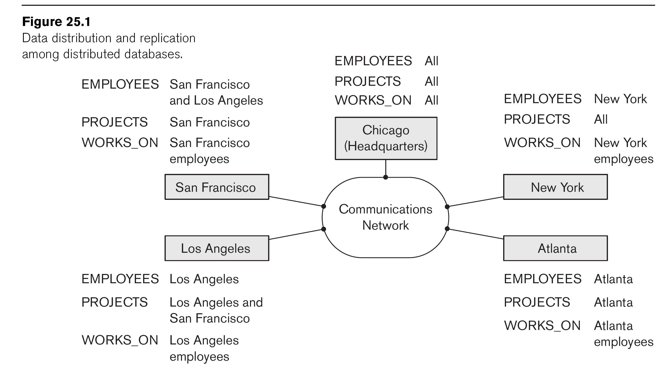
Distributed Database System
Advantages (transparency, contd.)
The EMPLOYEE, PROJECT, and WORKS_ON tables may be fragmented horizontally and stored with possible replication as shown below.
4

Slide 5
Distributed Database System
Advantages (transparency, contd.)
Distribution and Network transparency:
Users do not have to worry about operational details of the network.
There is Location transparency, which refers to freedom of issuing commands from any location without knowing the location of the data used for the commands.
Also, there is Naming transparency, which allows access to any names object (files, relations, etc.) from any location.
5

Slide 6
Distributed Database System
Advantages (transparency, contd.)
Replication transparency:
It allows to store copies of a data at multiple sites as shown in the previous diagram (also serves as backup of data).
This is done to minimize access time to the required data.
Fragmentation transparency:
Allows to fragment a relation horizontally (create a subset of tuples of a relation) or vertically (create a subset of columns of a relation).
6

Slide 7
Distributed Database System
Other Advantages
Increased availability and reliability:
Availability is the probability that a system, at a point in time, will be operational and able to deliver the requested services.
Reliability is the probability of failure-free operation over a specified time, in a given environment, for a specific purpose.
A distributed database system has multiple nodes (computers) and if one fails then others are available to do the job.
7

Slide 8
Distributed Database System
Other Advantages (contd.)
Improved performance:
A distributed DBMS fragments the database to keep data closer to where it is needed most.
This reduces data management (access and modification) time significantly.
Easier expansion (scalability):
Allows new nodes (computers) to be added anytime without changing the entire configuration.
8

Slide 9
Data Fragmentation, Replication and Allocation
Data Fragmentation
Split a relation into logically related and correct parts. A relation can be fragmented in two ways:
Horizontal Fragmentation
Vertical Fragmentation
9

Slide 10
Data Fragmentation, Replication and Allocation
Horizontal fragmentation
It is a horizontal subset of a relation which contain those tuples which satisfy selection conditions (sharding).
Consider the Employee relation with selection condition (DNO = 5). All tuples that satisfy this condition will create a subset which will be a horizontal fragment of Employee relation.
A selection condition may be composed of several conditions connected by AND or OR.
Derived horizontal fragmentation: It is the partitioning of a primary relation to other secondary relations which are related with foreign keys.
10

Slide 11
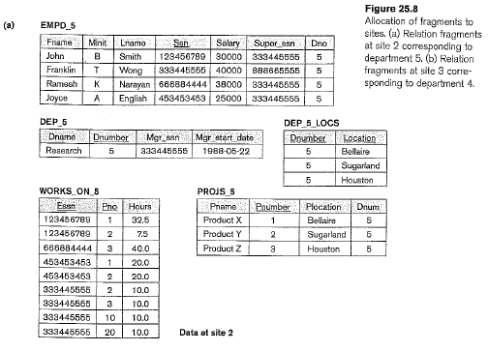
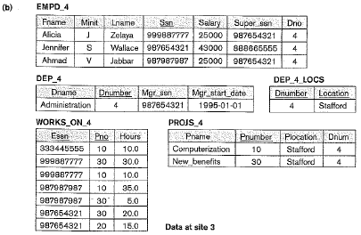
Data Fragmentation, Replication and Allocation
Horizontal fragmentation: an example
11

Slide 12
Data Fragmentation, Replication and Allocation
Vertical fragmentation
It is a subset of a relation which is created by a subset of columns. Thus a vertical fragment of a relation will contain values of selected columns. There is no selection condition used in vertical fragmentation.
Consider the Employee relation. A vertical fragment can be created by keeping the values of Name, Bdate, Sex, and Address.
Because there is no condition for creating a vertical fragment, each fragment must include the primary key attribute of the parent relation Employee. In this way all vertical fragments of a relation are connected.
12

Slide 13
Data Fragmentation, Replication and Allocation
Vertical fragmentation: an example
Emp_Generals
Emp_Business
Fname | Minit | Lname | Ssn | Bdate | Address | Sex
John | B | Smith | 123456789 | May-11-1987 | Add1 | M
Joyce | A | English | 453453453 | Apr-30-1982 | Add2 | F
- | - | - | - | - | - | -
Ssn | Salary | Super_ssn | Dno
123456789 | 3000 | 987654321 | 5
453453453 | 3500 | 987654321 | 5
- | - | - | -
13

Slide 14
Data Fragmentation, Replication and Allocation
Fragmentation schema
A definition of a set of fragments (horizontal or vertical or horizontal and vertical) that includes all attributes and tuples in the database that satisfies the condition that the whole database can be reconstructed from the fragments by applying some sequence of OUTER UNION (or OUTER JOIN) and UNION operations.
Allocation schema
It describes the distribution of fragments to sites of distributed databases. It can be fully or partially replicated.
14

Slide 15
Data Fragmentation, Replication and Allocation
Data Replication
Database is replicated to all sites.
In full replication the entire database is replicated and in partial replication some selected part is replicated to some of the sites.
15

Slide 16
Query Processing in Distributed Databases
Issues
Cost of transferring data (files and results) over the network.
This cost is usually high so some optimization is necessary.
Example relations: Employee at site 1 and Department at Site 2
Employee at site 1. 10,000 rows. Row size = 100 bytes. Table size = 10⁶ bytes.
Department at Site 2. 100 rows. Row size = 35 bytes. Table size = 3,500 bytes.
Q: For each employee, retrieve employee name and department name where the employee works.
Q: Π_{Fname,Lname,Dname} (Employee _{Dno = Dnumber} Department)
Fname | Minit | Lname | SSN | Bdate | Address | Sex | Salary | Superssn | Dno
Dname | Dnumber | Mgrssn | Mgrstartdate
16

Slide 17
Query Processing in Distributed Databases
Result
The result of this query will have 10,000 tuples, assuming that every employee is related to a department.
Suppose each result tuple is 40 bytes long. The query is submitted at site 3 and the result is sent to this site.
Problem: Employee and Department relations are not present at site 3.
17

Slide 18
Query Processing in Distributed Databases
Strategies:
Transfer Employee and Department to site 3.
Total transfer bytes = 1,000,000 + 3500 = 1,003,500 bytes.
Transfer Employee to site 2, execute join at site 2 and send the result to site 3.
Query result size = 40 * 10,000 = 400,000 bytes. Total transfer size = 1,000,000 + 400,000 = 1,400,000 bytes.
Transfer Department relation to site 1, execute the join at site 1, and send the result to site 3.
Total bytes transferred = 3500 + 400,000= 403,500 bytes.
Optimization criteria: minimizing data transfer.
Preferred approach: strategy 3.
18

Slide 19
Query Processing in Distributed Databases
Consider the query
Q’: For each department, retrieve the department name and the name of the department manager
Relational Algebra expression:
Π_{Fname,Lname,Dname} (Employee _{SSN = Mgrssn} Department)
19

Slide 20
Query Processing in Distributed Databases
The result of this query will have 100 tuples, assuming that every department has a manager, the execution strategies are:
Transfer Employee and Department to the result site and perform the join at site 3.
Total bytes transferred = 1,000,000 + 3500 = 1,003,500 bytes.
Transfer Employee to site 2, execute join at site 2 and send the result to site 3. Query result size = 40 * 100 = 4000 bytes.
Total transfer size = 1,000,000 + 4000 = 1,004,000 bytes.
Transfer Department relation to site 1, execute join at site 1 and send the result to site 3.
Total transfer size = 3500 + 4000 = 7500 bytes.
Preferred strategy: Choose strategy 3.
20

Slide 21
Query Processing in Distributed Databases
Now suppose the result site is 2. Possible strategies :
Transfer Employee relation to site 2, execute the query and present the result to the user at site 2.
Total transfer size = 1,000,000 bytes for both queries Q and Q’.
Transfer Department relation to site 1, execute join at site 1 and send the result back to site 2.
Total transfer size for Q = 3500 + 400,000 = 403,500 bytes and for Q’ = 3500 + 4000 = 7500 bytes.
21

Slide 22
Concurrency Control and Recovery
Distributed Databases encounter a number of concurrency control and recovery problems which are not present in centralized databases. Some of them are listed below.
Dealing with multiple copies of data items
Failure of individual sites
Communication link failure
Distributed commit
Distributed deadlock
22

Slide 23
Concurrency Control and Recovery
Details
Dealing with multiple copies of data items:
The concurrency control must maintain global consistency. Likewise the recovery mechanism must recover all copies and maintain consistency after recovery.
Failure of individual sites:
Database availability must not be affected due to the failure of one or two sites and the recovery scheme must recover them before they are available for use.
23

Slide 24
Concurrency Control and Recovery
Details (contd.)
Communication link failure:
This failure may create network partition which would affect database availability even though all database sites may be running.
Distributed commit:
A transaction may be fragmented and they may be executed by a number of sites. This require a two or three-phase commit approach for transaction commit.
Distributed deadlock:
Since transactions are processed at multiple sites, two or more sites may get involved in deadlock. This must be resolved in a distributed manner.
24

