Slide 1
?
CSDS 234 · FINAL PROJECT
But Why?
Data and Query Provenance for
Explainable Movie Recommendations
Qianyi (Alfred) Chen
Case Western Reserve University
May 2026

Slide 2
Why was this recommended?
Netflix recommends Fargo to Alfred. Why?
OUR ANGLE
Was it his love for Pulp Fiction? His rating of Shawshank? Some pattern shared with strangers?
Explain via the database.
§
Regulation
GDPR Art. 22 — users can demand meaningful information about automated decisions.
♥
Product trust
Most existing methods modify the model (hurting accuracy) or generate post-hoc text (may not be faithful).
We ground explanations in formal data provenance — fast, faithful, no model changes.
Explainable recommendations build user confidence and reduce churn.
■
Black-box CF
SVD models hide reasoning in 50-dim latent vectors — opaque by construction.
But Why? · CSDS 234 · 2 / 10

Slide 3
Two query classes
Both are general — defined for any user, any movie, any k ∈ [1, 20].
Q1
Why-Provenance
Q2
Query Rewrite
“Which ratings caused this recommendation?”
“What change would surface this missing movie?”
INPUT
INPUT
user u, movie m ∈ TopK(u, k)
user u, target movie t ∉ TopK(u, k)
OUTPUT
OUTPUT
minimal W ⊆ ratings(m)
such that m ∉ TopK_{R∖W}(u, k)
minimal edit e (single rating add)
such that t ∈ TopK_{R∪{e}}(u, k)
GOAL
GOAL
find smallest evidence set whose removal flips the recommendation
smallest counterfactual nudge that surfaces a desired movie
But Why? · CSDS 234 · 3 / 10

Slide 4
Inverted index for pruning
KEY INSIGHT
0.16 s
A movie's predicted score is
dominated by its strongest raters.
ONE-TIME INDEX BUILD
If they don't move the needle, the long tail won't either. So we precompute, for each movie, the top-C = 50 highest-rating contributors.
46,435
TOTAL ENTRIES (28/MOVIE)
NAIVE SEARCH
→
INDEX-PRUNED
O(|R|)
O(C)
< raw table
scan every rater of m
C = 50, fixed
STORAGE FOOTPRINT
But Why? · CSDS 234 · 4 / 10

Slide 5
WhyProv algorithm
ALGORITHM WhyProv(u, m, k, index I)
SCORE-DECAY
Approximation
1. contributors ← I.lookup(m) # O(C) lookup
2. removed ← {} ; witness ← []
3. FOR each (c, w) in contributors sorted by w DESC:
4. removed ← removed ∪ {c}
5. witness.append((c, m))
6. score_m ← ScoreDecayApprox(u, m, removed)
7. threshold ← Predict(u, TopK(u, k)[k−1])
8. IF score_m < threshold:
9. RETURN witness # minimal!
10. RETURN witness
score' = score · (1 − w_rm / w_total)
Why not retrain SVD per query?
It would dominate runtime — seconds per query.
Why is this OK?
Top-k membership is a ranking decision, not a numeric one. Score-decay is rank-monotonic — sufficient.
But Why? · CSDS 234 · 5 / 10

Slide 6
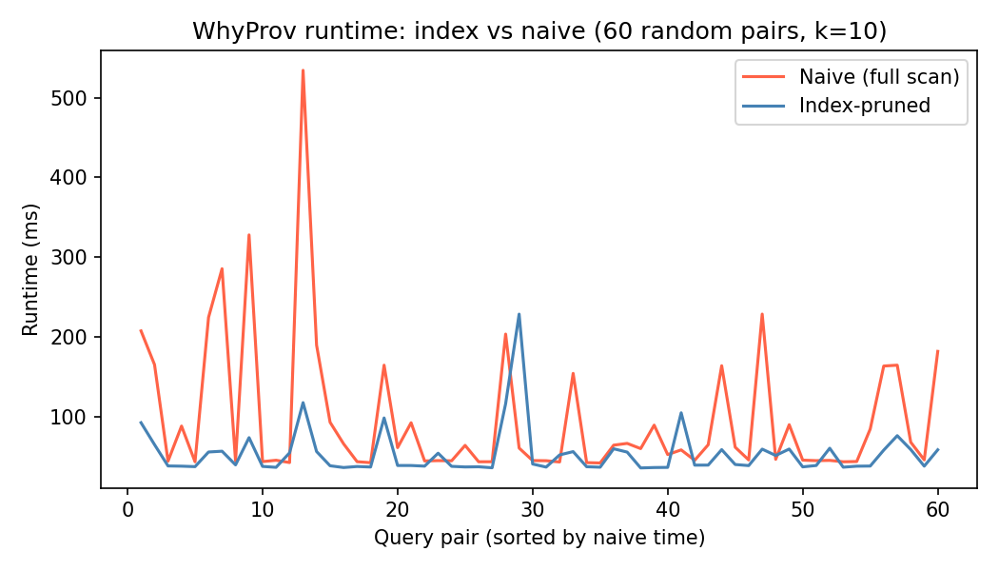
Result 1 · 1.77× speedup at k = 10
49 ms
MEAN — INDEX-PRUNED
95 ms
MEAN — NAIVE
1.77×
SPEEDUP
In 0 / 60 pairs does naive beat the index.
Runtime distribution across 60 (user, movie) pairs
But Why? · CSDS 234 · 6 / 10

Slide 7
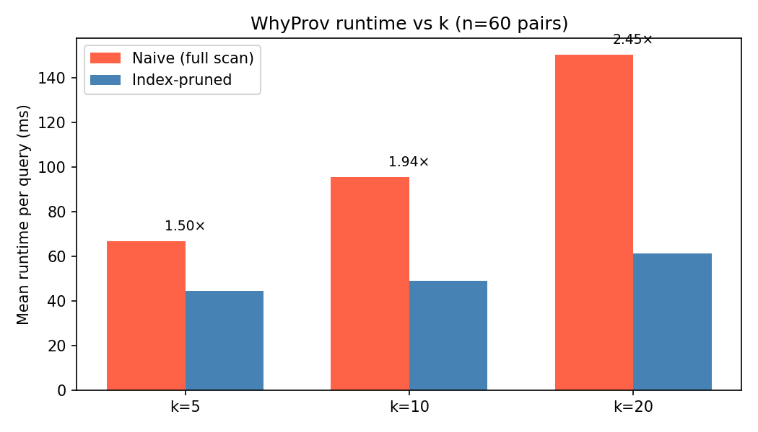
Result 2 · Speedup grows with k
k | Index | Naive | Speedup
5 | 44 ms | 67 ms | 1.50×
10 | 49 ms | 95 ms | 1.94×
20 | 61 ms | 150 ms | 2.45×
INSIGHT
Speedup grows monotonically with k. Larger k means more naive scan work — bigger pruning win.
But Why? · CSDS 234 · 7 / 10

Slide 8
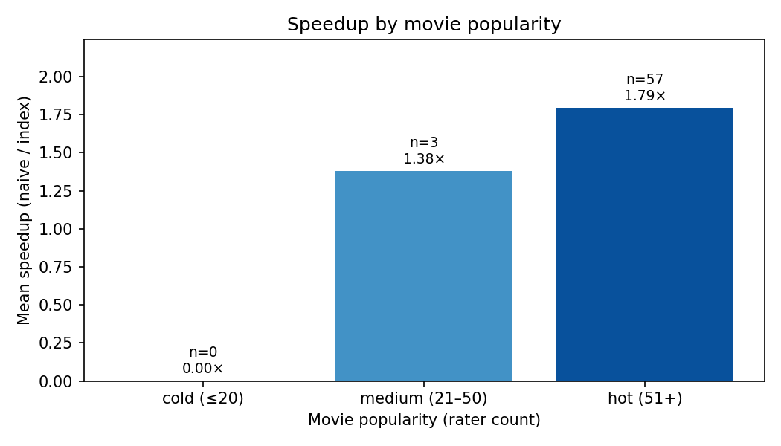
Result 3 · Speedup vs movie popularity
HOT · 51+ RATERS · n=57
1.79×
MEDIUM · 21–50 RATERS · n=3
1.38×
Hot movies have a long rater tail to prune — the index pays off most there.
But Why? · CSDS 234 · 8 / 10

Slide 9
Limitations · Future work
ACKNOWLEDGED
NEXT
Limitations
Future work
Score-decay approximation · rank-monotonic, not the true counterfactual SVD
Validate score-decay · compare vs. true counterfactual SVD on a small sample
Single-edit query rewrite · extending to multi-edit raises minimality search cost
Multi-hop provenance · explain the explainers — recursive why-queries
Popularity-biased sampling · no cold movies in our 60 pairs
Scale up · MovieLens 1M and 25M; measure index build & query time
One dataset · MovieLens 100K only — no scale validation yet
Human study · are why-provenance explanations more trusted?
Sequence models · extend to SASRec / BERT4Rec recommenders
But Why? · CSDS 234 · 9 / 10

Slide 10
CONCLUSION
Database provenance, applied.
A formal, faithful, and fast way to explain CF recommendations.
1.77×
2.45×
0.16 s
60
0
SPEEDUP @ k = 10
SPEEDUP @ k = 20
INDEX BUILD
RANDOM PAIRS TESTED
MODEL CHANGES
Thank you. Questions?
Code & report · github.com/Alfred-Chen-04/csds234-final-project
Qianyi (Alfred) Chen · CSDS 234 · CWRU · May 2026

