Slide 1
SSRP 2026 | PILOT METHODS REVIEW
Traceable Consent
Interface Audit
and Versioning
RQ1
score unbiased
choice
RQ2
capture and
version change
Qianyi (Alfred) Chen | Mentor: Dr. Jagdip Singh
Current evidence through June 6, 2026

Slide 2
One evidence bundle serves two research questions
02
The project is not a screenshot collection. Screenshots, DOM-derived refs, visible text, hashes, and path attempts are evidence inputs for scoring and versioning.
RQ1
RQ2
Score the full consent pathway for unbiased choice
Capture and version privacy interfaces over time
Availability -> effort -> transparency and unbiased choice
Repeated evidence -> fingerprints -> change events and summaries
SSRP 2026 | Qianyi (Alfred) Chen
Source: original proposal RQs; current_project_goal_2026-07-02.md

Slide 3
The current pilot is deterministic and locally reproducible
03
Active runtime
Playwright
Deterministic scoring
Structured outputs
Local persistence
screenshot, DOM-derived evidence, path attempts
Layer 1 / 2 / 3 rules
AuditReport, CSV exports, weekly summaries
append-only JSONL and file copies
Not active in this pilot
External LLM/VLM calls | PostgreSQL/R2 | APScheduler | hosted demo | per-report PDF generation
SSRP 2026 | Qianyi (Alfred) Chen
Source: src/consent_audit/, scripts/, July 22 implementation audit

Slide 4
Three layers move from access to unbiased choice
04
01
Path availability
Gate
Are accept, reject, customize, and dismiss reachable?
02
Path effort
Score
How much interaction and friction does each available path require?
03
Transparency + unbiased choice
Two grades
What is disclosed, how is it framed, and are choices structurally balanced?
SSRP 2026 | Qianyi (Alfred) Chen
Source: CONCEPTS.md; SCHEMA.md

Slide 5
The evidence package is substantial, but still a pilot
05
Counts below describe files and exported rows in this checkout. They are not a percentage-complete claim or a final sample result.
5
42
20
frozen Week 2 targets
audit-report rows
longitudinal-summary rows
326
0
tracked site screenshots
synced referenced raw HTML files
SSRP 2026 | Qianyi (Alfred) Chen
Source: data/research_package/ and audited capture tree, 2026-07-22

Slide 6
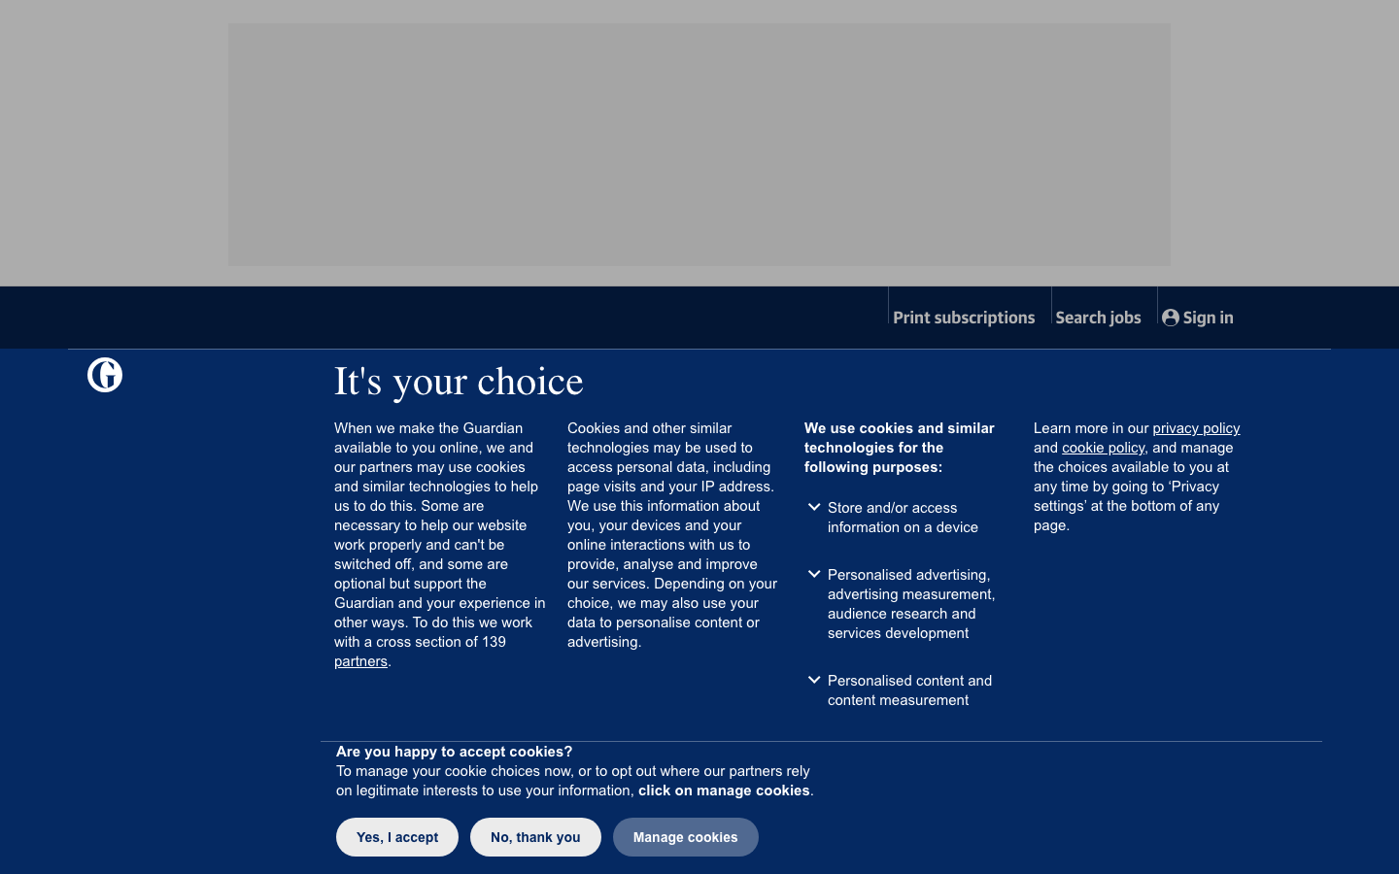
Guardian demonstrates a visible first-screen choice interface
06
Stored observation
The stored screenshot shows a visible consent-choice screen with accept, reject, and manage-cookie controls.
What this supports
A traceable banner-present evidence card. It does not establish a legal verdict or the site's current July state.
SSRP 2026 | Qianyi (Alfred) Chen
Stored screenshot: www_theguardian_com_20260605_160209/layer1.png

Slide 7
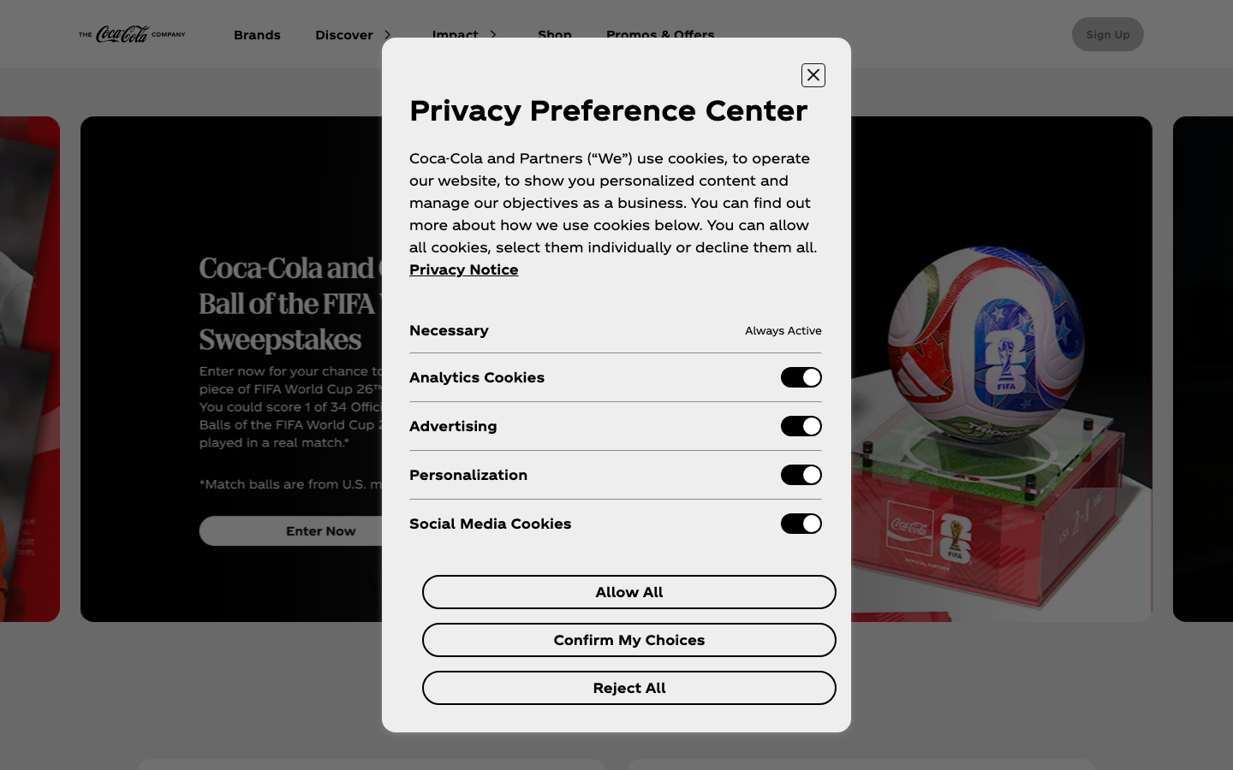
Coca-Cola demonstrates a visible preference center
07
Stored observation
The stored screenshot shows a Privacy Preference Center with consent controls.
What this supports
A second banner-present evidence card and a capture-agent regression example, not a final site judgment.
SSRP 2026 | Qianyi (Alfred) Chen
Stored screenshot: www_coca_cola_com_20260605_160238/layer1.png

Slide 8
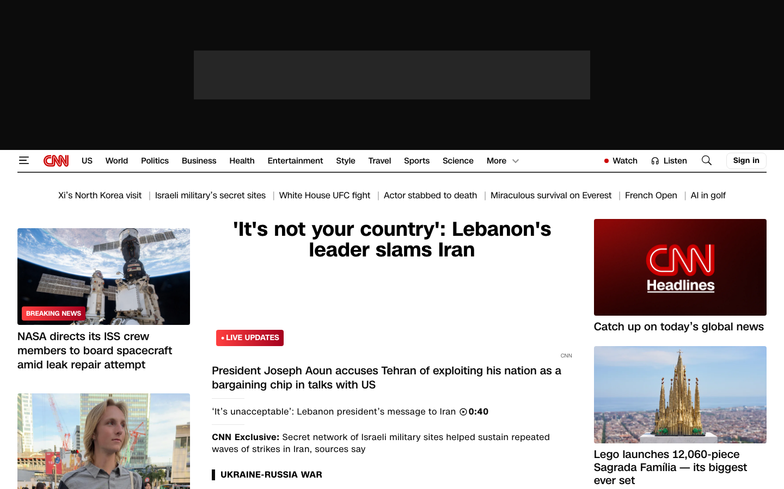
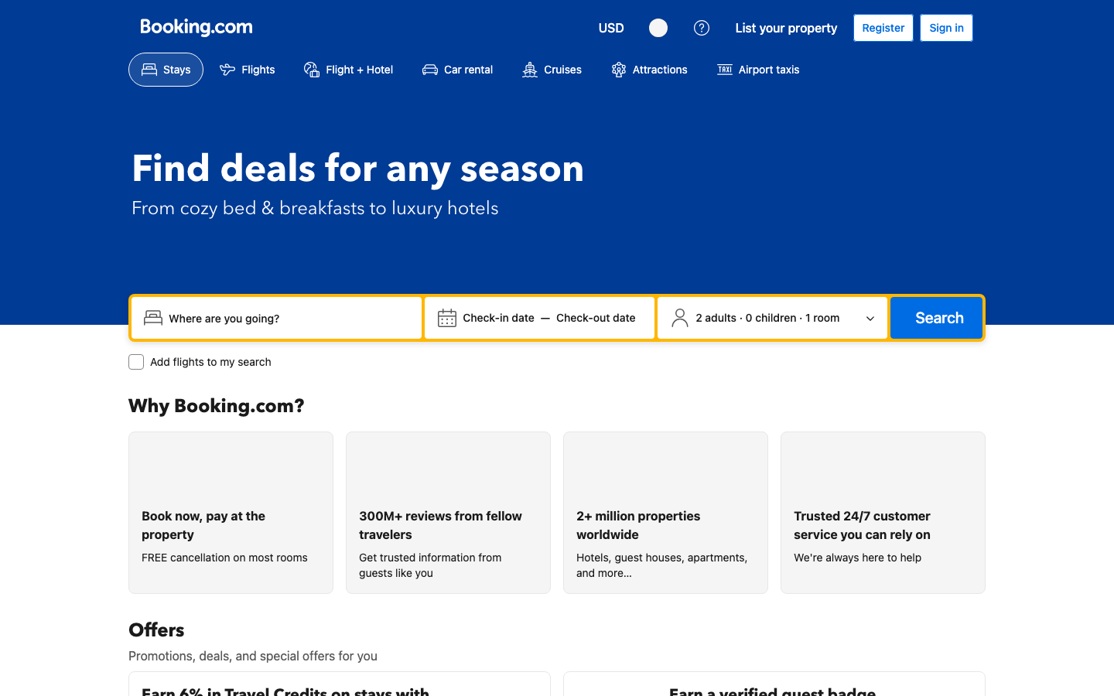

No visible first-screen banner is a contrast label, not a failure verdict
08
CNN
Booking.com
NerdWallet
No visible first-screen cookie banner in this stored screenshot.
No visible first-screen cookie banner in this stored screenshot.
No visible first-screen cookie banner in this stored screenshot.
These cases require a separate coding rule before any banner-path or sample-wide claim.
SSRP 2026 | Qianyi (Alfred) Chen
Stored screenshots captured 2026-06-05; current-five evidence packet

Slide 9
RQ2 works at pilot scale, but the current time series stops in June
09
The package proves that repeated records and deterministic summaries can be produced. It does not prove uninterrupted weekly tracking through July.
May 29
June 5
June 6
July 22
earliest report
observation
latest report
observation
latest exported
week_of
audit and
artifact work only
Closeout choice
Run one controlled continuity observation only if it answers an approved RQ2 question and does not delay the presentation or poster.
SSRP 2026 | Qianyi (Alfred) Chen
Source: audit_report_summary.csv; longitudinal_summary.csv

Slide 10
CORE CLOSEOUT
Freeze a defensible
pilot by August 7
16
calendar days from July 22
1
Confirm or visibly carry pending decisions
2
Review and revise presentation + poster together
3
Freeze evidence manifest, limitations, and hashes
4
Rehearse, verify, back up, and stop adding scope
SSRP 2026 | Qianyi (Alfred) Chen
Source: July 22 closeout audit and plan

