Slide 1
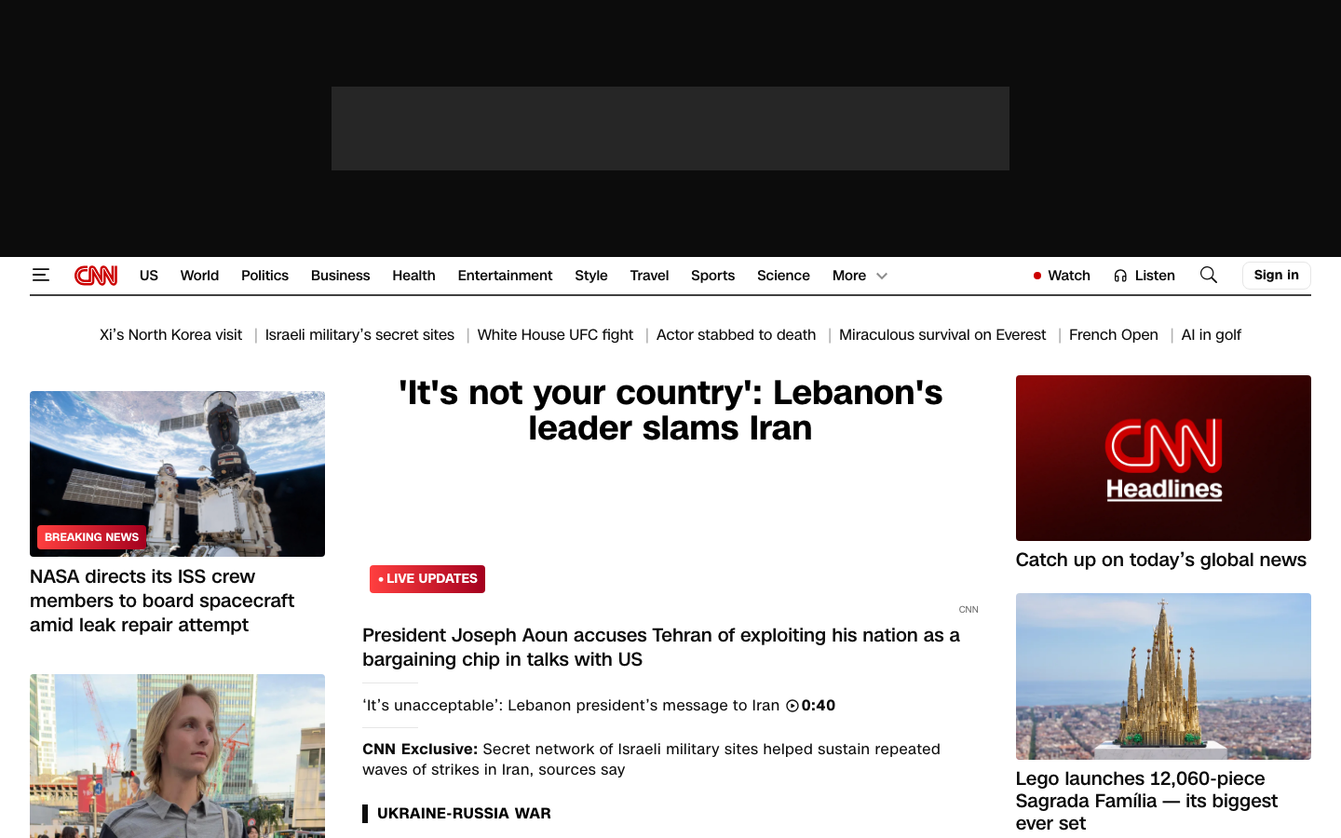
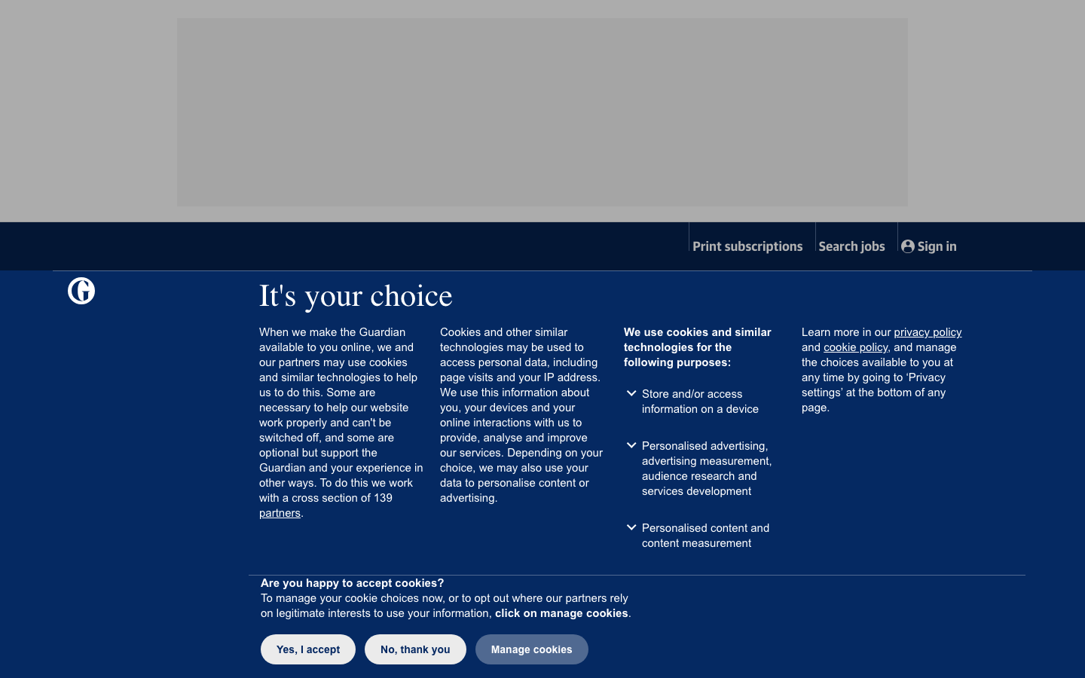
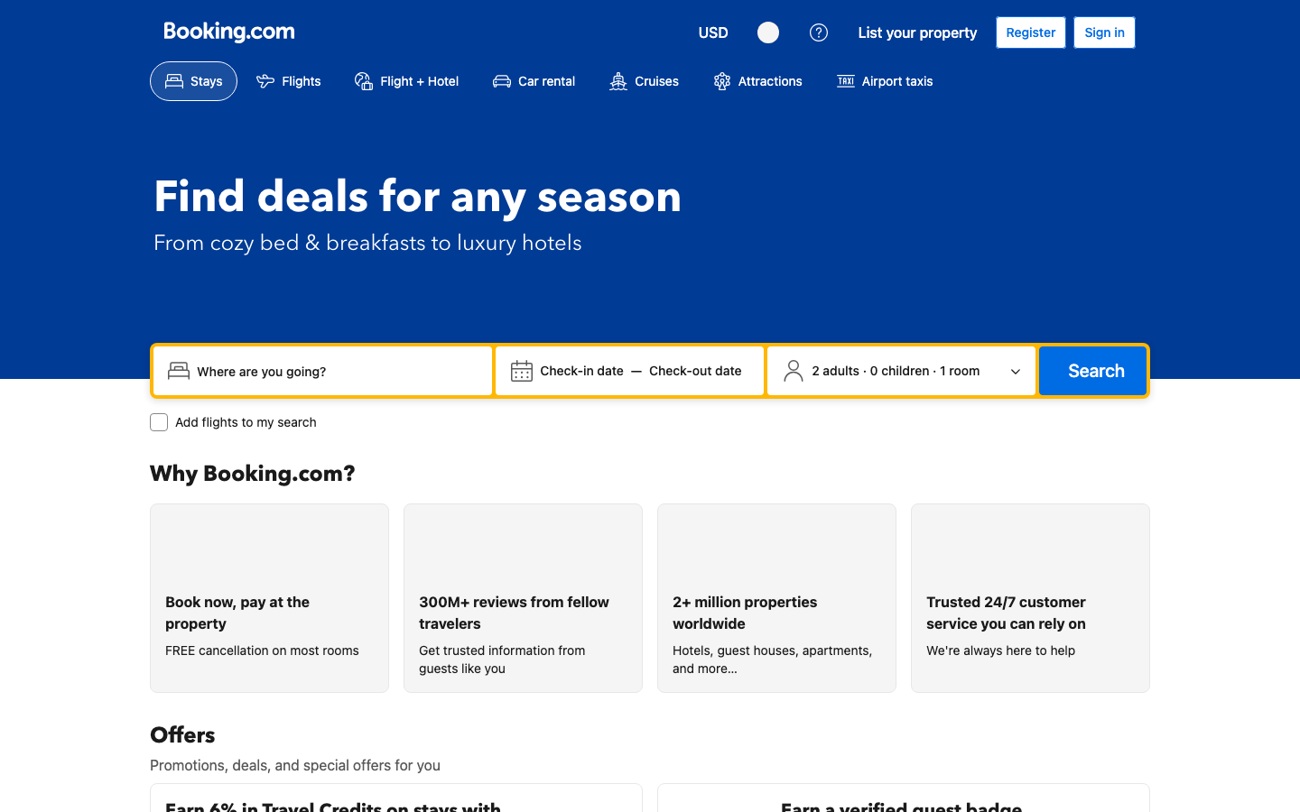

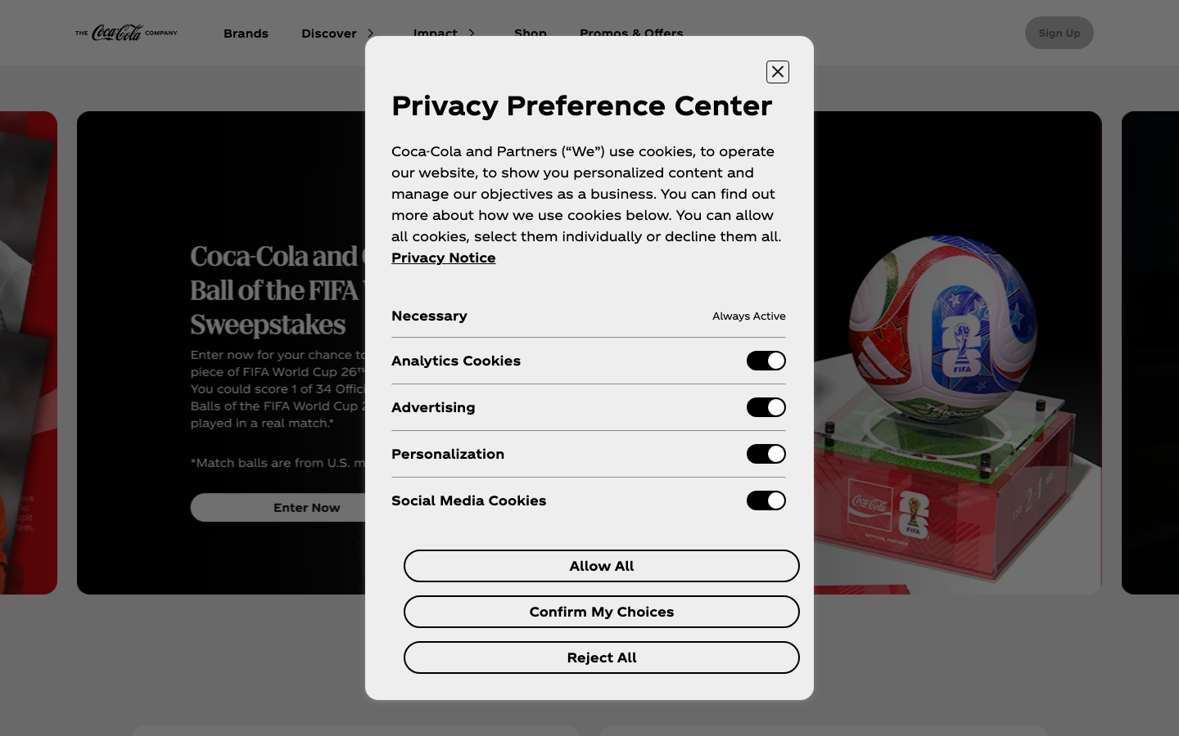
SSRP 2026 | PILOT / METHOD EVIDENCE
RQ1
How can full consent pathways be scored for unbiased choice?
Traceable Consent Interface Audit and Versioning
A workflow for scoring layered consent interfaces and tracking how privacy-interface evidence changes over time.
RQ2
How can consent interfaces be captured and versioned over time?
Current evidence package: pilot/method evidence, not a final 20-site dataset.
WHY THIS MATTERS
CURRENT EVIDENCE SNAPSHOT
CONTRAST CASES
Consent interfaces are layered design and communication systems. They can make privacy choices visible or hidden, easy or difficult, stable or volatile over time.
Week 2 target sites
5
No visible first-screen cookie banner in these stored screenshots.
Audit reports
42
CNN
Longitudinal summaries
20
Choice pathway
Site layer1.png screenshots
326
Are Accept, Reject, Customize, and Dismiss available?
Synced raw layer1.html files
0
Choice effort
Current-five blank decisions
7
How much interaction is needed to reach each path?
Pending CMP confirmations
8
Choice framing
Counts from the current evidence package, rechecked July 29, 2026.
No visible first-screen cookie banner in stored screenshot.
Does the text support transparent, unbiased choice?
EVIDENCE CARD: THE GUARDIAN
Booking.com
EVIDENCE PIPELINE
1
Capture
Screenshot, text, DOM ref/hash
2
Attempt
Accept / Reject / Customize / Dismiss
No visible first-screen cookie banner in stored screenshot.
NerdWallet
3
Score
Three deterministic layers
4
Version
AuditReport + WeeklySummary
Stored screenshot evidence shows a visible consent-choice screen with accept, reject, and manage-cookie choices. Method evidence only; not a legal-compliance claim.
One capture bundle supports both RQ1 scoring and RQ2 longitudinal versioning.
EVIDENCE CARD: COCA-COLA
No visible first-screen cookie banner in stored screenshot.
Important: no-visible-banner contrast cases are not banner-path failures. They remain separate contrasts; no final scoring claim is made.
SCORING GUARDRAIL
Current pilot scoring uses deterministic DOM and text rules. External models are not wired into scoring; future model output must be schema-validated and evidence-linked.
LIMITATIONS AND CLOSEOUT DECISIONS
Pilot/method evidence only. Raw layer1.html files are not synced; 7 current-five decisions are blank; 8 CMP/manual-review confirmations are pending.
Project closeout: retain pilot framing and the two main cards; keep contrast cases separate; carry unresolved review counts visibly.
Stored screenshot evidence shows a visible Privacy Preference Center with consent controls. Method evidence only; not a legal-compliance claim.
Contribution: a traceable audit-and-versioning workflow for consent-interface evidence. Deep, evidence-linked pilot cases are safer than broad unsupported claims.
Evidence sources: stored layer1.png screenshots; audit_report_summary.csv; longitudinal_summary.csv. Project closeout | 2026-07-29

