Slide 1
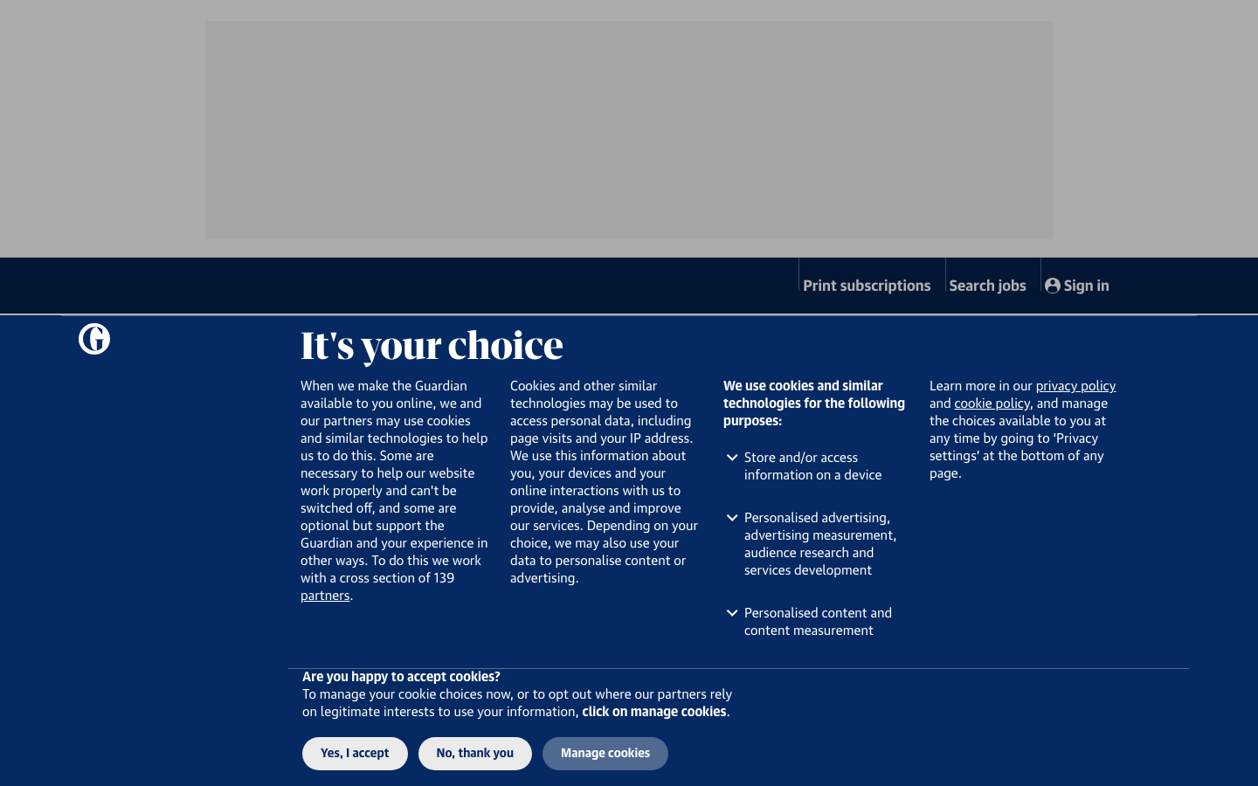
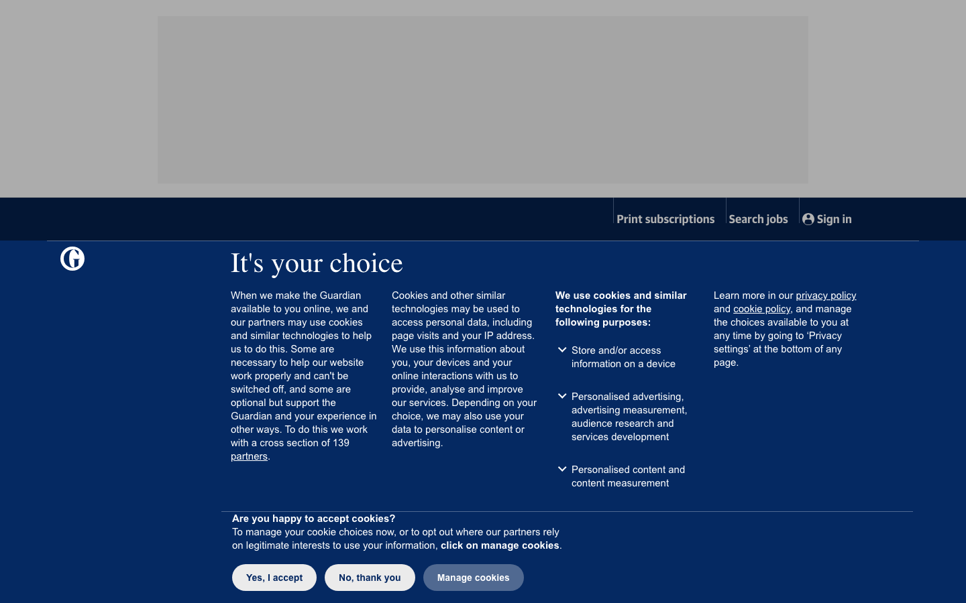
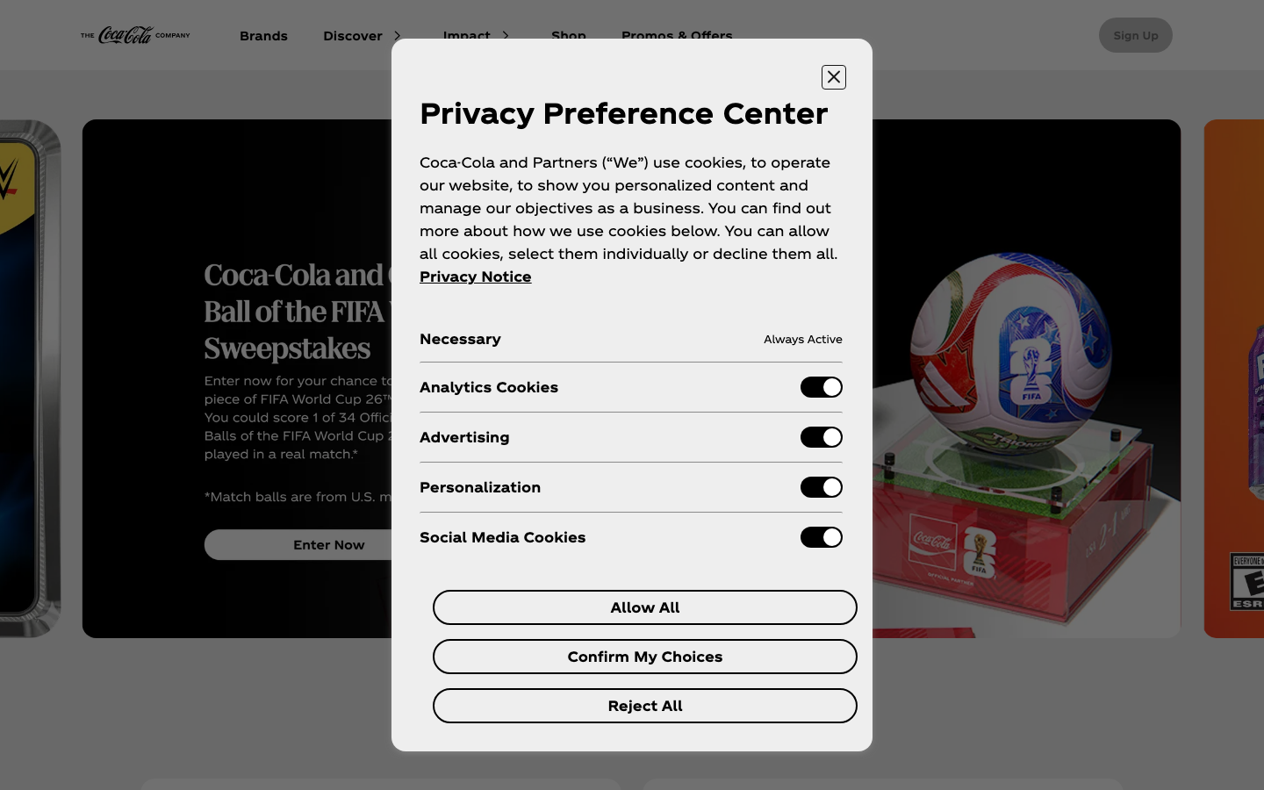
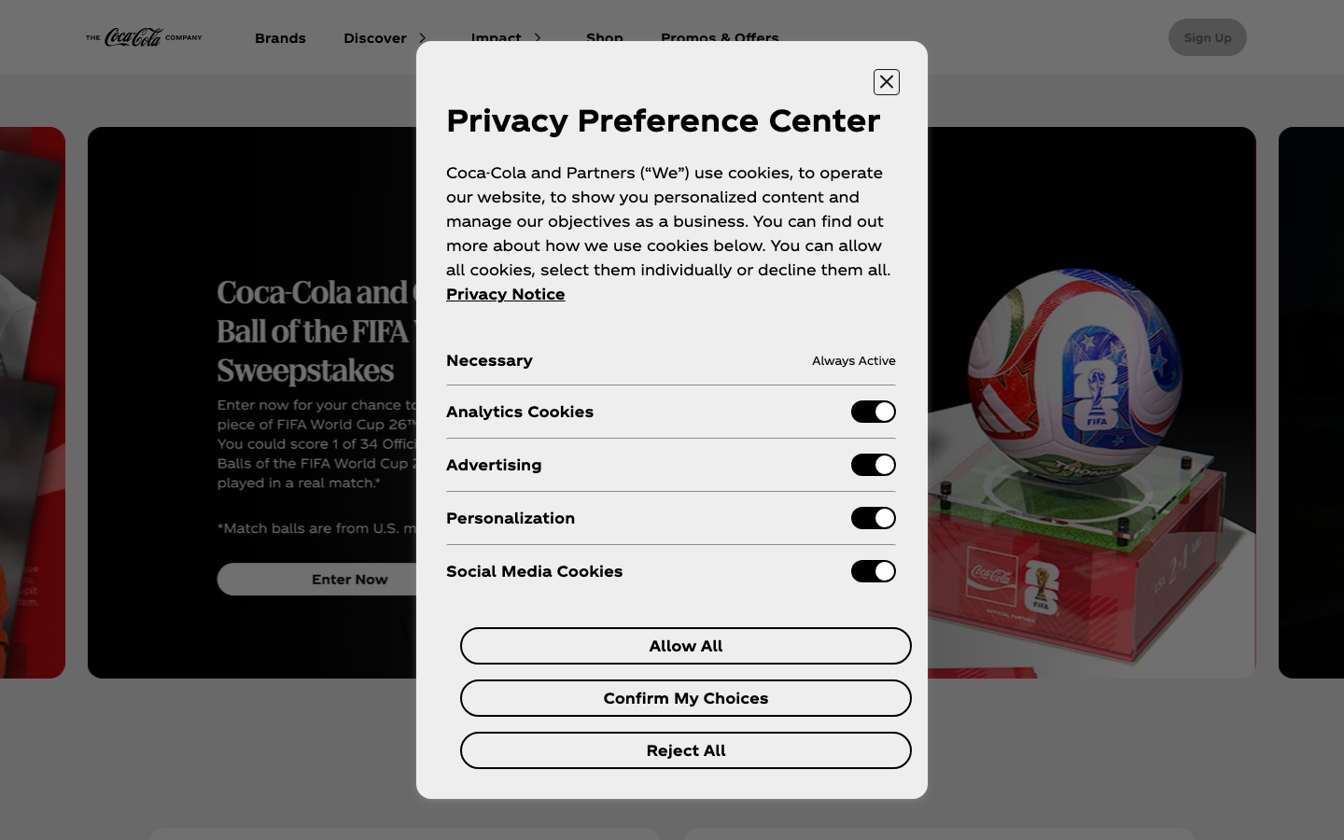
SSRP 2026 | LONGITUDINAL CONSENT STUDY
RQ1
component rubric
How Cookie Consent Interfaces Changed
RQ2
dated trajectories
A controlled capture method plus six dated company trajectories from primary sources
RESULT
5 improved | 1 regressed
Qianyi (Alfred) Chen | Mentor: Dr. Jagdip Singh
direction is separated from causal evidence strength
THESIS
Concrete interactions improved under regulatory pressure, but consent quality remained component-specific and reversible.
01
QUESTION + MEASURE
02
TWO EVIDENCE LANES
03
CASE SERIES RESULT + DISCUSSION
How did consent interfaces change over time, and what evidence can explain the direction?
Controlled local capture + source-complete retrospective cases
6
5
1
RQ1 codes user choice by component. RQ2 compares dated states while keeping direction separate from cause.
T1
RQ1
T2
D
companies
improved
regressed
capture
score
repeat
validate
RETROSPECTIVE RESULT
Across six purposively selected dated trajectories, five improved in at least one audited component; Vanity Fair regressed in functional refusal. This is not a prevalence estimate.
RQ1: the component ruler
Controlled pilot 1: The Guardian
Path availability
MAY 29
JUNE 5
Three first-layer cases
Can users reach Reject and Customize?
Google, Facebook, and TikTok moved from acceptance-favoring rejection effort to one-click or equivalent first-layer refusal. TikTok still had deficient purpose information.
Path effort
How much interaction does each path require?
Transparency
What changed, and what explains it?
What is disclosed, and how clearly?
- Google: >=5 -> 1 reject action; direct attribution
- Facebook: equivalent reject; order verified
- TikTok: first-layer reject; investigation-period change
- Orange: withdrawal fixed; order verified
- SHEIN: refusal/withdrawal fixed during proceedings
- Vanity Fair: later functional failure; cause unknown
Choice + effectiveness
Local lane: the same visible choice structure remains insufficient for a direction claim
Are options balanced, and does refusal stop tracking?
Directional coding
Controlled pilot 2: Coca-Cola
one or more dimensions improve; none regress
MAY 29
JUNE 5
Discussion prompts
IMPROVED
1
Visible parity or genuine user autonomy?
REGRESSED
one or more regress; none improve
MIXED
dimensions move in both directions
2
Publisher, CMP, or both when refusal fails?
STABLE
no meaningful component change
3
One-time certification or recurring re-audit?
INSUFFICIENT
context, evidence, or scoring is not comparable
4
Which component changes first under enforcement?
Claim guardrail
Local lane validates the comparison method. Historical direction comes from six dated primary-source cases.
5
Can controlled captures reproduce these cases?
Every direction needs dated before/after evidence. Every causal claim receives a separate strength label.
DISCUSSION FINDING
Regulators appear most effective where they can specify and verify a concrete interaction.
CONCLUSION
Consent interfaces improved where concrete interactions were specified and checked, but improvement was partial and reversible.
Methods and evidence
CONCEPTS.md | retrospective cases.csv | source registry.csv | local directional review
CWRU SOURCE / Intersections alignment: title, introduction, methods, results, conclusion, future research, and references. Poster size: 48 x 36 inches.
Notes:
[Sources]
- https://www.legifrance.gouv.fr/cnil/id/CNILTEXT000044840062
- https://blog.google/company-news/inside-google/around-the-globe/google-europe/new-cookie-choices-in-europe/
- https://www.legifrance.gouv.fr/cnil/id/CNILTEXT000044840532
- https://www.legifrance.gouv.fr/cnil/id/CNILTEXT000046096716
- https://www.legifrance.gouv.fr/cnil/id/CNILTEXT000046977994/
- https://www.cnil.fr/en/closure-injunction-issued-against-orange
- https://www.cnil.fr/sites/default/files/2025-09/cnil_sanction_shein_en.pdf
- https://www.cnil.fr/en/cookies-placed-without-consent-company-publishes-website-vanityfairfr-fined-750000-euros
- https://arxiv.org/abs/2606.31485
- Internal: data/retrospective_source_registry_2026-07-29.csv

