Slide 1
BGPD-3 Caida – Hacktahon San Diego Feb 2016
Luca Sani (IT)
Alejandro Acosta (VE)

Slide 2
Objective
BGPD-3
Replay BGP updates from BGPStream / MRT / other formats into BGP daemons

Slide 3
Tasks
Study current solutions
Create a lab
Hack
Documentation

Slide 4
Problems founds
After sending the BGP Updates for prefixes with more than one path only the last one was kept
Not IPv6 Support

Slide 5
Problems founds
After sending the BGP Updates for prefixes with more than one path only the last one was kept
Not IPv6 Support

Slide 6
Proposed solutions
Multiple path issue
Use add-path capability (Thanks to Alvaro)
Create new BGP session on the fly when prefixes had more than one path
IPv6 issue
Send bgp prefixes using v4
Do it the right way
Give up ☺

Slide 7
What was done
We found an anonymous perl script called bgpsimple.pl
We create a way to use bgpsimple along with bgpreader
We had to hack NET::BGP Perl modules to support Add-Path capability
We had to hack NET::BGP Perl modules to support IPv6

Slide 8
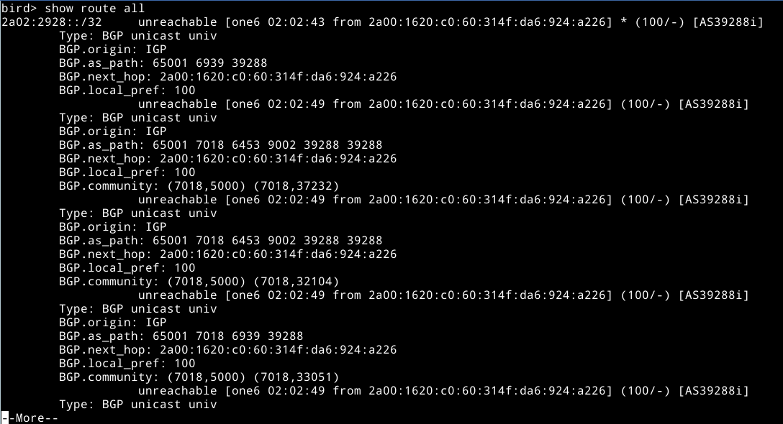
Screenshot

Slide 9
Q & A

