Slide 1
Predicting Home Values Through Random Forest
By: Alfredo Martinez
2018

Slide 2

Introduction
Goal
Build a Predictive Model System for Home Prices
Client
Keller Williams Realty, Inc.
Other Real Estate Investment Companies

Slide 3
Exploratory Data Analysis(EDA)
Housing Dataset
Categorical(Qualitative) data:
23 nominal (There was no natural order, e.g. Type of house)
23 ordinal (Order do exist, e.g. Property condition; bad, fair, good excellent)
Numerical data:
14 discrete(Integers, e.g. Number of rooms)
20 continuous(Can take on any value, e.g. Square Feet)
Weather Dataset
Subtracted from the National Center for Environmental Information Webpage.
Includes daily, monthly and yearly records from different weather stations in the city.

Slide 4
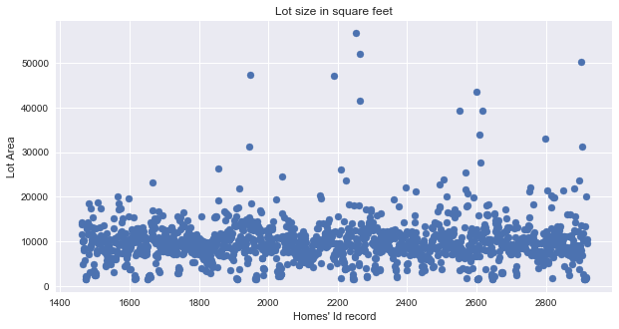
Exploratory Data Analysis(EDA)
Bad Data and Outliers
Random Forest:
Different people, different arguments weather to keep all data or not
Ideas
Not sensitive to outliers
Sensitive

Slide 5
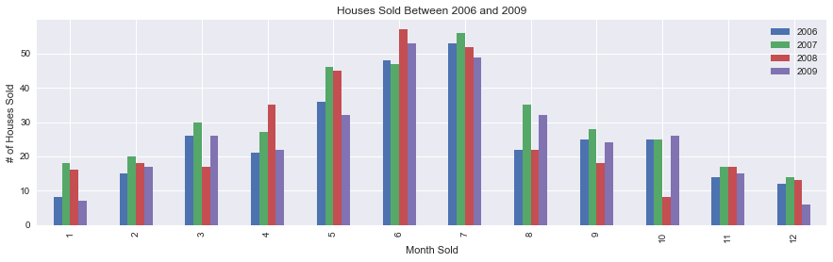
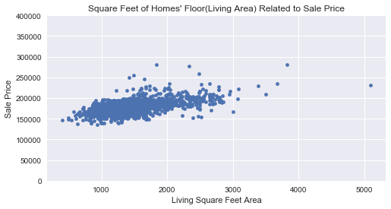
Exploratory Data Analysis
Monthly Homes’ Sales
Above ground living area in relationship to sale price

Slide 6
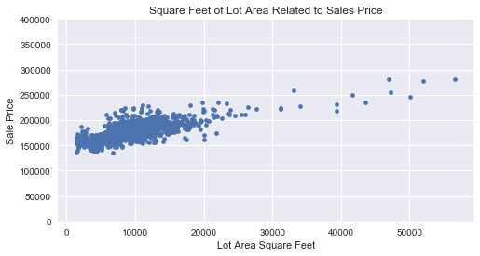
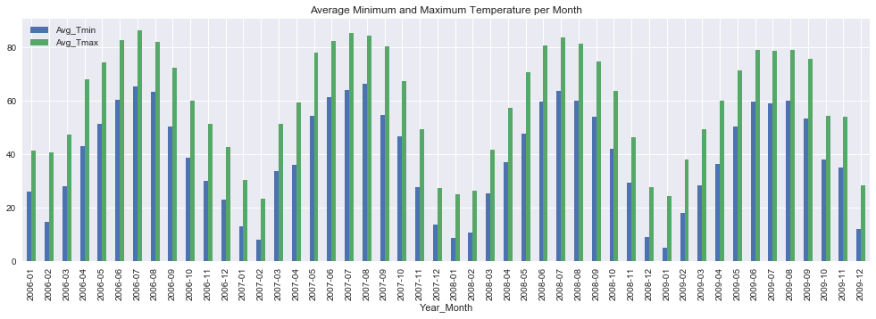
Exploratory Data Analysis
Home’s lot area in relationship to price
Yearly Weather Temperature

Slide 7
Inferential Analysis
Alpha set at .05
Significant price difference analysis about population.
Central unit vs not a central unit
P-value: 0.010090621217186681 (Significant)
One story houses vs Two story houses
P-value: 3.5535259636604621e-13 (Significant)
Good privacy fence vs minimum privacy fence
P-value: 0.37003494954970051 (Needs further research)

Slide 8
Data Challenges
Missing Data
N/A Values
Corrupted Data
Present as (-999) values
Categorical to Numerical
Transforming values to be able to use in predictive model(scikit-learn)
Fixed Values
Mean, Median, Mode, and dummy variables indexing(from train to test)

Slide 9
Technology
Pandas
To open and merge files
To filter and drop cells
To group by cells
Etc..
Numpy
To fill in Not a number values(NaN)
Etc..
Datetime
To fix and edit date times
Scipy
T-test for inferential analysis

Slide 10
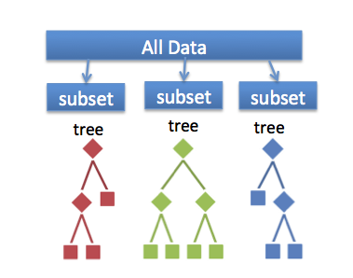
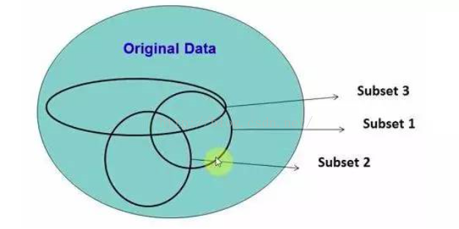
Modeling and Analysis
Random Forest Predictive Algorithm
Continues Target variable(Regression)
Based on Decision Trees Models
Bootstrapping
Root Mean Square Error Accuracy
Feature Importance

Slide 11
Modeling and Analysis
Main packages and libraries
Scikit-learn and math
RandomForestRegressor()
Param_grid(GridSearchCV)
Fit()
Best_estimators()
Predict()
RMSE = sqrt(mean_squared_error(y_test, y_predict)

Slide 12
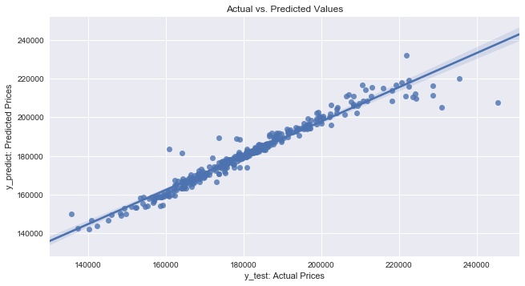

Results
Models Comparison:

Slide 13
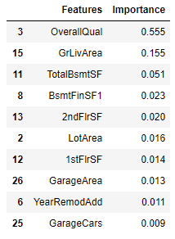
Modeling and Analysis
Feature Importance related to price

Slide 14
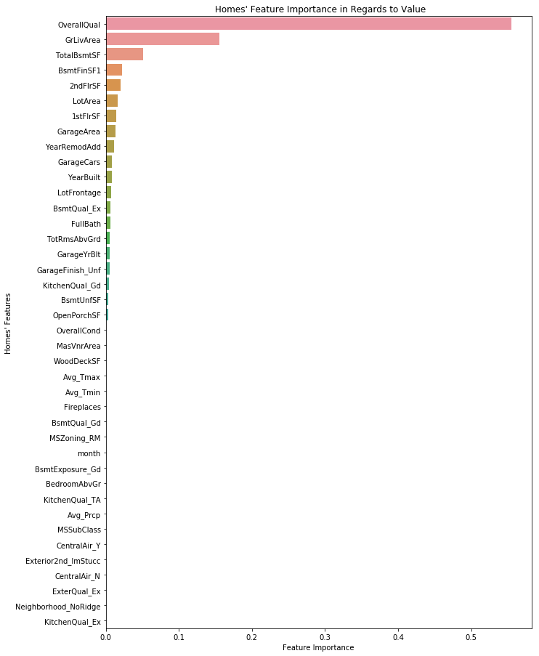

Slide 15
Business Value
Sharper report analyses to help:
Negotiation of sales
Better Purchases
Other strategic agreements related to real estate properties.

