Slide 1
Predicting Home Values Through Random Forest
By: Alfredo Martinez
MENTOR: Lucas Allen
2017

Slide 2
Introduction
Goal
Predict Home Prices
Client
Keller Williams Realty, Inc.
Other Real Estate Investment Companies
Value
Sharper report analyses to help the negotiation of sales, purchases and other strategic agreements related to real estate properties.

Slide 3
Data
Housing Dataset
Originally compile by Professor Dean De Cock at Truman State University
Consists of 2930 observations and 80 explanatory variables for the sale of homes between years 2006-2010.
Data is from records of city of Ames, Iowa
Weather Dataset
Subtracted from the National Center for Environmental Information Webpage.
Includes daily, monthly and yearly records from different weather stations in the city.
Data is from records of city of Ames, Iowa

Slide 4
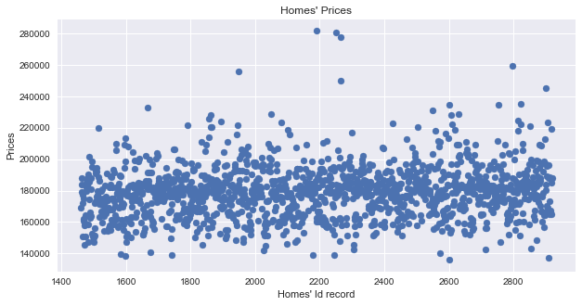
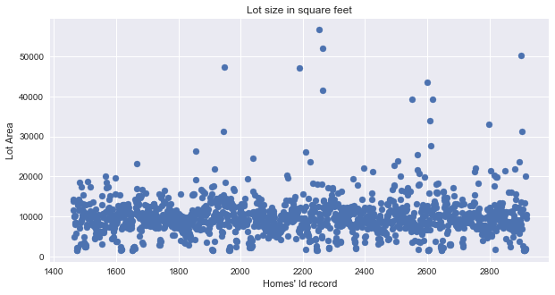
Cleaning Data
Bad Data and Outliers
Random Forest not very sensitive to outliers
Exploratory Data analysis for error type data

Slide 5
Cleaning Data Continue..
Housing Data
Attached homes’ Feature data set to price data set
Filtered cells to dates 2006 and 2009 to match weather dates available
Built and sorted a Date Time Index for the sale of homes
Rest of cleaning was done in future steps after splitting the data to build model
Weather Data
Subtracted the best dates and weather station available from the data
Filtered to the most significant weather variables
Dates were filtered to match housing data sets
Corrupted values were deleted, and averages obtained
At the end the two datasets were joined

Slide 6
Cleaning Data Continue..
Splitting the data into train and test to fit model
Train
Filled NaN values with means and modes
Built dummy columns for categorical variables
Test
Used means and mode values from training data for any NaN values.
Re-index and transfer the dummy variables from out training data

Slide 7
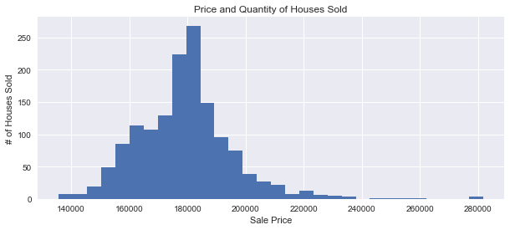
Exploratory Data Analysis

Slide 8
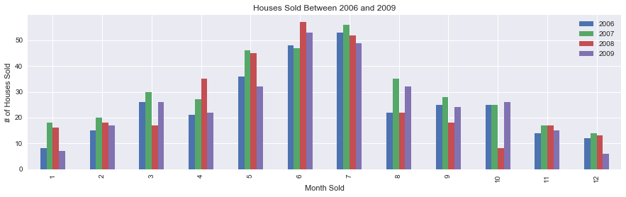
Exploratory Data Analysis

Slide 9
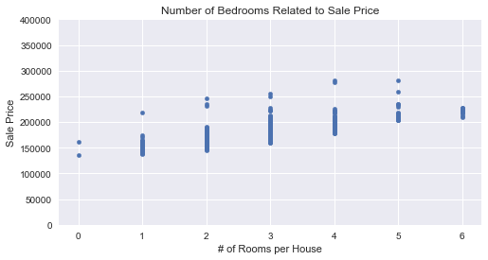
Exploratory Data Analysis

Slide 10
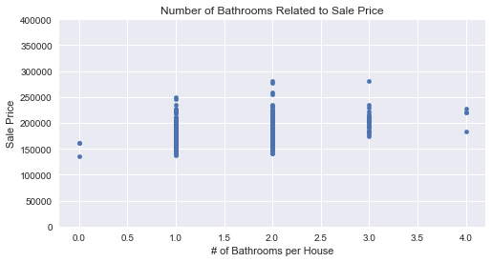
Exploratory Data Analysis

Slide 11
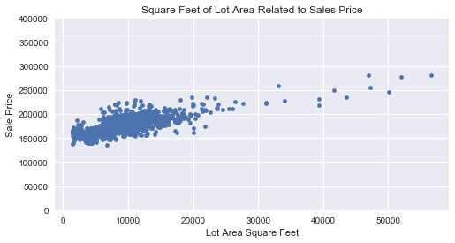
Exploratory Data Analysis

Slide 12
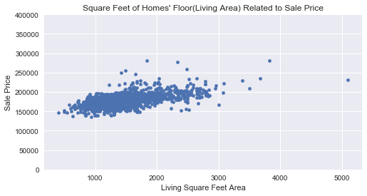
Exploratory Data Analysis

Slide 13
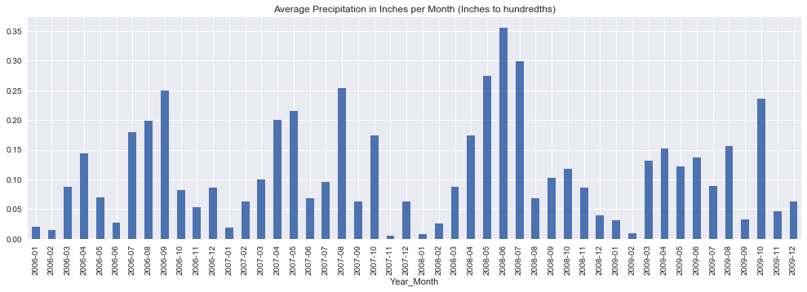
Exploratory Data Analysis

Slide 14
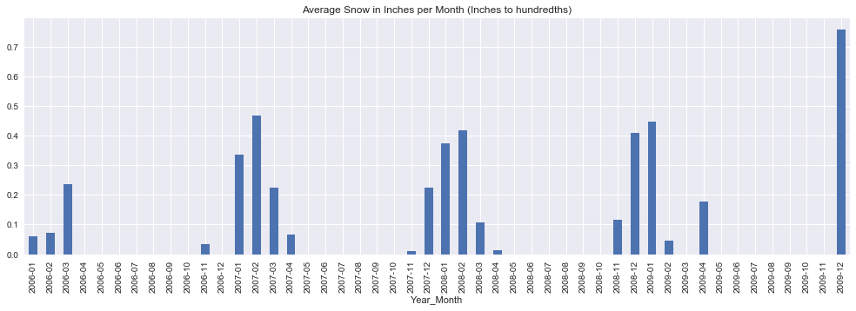
Exploratory Data Analysis

Slide 15
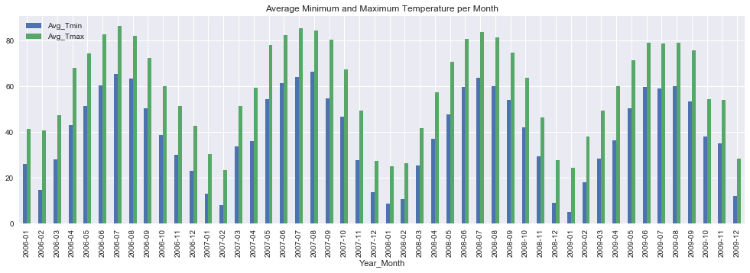
Exploratory Data Analysis

Slide 16
Inferential Analysis
Alpha set at .05
Significant price difference analysis about population.
Central unit vs not a central unit
P-value: 0.010090621217186681
One story houses vs Two story houses
P-value: 3.5535259636604621e-13
Good privacy fence vs minimum privacy fence
P-value: 0.37003494954970051

Slide 17
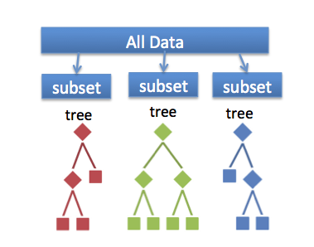
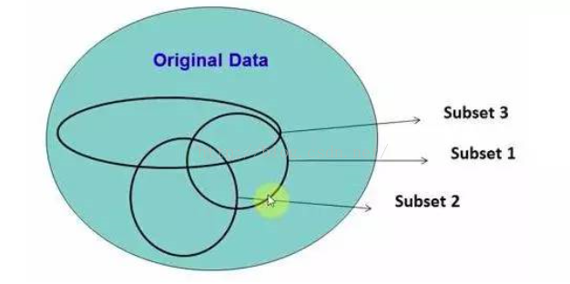
Modeling and Analysis
Random Forest Predictive Algorithm
Continues Target variable(Regression)
Based on Decision Trees Models
Bootstrapping
Root Mean Square Error Accuracy
Feature Importance

Slide 18
Modeling and Analysis
Main packages and libraries
Scikit-learn and math
RandomForestRegressor()
Param_grid(GridSearchCV)
Fit()
Best_estimators()
Predict()
RMSE = sqrt(mean_squared_error(y_test, y_predict)

Slide 19
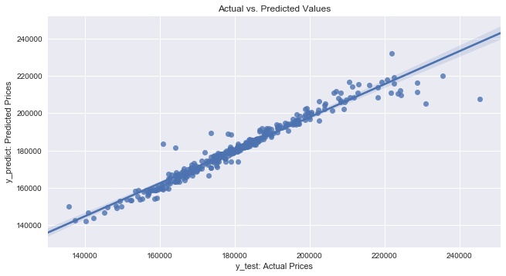
Modeling and Analysis

Slide 20
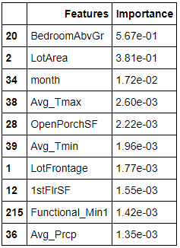
Modeling and Analysis
Feature Importance related to predicted price value

Slide 21
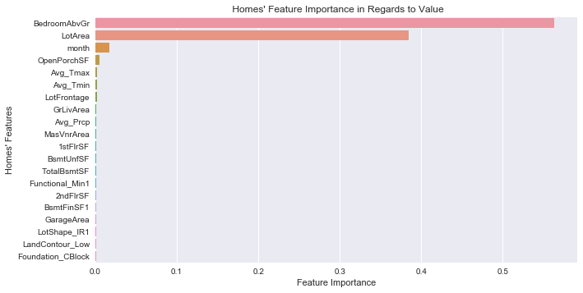
Modeling and Analysis

Slide 22
Thank you!
Any Questions?

