Slide 1
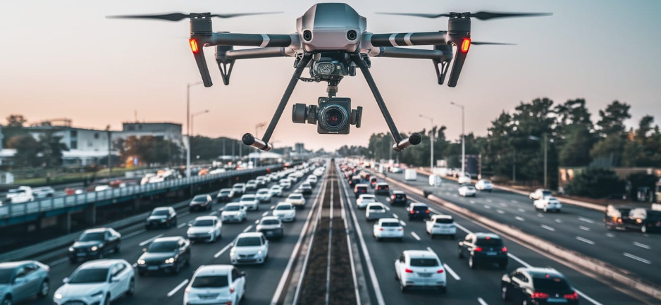
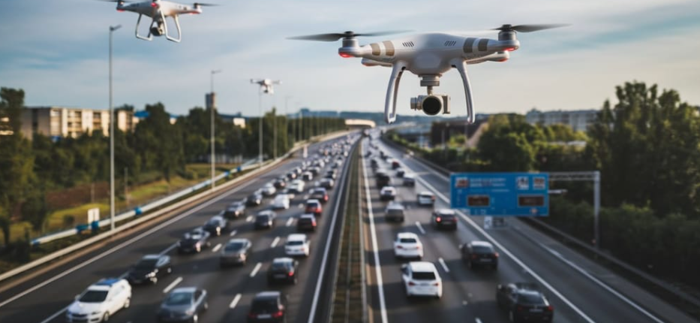
Lightweight YOLO for Real-Time UAV Detection in Urban Places
Justin-Marian Popescu
Alfred-Andrei Pietraru

Slide 2
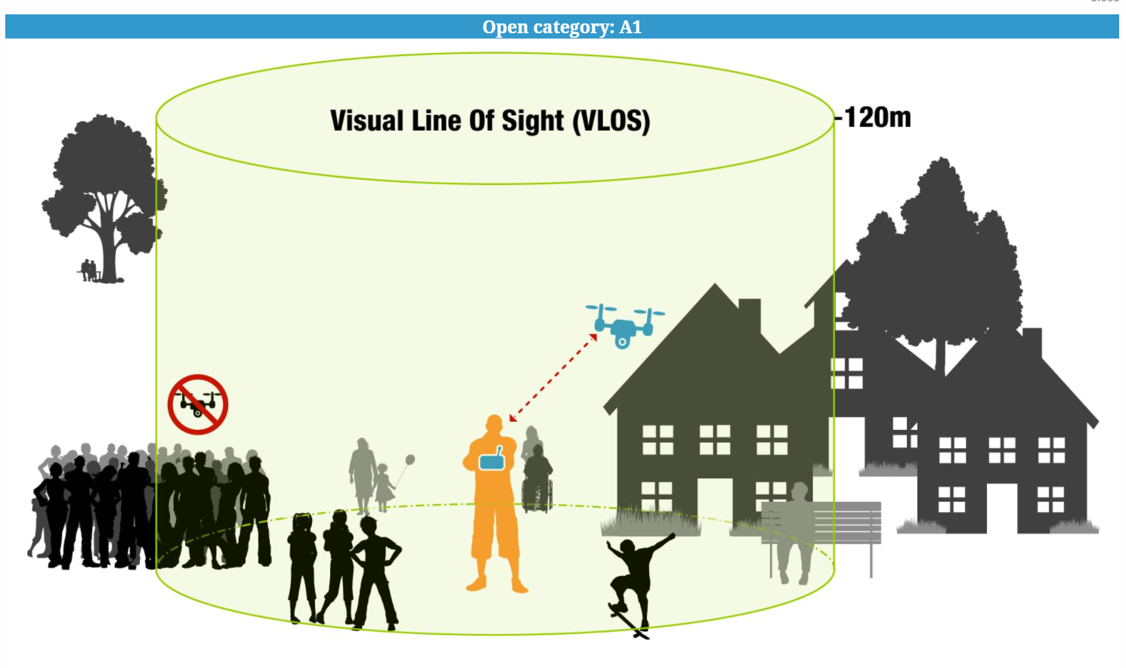
Problem
Safety legislation in Europe for UAVs
Open Category Drone type - small, up to 25kg, height less than 120m
Object detection task - real time, high image resolution, small objects

Slide 3

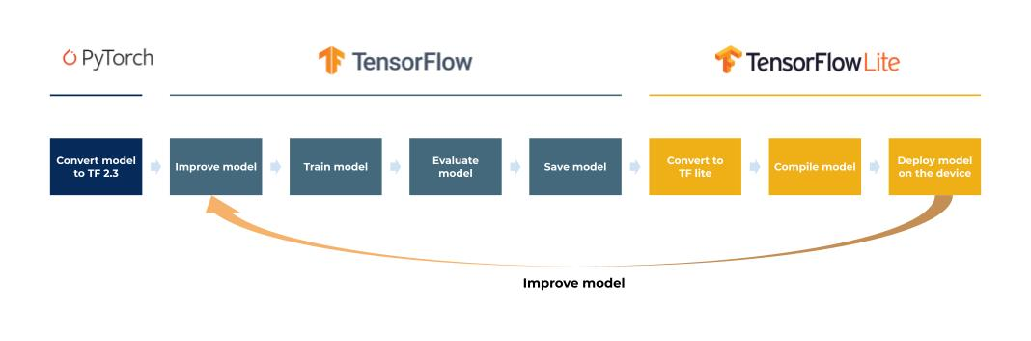
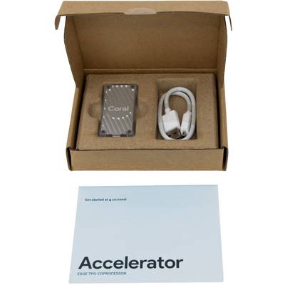

Software
Hardware
PyTorch for model training and validation
TensorLite (TensorFlow Lite) for lightweight, on device inference.
Voxel51 - results visualization
Tensorboard – real-time training visualization scores
ONNX, Tensorflow, TFLite – exporting model to the embedded device
Google Coral USB accelerator for testing with 8MB total space for model with quantization settled on INT8, only inference support
Model training is performed on a GeForce RTX 5090 GPU using the RunPod cloud platform, with all project code, experiments, and configurations managed through GitHub for version control and collaboration.

Slide 4


YOLO architecture
As an open-source architecture, YOLO has evolved through multiple optimized versions (v5 to v11) offering improvements in speed, accuracy, and deployment efficiency.
Extensive community support, wide range of research material
Metrics: mAP50, mAP95, F1-Score, parameter number, inference speed, GFLOPs.

Slide 5
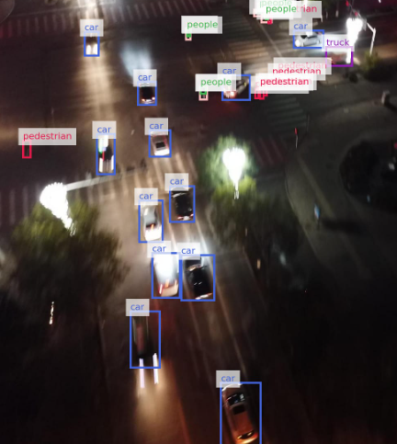
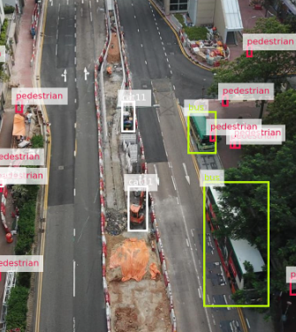
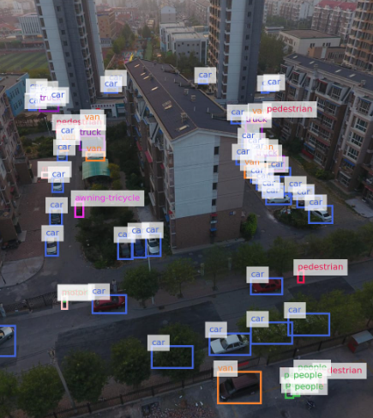
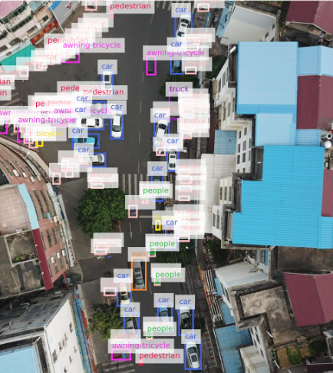
Datasets
Visdrone 10 classes, 10000 images
Standford Drone Dataset (SSD) 6 classes, 19000 images
AU-AIR 7 classes, 32000 images
UAVDT 4 classes, 78000 images

