Slide 1



SAPHAR.COM
PREPARED BY :-
Amanpreet Singh
Beant Kaur
Harmanpreet Kaur

Slide 2

This application is develop to provide best travelling services to the customers and travel agents. We have developed tours and travel management system to provide a search platform where a tourist can find their tour places according to their choices. This system also helps to promote responsible and interesting tourism so that people can enjoy their holidays at their favorable places. This system also helps to develop tourism with different cultures so that they enrich the tourism experience and build pride.

Slide 3

To Create Web Based Application For our Organization.
To Provide Search Facility For Customer.
To Generate Different Types of Reports.
To Provide package Details.

Slide 4

Processor : INTEL
RAM : 512MB
Hard Disk Drive : 40GB

Slide 5

FRONT END – PHP
BACK END – MYSQL
SERVER – XAMPP
OTHER TOOLS – HTML , CSS
OPERATING SYSTEM - Windows XP or any latest version of windows
WEB BROWSER - Mozilla Firefox or any browser

Slide 6

  Hyper Text Markup Language
  Developed by Tim Berners lee in 1990.
  An extended version of SGML.
  Easy to use ,Easy to learn
  Markup tags tell the browser how to display the page.
  A HTML file must have an extension .htm or.html.

Slide 7

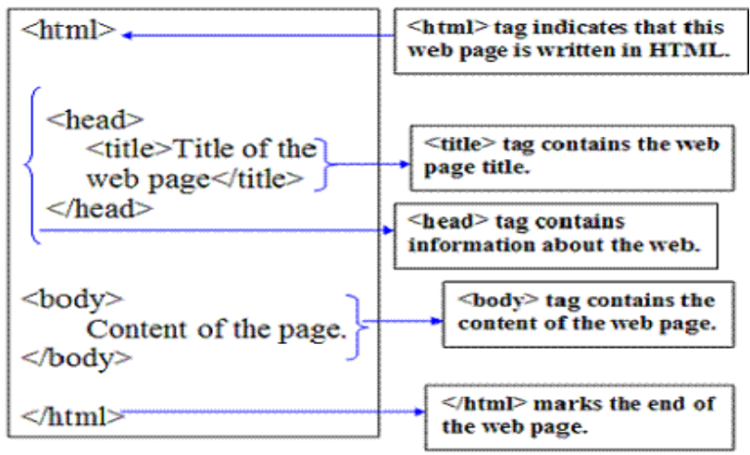

Slide 8


  PHP (Hypertext Preprocessor),
  Simple
  Dynamic web pages.
  It’s like ASP.
  PHP scripts are executed on the server .
  PHP files have a file extension of ".php", ".php3", or ".phtml".
  Full database Support
  Open source and free to download and use.
  Cross platform
  Easy for newcomer and advance features
  Non-case sensitive

Slide 9

  A PHP scripting block always starts with <?php and ends with ?>.
  We can start a scripting block with <? and end with ?> on some servers
  It is advised to use standard tags for best outputs.
  PHP runs on different platforms (Windows, Linux, Unix, etc.)
  PHP is compatible with almost all servers used today (Apache, IIS, etc.)
  PHP is easy to learn and runs efficiently on the server side
  $ sign is used to call objects

Slide 10
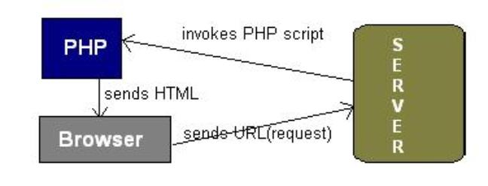
  URL is typed in the browser.
  The browser sends a request to the web server.
  The web server then calls the PHP script on that page.
  The PHP module executes the script, which then sends out the result in the form of HTML back to the browser, which can be seen on the screen.

Slide 11

  MySQL is the most popular open source database server.
  A database defines a structure for storing information.
  With MySQL, we can query a database for specific information and have a recordset returned
  MySQL is ideal for both small and large applications
  MySQL supports standard SQL
  MySQL compiles on a number of platform.
  PHP combined with MySQL are cross-platform

Slide 12

Admin Module
User Module

Slide 13
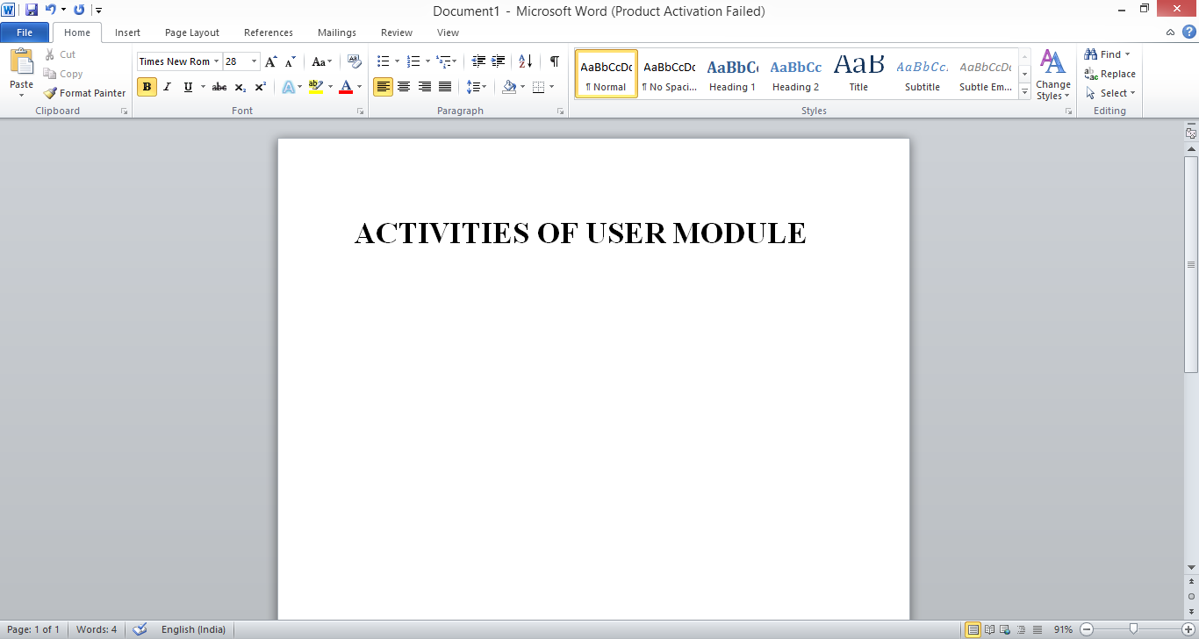
Register
Provides Feedback
Search the packages
View the packages
See details of selected packages
Contact us

Slide 14

Every forthcoming customer is required to create an account in order to get details of the package.
Customers can search for any package using search-box.
The feedback option is also coded for getting remarks of the users.
Users can write any query.
Customers can connect through phone_no.
The various deals information will be regularly updated for users convenience.

Slide 15


// mysql_connect(servername,username,password);
<?php
$con = mysql_connect("localhost",“root","");
if (!$con)
{
die('Could not connect: ' . mysql_error());
}
// some code
mysql_close($con);
?>

Slide 16


