Slide 1
WEB COMPUTATIONAL BIOLOGY TRAINING
1
Notes:
1

Slide 2

Today’s Instructor
Bioinformatics and Computational Biosciences Branch (BCBB), Rocky Mountain Laboratories (RML), NIAID,
NIH, Hamilton, MT USA.
Contact our team via email:
Email: ace@icermali.org
Listserv: ACE-MALI-L@LIST.NIH.GOV
Instructor: amitava.roy@nih.gov
Dr. Amitava Roy,
Ph.D. in Physics
Ongoing Computational Biology projects:
Vaccine development
Structure determination of prion
2

Slide 3
Alignment methods
Introduction to global and local sequence alignment methods
Global : Needleman-Wunsch
Local : Smith-Waterman
BLAST
Scoring Matrices
PAM
BLOSUM

Slide 4
Function Prediction
Multiple Sequence Alignment
Dynamics Programming
ClustlW, t-Coffee, Muscle
Motif Search and Function Prediction
Expectation Maximization, MEME
Software
Markov Model and Hidden Markov Model

Slide 5
Alignment - Why search sequence databases?
I have just sequenced something. What is known about the thing I sequenced?
I have a unique sequence. Is there similarity to another gene that has a known function?
I found a new protein in a lower organism. Is it similar to a protein from another species?

Slide 6
Alignment - Perfect Searches
First “hit” should be an exact match.
Next “hits” should contain all of the genes that are related to your gene (homologs)
Next “hits” should be similar but are not homologs

Slide 7
How does one achieve the “perfect search”?
Comparison Matrices (PAM vs. BLOSUM)
Database Search Algorithms
Databases
Search Parameters
Expect Value-change threshold for score reporting
Translation-of DNA sequence into protein
Filtering-remove repeat sequences

Slide 8
Alignment Algorithms
Global : Needleman-Wunch
Local : Smith-Watermann
➔ These two dynamic programming alignment algorithm are guaranteed to give OPTIMAL alignments
➔ But O(m*n) quadratic

Slide 9
Scoring
Quality = [10(match)] + [-1(mismatch)] -
[(Gap Creation Penalty)(#of Gaps) +(Gap Ext. Pen.)(Total length of Gaps)]
Scoring scheme incorporates an evolutionary model--
Matches are conserved
Mismatches are divergences
Gaps are more likely to disrupt function, hence greater penalty than mismatch.
Introduction of a gap (indel) penalized more than extension of a gap.

Slide 10
Scoring - Estimating p(·,·) for proteins
Generate a large diverse collection of accepted mutations. An accepted mutation is a mutation due to an alignment of closely related protein sequences. For example, Hemoglobin alpha chain in humans and other organisms (homologous proteins).
Let p_{a} = n_{a}/n where n_{a} is the number of occurrences of letter a and n is the total number of letters in the collection, so n = Σ_{a}n_{a}.
Mutation counts
be the number of mutations a ⇔ b,
be the total number of mutations that involve a,
be the total number of amino acids involved in a mutation.
Note that f is twice the number of mutations.

Slide 11
Scoring - PAM-1 matrices
Define M_{ab} to be the symmetric probability matrix for switching between a and b. We set, M_{aa} = 1 – m_{a}, so that m_{a} is the probability that a is involved in a change.
We define M_{ab}, such that only 1% of amino acids change according to this matrix or 99% don’t. Hence the name, 1-Percent Accepted Mutation (PAM). In other words,

Slide 12
Scoring - BLOSUM Outline
Idea: use aligned ungapped regions of protein families.These are assumed to have a common ancestor. Similar ideas but better statistics and modeling. It uses 2000 conserved blocks from 500 families.
Procedure:
Cluster together sequences in a family whenever more than L% identical residues are shared, for BLOSUM-L.
Count number of substitutions across different clusters (in the same family).
Estimate frequencies using the counts.
Practice: BlOSUM-50 and BLOSOM62 are widely used.
Considered the state of the art nowadays.

Slide 13
Scoring - BLOSUM vs PAM
Rat versus
mouse RBP
Rat versus
bacterial
lipocalin

Slide 14
MSA
Multiple sequence alignment (MSA)
Generalize DP to 3 sequence alignment
Impractical
Heuristic approaches to MSA
Progressive alignment – ClustalW (using substitution matrix based scoring function)
Consistency-based approach – T-Coffee (consistency-based scoring function)
MUSCLE (MUSCLE-fast, MUSCLE-prog): reduces time and space complexity

Slide 15
MSA -From pairwise to multiple alignment
Alignment of 2 sequences is represented as a
2-row matrix
In a similar way, we represent alignment of 3 sequences as a 3-row matrix
A T _ G C G _
A _ C G T _ A
A T C A C _ A
Score: more conserved columns, better alignment

Slide 16
What’s multiple sequence alignment (MSA)
A model
Indicates relationship between residues of different sequences
Reveals similarity/disimilarity

Slide 17
Why we need MSA
MSA is central to many bioinformatics applications
Phylogenetic tree
Motifs
Patterns
Structure prediction (RNA, protein)

Slide 18
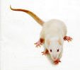

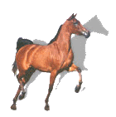
Motif
Set of similar substrings,
within a single long sequence
or a family of diverged sequences
long biosequence
Motif

Slide 19
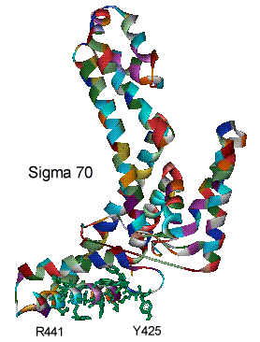
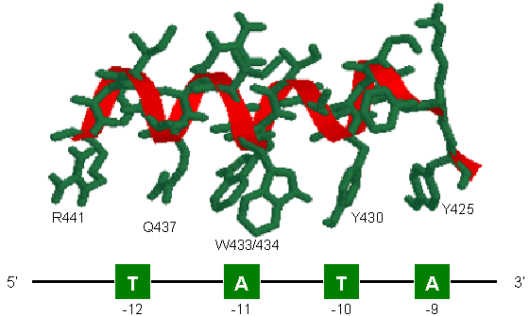
Protein Motif: Activity Sites
..YKFSTYATWWIRQAITR..

Slide 20
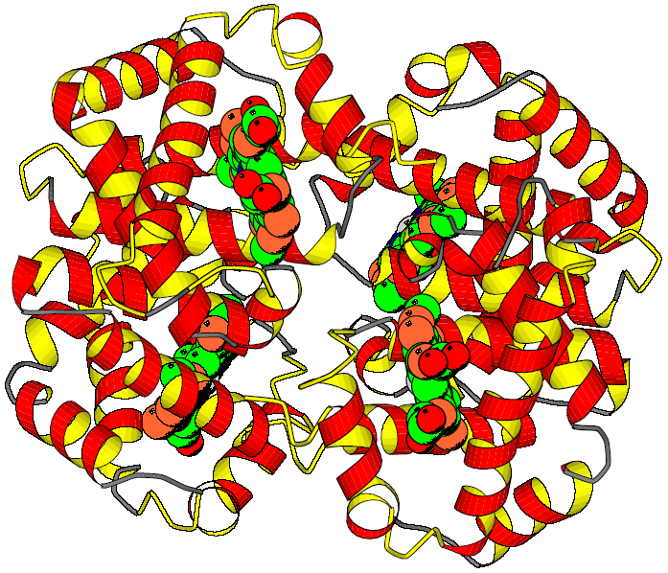
Example: Globin Motifs
xxxxxxxxxxx.xxxxxxxxx.xxxxx..........xxxxxx.xxxxxxx.xxxxxxxxxx.xxxxxxxxx
HAHU V.LSPADKTN..VKAAWGKVG.AHAGE..........YGAEAL.ERMFLSF..PTTKTYFPH.FDLS.HGSA
HAOR M.LTDAEKKE..VTALWGKAA.GHGEE..........YGAEAL.ERLFQAF..PTTKTYFSH.FDLS.HGSA
HADK V.LSAADKTN..VKGVFSKIG.GHAEE..........YGAETL.ERMFIAY..PQTKTYFPH.FDLS.HGSA
HBHU VHLTPEEKSA..VTALWGKVN.VDEVG...........G.EAL.GRLLVVY..PWTQRFFES.FGDL.STPD
HBOR VHLSGGEKSA..VTNLWGKVN.INELG...........G.EAL.GRLLVVY..PWTQRFFEA.FGDL.SSAG
HBDK VHWTAEEKQL..ITGLWGKVNvAD.CG...........A.EAL.ARLLIVY..PWTQRFFAS.FGNL.SSPT
MYHU G.LSDGEWQL..VLNVWGKVE.ADIPG..........HGQEVL.IRLFKGH..PETLEKFDK.FKHL.KSED
MYOR G.LSDGEWQL..VLKVWGKVE.GDLPG..........HGQEVL.IRLFKTH..PETLEKFDK.FKGL.KTED
IGLOB M.KFFAVLALCiVGAIASPLT.ADEASlvqsswkavsHNEVEIlAAVFAAY.PDIQNKFSQFaGKDLASIKD
GPUGNI A.LTEKQEAL..LKQSWEVLK.QNIPA..........HS.LRL.FALIIEA.APESKYVFSF.LKDSNEIPE
GPYL GVLTDVQVAL..VKSSFEEFN.ANIPK...........N.THR.FFTLVLEiAPGAKDLFSF.LKGSSEVPQ
GGZLB M.L.DQQTIN..IIKATVPVLkEHGVT...........ITTTF.YKNLFAK.HPEVRPLFDM.GRQ..ESLE
xxxxx.xxxxxxxxxxxxx..xxxxxxxxxxxxxxx..xxxxxxx.xxxxxxx...xxxxxxxxxxxxxxxx
HAHU QVKGH.GKKVADA.LTN......AVA.HVDDMPNA...LSALS.D.LHAHKL....RVDPVNF.KLLSHCLL
HAOR QIKAH.GKKVADA.L.S......TAAGHFDDMDSA...LSALS.D.LHAHKL....RVDPVNF.KLLAHCIL
HADK QIKAH.GKKVAAA.LVE......AVN.HVDDIAGA...LSKLS.D.LHAQKL....RVDPVNF.KFLGHCFL
HBHU AVMGNpKVKAHGK.KVLGA..FSDGLAHLDNLKGT...FATLS.E.LHCDKL....HVDPENF.RL.LGNVL
HBOR AVMGNpKVKAHGA.KVLTS..FGDALKNLDDLKGT...FAKLS.E.LHCDKL....HVDPENFNRL..GNVL
HBDK AILGNpMVRAHGK.KVLTS..FGDAVKNLDNIKNT...FAQLS.E.LHCDKL....HVDPENF.RL.LGDIL
MYHU EMKASeDLKKHGA.TVL......TALGGILKKKGHH..EAEIKPL.AQSHATK...HKIPVKYLEFISECII
MYOR EMKASaDLKKHGG.TVL......TALGNILKKKGQH..EAELKPL.AQSHATK...HKISIKFLEYISEAII
IGLOB T.GA...FATHATRIVSFLseVIALSGNTSNAAAV...NSLVSKL.GDDHKA....R.GVSAA.QF..GEFR
GPUGNI NNPK...LKAHAAVIFKTI...CESATELRQKGHAVwdNNTLKRL.GSIHLK....N.KITDP.HF.EVMKG
GPYL NNPD...LQAHAG.KVFKL..TYEAAIQLEVNGAVAs.DATLKSL.GSVHVS....K.GVVDA.HF.PVVKE
GGZLB Q......PKALAM.TVL......AAAQNIENLPAIL..PAVKKIAvKHCQAGVaaaH.YPIVGQEL.LGAIK
xxxxxxxxx.xxxxxxxxx.xxxxxxxxxxxxxxxxxxxxxxx..x
HAHU VT.LAA.H..LPAEFTPA..VHASLDKFLASV.STVLTS..KY..R
HAOR VV.LAR.H..CPGEFTPS..AHAAMDKFLSKV.ATVLTS..KY..R
HADK VV.VAI.H..HPAALTPE..VHASLDKFMCAV.GAVLTA..KY..R
HBHU VCVLAH.H..FGKEFTPP..VQAAYQKVVAGV.ANALAH..KY..H
HBOR IVVLAR.H..FSKDFSPE..VQAAWQKLVSGV.AHALGH..KY..H
HBDK IIVLAA.H..FTKDFTPE..CQAAWQKLVRVV.AHALAR..KY..H
MYHU QV.LQSKHPgDFGADAQGA.MNKALELFRKDM.ASNYKELGFQ..G
MYOR HV.LQSKHSaDFGADAQAA.MGKALELFRNDM.AAKYKEFGFQ..G
IGLOB TA.LVA.Y..LQANVSWGDnVAAAWNKA.LDN.TFAIVV..PR..L
GPUGNI ALLGTIKEA.IKENWSDE..MGQAWTEAYNQLVATIKAE..MK..E
GPYL AILKTIKEV.VGDKWSEE..LNTAWTIAYDELAIIIKKE..MKdaA
GGZLB EVLGDAAT..DDILDAWGK.AYGVIADVFIQVEADLYAQ..AV..E
 | Hemoglobin alpha subunit

Slide 21
Motif discovery problem
Given sequences
Find motif
the number of motifs
the width of each motif
the locations of motif occurrences
seq. 1
seq. 2
seq. 3
IGRGGFGEVY at position 515
LGEGCFGQVV at position 430
VGSGGFGQVY at position 682

Slide 22
Why find motifs?
In proteins—may be a critical component
Find similarities to known proteins
Find important areas of new protein family
In DNA—may be a binding site
Discover how the gene expression is regulated

Slide 23
Why is this hard?
Input sequences are long (thousands or millions of residues)
Motif may be subtle
Instances are short.
Instances may be only slightly similar.
?
?

Slide 24
Computational problems for in silico motif detection
Extract a motif model based on (experimentally) identified motifs
Search for motif instances based on given motif model(s)
Uncover novel motifs computationally from genomic sequences
Supervised learning
Prediction
Unsupervised learning
Notes:
These three subproblems roughly fall into the following three classes of problems in statistical machine learning, namely, supervised learning, model based prediction, and unsupervised learning.

Slide 25




Profile based predictors of protein domains / motifs
Motif database in form of regular expressions. Not necessarily the whole domain.
K-x(12)-[DE] = lysine, any 12, Aspartic acid or Glutamic acid.
Returns 1 or 0, i.e. very rigid and can be very inaccurate for small simple motifs
Motif search tools based on Prosite but with multiple alignment profiling
Collection of HMM’s usually covering the whole domain

Slide 26
Exercises:
Section A:
• Sequence retrieval of a P. falciparum protein (cyclophilin) using SRS
• BLAST and Fasta searches by cutting & pasting the sequence.
Section B:
Exercise 1 Part I (row 1):
• Search PROSITE server by cutting & pasting the cyclophilin sequence
Exercise 1 Part II (row2):
• Pfam server
Exercise 1 Part III (row3):
• SMART server
Exercise 1 Part IV (row4):
• InterPro server
Exercise 2:
• Sequence retrieval of P. falciparum PFC0125w protein using SRS.
• TMHMMv2.0 server.
• SignalPv3.0 server.
Section C:
• Other web resources

Slide 27
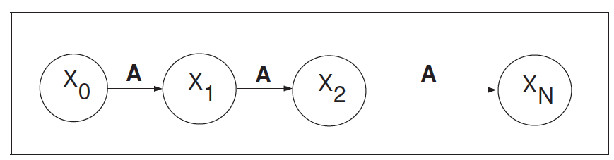



Introducing Hidden Markov Models First – a Markov Model
A Markov Model is a chain-structured process where future states depend only on the present state, not on the sequence of events that preceded it.
The X at a given time is called the state.
The value of Xn depends only on Xn-1.
?
State : sunny cloudy rainy sunny ?
Notes:
Zongtai Qi, 1/17/2016
Before introducing the Hidden Markov Model (HMM), start with the Markov Model.
The definition of a Markov Model;
a schematic illustration of a chained-structured process where Xn depends only on Xn-1;
introduce the concept of “state”;
an example of how the Markov Model concept was applied in a weather report; tomorrow’s weather is dependent only on today’s weather, not yesterday’s.

Slide 28
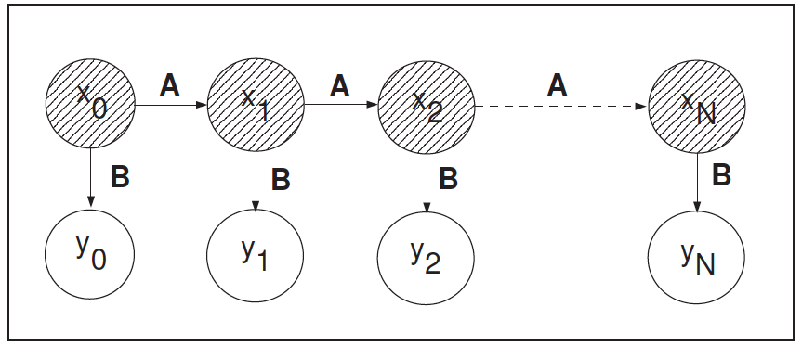
The Hidden Markov Model
A Hidden Markov Model is a Markov chain for which the state is only partially observable.
A Markov Model
A Hidden Markov Model
Hidden states : the (TRUE) states of a system that can be described by a Markov process (e.g., the weather).
Observed states : the states of the process that are `visible' (e.g., umbrella).
Notes:
Based on the Markov Model, introduce the Hidden Markov Model.
Definition of Hidden Markov model;
schematic illustration of the differences between the Markov model and the Hidden Markov Model: the X state is now hidden.
Introduce the concept of “Hidden States.”
Introduce the concept of “Observed States.”

