Slide 1
WEB COMPUTATIONAL BIOLOGY TRAINING
1
Notes:
1

Slide 2

Today’s Instructor
Bioinformatics and Computational Biosciences Branch (BCBB), Rocky Mountain Laboratories (RML), NIAID,
NIH, Hamilton, MT USA.
Contact our team via email:
Email: ace@icermali.org
Listserv: ACE-MALI-L@LIST.NIH.GOV
Instructor: amitava.roy@nih.gov
Dr. Amitava Roy,
Ph.D. in Physics
Ongoing Computational Biology projects:
Vaccine development
Structure determination of prion
2

Slide 3
Alignment methods
Introduction to global and local sequence alignment methods
Global : Needleman-Wunsch
Local : Smith-Waterman
BLAST
Scoring Matrices
PAM
BLOSUM

Slide 4
Function Prediction
Multiple Sequence Alignment
Dynamics Programming
ClustlW, t-Coffee, Muscle
Motif Search and Function Prediction
Expectation Maximization, MEME
Markov Model and Hidden Markov Model
Software

Slide 5
Motifs - Sites – Signals/Function - Domains
For this lecture, I’ll use these terms interchangeably to describe recurring elements of interest to us.
In PROTEINS we have: transmembrane domains, coiled-coil domains, EGF-like domains, signal peptides, phosphorylation sites, antigenic determinants, ...
In DNA / RNA we have: enhancers, promoters, terminators, splicing signals, translation initiation sites, centromeres, ...

Slide 6
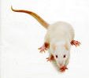

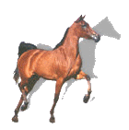
Motif
Set of similar substrings,
within a single long sequence
or a family of diverged sequences
long biosequence
Motif

Slide 7
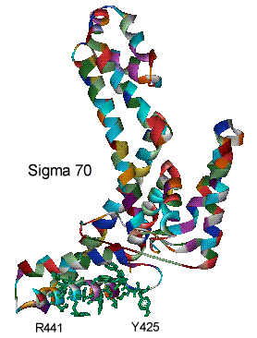
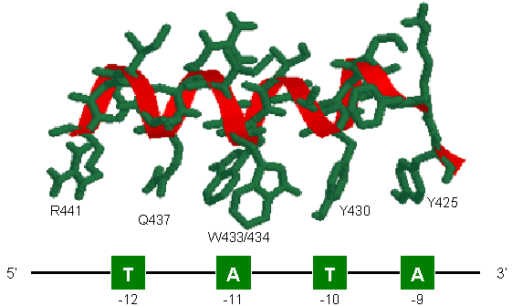
Protein Motif: Activity Sites
..YKFSTYATWWIRQAITR..

Slide 8
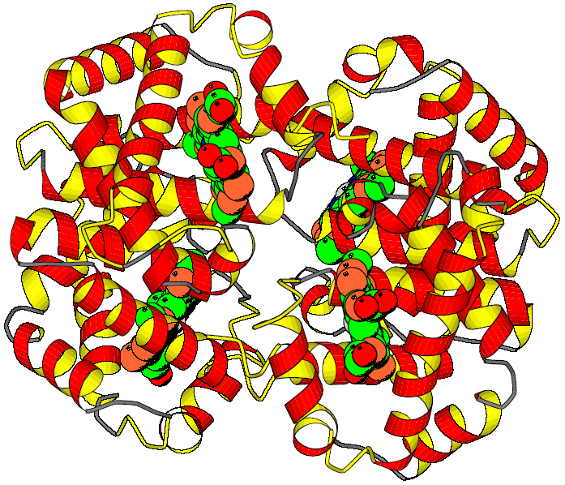
Example: Globin Motifs
xxxxxxxxxxx.xxxxxxxxx.xxxxx..........xxxxxx.xxxxxxx.xxxxxxxxxx.xxxxxxxxx
HAHU V.LSPADKTN..VKAAWGKVG.AHAGE..........YGAEAL.ERMFLSF..PTTKTYFPH.FDLS.HGSA
HAOR M.LTDAEKKE..VTALWGKAA.GHGEE..........YGAEAL.ERLFQAF..PTTKTYFSH.FDLS.HGSA
HADK V.LSAADKTN..VKGVFSKIG.GHAEE..........YGAETL.ERMFIAY..PQTKTYFPH.FDLS.HGSA
HBHU VHLTPEEKSA..VTALWGKVN.VDEVG...........G.EAL.GRLLVVY..PWTQRFFES.FGDL.STPD
HBOR VHLSGGEKSA..VTNLWGKVN.INELG...........G.EAL.GRLLVVY..PWTQRFFEA.FGDL.SSAG
HBDK VHWTAEEKQL..ITGLWGKVNvAD.CG...........A.EAL.ARLLIVY..PWTQRFFAS.FGNL.SSPT
MYHU G.LSDGEWQL..VLNVWGKVE.ADIPG..........HGQEVL.IRLFKGH..PETLEKFDK.FKHL.KSED
MYOR G.LSDGEWQL..VLKVWGKVE.GDLPG..........HGQEVL.IRLFKTH..PETLEKFDK.FKGL.KTED
IGLOB M.KFFAVLALCiVGAIASPLT.ADEASlvqsswkavsHNEVEIlAAVFAAY.PDIQNKFSQFaGKDLASIKD
GPUGNI A.LTEKQEAL..LKQSWEVLK.QNIPA..........HS.LRL.FALIIEA.APESKYVFSF.LKDSNEIPE
GPYL GVLTDVQVAL..VKSSFEEFN.ANIPK...........N.THR.FFTLVLEiAPGAKDLFSF.LKGSSEVPQ
GGZLB M.L.DQQTIN..IIKATVPVLkEHGVT...........ITTTF.YKNLFAK.HPEVRPLFDM.GRQ..ESLE
xxxxx.xxxxxxxxxxxxx..xxxxxxxxxxxxxxx..xxxxxxx.xxxxxxx...xxxxxxxxxxxxxxxx
HAHU QVKGH.GKKVADA.LTN......AVA.HVDDMPNA...LSALS.D.LHAHKL....RVDPVNF.KLLSHCLL
HAOR QIKAH.GKKVADA.L.S......TAAGHFDDMDSA...LSALS.D.LHAHKL....RVDPVNF.KLLAHCIL
HADK QIKAH.GKKVAAA.LVE......AVN.HVDDIAGA...LSKLS.D.LHAQKL....RVDPVNF.KFLGHCFL
HBHU AVMGNpKVKAHGK.KVLGA..FSDGLAHLDNLKGT...FATLS.E.LHCDKL....HVDPENF.RL.LGNVL
HBOR AVMGNpKVKAHGA.KVLTS..FGDALKNLDDLKGT...FAKLS.E.LHCDKL....HVDPENFNRL..GNVL
HBDK AILGNpMVRAHGK.KVLTS..FGDAVKNLDNIKNT...FAQLS.E.LHCDKL....HVDPENF.RL.LGDIL
MYHU EMKASeDLKKHGA.TVL......TALGGILKKKGHH..EAEIKPL.AQSHATK...HKIPVKYLEFISECII
MYOR EMKASaDLKKHGG.TVL......TALGNILKKKGQH..EAELKPL.AQSHATK...HKISIKFLEYISEAII
IGLOB T.GA...FATHATRIVSFLseVIALSGNTSNAAAV...NSLVSKL.GDDHKA....R.GVSAA.QF..GEFR
GPUGNI NNPK...LKAHAAVIFKTI...CESATELRQKGHAVwdNNTLKRL.GSIHLK....N.KITDP.HF.EVMKG
GPYL NNPD...LQAHAG.KVFKL..TYEAAIQLEVNGAVAs.DATLKSL.GSVHVS....K.GVVDA.HF.PVVKE
GGZLB Q......PKALAM.TVL......AAAQNIENLPAIL..PAVKKIAvKHCQAGVaaaH.YPIVGQEL.LGAIK
xxxxxxxxx.xxxxxxxxx.xxxxxxxxxxxxxxxxxxxxxxx..x
HAHU VT.LAA.H..LPAEFTPA..VHASLDKFLASV.STVLTS..KY..R
HAOR VV.LAR.H..CPGEFTPS..AHAAMDKFLSKV.ATVLTS..KY..R
HADK VV.VAI.H..HPAALTPE..VHASLDKFMCAV.GAVLTA..KY..R
HBHU VCVLAH.H..FGKEFTPP..VQAAYQKVVAGV.ANALAH..KY..H
HBOR IVVLAR.H..FSKDFSPE..VQAAWQKLVSGV.AHALGH..KY..H
HBDK IIVLAA.H..FTKDFTPE..CQAAWQKLVRVV.AHALAR..KY..H
MYHU QV.LQSKHPgDFGADAQGA.MNKALELFRKDM.ASNYKELGFQ..G
MYOR HV.LQSKHSaDFGADAQAA.MGKALELFRNDM.AAKYKEFGFQ..G
IGLOB TA.LVA.Y..LQANVSWGDnVAAAWNKA.LDN.TFAIVV..PR..L
GPUGNI ALLGTIKEA.IKENWSDE..MGQAWTEAYNQLVATIKAE..MK..E
GPYL AILKTIKEV.VGDKWSEE..LNTAWTIAYDELAIIIKKE..MKdaA
GGZLB EVLGDAAT..DDILDAWGK.AYGVIADVFIQVEADLYAQ..AV..E
 | Hemoglobin alpha subunit

Slide 9
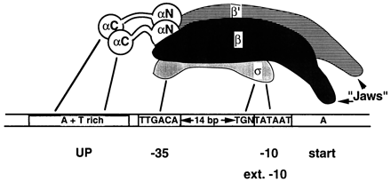
DNA Motif
RNA polymerase-promotor interactions
Transcription Initiation in E. coli
In E. coli transcription is initiated at the promotor , whose sequence is recognised by the Sigma factor of RNA polymerase.

Slide 10
Example: Gcn4
Regulatory Signals
5’- TCTCTCTCCACGGCTAATTAGGTGATCATGAAAAAATGAAAAATTCATGAGAAAAGAGTCAGACATCGAAACATACAT
…HIS7
5’- ATGGCAGAATCACTTTAAAACGTGGCCCCACCCGCTGCACCCTGTGCATTTTGTACGTTACTGCGAAATGACTCAACG
…ARO4
5’- CACATCCAACGAATCACCTCACCGTTATCGTGACTCACTTTCTTTCGCATCGCCGAAGTGCCATAAAAAATATTTTTT
…ILV6
5’- TGCGAACAAAAGAGTCATTACAACGAGGAAATAGAAGAAAATGAAAAATTTTCGACAAAATGTATAGTCATTTCTATC
…THR4
5’- ACAAAGGTACCTTCCTGGCCAATCTCACAGATTTAATATAGTAAATTGTCATGCATATGACTCATCCCGAACATGAAA
…ARO1
5’- ATTGATTGACTCATTTTCCTCTGACTACTACCAGTTCAAAATGTTAGAGAAAAATAGAAAAGCAGAAAAAATAAATAA
…HOM2
5’- GGCGCCACAGTCCGCGTTTGGTTATCCGGCTGACTCATTCTGACTCTTTTTTGGAAAGTGTGGCATGTGCTTCACACA
…PRO3
Given a collection of genes with common expression,
Can we find the TF-binding site in common?

Slide 11
Motif discovery problem
Given sequences
Find motif
the number of motifs
the width of each motif
the locations of motif occurrences
seq. 1
seq. 2
seq. 3
IGRGGFGEVY at position 515
LGEGCFGQVV at position 430
VGSGGFGQVY at position 682

Slide 12
Why find motifs?
In proteins—may be a critical component
Find similarities to known proteins
Find important areas of new protein family
In DNA—may be a binding site
Discover how the gene expression is regulated

Slide 13
Why is this hard?
Input sequences are long (thousands or millions of residues)
Motif may be subtle
Instances are short.
Instances may be only slightly similar.
?
?

Slide 14
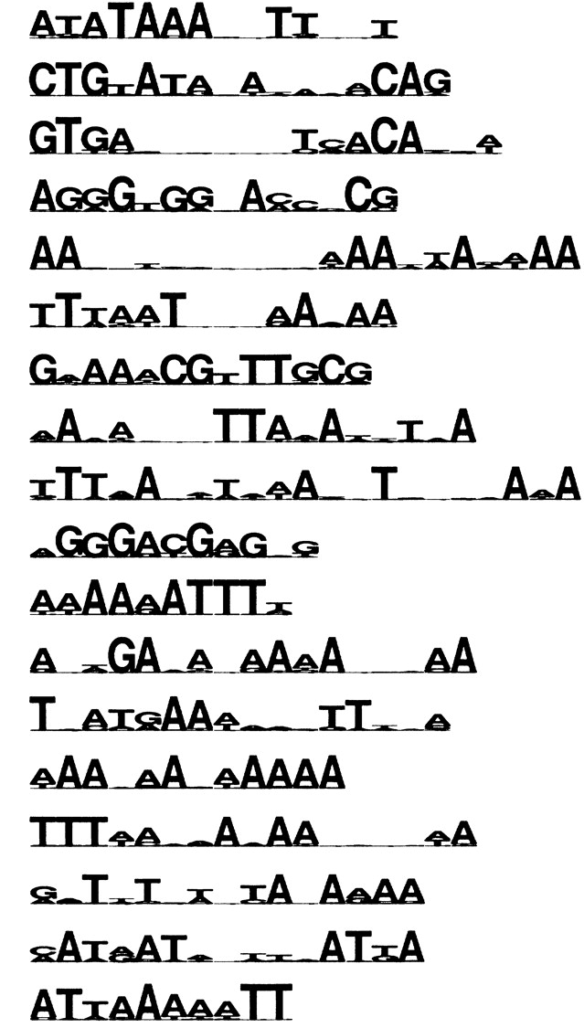
Characteristics of Regulatory Motifs
Tiny
Highly Variable
~Constant Size
Because a constant-size transcription factor binds
Often repeated
Low-complexity-ish

Slide 15
Motif Representation

Slide 16
Measuring similarity
What counts as a similarity?
How can such a pattern be searched for?
Need a concrete measure of how good a motif is, and how well-matched an instance is.
?
?
?

Slide 17
Determinism 1: Consensus Sequences
σ Factor Promotor consensus sequence
-35 -10
σ⁷⁰ TTGACA TATAAT
σ²⁸ CTAAA CCGATAT
Similarly for σ³² , σ³⁸ and σ⁵⁴.
Consensus sequences have the obvious limitation: there is usually some deviation from them.

Slide 18
Determinism 2: Regular Expressions
The characteristic motif of a Cys-Cys-His-His zinc finger DNA binding domain has regular expression
C-X(2,4)-C-X(3)-[LIVMFYWC]-X(8)-H-X(3,5)-H
Here, as in algebra, X is unknown. The 29 a.a. sequence of an example domain 1SP1 is as follows, clearly fitting the model.
1SP1:
KKFACPECPKRFMRSDHLSKHIKTHQNKK

Slide 19
Regular Expressions Can Be Limiting
The regular expression syntax is still too rigid to represent many highly divergent protein motifs.
Also, short patterns are sometimes insufficient with today’s large databases. Even requiring perfect matches you might find many false positives. On the other hand some real sites might not be perfect matches.
We need to go beyond apparently equally likely alternatives, and ranges for gaps. We deal with the former first, having a distribution at each position.

Slide 20
Weight Matrix Model (WMM)
Weight matrix model (WMM) = Stochastic consensus sequence
Weight matrices are also known as
Position-specific scoring matrices
Position-specific probability matrices
Position-specific weight matrices
A motif is interesting if it is very different from the background distribution
A
C
G
T
9 | 214 | 63 | 142 | 118 | 8
22 | 7 | 26 | 31 | 52 | 13
18 | 2 | 29 | 38 | 29 | 5
193 | 19 | 124 | 31 | 43 | 216
A
C
G
T
.04 | .88 | .26 | .59 | .49 | .03
.09 | .03 | .11 | .13 | .21 | .05
.07 | .01 | .12 | .16 | .12 | .02
.80 | .08 | .51 | .13 | .18 | .89
Counts from 242 known σ⁷⁰ sites Relative frequencies: θ_{li}
less interesting
more interesting

Slide 21
Weight Matrix Model (WMM)
Weight matrix model (WMM) = Stochastic consensus sequence
A
C
G
T
9 | 214 | 63 | 142 | 118 | 8
22 | 7 | 26 | 31 | 52 | 13
18 | 2 | 29 | 38 | 29 | 5
193 | 19 | 124 | 31 | 43 | 216
A
C
G
T
.04 | .88 | .26 | .59 | .49 | .03
.09 | .03 | .11 | .13 | .21 | .05
.07 | .01 | .12 | .16 | .12 | .02
.80 | .08 | .51 | .13 | .18 | .89
Counts from 242 known σ⁷⁰ sites Relative frequencies: f_{bl}
2
1
0
A
C
G
T
-38 | 19 | 1 | 12 | 10 | -48
-15 | -38 | -8 | -10 | -3 | -32
-13 | -48 | -6 | -7 | -10 | -40
17 | -32 | 8 | -9 | -6 | 19
1
2
3
4
5
6
10 log₂θ_{li}/θ_{0i} Informativeness: 2-Σ_{i}θ_{li} log₂θ_{li}/θ_{0i}

Slide 22
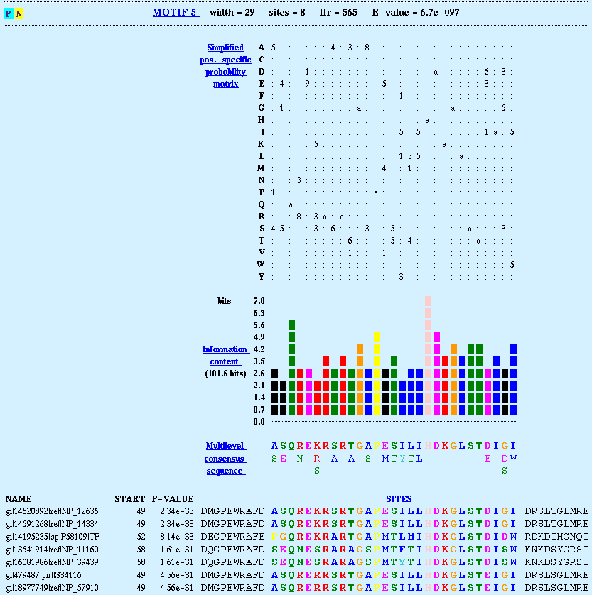
Relative entropy
A motif is interesting if it is very different from the background distribution
Use relative entropy:
Relative entropy is sometimes called
information content
θ_{li} = probability of i in matrix position l
θ_{0i} = background frequency (in non-motif sequence)
A
C
G
T
.04 | .88 | .26 | .59 | .49 | .03
.09 | .03 | .11 | .13 | .21 | .05
.07 | .01 | .12 | .16 | .12 | .02
.80 | .08 | .51 | .13 | .18 | .89
Informativeness: 2-Σ_{i}θ_{li} log₂θ_{li}/θ_{0i}

Slide 23
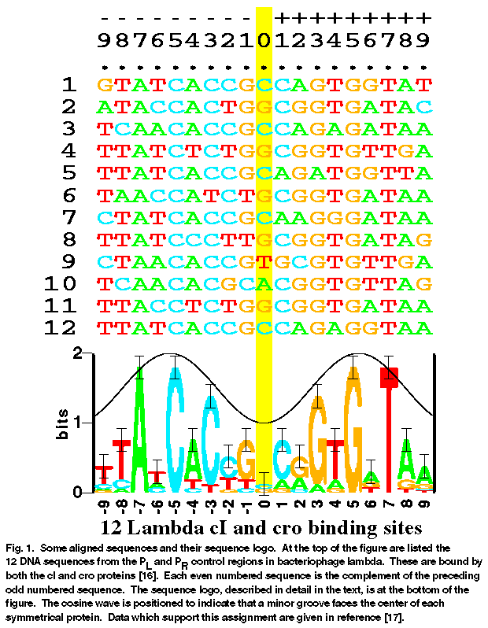
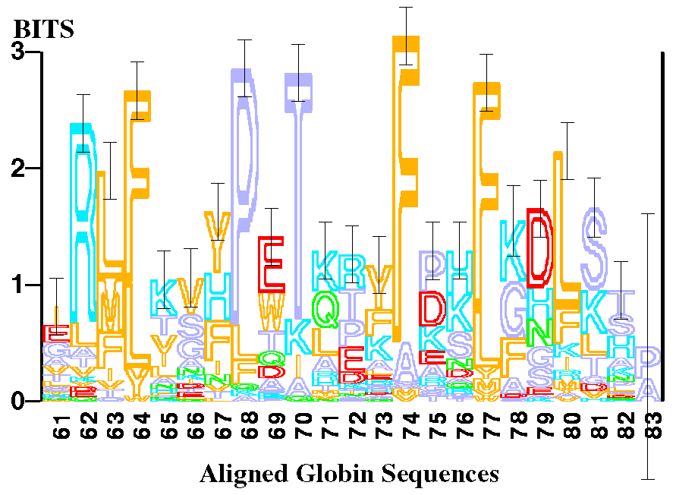
Sequence Logo
Information at pos’n l, H(l) = – Σ_{{letter i}} θ_{li} log₂ θ_{li}
Height of x at pos’n l, L(l,i) = θ_{li} (2 – H(l))
Examples:
θ_{lA} = 1; H(l) = 0; L(l, A) = 2
A: ½; C: ¼; G: ¼; H(l) = 1.5; L(l, A) = ¼; L(l, not T) = ¼

Slide 24
The Product Multinomial (PM) Model
[Lawrence et al. Science 1993]
Positional specific multinomial distribution: θ_{l} = [θ_{lA}, …, θ_{lC}]^{T}
Position weight matrix (PWM): θ
The nucleotide distributions at different positions are independent
θ₁
θ₂
θ₃
...
θ_{L}
A₁
A₂
A₃
...
A_{L}
AAAAGAGTCA
AAAAGAGTCA
AAATGACTCA
AAGTGAGTCA
AAAAGAGTCA
GGATGCGTCA
AAATGAGTCA
GAATGAGTCA
AAAAGAGTCA
Notes:
Before presenting our approach to model the meta-sequence features of motifs, let me briefly review a popular baseline model for motif to set up a reference point and to get familiar with the relevant terminologies. This model is called a product multinomial model. It assumes that the probability of a nucleotide at a particular position of a motif is defined by a positional specific multinomial distribution parameterized by a 4-deiemsional vector theta, and given theta, all nucleotides observed at the corresponding position from all instances of the same motif are iid. In the graphical model representation, we use a plate over the node to denote iid replicates of the random variable. The entire motif can be represented by a list of such multinomial distributions, whose parameters form a matrix called a position weight matrix (PWM). Note that in the PM model the nucleotide distribution at different motif positions are assumed to be independent.

Slide 25
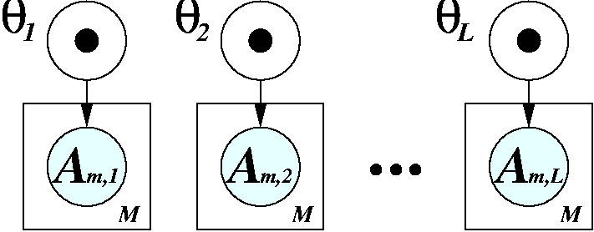
More on PM Model
The PM parameter, θ_{l} = [θ_{lA}, …, θ_{lC}]^{T}, corresponds exactly to the PWM of a motif
The score (likelihood-ratio) of a candidate substring: AAAAGAGTCA
Log Likelihood-Ratio:
 | 1 | 2 | 3 | 4 | 5 | 6 | 7 | 8 | 9 | 10
A | .750 | .875 | .875 | .375 | 0 | 1 | 0 | 0 | 0 | 1
C | 0 | 0 | 0 | 0 | 0 | 0 | .125 | 0 | 1 | 0
G | .250 | .125 | .125 | 0 | 1 | 0 | .875 | 0 | 0 | 0
T | 0 | 0 | 0 | .635 | 0 | 0 | 0 | 1 | 0 | 0
The nucleotide distributions at different sites are independent !

Slide 26

Computational problems for in silico motif detection
Extract a motif model based on (experimentally) identified motifs
Search for motif instances based on given motif model(s)
Uncover novel motifs computationally from genomic sequences
1: AAAAGAGTCA
2: AAATGACTCA
⇒
. AAGTGAGTCA
. AAAAGAGTCA
. GGATGAGTCA
. AAATGAGTCA
. GAATGAGTCA
M: AAAAGAGTCA
5’- ATGGCAGAATCACTTTAAAACGTGGCCCCACCCGCTGCACCCTGTGCATTTTGTACGTTACTGCGAAATGACTCAACG
5’- CACATCCAACGAATCACCTCACCGTTATCGTGACTCACTTTCTTTCGCATCGCCGAAGTGCCATAAAAAATATTTTTT
5’- TGCGAACAAAAGAGTCATTACAACGAGGAAATAGAAGAAAATGAAAAATTTTCGACAAAATGTATAGTCATTTCTATC
⇒
5’- ATGGCAGAATCACTTTAAAACGTGGCCCCACCCGCTGCACCCTGTGCATTTTGTACGTTACTGCGAAATGACTCAACG
5’- ACAAAGGTACCTTCCTGGCCAATCTCACAGATTTAATATAGTAAATTGTCATGCATATGACTCATCCCGAACATGAAA
5’- CACATCCAACGAATCACCTCACCGTTATCGTGACTCACTTTCTTTCGCATCGCCGAAGTGCCATAAAAAATATTTTTT
5’- ATTGATTGACTCATTTTCCTCTGACTACTACCAGTTCAAAATGTTAGAGAAAAATAGAAAAGCAGAAAAAATAAATAA
5’- TGCGAACAAAAGAGTCATTACAACGAGGAAATAGAAGAAAATGAAAAATTTTCGACAAAATGTATAGTCATTTCTATC
5’- GGCGCCACAGTCCGCGTTTGGTTATCCGGCTGACTCATTCTGACTCTTTTTTGGAAAGTGTGGCATGTGCTTCACACA
5’- ACAAAGGTACCTTCCTGGCCAATCTCACAGATTTAATATAGTAAATTGTCATGCATATGACTCATCCCGAACATGAAA
+
5’- ATTGATTGACTCATTTTCCTCTGACTACTACCAGTTCAAAATGTTAGAGAAAAATAGAAAAGCAGAAAAAATAAATAA
5’- GGCGCCACAGTCCGCGTTTGGTTATCCGGCTGACTCATTCTGACTCTTTTTTGGAAAGTGTGGCATGTGCTTCACACA
5’- ATGGCAGAATCACTTTAAAACGTGGCCCCACCCGCTGCACCCTGTGCATTTTGTACGTTACTGCGAAATGACTCAACG
5’- ATGGCAGAATCACTTTAAAACGTGGCCCCACCCGCTGCACCCTGTGCATTTTGTACGTTACTGCGAAATGACTCAACG
⇒
5’- CACATCCAACGAATCACCTCACCGTTATCGTGACTCACTTTCTTTCGCATCGCCGAAGTGCCATAAAAAATATTTTTT
5’- CACATCCAACGAATCACCTCACCGTTATCGTGACTCACTTTCTTTCGCATCGCCGAAGTGCCATAAAAAATATTTTTT
5’- TGCGAACAAAAGAGTCATTACAACGAGGAAATAGAAGAAAATGAAAAATTTTCGACAAAATGTATAGTCATTTCTATC
5’- TGCGAACAAAAGAGTCATTACAACGAGGAAATAGAAGAAAATGAAAAATTTTCGACAAAATGTATAGTCATTTCTATC
5’- ACAAAGGTACCTTCCTGGCCAATCTCACAGATTTAATATAGTAAATTGTCATGCATATGACTCATCCCGAACATGAAA
5’- ACAAAGGTACCTTCCTGGCCAATCTCACAGATTTAATATAGTAAATTGTCATGCATATGACTCATCCCGAACATGAAA
5’- ATTGATTGACTCATTTTCCTCTGACTACTACCAGTTCAAAATGTTAGAGAAAAATAGAAAAGCAGAAAAAATAAATAA
5’- ATTGATTGACTCATTTTCCTCTGACTACTACCAGTTCAAAATGTTAGAGAAAAATAGAAAAGCAGAAAAAATAAATAA
5’- GGCGCCACAGTCCGCGTTTGGTTATCCGGCTGACTCATTCTGACTCTTTTTTGGAAAGTGTGGCATGTGCTTCACACA
5’- GGCGCCACAGTCCGCGTTTGGTTATCCGGCTGACTCATTCTGACTCTTTTTTGGAAAGTGTGGCATGTGCTTCACACA
+
de novo motif detection
Notes:
To improve over the naive approach, let’s take a close look at the motif detection problem to see how it can be reformulated. We felt that this complex problem can be best underatood by decomposing it into three subproblems. First, a biologist may begin with a set of experimentally identified instances of a motif, and he wants to extract a good model from it for later applications, such as the task addressed in the second subproblem, which is to search for presence of this motif in an new set of sequences. In the third scenario, all we have is just the row sequences, and we want to discover previously uncharacterized motifs, and learn a model for such motifs.

Slide 27
Computational problems for in silico motif detection
Extract a motif model based on (experimentally) identified motifs
Search for motif instances based on given motif model(s)
Uncover novel motifs computationally from genomic sequences
Supervised learning
Prediction
Unsupervised learning
Notes:
These three subproblems roughly fall into the following three classes of problems in statistical machine learning, namely, supervised learning, model based prediction, and unsupervised learning.

Slide 28
Problem definition
Given a collection of promoter sequences s₁,…, s_{N} of genes with common expression
Combinatorial
Motif M: substring m₁…m_{W}
Some of the m_{i}’s blank
Find M that occurs in all s_{i} with ≤ k differences
Or, Find M with smallest total hamming dist
Probabilistic
Motif M: {θ_{ij}}; 1 ≤ i ≤ W
j = A,C,G,T
θ_{ij} = Prob[ letter j, pos i ]
Find best M, and positions p₁,…, p_{N} in sequences

Slide 29
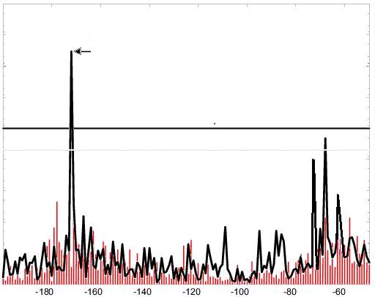
Supervised motif search
Supervised learning
Given biologically identified aligned motifs A, maximal likelihood estimation:
Application:
search for known motifs in silico from genomic sequences
Need more more sophisticated search model: HMM?

Slide 30
de novo motif detection
Unsupervised learning
Given no training examples, predict locations of all instances of novel motifs in given sequences, and learn motif models simultaneously.
Learning algorithms:
Expectation Maximization: e.g., MEME
Gibbs Sampling: e.g., AlignACE, BioProspector
Advanced models: Bayesian network, Bayesian Markovian models
5’- TCTCTCTCCACGGCTAATTAGGTGATCATGAAAAAATGAAAAATTCATGAGAAAAGAGTCAGACATCGAAACATACAT
…HIS7
?
…ARO4
5’- ATGGCAGAATCACTTTAAAACGTGGCCCCACCCGCTGCACCCTGTGCATTTTGTACGTTACTGCGAAATGACTCAACG
5’- CACATCCAACGAATCACCTCACCGTTATCGTGACTCACTTTCTTTCGCATCGCCGAAGTGCCATAAAAAATATTTTTT
…ILV6
5’- TGCGAACAAAAGAGTCATTACAACGAGGAAATAGAAGAAAATGAAAAATTTTCGACAAAATGTATAGTCATTTCTATC
…THR4
5’- ACAAAGGTACCTTCCTGGCCAATCTCACAGATTTAATATAGTAAATTGTCATGCATATGACTCATCCCGAACATGAAA
…ARO1
5’- ATTGATTGACTCATTTTCCTCTGACTACTACCAGTTCAAAATGTTAGAGAAAAATAGAAAAGCAGAAAAAATAAATAA
…HOM2
5’- GGCGCCACAGTCCGCGTTTGGTTATCCGGCTGACTCATTCTGACTCTTTTTTGGAAAGTGTGGCATGTGCTTCACACA
…PRO3

Slide 31
de novo motif detection
Problem setting:
Given UTR sequences: y= {y₁, …, y_{N}}
Goal: the background model: θ₀={θ_{0,A}, θ_{0,T}, θ_{0,G}, θ_{0,C}}t
and K motif models θ₁, … , θ_{K} from y,
where
A missing value problem:
The locations of instances of motifs are unknown, thus the aligned motif sequences A₁, …, A_{K} and the background sequence are not available.

Slide 32
Expectation-maximization
For each subsequence of width W
convert subsequence to a matrix
do {
re-estimate motif occurrences from matrix
re-estimate matrix model from motif occurrences
} until (matrix model stops changing)
end
select matrix with highest score
EM

Slide 33
Sample DNA sequences
>ce1cg
TAATGTTTGTGCTGGTTTTTGTGGCATCGGGCGAGAATA
GCGCGTGGTGTGAAAGACTGTTTTTTTGATCGTTTTCAC
AAAAATGGAAGTCCACAGTCTTGACAG
>ara
GACAAAAACGCGTAACAAAAGTGTCTATAATCACGGCAG
AAAAGTCCACATTGATTATTTGCACGGCGTCACACTTTG
CTATGCCATAGCATTTTTATCCATAAG
>bglr1
ACAAATCCCAATAACTTAATTATTGGGATTTGTTATATA
TAACTTTATAAATTCCTAAAATTACACAAAGTTAATAAC
TGTGAGCATGGTCATATTTTTATCAAT
>crp
CACAAAGCGAAAGCTATGCTAAAACAGTCAGGATGCTAC
AGTAATACATTGATGTACTGCATGTATGCAAAGGACGTC
ACATTACCGTGCAGTACAGTTGATAGC

Slide 34
Motif occurrences
>ce1cg
taatgtttgtgctggtttttgtggcatcgggcgagaata
gcgcgtggtgtgaaagactgttttTTTGATCGTTTTCAC
aaaaatggaagtccacagtcttgacag
>ara
gacaaaaacgcgtaacaaaagtgtctataatcacggcag
aaaagtccacattgattaTTTGCACGGCGTCACactttg
ctatgccatagcatttttatccataag
>bglr1
acaaatcccaataacttaattattgggatttgttatata
taactttataaattcctaaaattacacaaagttaataac
TGTGAGCATGGTCATatttttatcaat
>crp
cacaaagcgaaagctatgctaaaacagtcaggatgctac
agtaatacattgatgtactgcatgtaTGCAAAGGACGTC
ACattaccgtgcagtacagttgatagc

Slide 35
Starting point
…gactgttttTTTGATCGTTTTCACaaaaatgg…
T T T G A T C G T T
A 0.17 0.17 0.17 0.17 0.50 ...
C 0.17 0.17 0.17 0.17 0.17
G 0.17 0.17 0.17 0.50 0.17
T 0.50 0.50 0.50 0.17 0.17
This a special initialization scheme, many others scheme, including random starts, are also valid

Slide 36
Re-estimating motif occurrences
TAATGTTTGTGCTGGTTTTTGTGGCATCGGGCGAGAATA
T T T G A T C G T T
A 0.17 0.17 0.17 0.17 0.50 ...
C 0.17 0.17 0.17 0.17 0.17
G 0.17 0.17 0.17 0.50 0.17
T 0.50 0.50 0.50 0.17 0.17
Score = 0.50 + 0.17 + 0.17 + 0.17 + 0.17 + ...

Slide 37
Scoring each subsequence
Score from each sequence the subsequence with maximal score.
Sequence: TGTGCTGGTTTTTGTGGCATCGGGCGAGAATA
Subsequences Score
TGTGCTGGTTTTTGT 2.95
GTGCTGGTTTTTGTG 4.62
TGCTGGTTTTTGTGG 2.31
GCTGGTTTTTGTGGC ...

Slide 38
Re-estimating motif matrix
From each sequence, take the substring that has the maximal score
Align all of them and count:
Occurrences
TTTGATCGTTTTCAC
TTTGCACGGCGTCAC
TGTGAGCATGGTCAT
TGCAAAGGACGTCAC
Counts
A 000132011000040
C 001010300200403
G 020301131130000
T 423001002114001

Slide 39
Adding pseudocounts
Counts
A 000132011000040
C 001010300200403
G 020301131130000
T 423001002114001
Counts + Pseudocounts
A 111243122111151
C 112121411311514
G 131412242241111
T 534112113225112

Slide 40
Converting to frequencies
Counts + Pseudocounts
A 111243122111151
C 112121411311514
G 131412242241111
T 534112113225112
T T T G A T C G T T
A 0.13 0.13 0.13 0.25 0.50 ...
C 0.13 0.13 0.25 0.13 0.25
G 0.13 0.38 0.13 0.50 0.13
T 0.63 0.38 0.50 0.13 0.13

Slide 41
Expectation-maximization
Problem:
This procedure doesn't allow the motifs to move around very much. Taking the max is too brittle.
Solution:
Associate with each start site a probability of motif occurrence.
For each subsequence of width W
convert subsequence to a matrix
do {
re-estimate motif occurrences from matrix
re-estimate matrix model from motif occurrences
} until (matrix model stops changing)
end
select matrix with highest score
EM

Slide 42
Converting to probabilities
Sequence: TGTGCTGGTTTTTGTGGCATCGGGCGAGAATA
Occurrences Score Prob
TGTGCTGGTTTTTGT 2.95 0.023
GTGCTGGTTTTTGTG 4.62 0.037
TGCTGGTTTTTGTGG 2.31 0.018
GCTGGTTTTTGTGGC ... ...
Total 128.2 1.000

Slide 43
Computing weighted counts
Occurrences Prob
TGTGCTGGTTTTTGT 0.023
GTGCTGGTTTTTGTG 0.037
TGCTGGTTTTTGTGG 0.018
GCTGGTTTTTGTGGC ...
 | 1 | 2 | 3 | 4 | 5 | …
A
C
G
T
Include counts from all subsequences, weighted by the degree to which they match the motif model.

Slide 44
Q. and A.
Problem: How do we estimate counts accurately when we have only a few examples?
Solution: Use Dirichlet mixture priors.
Problem: Too many possible starting points.
Solution: Save time by running only one iteration of EM.
Problem: Too many possible widths.
Solution: Consider widths that vary by √2 and adjust motifs afterwards.
Problem: Algorithm assumes exactly one motif occurrence per sequence.
Solution: Normalize motif occurrence probabilities across all sequences, using a user-specified parameter.

Slide 45
Q. and A.
Problem: The EM algorithm finds only one motif.
Solution: Probabilistically erase the motif from the data set, and repeat.
Problem: The motif model is too simplistic.
Solution: Use a two-component mixture model that captures the background distribution. Allow the background model to be more complex.
Problem: The EM algorithm does not tell you how many motifs there are.
Solution: Compute statistical significance of motifs and stop when they are no longer significant.

Slide 46
MEME algorithm
do
for (width = min; width *= √2; width < max)
foreach possible starting point
run 1 iteration of EM
select candidate starting points
foreach candidate
run EM to convergence
select best motif
erase motif occurrences
until (E-value of found motif > threshold)

Slide 47
Overview of EM Algorithm
Initialize parameters Θ = (θ, θ₀), :
Try different values of ε, say, from N^{-1/2} up to 1/(2L)
Repeat:
Expectation
Maximization
Until change in Θ = (θ, θ₀), falls below δ
Report results for several “good” ε

Slide 48
Overview of EM Algorithm
One iteration running time: O(NL)
Usually need < N iterations for convergence, and < N starting points.
Overall complexity: unclear
EM is a local optimization method
Initial parameters matter
MEME: Bailey and Elkan, ISMB 1994.

