Slide 1
WEB COMPUTATIONAL BIOLOGY TRAINING
1
Notes:
1

Slide 2

Today’s Instructor
Bioinformatics and Computational Biosciences Branch (BCBB), Rocky Mountain Laboratories (RML), NIAID,
NIH, Hamilton, MT USA.
Contact our team via email:
Email: ace@icermali.org
Listserv: ACE-MALI-L@LIST.NIH.GOV
Instructor: amitava.roy@nih.gov
Dr. Amitava Roy,
Ph.D. in Physics
Ongoing Computational Biology projects:
Vaccine development
Structure determination of prion
2

Slide 3
Alignment methods
Introduction to global and local sequence alignment methods
Global : Needleman-Wunsch
Local : Smith-Waterman
BLAST
Scoring Matrices
PAM
BLOSUM

Slide 4
Function Prediction
Multiple Sequence Alignment
Dynamics Programming
ClustlW, t-Coffee, Muscle
Motif Search and Function Prediction
Expectation Maximization, MEME
Markov Model and Hidden Markov Model
Software

Slide 5
Multiple Sequence Alignment (MSA)

Slide 6
Outline
Multiple sequence alignment (MSA)
Generalize DP to 3 sequence alignment
Impractical
Heuristic approaches to MSA
Progressive alignment – ClustalW (using substitution matrix based scoring function)
Consistency-based approach – T-Coffee (consistency-based scoring function)
MUSCLE (MUSCLE-fast, MUSCLE-prog): reduces time and space complexity

Slide 7
From pairwise to multiple alignment
Alignment of 2 sequences is represented as a
2-row matrix
In a similar way, we represent alignment of 3 sequences as a 3-row matrix
A T _ G C G _
A _ C G T _ A
A T C A C _ A
Score: more conserved columns, better alignment

Slide 8
What’s multiple sequence alignment (MSA)
A model
Indicates relationship between residues of different sequences
Reveals similarity/disimilarity

Slide 9
Why we need MSA
MSA is central to many bioinformatics applications
Phylogenetic tree
Motifs
Patterns
Structure prediction (RNA, protein)

Slide 10
Aligning three sequences
source
Same strategy as aligning two sequences
Use a 3-D “Manhattan Cube”, with each axis representing a sequence to align
For global alignments, go from source to sink
sink

Slide 11
2D vs 3D alignment grid
V
W
2D table
3D graph

Slide 12
DP recursion (3 edges vs 7)
Pairwise: 3 possible paths (match/mismatch, insertion, and deletion)
In 3-D, 7 edges in each unit cube

Slide 13
Architecture of 3D alignment cell
(i-1,j-1,k-1)
(i-1,j,k-1)
(i-1,j-1,k)
(i-1,j,k)
(i,j,k-1)
(i,j-1,k-1)
(i,j-1,k)
(i,j,k)

Slide 14
Multiple alignment: dynamic programming
cube diagonal: no indels
s_{i,j,k} = max
δ(x, y, z) is an entry in the 3D scoring matrix
s_{i-1,j-1,k-1} + δ(v_{i}, w_{j}, u_{k})
s_{i-1,j-1,k} + δ (v_{i}, w_{j}, _ )
s_{i-1,j,k-1} + δ (v_{i}, _, u_{k})
s_{i,j-1,k-1} + δ (_, w_{j}, u_{k})
s_{i-1,j,k} + δ (v_{i}, _ , _)
s_{i,j-1,k} + δ (_, w_{j}, _)
s_{i,j,k-1} + δ (_, _, u_{k})
face diagonal: one indel
edge diagonal: two indels

Slide 15
MSA: running time
For 3 sequences of length n, the run time is 7n³; O(n³)
For k sequences, build a k-dimensional Manhattan, with run time (2^{k}-1)(n^{k}); O(2^{k}n^{k})
Conclusion: dynamic programming approach for alignment between two sequences is easily extended to k sequences (simultaneous approach) but it is impractical due to exponential running time.
Computing exact MSA is computationally almost impossible, and in practice heuristics are used (progressive alignment)

Slide 16
Aligning alignments/profiles
Given two alignments, can we align them?
x GGGCACTGCAT
y GGTTACGTC-- Alignment 1
z GGGAACTGCAG
w GGACGTACC-- Alignment 2
v GGACCT-----

Slide 17
Aligning alignments/profiles
Given two alignments, can we align them?
Hint: use alignment of corresponding profiles
x GGGCACTGCAT
y GGTTACGTC-- Combined Alignment
z GGGAACTGCAG
w GGACGTACC--
v GGACCT-----

Slide 18
Progressive alignment
Progressive alignment uses guide tree
Sequence weighting & scoring scheme and gap penalties
Progressive alignment works well for close sequences, but deteriorates for distant sequences
Gaps in consensus string are permanent
Use profiles to compare sequences

Slide 19
ClustalW
Popular multiple alignment tool today
‘W’ stands for ‘weighted’ (sequences are weighted differently).
Three-step process
1.) Construct pairwise alignments
2.) Build guide tree
3.) Progressive alignment guided by the tree

Slide 20
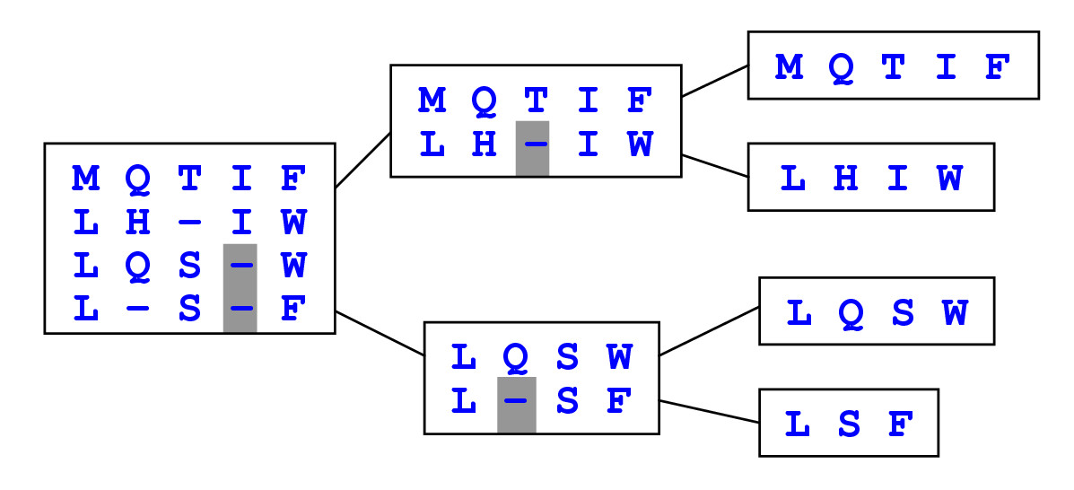
ClustalW algorithm
Dynamic Programming Using A Substitution Matrix

Slide 21
Step 1: Pairwise alignment
Aligns each sequence again each other giving a similarity matrix
Similarity = exact matches / sequence length (percent identity)
v₁ v₂ v₃ v₄
v₁ -
v₂ .17 -
v₃ .87 .28 -
v₄ .59 .33 .62 -
(.17 means 17 % identical)

Slide 22
Step 2: Guide tree
v₁ v₂ v₃ v₄
v₁ -
v₂ .17 -
v₃ .87 .28 -
v₄ .59 .33 .62 -
v₁
v₃
v₄
v₂
Calculate: v_{1,3} = alignment (v₁, v₃) v_{1,3,4} = alignment((v_{1,3}),v₄) v_{1,2,3,4} = alignment((v_{1,3,4}),v₂)
ClustalW uses NJ to build guide tree;
Guide tree roughly reflects evolutionary relations

Slide 23
Step 3: Tree based recursion
Align ( Node N)
{
if ( N->left_child is a Node)
A1=Align ( N->left_child)
else if ( N->left_child is a Sequence)
A1=N->left_child
if (N->right_child is a node)
A2=Align (N->right_child)
else if ( N->right_child is a Sequence)
A2=N->right_child
Return dp_alignment (A1, A2)
}
A
B
C
D
E
F
G

Slide 24
Progressive alignment: Scoring scheme
Scoring scheme is arguably the most influential component of the progressive algorithm
Matrix-based algorithms
ClustalW, MUSCLE, Kalign
Use a substitution matrix to assess the cost of matching two symbols or two profiled columns
Once a gap, always a gap
Consistency-based schemes
T-Coffee, Dialign
Compile a collection of pairwise global and local alignments (primary library) and to use this collection as a position-specific substitution matrix

Slide 25
Substitution matrix based scoring
Sum of pairs (SP score)
Tree based scoring
Entropy score

Slide 26
Sum of pairs score (SP score)
Seq Column-A -B
……N……………N……
……N……………N……
……N……………N……
……N……………C……
……N……………C……
N
N
N
N
N
C
N
N
N
C
Score= 10 * S(N,N)
= 10 * 6 = 60
Score= 3 * S(N,N) + 6 * S(N,C) + S(C,C)
= 3 * 6 + 6 * (-3) + 9 = 9 (BLOSUM62)
Problem: over-estimation of the mutation costs (assuming each sequence is the ancestor of itself; requires a weighting scheme

Slide 27
Tree-based scoring
N
N
C
“Real” tree:
Cost = 1
But we do not know the tree!
N
N
C
N
C
A
C
Star tree
Cost=2
But the tree is wrong!
A
A
A
C

Slide 28
Entropy-based scoring

Slide 29
Entropy: Example
Given a DNA sequence, what is its maximum entropy?

Slide 30
Alignment entropy
Define frequencies for the occurrence of each letter in each column of multiple alignment
p_{A} = 1, p_{T}=p_{G}=p_{C}=0 (1st column)
p_{A} = 0.75, p_{T} = 0.25, p_{G}=p_{C}=0 (2nd column)
p_{A} = 0.50, p_{T} = 0.25, p_{C}=0.25 p_{G}=0 (3rd column)
Compute entropy of each column
A | A | A
A | C | C
A | C | G
A | C | T
An alignment with 3 columns
0
0.811
2.0
Alignment entropy= 2.811

Slide 31
Consistency-based approaches
T-Coffee
M-Coffee & 3D-Coffee (Expresso)
Principle
Primary library
Library extension

Slide 32
T-Coffee: Primary library
Input sequences
SeqA GARFIELD THE LAST FAT CAT
SeqB GARFIELD THE FAST CAT
SeqC GARFIELD THE VERY FAST CAT
SeqD THE FAT CAT
Primary library: collection of global/local pairwise alignments
SeqA GARFIELD THE LAST FAT CAT
SeqB GARFIELD THE FAST CAT
SeqA GARFIELD THE LAST FA-T CAT
SeqC GARFIELD THE VERY FAST CAT
SeqA GARFIELD THE LAST FAT CAT
SeqD -------- THE ---- FAT CAT
SeqB GARFIELD THE ---- FAST CAT
SeqC GARFIELD THE VERY FAST CAT
SeqB GARFIELD THE FAST CAT
SeqD -------- THE FA-T CAT
SeqC GARFIELD THE VERY FAST CAT
SeqD -------- THE ---- FA-T CAT

Slide 33
T-Coffee: Library extension
SeqA GARFIELD THE LAST FAT CAT
SeqB GARFIELD THE FAST CAT
SeqA GARFIELD THE LAST FA-T CAT
SeqC GARFIELD THE VERY FAST CAT
SeqA GARFIELD THE LAST FAT CAT
SeqD -------- THE ---- FAT CAT
SeqB GARFIELD THE ---- FAST CAT
SeqC GARFIELD THE VERY FAST CAT
SeqB GARFIELD THE FAST CAT
SeqD -------- THE FA-T CAT
SeqC GARFIELD THE VERY FAST CAT
SeqD -------- THE ---- FA-T CAT
SeqA GARFIELD THE LAST FAT CAT
|||||||| ||| |||| |||
SeqB GARFIELD THE FAST CAT
SeqA GARFIELD THE LAST FAT CAT
|||||||| ||| |||| ||
SeqC GARFIELD THE VERY FAST CAT
|||||||| ||| |||| |||
SeqB GARFIELD THE FAST CAT
SeqA GARFIELD THE LAST FAT CAT
||| ||| |||
SeqD THE FAT CAT
||| ||
SeqB GARFIELD THE FAST CAT
Different “weights”
SeqA GARFIELD THE LAST FAT CAT
|||||||| |||
SeqB GARFIELD THE FAST CAT
Triplets
DP on the “consistency matrix”
SeqA GARFIELD THE LAST FA-T CAT
SeqB GARFIELD THE ---- FAST CAT
Extended library: new pairwise alignment (AB), (AC), (AD), (BC), (BD) and (CD)

Slide 34
T-Coffee uses progressive strategy to derive multiple alignment
Guide tree
First align the closest two sequences (DP using the weights derived from the extended library)
Align two “alignments” (using the weights from the extended library -- average over each column)
No additional parameters (gaps etc)
The substitution values (weights) are derived from extended library which already considered gaps
High scoring segments (consistent segments) enhanced by the data set to the point that they are insensitive to the gap penalties

Slide 35
MUSCLE: a tool for fast MSA
Initial progressive alignment followed by horizontal refinement (stochastic search for a maximum objective score
Step 1: draft progressive (using k-mer counting for fast computation of pairwise distance; tree building using UPGMA or NJ)
Step 2: Improved progressive to improve the tree and builds a new progressive alignment according to this tree (can be iterated).
Step 3: Refinement using tree-dependent restricted partitioning (each edge is deleted from the tree to divide the sequences into two disjoint subsets, from each a profile is built; the profile-profile alignment is computed, and if the score improves, retain the new alignment).
Ref: MUSCLE: a multiple sequence alignment method with reduced time and space complexity; BMC Bioinformatics 2004, 5:113

Slide 36
Multiple alignment: History
1975 Sankoff
Formulated multiple alignment problem and gave DP solution
1988 Carrillo-Lipman
Branch and Bound approach for MSA
1990 Feng-Doolittle
Progressive alignment
1994 Thompson-Higgins-Gibson-ClustalW
Most popular multiple alignment program
1998 DIALIGN (Segment-based multiple alignment)
2000 T-coffee (consensus-based)
2004 MUSCLE
2005 ProbCons (uses Bayesian consistency)
2006 M-Coffee (consensus meta-approach)
2006 Expresso (3D-Coffee; use structural template)
2007 PROMALS (profile-profile alignment)

Slide 37
Summary & references
“A majority of studies indicate that consistency-based methods are more accurate than their matrix-based counterparts, although they typically require an amount of CPU time N times higher than simpler methods (N being the number of sequences)”
https://www.ebi.ac.uk/Tools/msa/tcoffee/
Recent evolutions of multiple sequence alignment algorithms. 2007, 3(8):e123
Issues in bioinformatics benchmarking: the case study of multiple sequence alignment. Nucleic Acids Res. 2010 Jul 1

