Slide 1
WEB COMPUTATIONAL BIOLOGY TRAINING
1
Notes:
1

Slide 2

Today’s Instructor
Bioinformatics and Computational Biosciences Branch (BCBB), Rocky Mountain Laboratories (RML), NIAID,
NIH, Hamilton, MT USA.
Contact our team via email:
Email: ace@icermali.org
Listserv: ACE-MALI-L@LIST.NIH.GOV
Instructor: amitava.roy@nih.gov
Dr. Amitava Roy,
Ph.D. in Physics
Ongoing Computational Biology projects:
Vaccine development
Structure determination of prion
2

Slide 3
Alignment methods
Introduction to global and local sequence alignment methods
Global : Needleman-Wunsch
Local : Smith-Waterman
BLAST
Scoring Matrices
PAM
BLOSUM

Slide 4
Function Prediction
Multiple Sequence Alignment
Dynamics Programming
ClustlW, t-Coffee, Muscle
Motif Search and Function Prediction
Expectation Maximization, MEME
Markov Model and Hidden Markov Model
Software

Slide 5
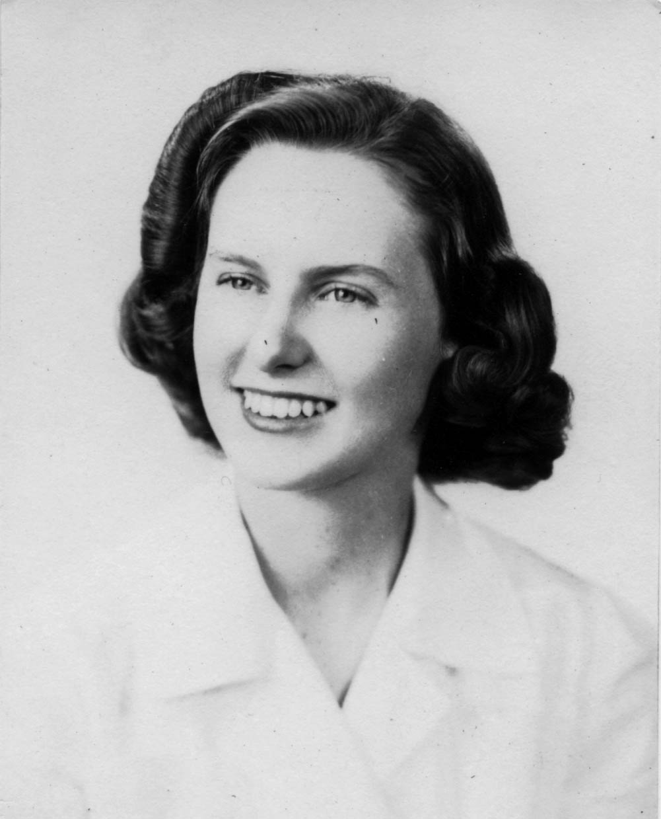
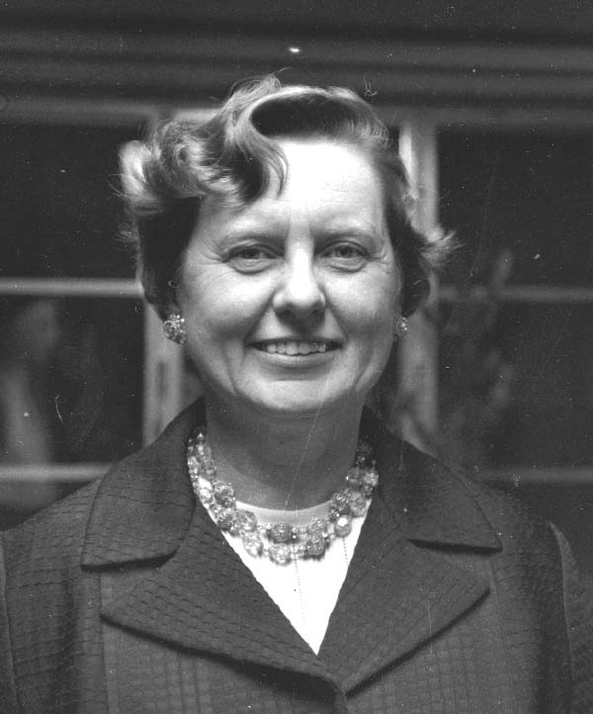
Dr. Margaret Oakley Dayhoff (1925-1983)

Slide 6
Estimating p(·,·) for proteins
Generate a large diverse collection of accepted mutations. An accepted mutation is a mutation due to an alignment of closely related protein sequences. For example, Hemoglobin alpha chain in humans and other organisms (homologous proteins).
Let p_{a} = n_{a}/n where n_{a} is the number of occurrences of letter a and n is the total number of letters in the collection, so n = Σ_{a}n_{a}.
Mutation counts
be the number of mutations a ⇔ b,
be the total number of mutations that involve a,
be the total number of amino acids involved in a mutation.
Note that f is twice the number of mutations.

Slide 7
PAM-1 matrices
Define M_{ab} to be the symmetric probability matrix for switching between a and b. We set, M_{aa} = 1 – m_{a}, so that m_{a} is the probability that a is involved in a change.
We define M_{ab}, such that only 1% of amino acids change according to this matrix or 99% don’t. Hence the name, 1-Percent Accepted Mutation (PAM). In other words,

Slide 8
PAM-1 matrices
We wish that m_{a} will be proportional to the relative mutability of letter a compared to other letters.
where K is a proportional constant.
We select K to satisfy the PAM-1 definition:
So K=100 for PAM-1 matrices. Note that K=50 yields 2% change, etc.

Slide 9
Evolutionary distance
The choice that 1% of amino acids change (and that K =100) is quite arbitrary. It could fit specific set of proteins whose evolutionary distance is such that indeed 1% of the letters have mutated.
This is a unit of evolutionary change, not time because evolution acts differently on distinct sequence types.
What is the substitution matrix for k units of evolutionary time ?

Slide 10
Model of Evolution
We make some assumptions:
Each position changes independently of the rest
The probability of mutations is the same in each position
Evolution does not “remember”
T
T
T
C
G
A
A
C
C
G
t
t+Δ
t+2Δ
t+3Δ
t+4Δ
Time

Slide 11
Model of Evolution
How do we model such a process?
This process is called a Markov Chain
A chain is defined by the transition probability
P(X^{t+Δ} =b|X^{t}=a) - the probability that the next state is b given that the current state is a
We often describe these probabilities by a matrix: M[Δ]_{ab} = P(X^{t+Δ} =b|X^{t}=a)
M[2Δ] = M[Δ]M[Δ]
By induction: M[nΔ] = M[Δ] ^{n}

Slide 12
Longer Term Changes
Estimate M[Δ] = M (PAM-1 matrices)
Use M[nΔ] = M^{n} (PAM-n matrices)
Define
Use this quantity to define the score for your application of interest.

Slide 13
PAM250 mutation probability matrix
Top: original amino acid
Side: replacement amino acid

Slide 14
PAM250 log odds
scoring matrix

Slide 15
How do we go from a mutation probability
matrix to a log odds matrix?
The cells in a log odds matrix consist of an “odds ratio”:
the probability that an alignment is authentic
the probability that the alignment was random
The score S for an alignment of residues a,b is given by:
S(a,b) = 10 log₁₀ ( M_{ab} / p_{b} )
As an example, for tryptophan,
S( W, W ) = 10 log₁₀ ( 0.55 / 0.01 ) = 17.4

Slide 16
Comments regarding PAM
Historically researchers use PAM-250. (The only one published in the original paper.)
Original PAM matrices were based on small number of proteins (circa 1978). Later versions use many more examples.
Used to be the most popular scoring rule, but there are some problems with PAM matrices.

Slide 17
Problems in building distance matrices
How do we find pairs of aligned sequences?
How far is the ancestor ?
earlier divergence ⇒ low sequence similarity
later divergence ⇒ high sequence similarity
E.g., M[250Δ] is known not reflect well long period changes.
Does one letter mutate to the other or are they both mutations of a third letter ?

Slide 18
BLOSUM Outline
Idea: use aligned ungapped regions of protein families.These are assumed to have a common ancestor. Similar ideas but better statistics and modeling. It uses 2000 conserved blocks from 500 families.
Procedure:
Cluster together sequences in a family whenever more than L% identical residues are shared, for BLOSUM-L.
Count number of substitutions across different clusters (in the same family).
Estimate frequencies using the counts.
Practice: BlOSUM-50 and BLOSOM62 are widely used.
Considered the state of the art nowadays.

Slide 19
BLOSUM Matrices
BLOSUM matrices are based on local alignments.
BLOSUM stands for blocks substitution matrix.
BLOSUM62 is a matrix calculated from comparisons of
sequences with less than 62% identical sites.

Slide 20
BLOSUM Matrices
All BLOSUM matrices are based on observed alignments;
they are not extrapolated from comparisons of
closely related proteins.
The BLOCKS database contains thousands of groups of
multiple sequence alignments.
BLOSUM62 is the default matrix in BLAST 2.0.
Though it is tailored for comparisons of moderately distant
proteins, it performs well in detecting closer relationships.
A search for distant relatives may be more sensitive
with a different matrix.

Slide 21
Blosum62 scoring matrix

Slide 22
BLOSUM Matrices
100
collapse
62
Percent amino acid identity
30
BLOSUM62

Slide 23
BLOSUM Matrices
100
collapse
100
100
collapse
62
62
62
collapse
Percent amino acid identity
30
30
30
BLOSUM80
BLOSUM62
BLOSUM30

Slide 24
Rat versus
mouse RBP
Rat versus
bacterial
lipocalin

